Slide 1
HHW and VSQG Annual Update- DOT Hazardous Materials Compliance
MPCA 2013 Household Hazardous Waste Training

Slide 2
Transportation in Commerce
Movement of hazmat by householder to collection site is not regulated by HMR
Movement by VSQG to collection site is regulated
Shipping or offering waste from consolidation site to commercial transporter is fully regulated by HMR
Notes:
Mn/DOT truck & driver moving VSQG waste to Mn/DOT collection facility not covered by HMR.

Slide 3
Offering the Shipment Collection Site to Commercial Transporter
USDOT hazardous materials regulations apply to government agencies who offer hazmat for transportation in commerce
Commercial carrier may not accept the hazmat unless it is packaged and documented as required in the HMR

Slide 4
“Household Waste”
Solid waste (including garbage, trash, sanitary waste from septic tanks) derived from households including:
Single & multiple residences
Hotels & motels
Ranger stations, crew quarters, campgrounds
Household Waste definition NOT applicable to consolidated shipments transported from a collection center

Slide 5
“Household Waste”
HHW definition and exceptions clarified in 2009 rulemaking. Hotels, motels, etc., cannot use this exception for transporting large quantities of hazardous waste/materials generated during renovation.
49 CFR 171.8 & 173.12

Slide 6
Remember the Basics
USDOT Regulated Activities
Classify the material: Hazard class, subsidiary hazards, packing group, haz substance, haz waste
Create the Shipping Paper: Basic Description and Other DOT required information
Select correct packaging: Packagings must be “authorized” by the HMR
Prepare the packages: Properly filled, closed, in condition for transport

Slide 7
Remember the Basics
USDOT Regulated Activities
Mark the package: PSN, ID #, and other required information for some materials
Label the package: Column 6 on HMT
Offer the load: Containers loaded, blocked, braced, & segregated
Placard: Offering the required placards to the commercial carrier

Slide 8
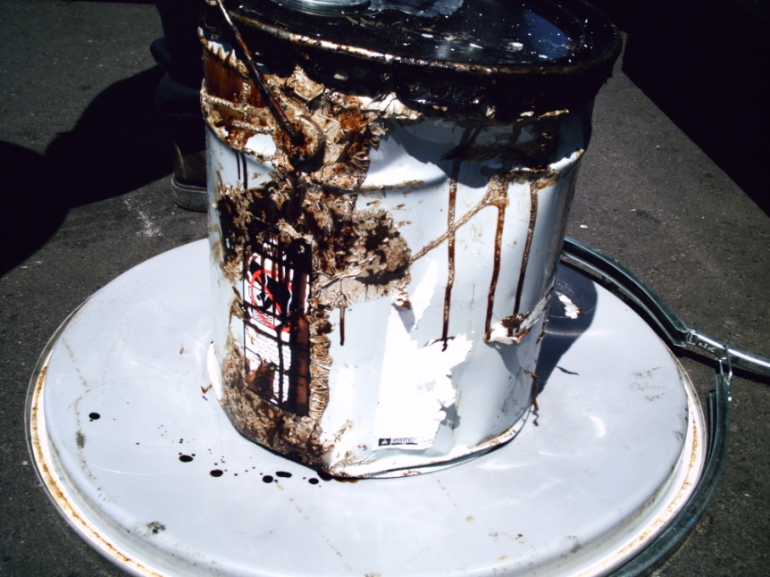
Hazmat Identification
Unidentified materials are brought to or dropped off at HHW facilities. It must be classified and identified before it can be shipped from the collection center

Slide 9
Identify the Material
DOT hazard class, including any subsidiary hazards
DOT hazmat shipping description
UNKNOWN MATERIAL?!? It must be classified and be moved with correct shipping description

Slide 10
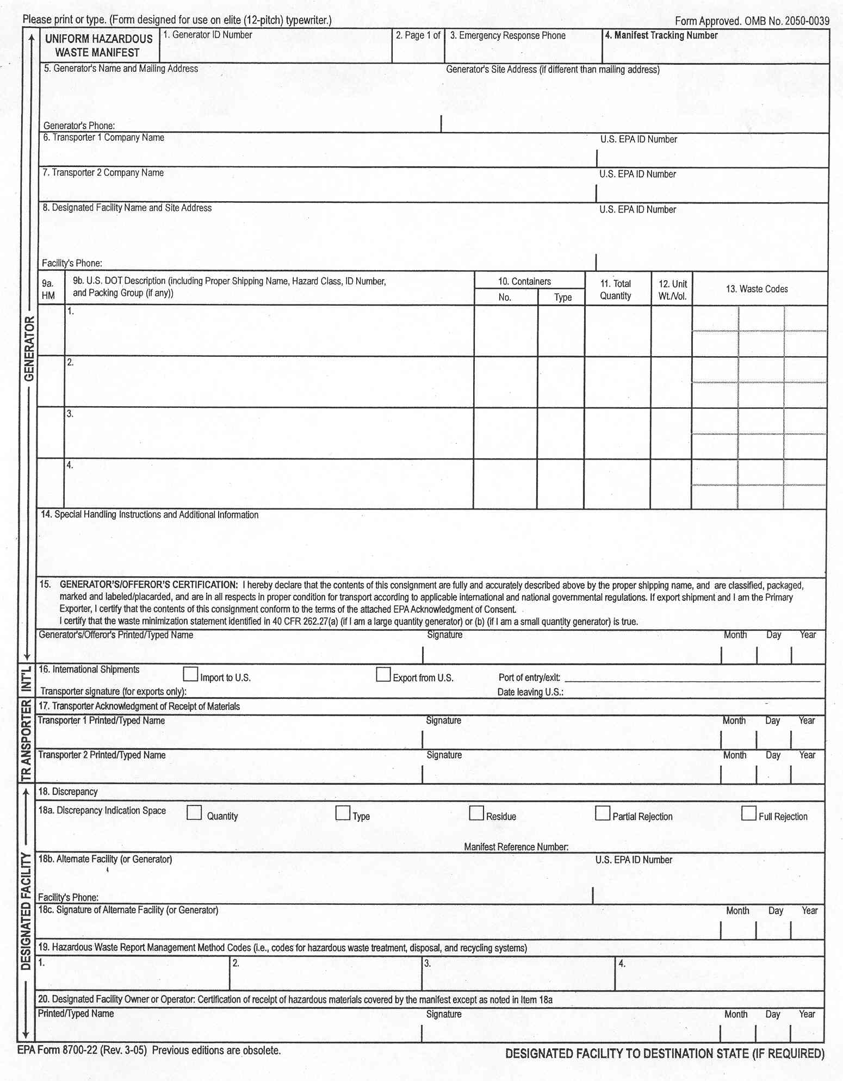
Hazardous Waste Manifest is the Required Shipping Paper
It must be completed to EPA & USDOT standards
Signed, dated, and maintained for 3 years

Slide 11
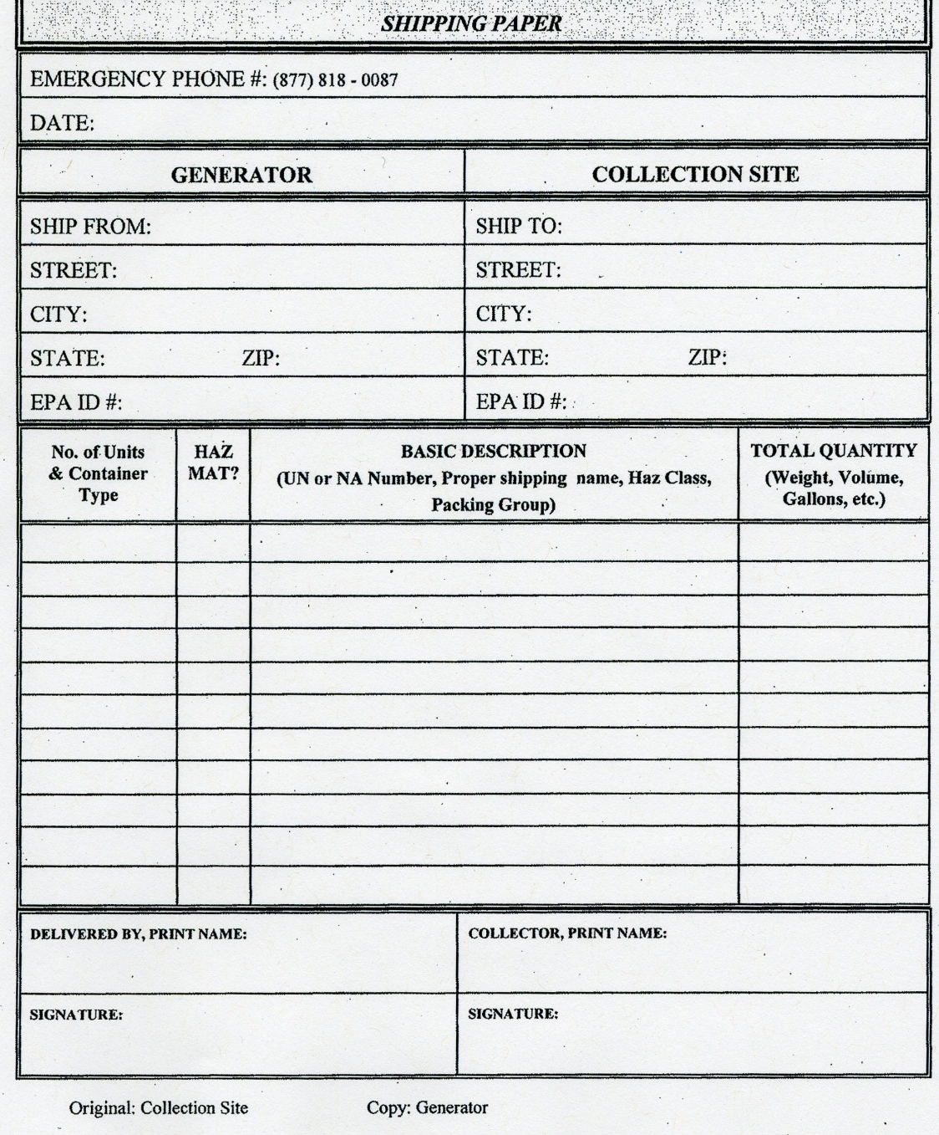
Is material excepted from HW Manifest by EPA/MPCA?
But it meets DOT’s HM definition, a Shipping Paper must be offered!

Slide 12
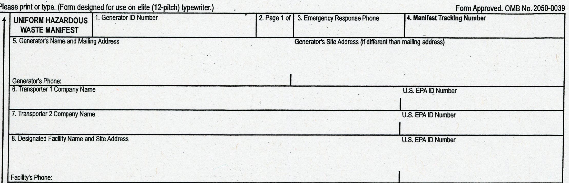
UHWM Identifies the Generator, All Transporters, and the TSDF
MND 12345678910
XYZ Company
123 Main St. St. Paul, MN 55155
(651) 987-6543
Waste Haulers Inc. MNR34567891011
Haz Waste Movers, LLC SDR 23456789109
Do-All Disposal Company
Oak St. WYD567891011
Left Fork WY 78945
Make sure ALL transporters are correctly identified

Slide 13
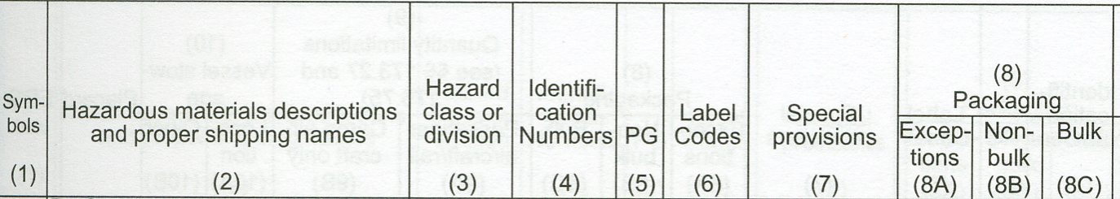
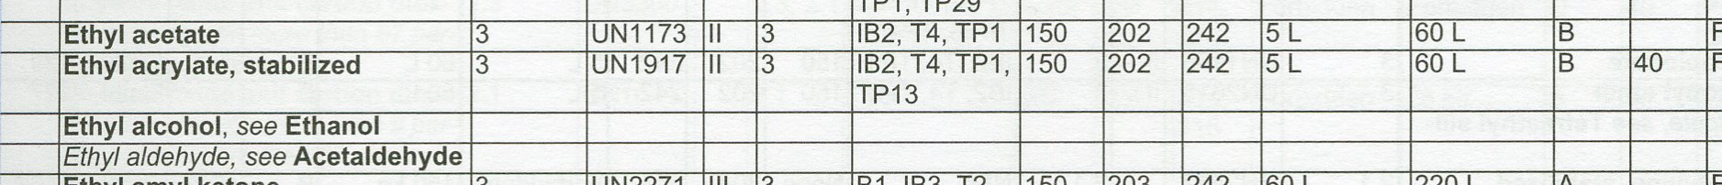
Hazmat Table Gives Basic Descriptions for Shipping Papers/Manifests
Column (4) Identification Numbers
Column (2) Proper Shipping Name
Column (3) Hazard Class/Division Number
Column (5) Packing Group

Slide 14
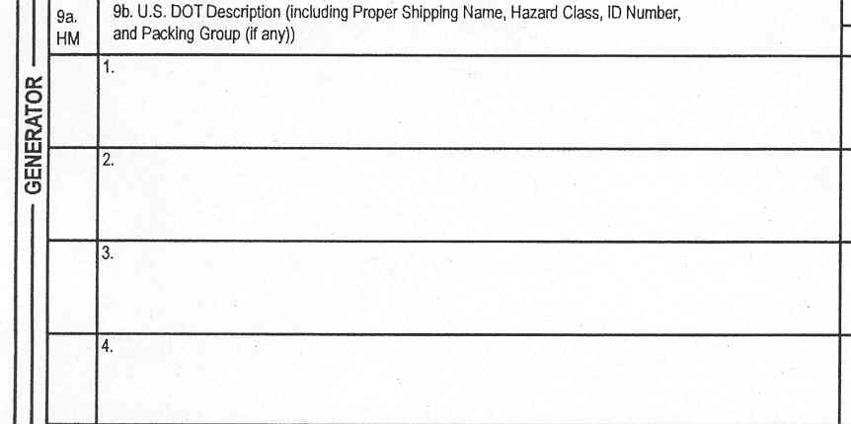
Use Box 9b on Uniform HW Manifest for USDOT
Shipping Description
UN1170, Waste ethanol, 3, PG II
X
X
UN1173, Waste ethyl acetate, 3, PG II
49 CFR 172.205
Notes:
Boxes 9a and 9b work like any HM shipping paper with a hazmat column. An X or a RQ if it’s a hazardous substance, go in the HM column.

Slide 15
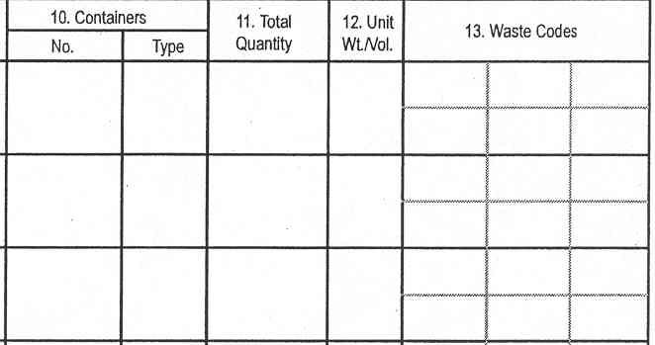
Boxes 10, 11, &12 Records Container Type, Quantity & Unit of Measure
D001
12
DM
3500
G
D001
8
DM
L
108
Box 13 is EPA Waste Code Numbers
49 CFR 172.205
Notes:
Sections 10, 11, and 12 give number and type of containers. Abbreviations are listed on the manifest instructions, and are authorized. Waste codes should be listed but are not a DOT issue.

Slide 16
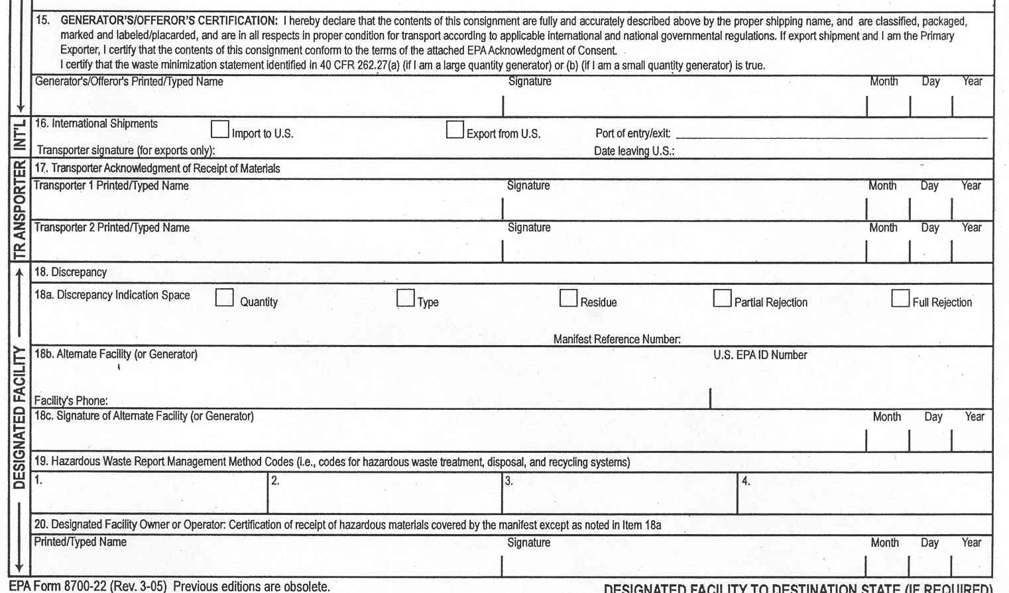
Handwritten Signatures Required on HW Manifests
George Washington
George Washington
02 22 06
John Adams
John Adams
02 22 06
Tom Jefferson
Tom Jefferson
02 25 06
Notes:
Manifests require printed or typed names, and live, handwritten, signatures per 172.205 (d) and EPA regulations.

Slide 17

Shipping Papers
Emergency Contact Telephone Number must be entered on document in “prominent, readily identifiable, & clearly visible manner”
Shipper/Offeror must ensure that Emergency Contact has “comprehensive, product specific emergency information for each hazmat”
172.201 (d) 172.604 (a)

Slide 18
Shipping Papers
Emergency Response Telephone Number
If Shipper/Offeror answers the Emergency Telephone number, their name MUST be either immediately above, below or next to the emergency telephone number or prominently entered elsewhere on the shipping paper

Slide 19
Shipping Papers-Emergency Response Information Providers
Use an ERIP (like CHEMTREC, INFOTRAC, WCEC) as emergency telephone #?
Person using ERIP must be identified by name on shipping paper; or
Contract number between ERIP and offeror must be displayed on shipping paper near the emergency phone number
49 CFR 172.604 (b)

Slide 20
Packaging Materials
All hazmat to be moved in USDOT authorized packages
USDOT packaging authorizations found on Hazmat table at 49 CFR 172.101
USDOT has some limited packaging exceptions for waste material in 49 CFR 173.12

Slide 21
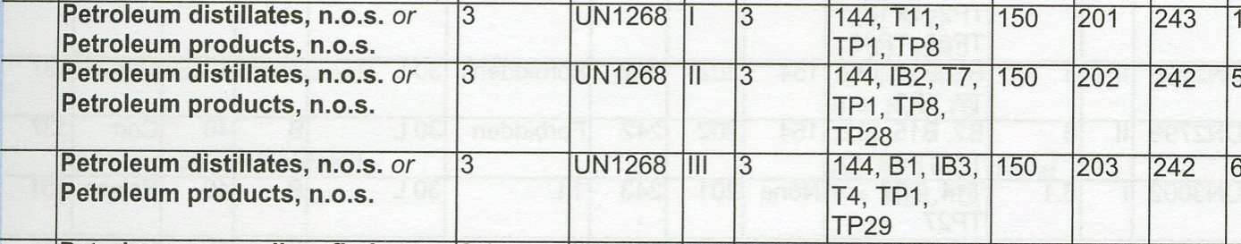
Selecting an Authorized Packaging from the Hazmat Table
Identify material by name, ID# & Packing Group
Go to Column 8A-package exceptions, 8B-Non-bulk packages, or 8C-bulk packages > 119 gallon

Slide 22
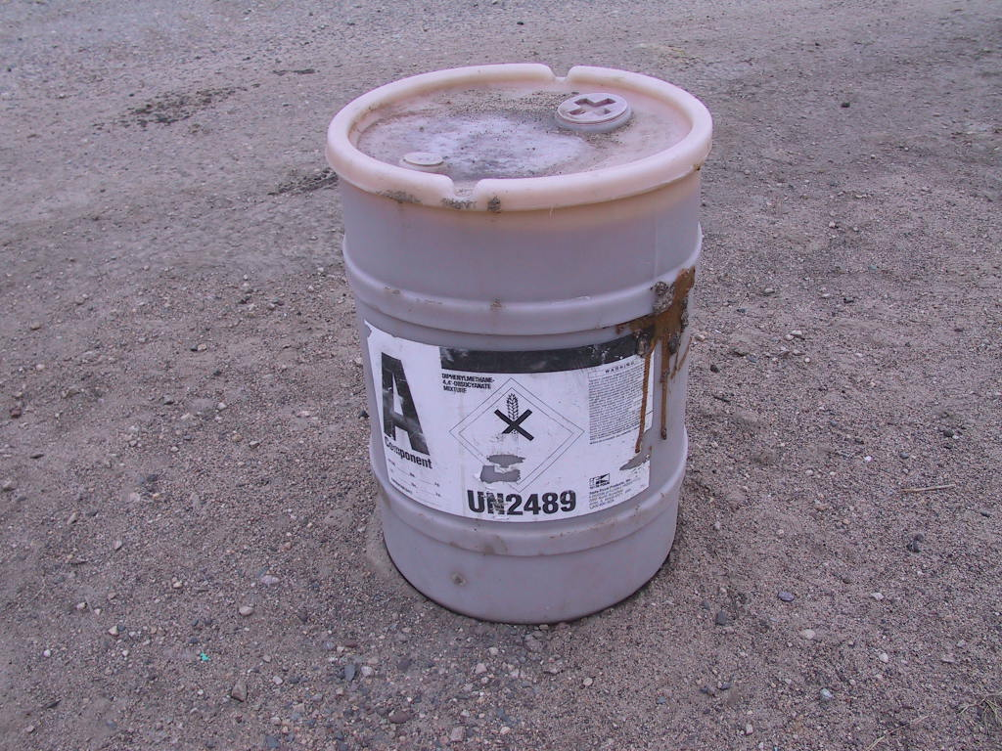
Packaging Waste Packagings Must Be Designed, Filled and Closed So There is No Release to the Environment
No HM Residue on Outside of Packages
49 CFR 173.24 (b) (4)

Slide 23
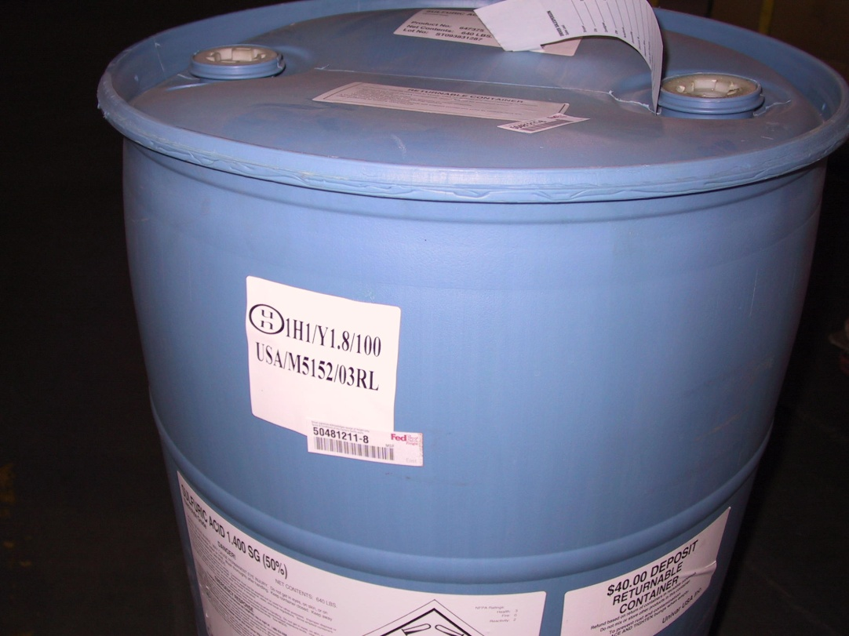
Re-use of Packagings for Waste Materials
Must be a package authorized by HMR
In good condition & closed
Not moved for 24 hours (leak test)
Package used only once (unless retested)
49 CFR 173.12

Slide 24
Waste Package Exceptions Clarified Final Rule 02/02/2010
Exception in 173.12 (c) is not authorized for a packaging intended to be used more than 2 times (Initial use & return shipment of waste)
Packages used more than twice must be reconditioned per 173.28

Slide 25
Package Marking & Labeling
Marking & labeling information must be consistent with hazmat shipping information on the shipping paper or hazardous waste manifest
Inconsistent information may lead to shipment being placed Out-of -Service & violation notices

Slide 26
Package Marking & Labels
Marking
Labeling
Proper shipping name
Technical names for generic descriptions ( )
Identification number
EPA haz waste mark
Orientation arrows for liquid combination packages
RQ for haz substances
Hazard labels as required in Column 6 of hazmat table
Affixed on or attached to package
Label in good condition
NO label displayed unless that class of hazmat is in the package

Slide 27
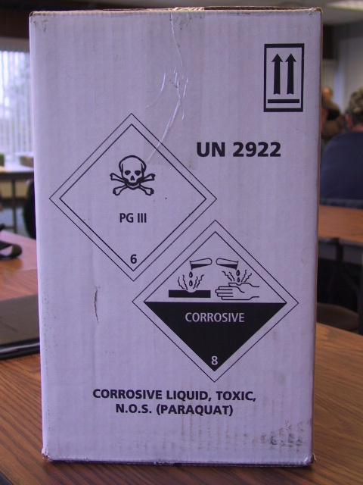
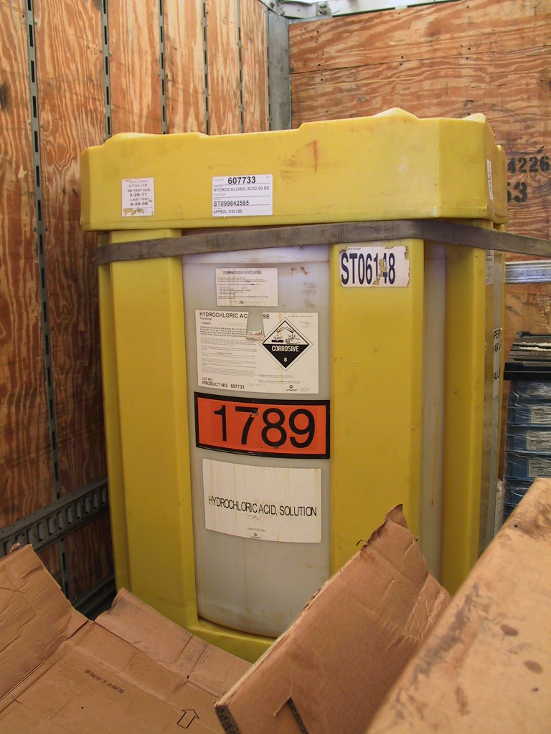
Package Marking & Labels

Slide 28

New Limited Quantity by Aircraft Mark Required December 31, 2012
New Mark must be durable, legible, and of a size relative to the package that is readily visible:
100 mm sides or:
50mm side for small packages
“Y” mark OK for all modes
Notes:
Limited quantity packages marked with this “Y” device, indicates LTD QYT for aircraft but can be used for all modes per comment in the preamble to HM 215K, as air limits are more restrictive.

Slide 29

New Limited Quantity Mark Required by December 31, 2020 (not 2013)
New Mark must be durable, legible, &readily visible:
100 mm sides or:
50mm side for small packages
Applied at least on 1 side or end of package
New rule issued January 7, 2013
Notes:
Limited quantity marking changed in new rule issued on January 19, 2011. should be same size as a label, but no smaller than 50 mm on a side for smaller packages.

Slide 30
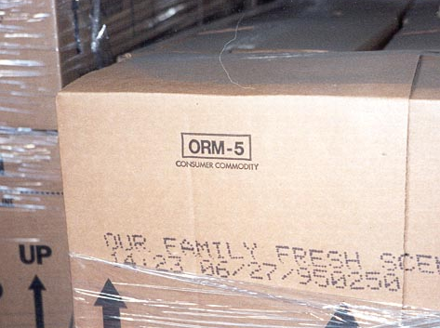
ORM-D Consumer Commodity Classification Ends December 31, 2020 (not 2013) 172.316 Revised
ORM-D
Notes:
January 19, 2011 rule eliminates ORM-D classification and marks on December 31. 2013 for highway transport, and December 31, 2012 for aircraft. Until those dates ORM-D marks still required.

Slide 31
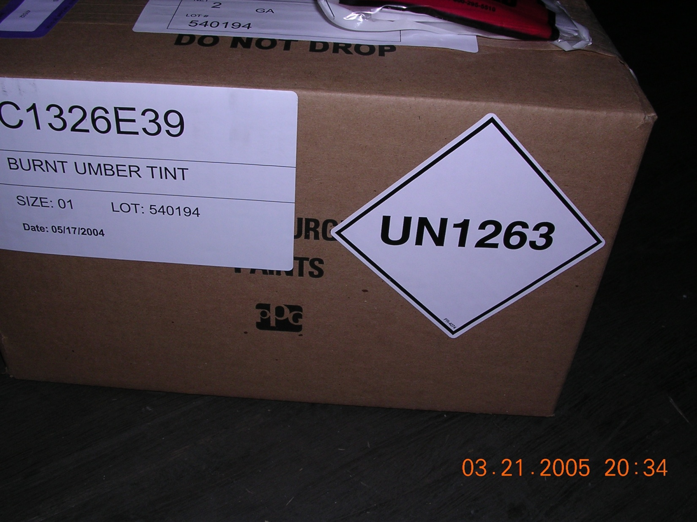
LTD QTY Packages Don’t Require Shipping Name if Marked with ID Number as Authorized in 172.315
Notes:
Limited quantity packages marked with this device, with full ID number and prefix, excepted from proper shipping name mark. LTD QTY mark being replaced with new mark as shown in following slides.

Slide 32
Limited Quantity Packagings Excepted From
Labeling, except when offered by aircraft
Specification packaging, when in combination packagings as authorized
Shipping papers, unless it’s a hazardous substance, waste, marine pollutant or is offered or transported by aircraft or vessel
Placarding
Notes:
Discuss limited quantity and have them look at column 8A on the table.

Slide 33
No Person Shall Offer for Transport, or Transport Hazardous Waste Unless:
Transport Vehicle is Marked with Name & USDOT Number per 49 CFR 390.21
Shipper & Transporter Comply with Uniform HW Manifest requirements in 49 CFR 172.205
Entire Quantity of HW Delivered to Designated Facility or Another Carrier
49 CFR 171.3
Notes:
HW generator? You need to check if the transport vehicle displays transporters USDOT number. You should record it, and the company name, plate number of the truck and trailer.

Slide 34

Commercial Transport Vehicle Marked with Name & USDOT #
Make sure Name & DOT # are there

Slide 35
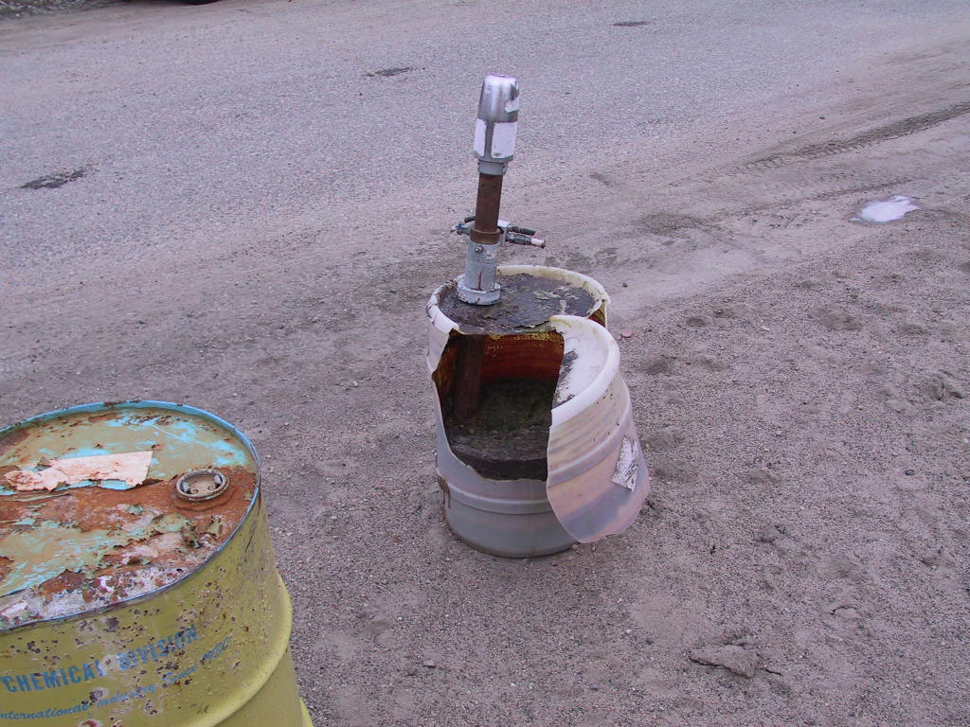
Offering Hazmat
All packages must be properly closed. Open or leaking packages must be overpacked before transportation

Slide 36
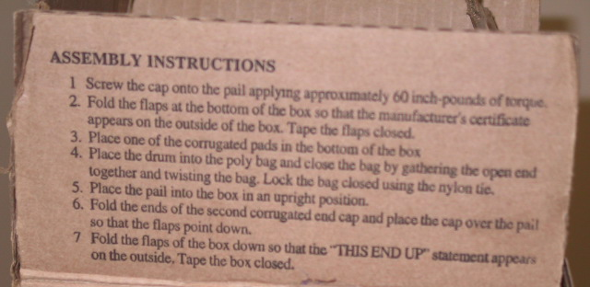
NEW-49 CFR 172.22 (a) (4)
Shipper must keep copy of package closure instructions unless printed on the packaging

Slide 37
Offering Hazmat
Hazmat Package Securement
All hazmat packages secured against shifting, including relative motion between packages
Valves & fittings protected
Any other cargo or equipment secured to prevent damage to the hazmat

Slide 38
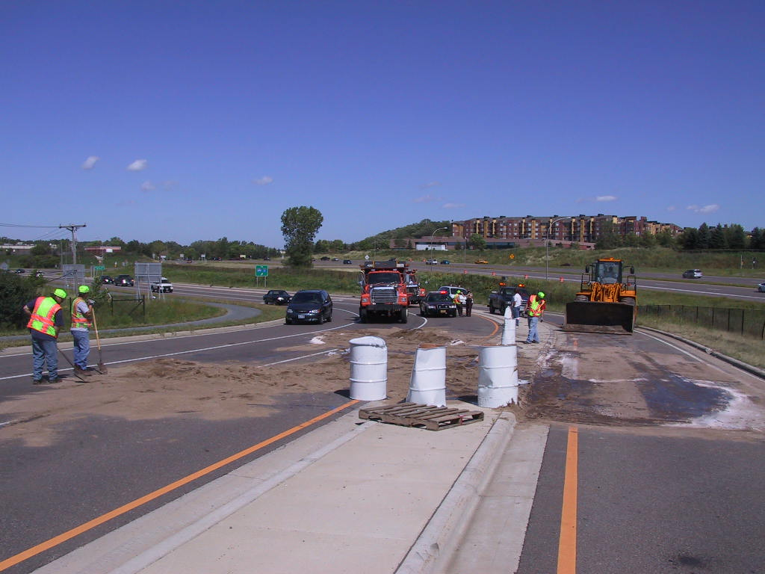
ALL Cargo Secured to Prevent Leaking, Spilling, or Falling From Vehicle
Every Package, Every Time!!
Notes:
The securement standard is “every package, every time.” Note, drums in photo are not hazmat, or we would not have workers in the spill area without protective gear. These drums weighed 640 pounds each, and were secured on a flatbed truck with plastic twine. Drums could have killed someone if they had hit a following car.

Slide 39

Shipper Must Provide Placards for HM They Offer to Truckers Carrier May Not Haul Unless Placards Affixed
49 CFR 172.506
Notes:
Placarding is a joint shipper and transporter responsibility. Shipper is responsible for placards for the HM they offer to the trucker, not other HM cargo from another source. Carrier must ensure that all required placards are displayed.

Slide 40
Hazmat Transportation Security
USDOT Security Regulations in effect
Facility security
En-route security
Personnel security
Security training for employees
Written Security Plan
“New” Final rule eliminates security requirements for low hazard materials-increase for high hazard

Slide 41
USDOT Revised HM Security Requirements on March 9, 2010
Security Plans Required for Shippers/Carriers of Any Quantity of:
1.1, 1.2, 1.3 Explosives
Materials poisonous by inhalation
4.3 Dangerous when wet
5.2 Type B, temperature controlled

Slide 42
Revised HM Security Requirements “Large Bulk Quantities”
3,000 kg for solids or 3,000 Liters for Liquids in a single packaging:
2.1 Flammable gases
2.2 non-flammable with 5.1 subsidiary
Class 3 PG I & II
4.2 PG I or II
5.1 PG I or II
6.1 other than PIH
Class 8 PG I

Slide 43
Revised HM Security Requirements Quantities Requiring Placards
1.4, 1.5, 1.6 Explosives
Desensitized explosives in 4.1 or Class 3 on a single transport vehicle
Other Materials Requiring SP
Agents & toxins in 42 CFR part 73
Agents & toxins in 9 CFR part 121
Uranium hexaflouride (placarded)
Radioactive HRCQ & Quantities of Concern

Slide 44
Battery Rules & Safety Advisory 2009
January 14, 2009 rule changed Special Provision 130-Battery terminal must be protected
April 3, 2009 Battery Safety Advisory letter “All batteries must be packaged to prevent short circuits and damage.”
November 25, 2009 interpretation letters modify requirements-dry batteries marked with rating up to 9 volts excepted

Slide 45
Lead Acid Battery Transport
01/14/09 final rule clarifies wet battery requirements-outlines specific requirements for protecting terminals from damage
USDOT, State Patrol, & Mn/DOT conducting focused roadside inspections of battery transporters
Shippers who offer batteries not in conformance with new rule face action

Slide 46
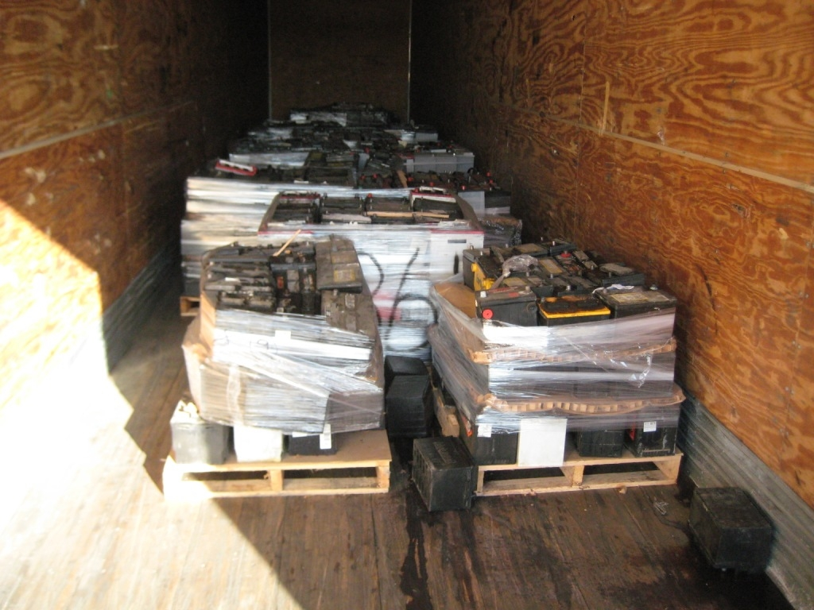
Lead Acid Battery Transport
Batteries not secured, leaking

Slide 47
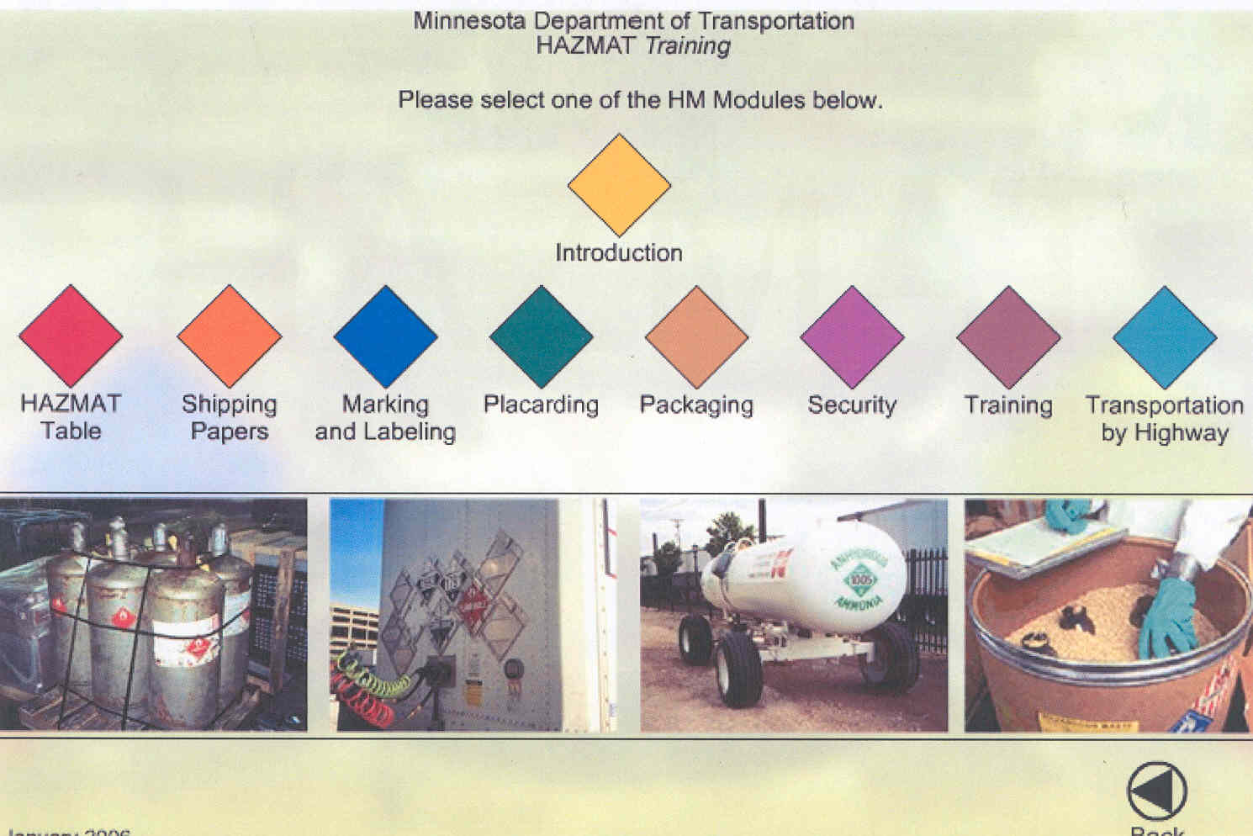
Check Out Our Web-Based HazMat Training!!
www.dot.state.mn.us/cvo/hazmatElearning/
Notes:
Ask students to look at OFCVO web-based training and the PHMSA site.

Slide 48
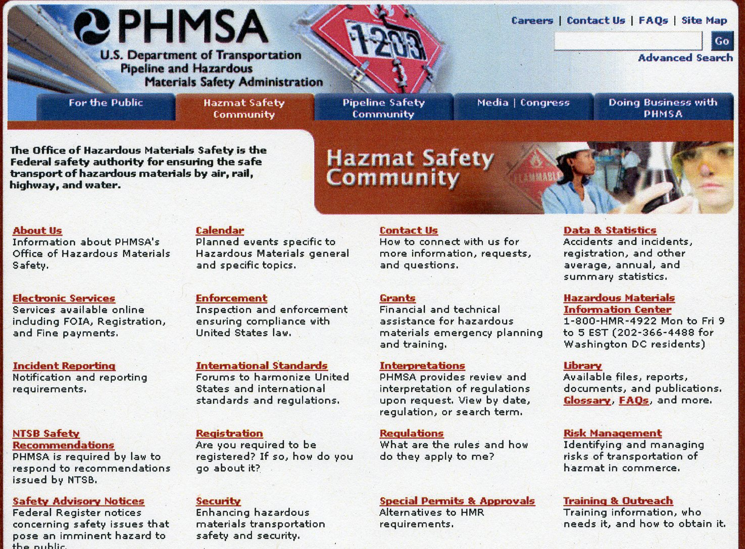
(800) 467-4922
www.phmsa.dot.gov/hazmat

Slide 49

Office of Freight & Commercial Vehicle Operations
3485 Hadley Avenue Mail Stop 610, Oakdale, MN 55128 (651) 366-4348
www.dot.state.mn.us/cvo
jim.fox@state.mn.us

