Slide 1
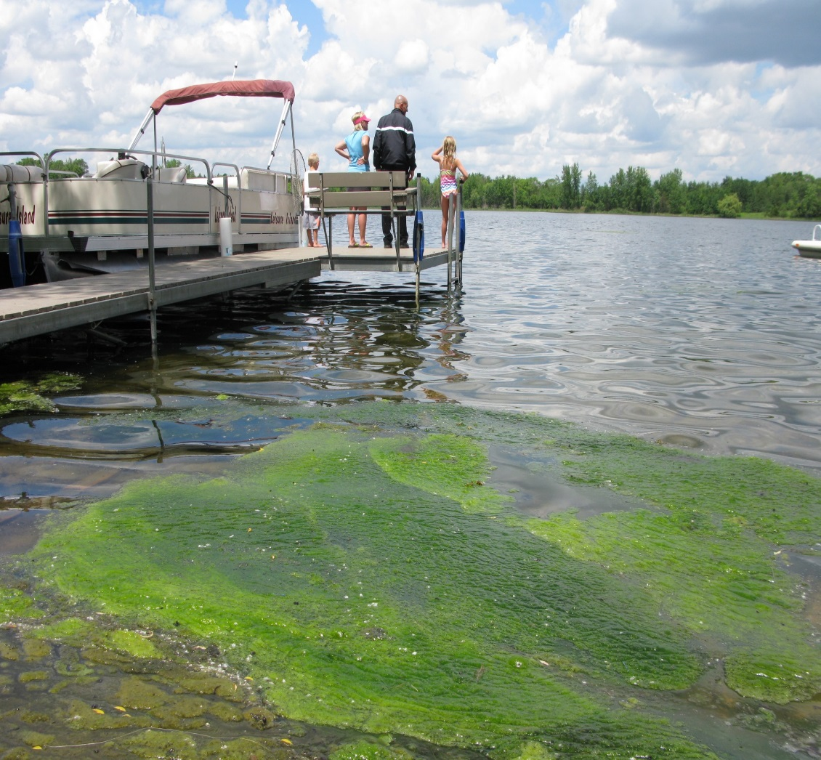
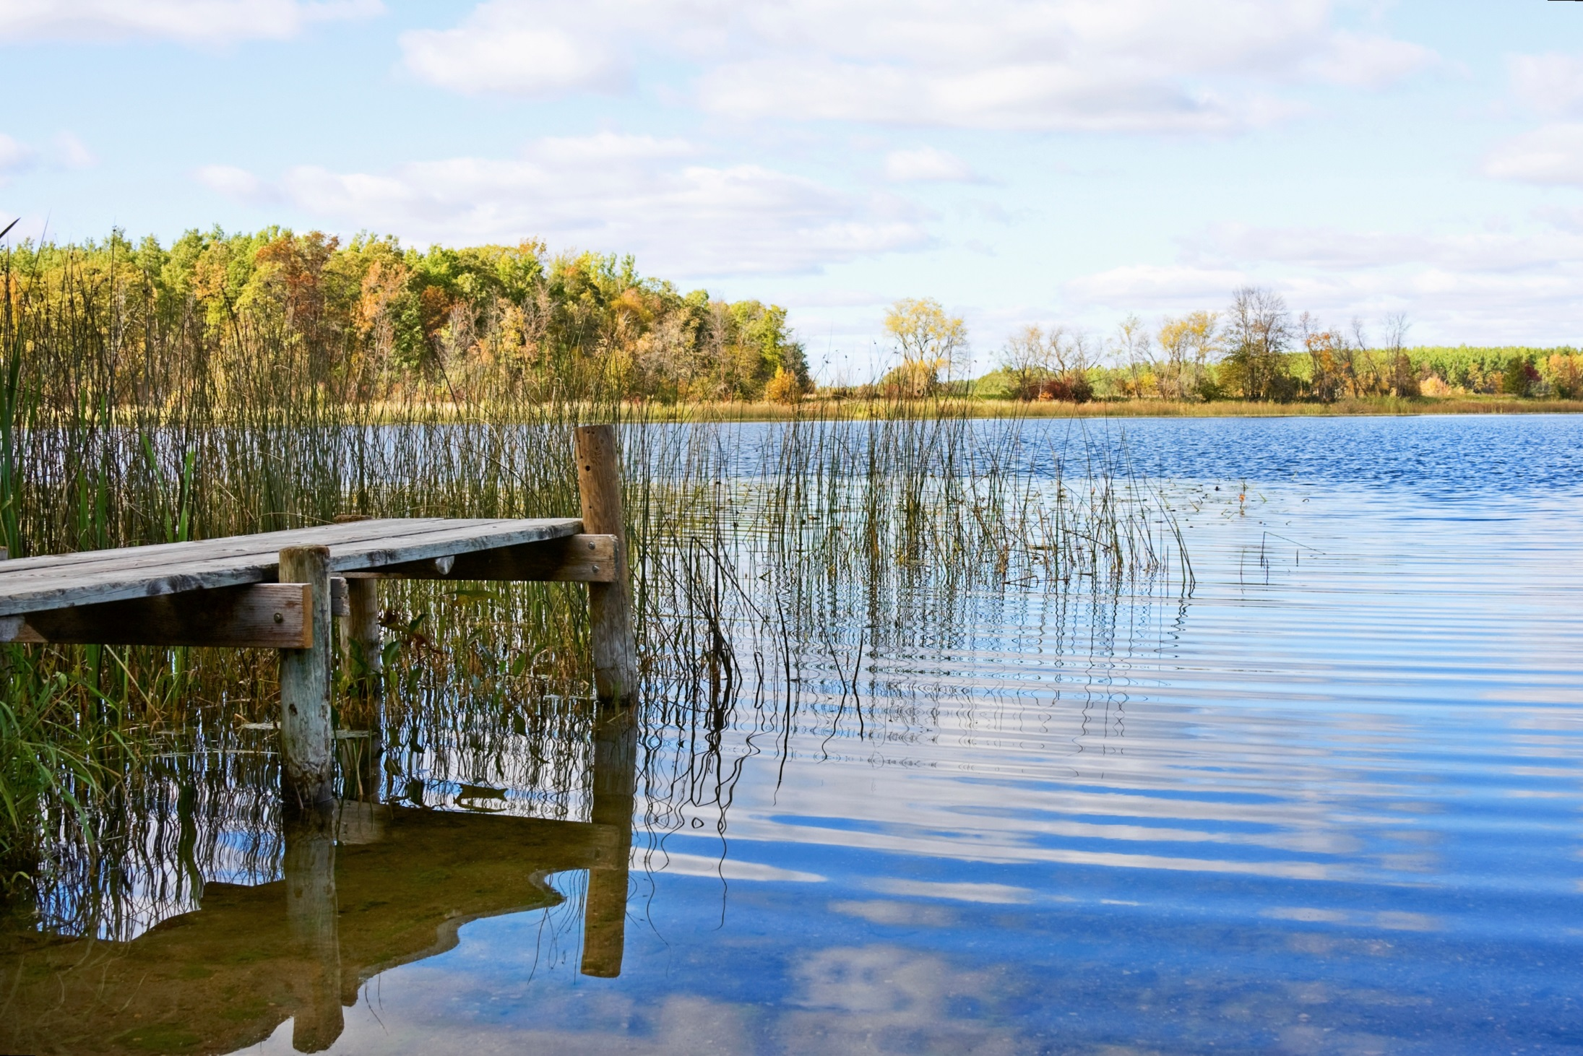
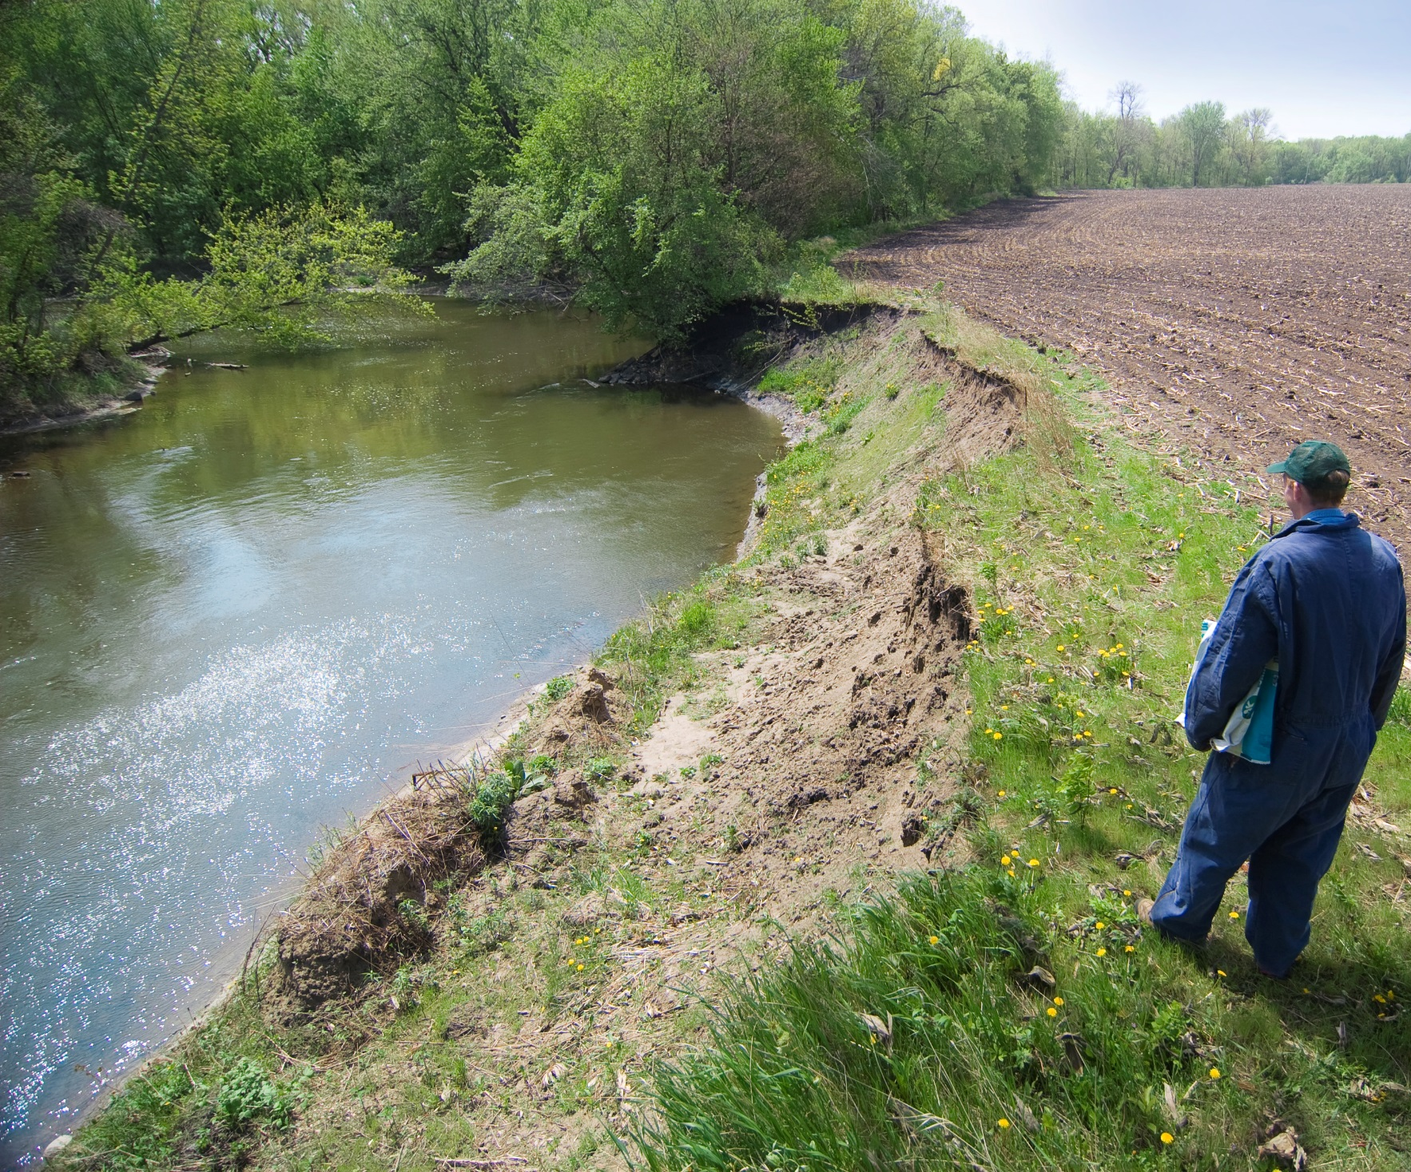
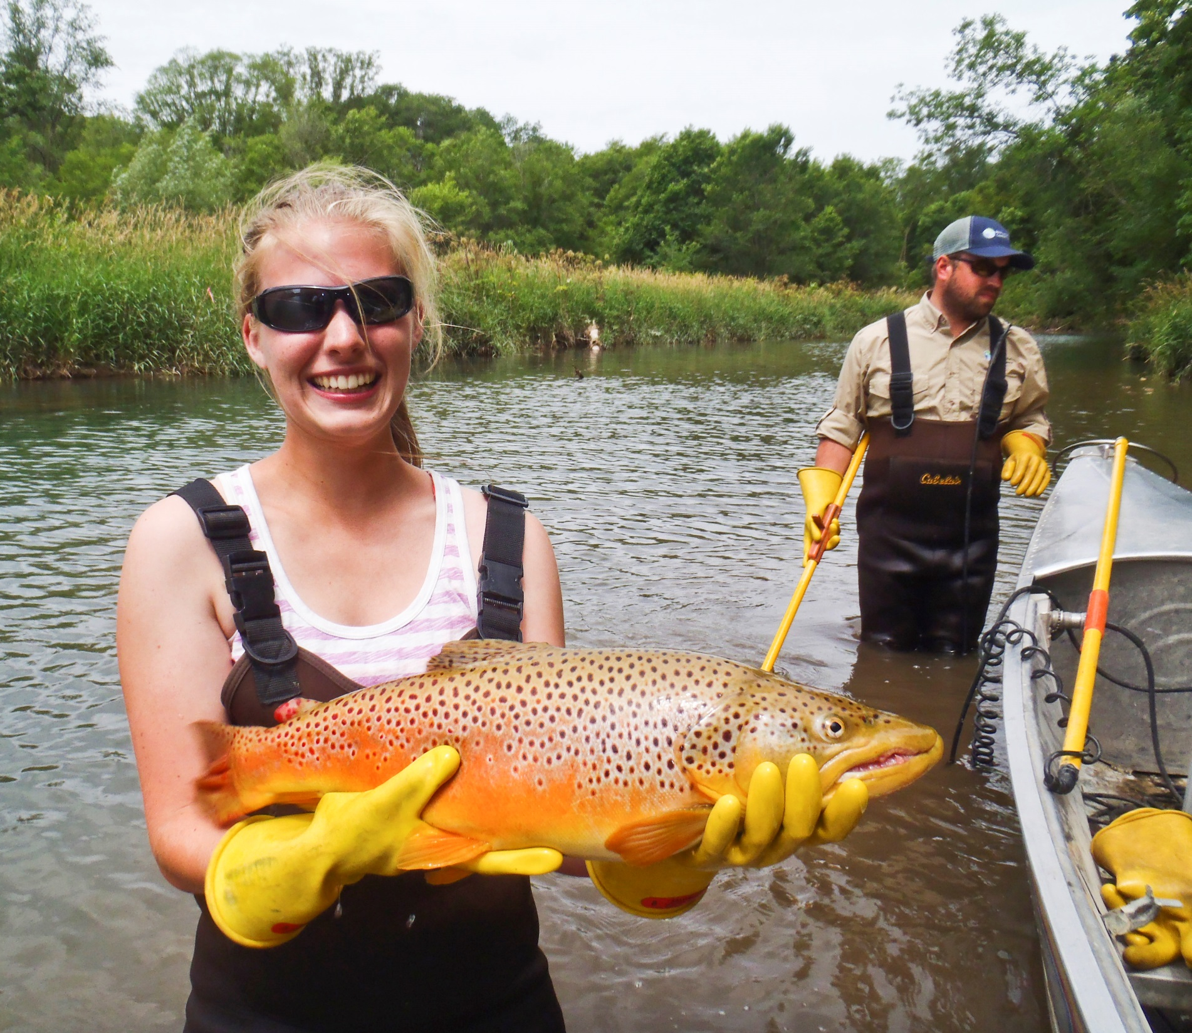
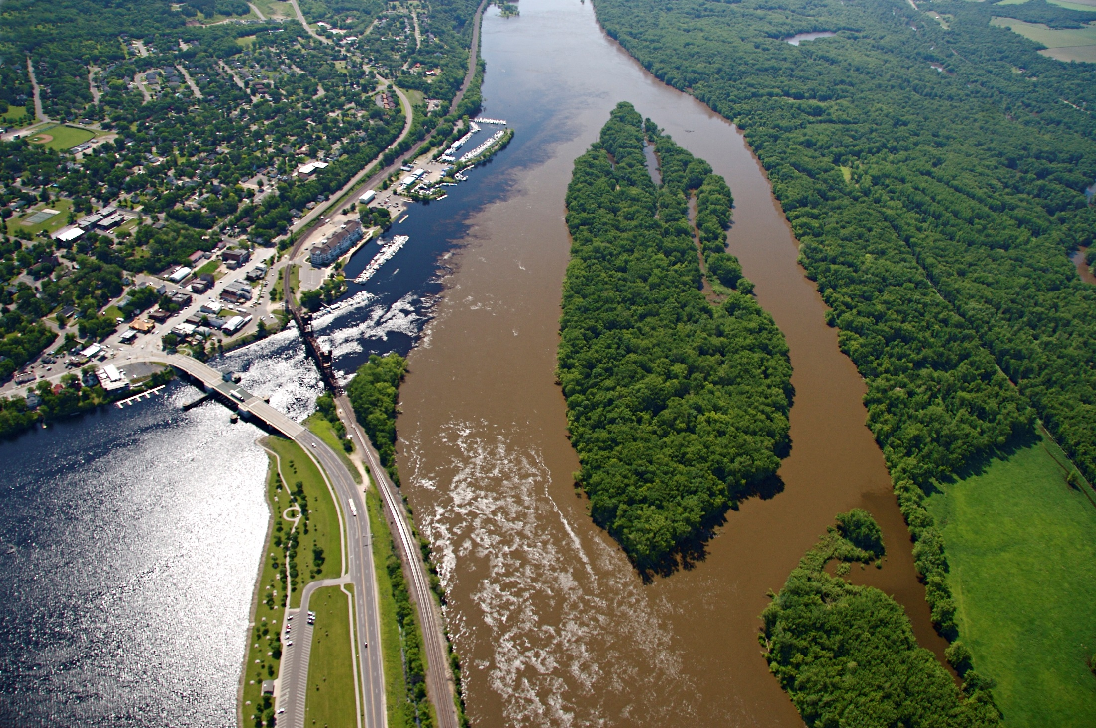
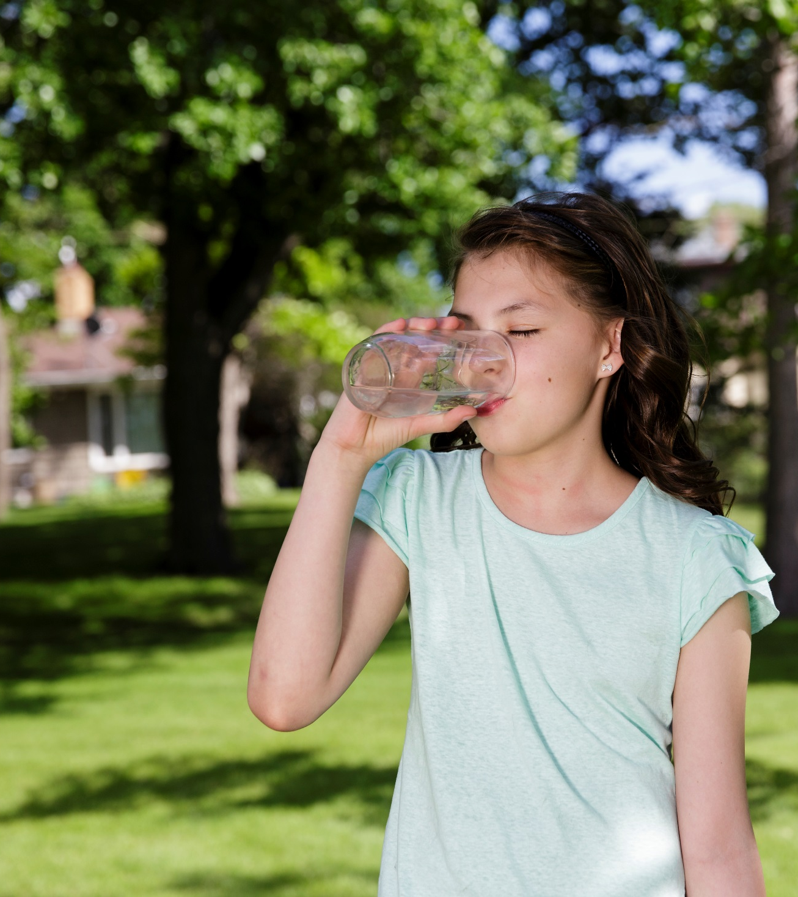
Clean Water Council
SLIDE 1

Slide 2
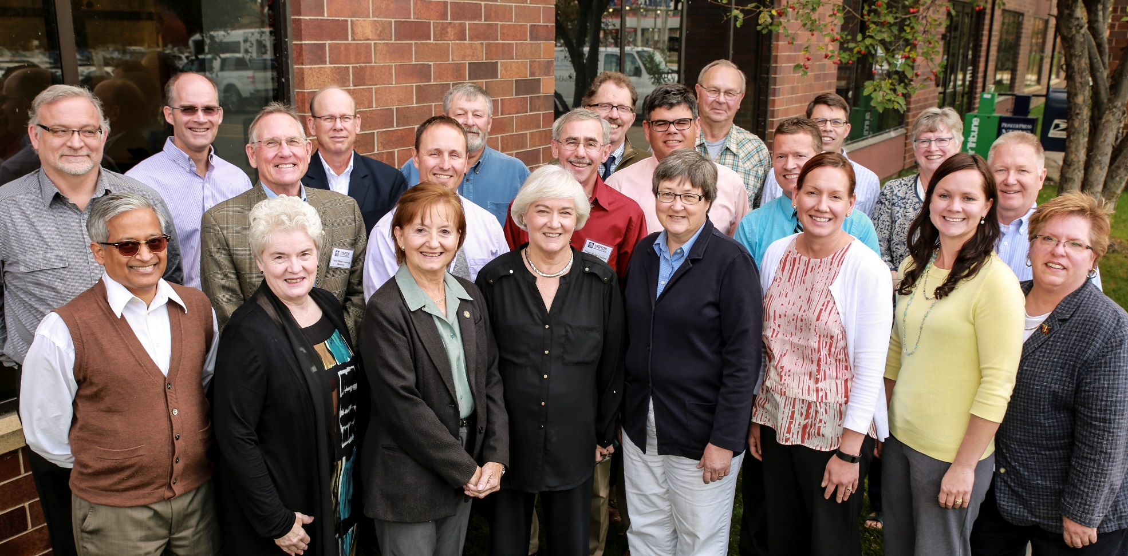
Clean Water Council
Established in 2006 to advise the Legislature and Governor on the implementation of the Clean Water Legacy Act
SLIDE 2

Slide 3

Clean Water Council
(28 members)
Governor appoints 17 voting members representing:
Business Organizations
City Governments
County Governments
Environmental Organizations
Lake and Stream Nonprofit Organizations
Soil and Water Conservation Districts
Statewide Farm Organizations
Statewide Fishing Organizations
Statewide Hunting Organizations
Township Officers
Tribal Governments
Watershed Districts
Legislature appoints 4 non-voting members:
MN Senate (majority and minority)
MN House of Representatives (majority and minority)
Entity heads appoint 7 non-voting members:
Board of Water and Soil Resources
Department of Natural Resources
Metropolitan Council
MN Department of Agriculture
MN Department of Health
MN Pollution Control Agency
University of Minnesota
SLIDE 3

Slide 4
Council comparison
Clean Water Council | Lessard-Sams Outdoor Heritage Council
28 members - mix of voting and non-voting | 12 members - all voting
Biennial Recommendations | Annual Recommendations
Programs (~60) | Programs/Projects (~40)
Receives informal program ideas from agencies and stakeholder groups | Issues a formal “call for funding request”
MPCA Staff - 1.65 | Legislative staff - 4
SLIDE 4

Slide 5
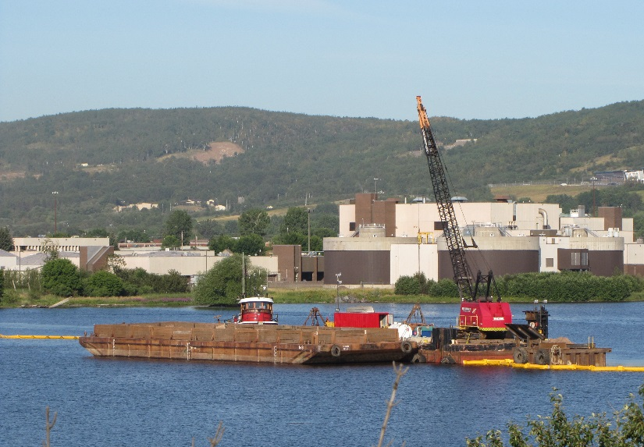
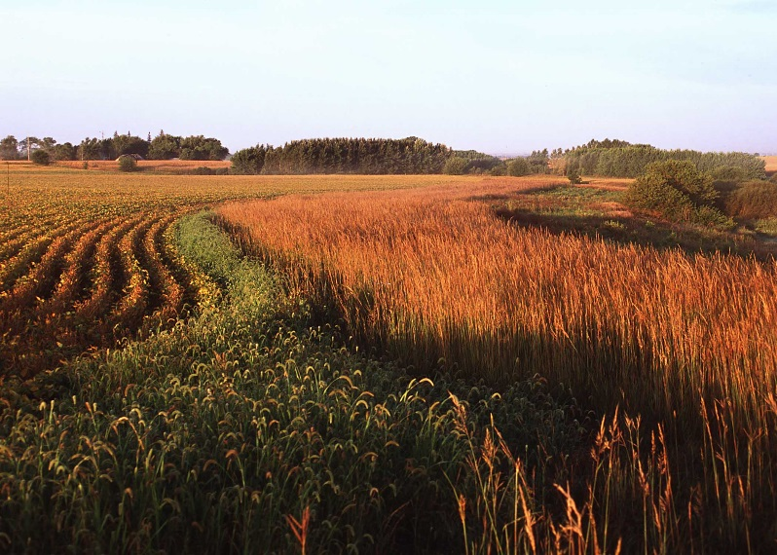
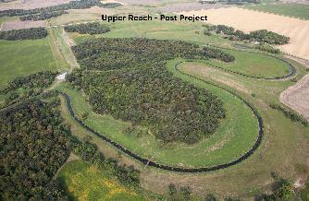

Clean Water and Outdoor Heritage
Legacy FUNDS WORKING TOGETHER
  St. Louis River Area of Concern
  Conservation Easements
  Grand Marais Creek Restoration
SLIDE 5

Slide 6

CLEAN WATER FUND
  The Clean Water Fund is 1 of the 4 Legacy Funds
MN Constitution Article XI, Sec. 15
(2008 Legacy Amendment)
The Clean Water Fund may be spent only to:
  protect, enhance, and restore water quality in lakes, rivers, and streams,
  protect groundwater from degradation, and
  protect drinking water sources
SLIDE 6

Slide 7

Clean Water Council
Established in 2006 to advise the Legislature and Governor on the implementation of the Clean Water Legacy Act and recommend how Clean Water Fund dollars are appropriated
SLIDE 7

Slide 8
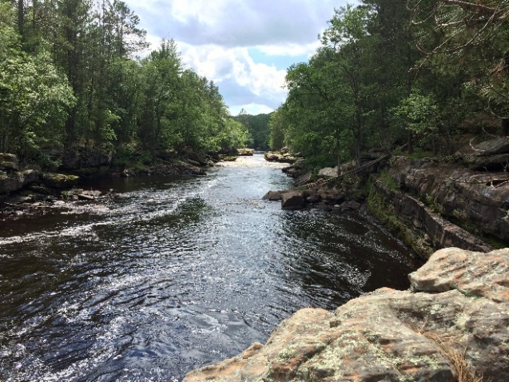
Process used to Develop FY18-19
Clean Water Fund Recommendations
  Council developed Guiding Principles &
  Funding Priorities (Jan. 2016)
  Budget and Outcomes Committee
  7 members met once/month from Oct. 2015 – Oct. 2016
  Reviewed funding proposals and outcomes for ~ 74 programs
  Solicited new ideas from stakeholder groups and agencies
  Developed draft funding recommendations for the full Council
  Council passed FY18-19 Clean Water Fund Recommendations (Sept. 2016)
SLIDE 8

Slide 9
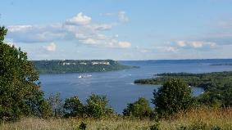
Guiding Principles and Funding Priorities (examples)
Guiding Principles (examples)
Promote programs that demonstrate significant new progress towards clean and sustainable water resources
Promote actions that protect groundwater quantity and quality particularly in vulnerable drinking water areas
Keep water where it falls by promoting water storage, retention, and infiltration where appropriate
Funding Priorities (examples)
FY18-19 Clean Water Funds will be prioritized for programs that:
Restore impaired waters and protect high quality waters
Target implementation activities through surface water and groundwater monitoring
Leverage other available funds
Implement the State’s Watershed Approach
SLIDE 9

Slide 10
FY18-19 Clean Water Fund Recommendations
($220.514 million)
Research & Evaluation
$8 million (4%)
Monitoring, Mapping & Data Analysis
$41 million (18%)
Implementation Activities
$105 million (48%)
Planning & Technical Assistance
$67 million (30%)
SLIDE 10

Slide 11
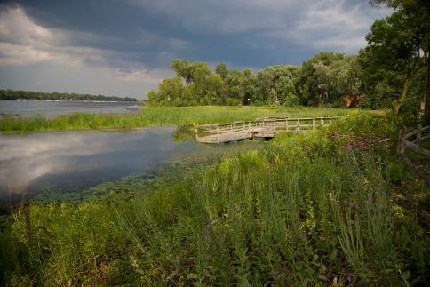
IMPLEMENTATION ACTIVITIES
~$105 million (48%)
Projects that restore and protect lakes, streams, drinking water, and groundwater
SLIDE 11

Slide 12
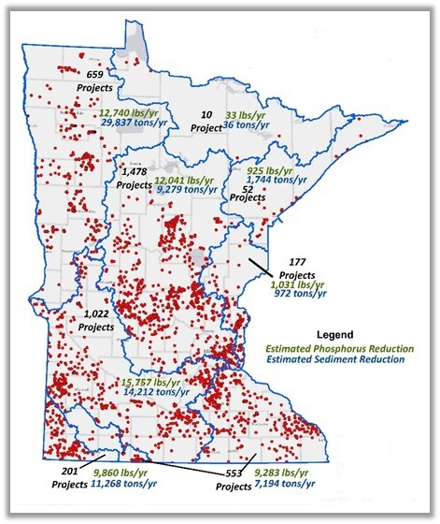
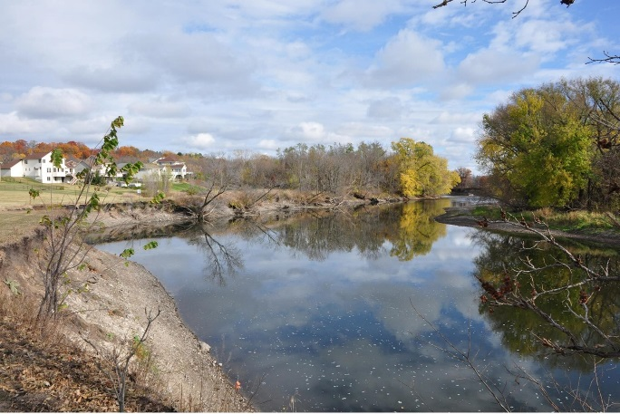
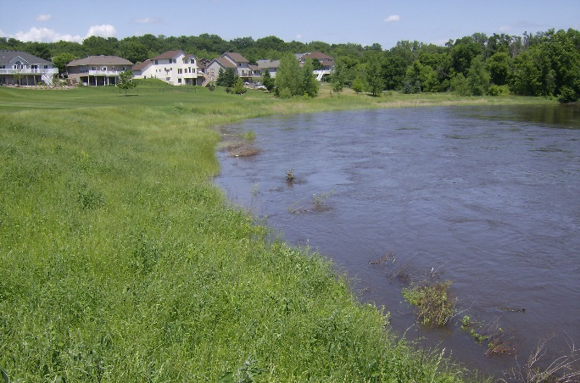
CLEAN WATER FUND OUTCOMES - IMPLEMENTATION
Grants to LGUs installed > 5,000 conservations practices
Projects reduced sediment by >120,000 tons/year
Projects reduced phosphorus by >95,000 lbs./year
Completed Clean Water Projects
SLIDE 12

Slide 13
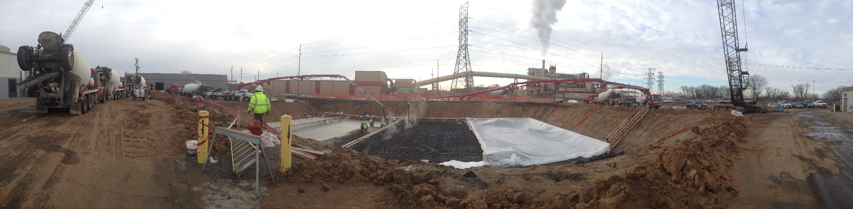
CLEAN WATER FUND OUTCOMES - IMPLEMENTATION
Grants for stormwater/wastewater projects
Projects reduced phosphorus by over 140,000 lbs./year
Grants/Loans to small communities
Projects removed 231 non-complying septic systems
SLIDE 13

Slide 14
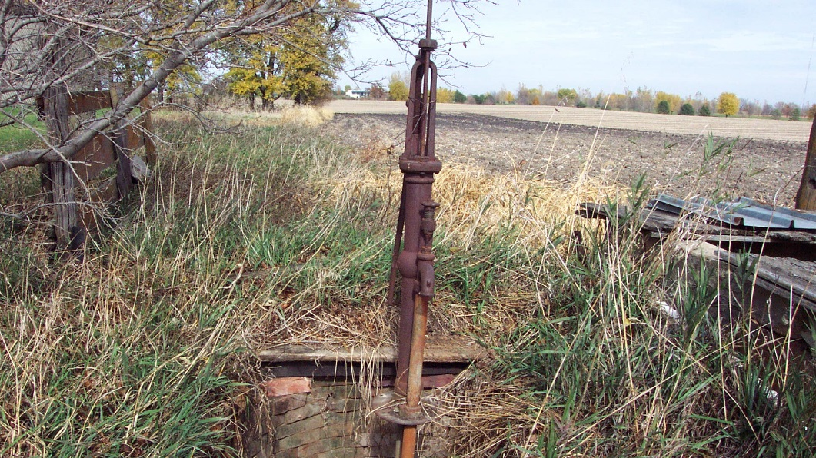
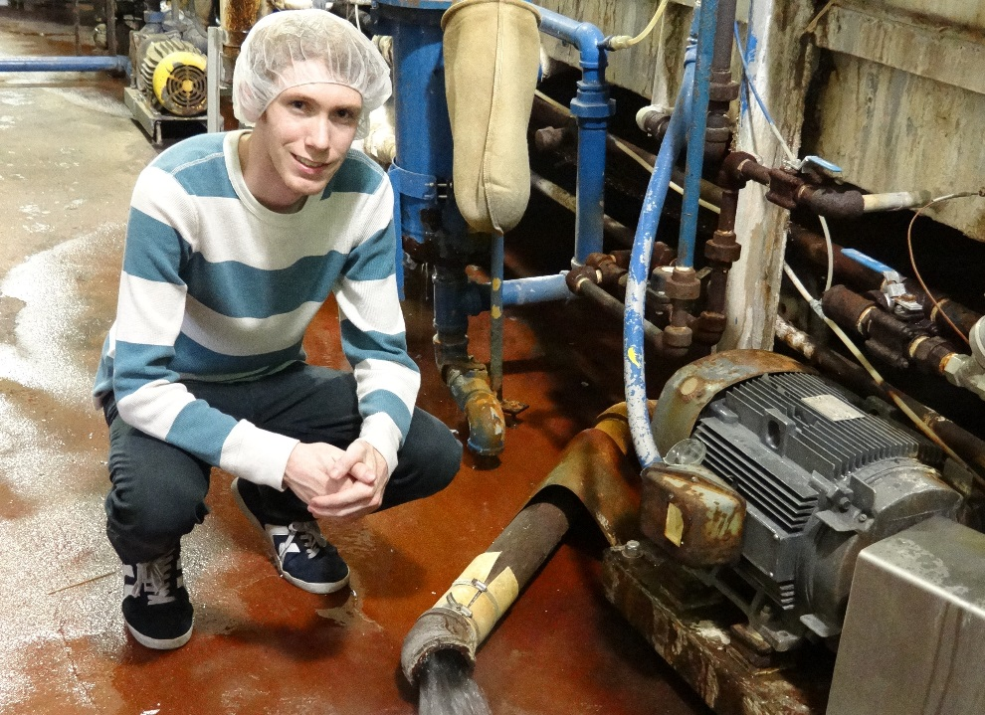
CLEAN WATER FUND OUTCOMES - IMPLEMENTATION
Grants to public and
private well owners
Sealed >500 unused wells
Grants to Municipalities
Reduced water use by 86 million gallons annually
SLIDE 14

Slide 15
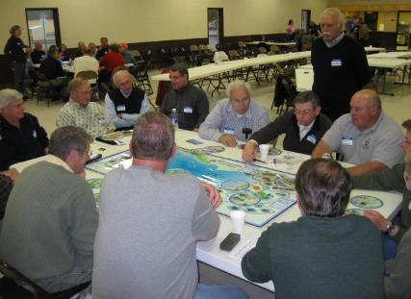
PLANNING & TECHNICAL ASSISTANCE
~$67 million (30%)
Develop clean up and protection plans
Provide technical assistance to local governments, drinking water suppliers, well owners, permittees, and agricultural producers
Planning & Technical Assistance
(30%)
SLIDE 15

Slide 16
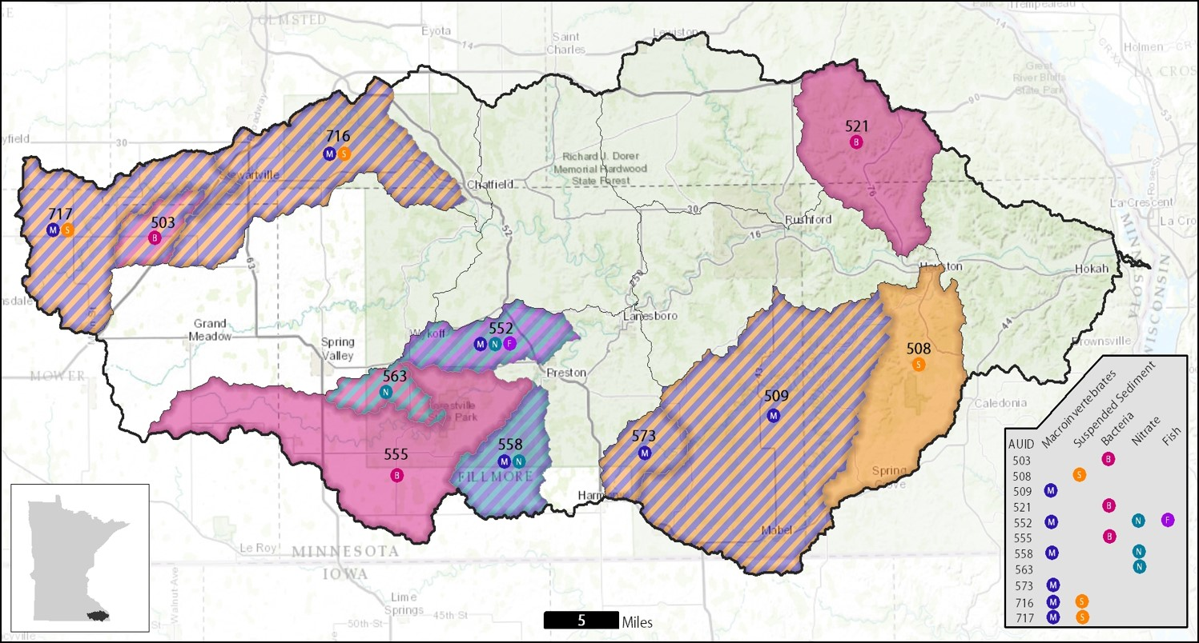
CLEAN WATER FUND OUTCOMES – PLANNING
& TECHNICAL ASSISTANCE
Completed 9 Major Watershed Plans
Identified sources of pollution to guide implementation efforts
SLIDE 16

Slide 17
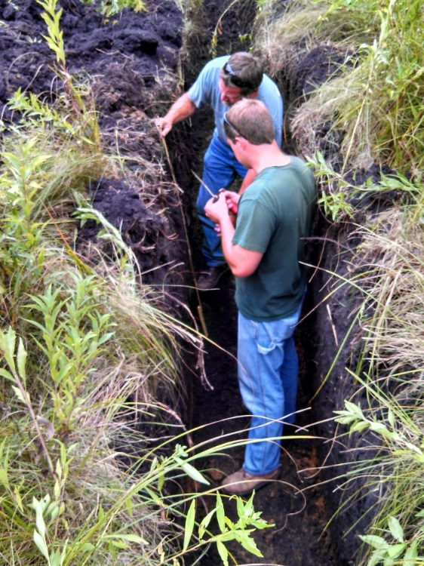
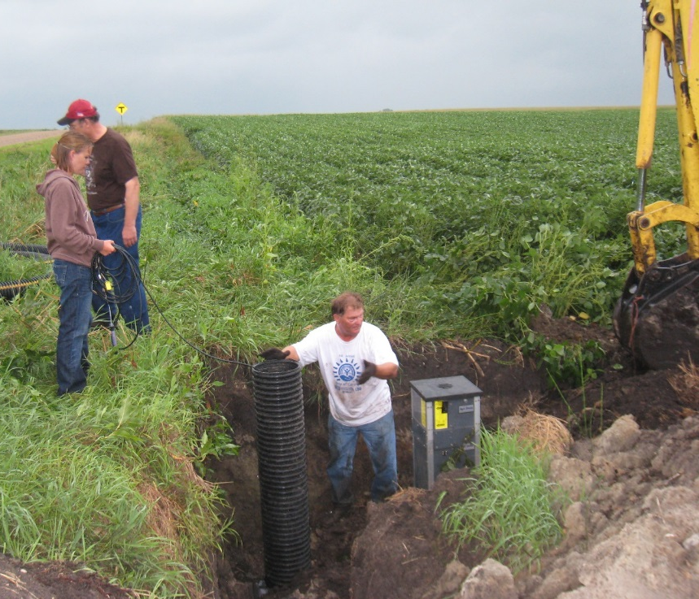
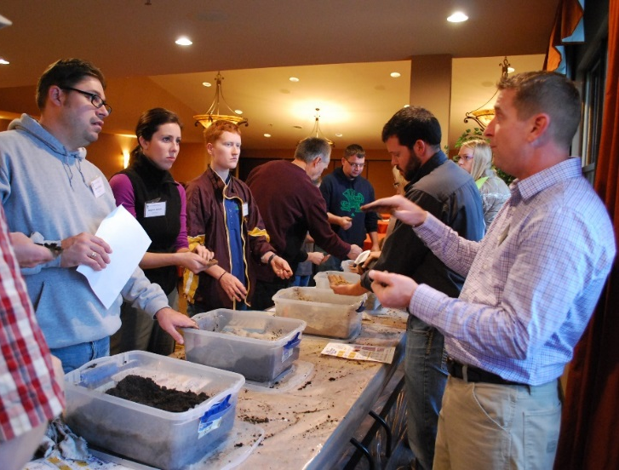
CLEAN WATER FUND OUTCOMES – PLANNING
& TECHNICAL ASSISTANCE
Engaged 3,000+ farmers through 150 outreach events
Improved nutrient and fertilizer management
Provided grants/technical assistance to drinking water suppliers
~450 approved plans help protect 85% of Minnesotans
Provided technical assistance to LGUs
Accelerates implementation efforts
SLIDE 17

Slide 18
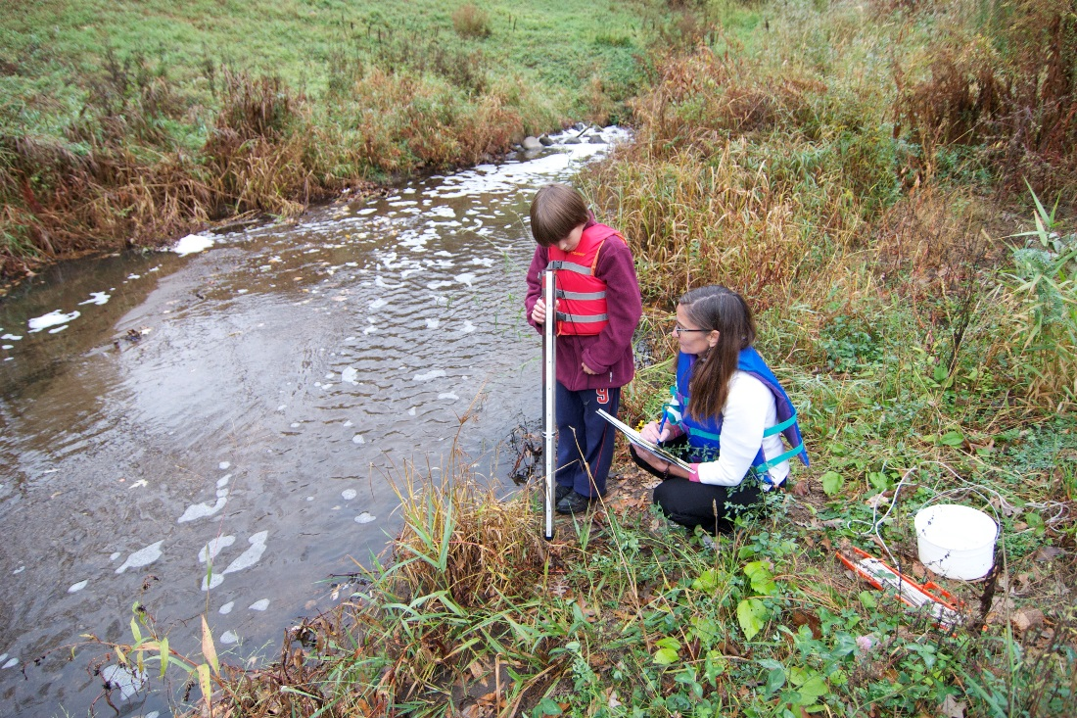
MONITORING, MAPPING & DATA ANALYSIS
~$41 million (18%)
Monitor lakes, streams, groundwater, and wells
Analyze water quality and quantity data
Monitor fish and aquatic plant communities
Map geology and buffers
Monitoring
(18%)
SLIDE 18

Slide 19
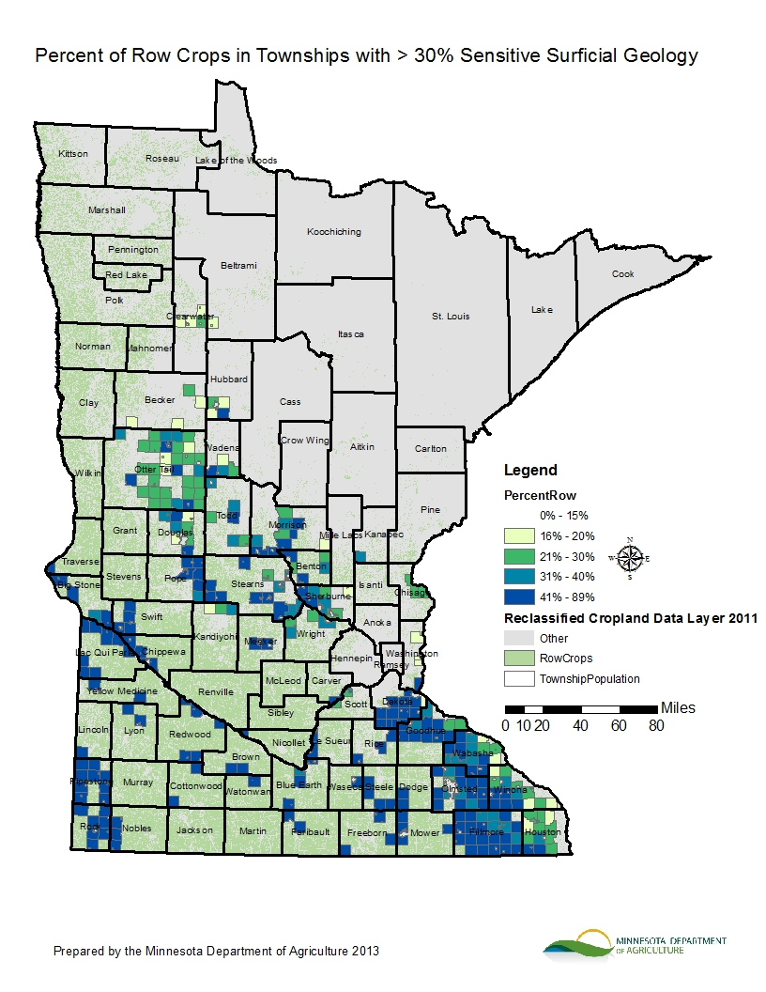
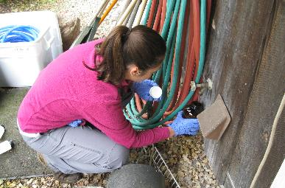
CLEAN WATER FUND OUTCOMES - MONITORING,
MAPPING & DATA ANALYSIS
13,720 private wells tested
9.6% found to be over the drinking water standard for nitrate
600 additional pesticides sampled
6 pesticide impairments identified in surface water
SLIDE 19

Slide 20
CLEAN WATER FUND OUTCOMES - MONITORING,
MAPPING & DATA ANALYSIS
70% of Minnesota’s watersheds now have water quality data
4,607 impaired lakes & streams
SLIDE 20

Slide 21
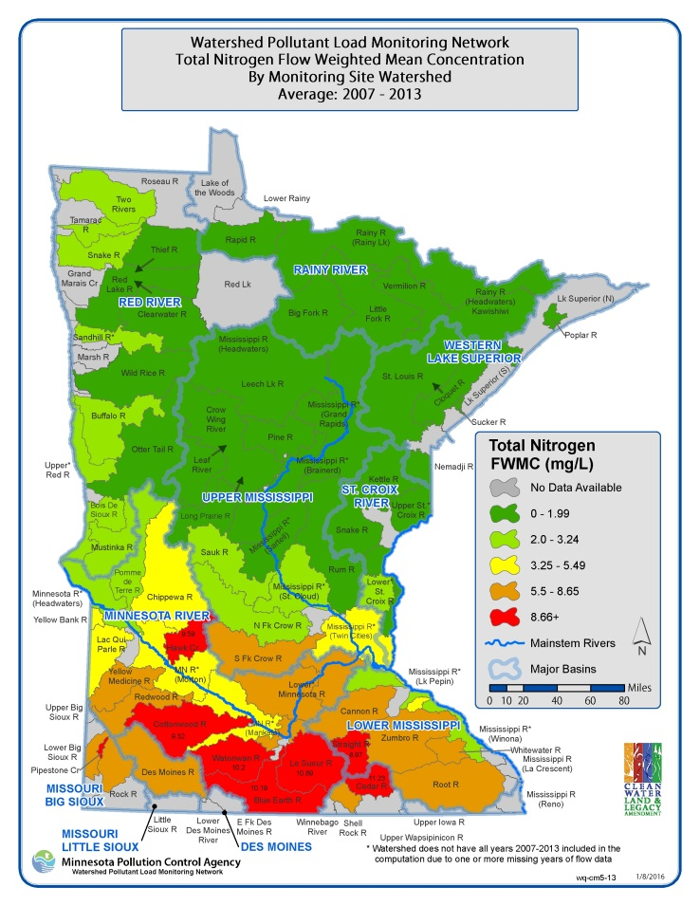
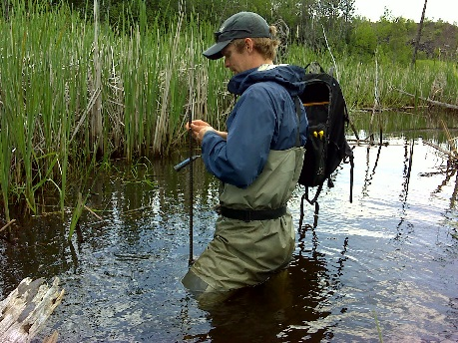
CLEAN WATER FUND OUTCOMES - MONITORING,
MAPPING & DATA ANALYSIS
Total Nitrogen
SLIDE 21

Slide 22

CLEAN WATER FUND OUTCOMES - MONITORING,
MAPPING & DATA ANALYSIS
Provided health-based guidance for 32 drinking water contaminants that raise new concern for human health
“New contaminant found in New Brighton drinking water
While levels of new contaminant are not considered dangerous, city will use water from deeper wells.”
- Star Tribune, April 17, 2015
SLIDE 22

Slide 23
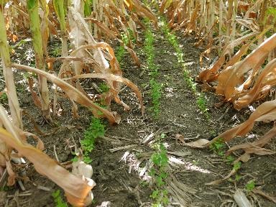
RESEARCH & EVALUATION
~$8 million (4%)
Conduct agricultural and stormwater research
Evaluate projects and programs
Report results
Research & Evaluation
(4%)
SLIDE 23

Slide 24
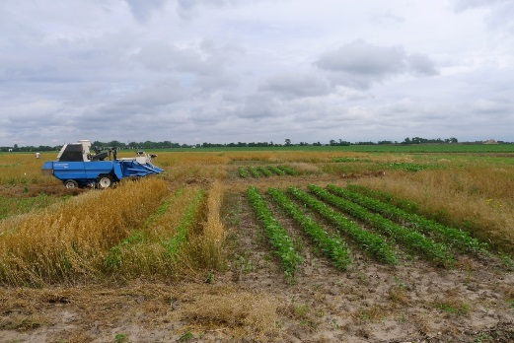
CLEAN WATER FUND OUTCOMES – RESEARCH
& EVALUATION
Forever Green Initiative (University of Minnesota)
Develops new crops that have commercial value and improve water quality by keeping plant cover on the landscape for an extended period of the year
SLIDE 24

Slide 25
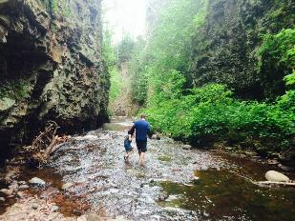
Process used to Develop
Policy Recommendations
  Policy Committee
  7 members met once/month from Dec. 2015 – Oct. 2016
  Solicited ideas from stakeholder groups and agencies
  Discussed water policy ideas related to over ~20 topics
  Developed draft policy recommendations for the full Council
  Council passed 2 Policy Recommendations (Sept. 2016)
SLIDE 25

Slide 26

Advancing Drinking Water Protection
Drinking Water Think Tank
Lead Issues
Economic Incentives
Private Well Testing
Protection Plans for Surface Waters
SLIDE 26

Slide 27
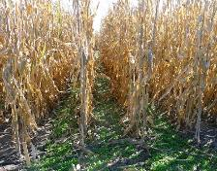
LIVING COVER FOR DRINKING WATER PROTECTION
Policy Statement: The Clean Water Council recommends that the State require the establishment of living cover or equivalent practices in vulnerable areas as identified in wellhead and surface water intake protection plans to protect public and private drinking water sources.
SLIDE 27

Slide 28
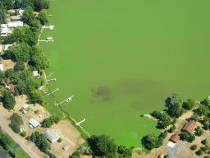
CLOSING THOUGHTS
Minnesota voters approved the Legacy Amendment with a belief that an increase in funds could improve and protect Minnesota’s lakes, rivers, and groundwater supplies.
The Council’s FY18-19 Budget and Policy Recommendations reflect our best ideas for the protection and restoration of Minnesota’s water resources.
But we also acknowledge that the amount of Clean Water Fund dollars available will not meet all the needs and expectations of citizens.
SLIDE 28

Slide 29
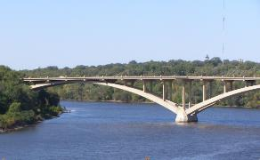
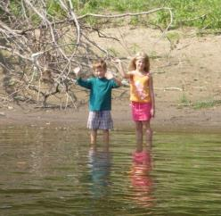
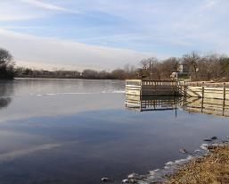

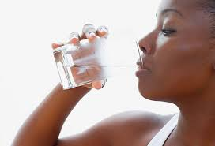
Clean Water Council
  For more information
  www.pca.state.mn.us/cleanwatercouncil
SLIDE 29

