Slide 1
PFAS Regulations – MN and other states MPCA-MDH Staff PFAS Training June 25, 2018
Ginny Yingling | Hydrogeologist – Minnesota Dept. of Health

Slide 2
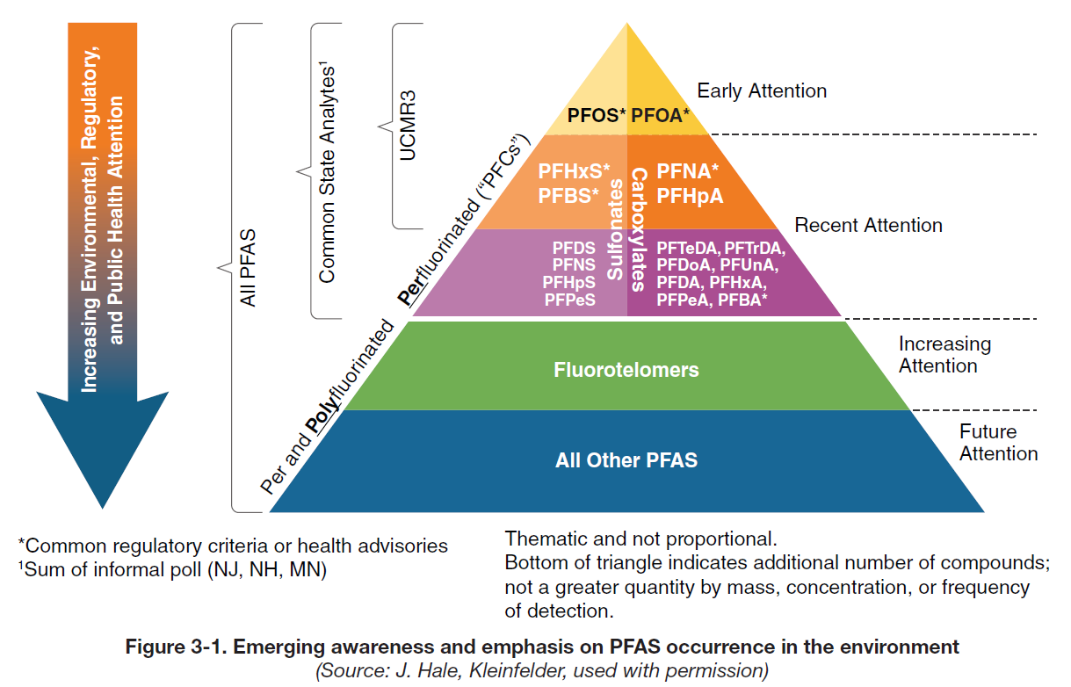
PFAS in the United States
Federal Values
State Values
Investigations
Analytical
Source: ITRC (2017); image reprinted with permission of Jeff Hale, Kleinfelder.
Notes:
Although there may be several thousand chemicals in the class known as per- and polyfluorinated alkyl sustances (or PFAS), in the US and around the world, as this figure illustrates, most of the investigative and regulatory attention has focused on what some call the “tip of the iceberg” – primarily PFOA and PFOS, and more recently some of the other perfluoroalkyl acids (PFAAs, or what we used to call PFCs). Global reports of PFOS and PFOA detections in wildlife and human blood samples, coupled with several high-profile contaminated sites, led to these chemicals garnering most of the early attention of state and federal agencies and researchers. But we’ve quickly learned that except at certain industrial settings, PFAS usually are present as complex mixtures and regulatory interest has progressively shifted to encompass an ever increasing list of PFAAs – although the focus even now is on a very short list of about 6-8 PFAAs. Meanwhile, site investigations typically employ target analyte lists of 12-20 PFAS and advances in analytical chemistry have allowed us to detect ever more of the precursor compounds that may degrade to form PFAAs. Unfortunately our understanding of the ecological and human health risks associated with these chemicals lags far behind our ability to detect them, with debates still raging over health-based values for PFOS and PFOA, and this appears to be how things will be for the foreseeable future.

Slide 3
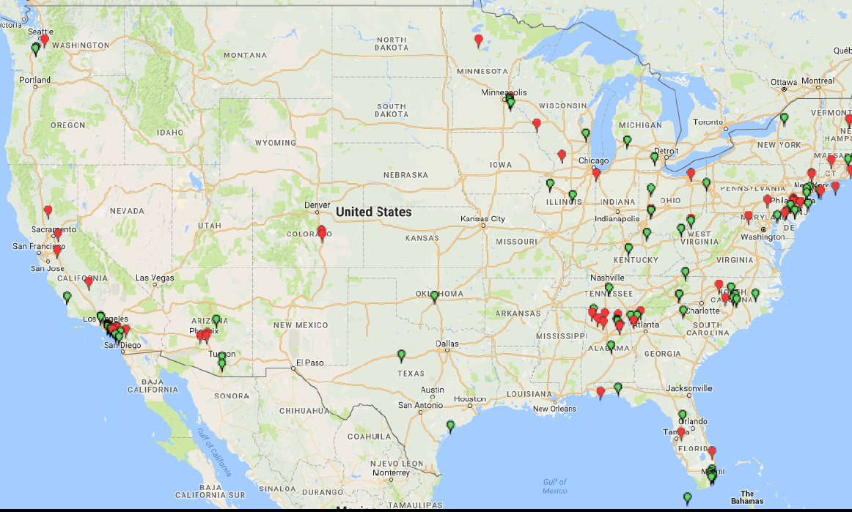
PFAS in US drinking water – UCMR3
Bemidji, MN
2013-2015 list included 6 PFAAs (PFOS, PFOA, PFNA, PFHxS, PFHpA, PFBS)
Municipal systems >10,000 and selected smaller systems
Detected in ~4%, exceeded EPA LHAs in ~1.3%
High RLs and sampled only at entry points, not wellheads
Did NOT test for
PFBA or PFPeA
Washington Co., MN
Hoosick Falls, NY
Little Hocking, OH
Colorado Springs, CO
Decatur, AL
Cape Fear
River, NC -
GenX
UCMR3: PFOS and PFOA Detections
Figure adapted from Andy Eaton, Eurofins-Eaton Analytical
Notes:
Although several large, industrial PFAS sites in Ohio, Minnesota, and Alabama were already known, and the US Dept. of Defense has identified over 400 known or suspected PFAS release sites, it wasn’t until the third round of the Unregulated Contaminant Monitoring Rule (or UCMR3) sampling of municipal water supplies was completed by EPA that the public began to understand the potential national scope of the problem and other sites began to hit the news, like those in Colorado Springs, Hoosick Falls, and Bemidji. Although PFOS and PFOA were detected in only about 1.3% of municipal systems tested, this still constitutes the drinking water of nearly 6 million Americans. And while this is a robust drinking water data set, researchers have noted that limitations to how the sampling was conducted may have led to under-reporting of the actual extent of PFAS in drinking water. More recently, widespread detections of GenX in the Cape Fear River in North Carolina have raised concerns about other PFAS compounds, including PFOA and PFOS replacement chemistries. This has turned up the pressure on state and federal agencies to respond.

Slide 4
Target analyte lists still evolving
Analyte Name | Acronym | CAS Number
Perfluorotetradecanoic acid* | PFTreA** | 376-06-7
Perfluorotridecanoic acid* | PFTriA*** | 72629-94-8
Perfluorododecanoic acid* | PFDoA | 307-55-1
Perfluoroundecanoic acid* | PFUnA | 2058-94-8
Perfluorodecanoic acid* | PFDA | 335-76-2
Perfluorononanoic acid* | PFNA | 375-95-1
Perfluorooctanoic acid* | PFOA | 335-67-1
Perfluoroheptanoic acid* | PFHpA | 375-85-9
Perfluorohexanoic acid* | PFHxA | 307-24-4
Perfluoropentanoic acid | PFPeA | 2706-90-3
Perfluorobutanoic acid | PFBA | 375-22-4
Perfluorodecanesulfonate | PFDS | 335-77-3
Perfluorononanesulfonate | PFNS | 68259-12-1
Perfluorooctanesulfonate* | PFOS | 1763-23-1
Perfluoroheptanesulfonate | PFHpS | 375-92-8
Perfluorohexanesulfonate* | PFHxS | 355-46-4
Perfluoropentansulfonate | PFPeS | 2706-91-4
Perfluorobutanesulfonate* | PFBS | 375-73-5
Perfluorooctanesulfonamide | PFOSA | 754-91-6
Fluorotelomer sulfonate 8:2 | FtS 8:2 | 39108-34-4
Fluorotelomer sulfonate 6:2 | FtS 6:2 | 27619-97-2
Fluorotelomer sulfonate 4:2 | FtS 4:2 | NA
N-ethyl-N-((heptadecafluorooctyl)sulfonyl)glycine* | NEtFOSAA | 2991-50-6
N-(Heptadecafluorooctylsulfonyl)-N-methylglycine* | NMeFOSAA | 2355-31-9
Notes:
Most PFAS target analyte lists are driving our approach to contaminated sites, but as the previous slide showed we are still just scratching the surface. EPA method 537 tests only for the 14 PFAS highlighted in blue – 12 PFAAs and 2 precursors that can degrade to persistent PFAAs. From my Minnesota perspective, what leaps out at me is that neither PFBA or PFPeA are on this list – yet these are two of the most frequently detected groundwater contaminants in our state (and I suspect, would also be widely present elsewhere, if we were looking for them). A proposed new list, currently being validated, would add 6 more PFAAs (including PFBA and PFPeA) and four additional precursor PFAS commonly found at AFFF sites.

Slide 5
Minnesota Drinking Water Guidance
MDH health-based guidance values evolve over time as additional research becomes available
Surrogate values used when widespread detection of chemical in drinking water, but insufficient toxicological data to set an HBV
Health Risk Index (HI): allows us to evaluate mixtures of similar chemicals
Similar to TEQ approach
If HI > 1, considered an exceedance
 | PFOA | PFOS | PFBA | PFBS | PFHxS*
2002 | 7 | 1
2006 | 1 | 0.6 | 1
2007 | 0.5 | 0.3 | 7
2009 | 0.3 | 0.3 | 7 | 7
2013 | 0.3 | 0.3 | 7 | 7 | 0.3
2016 | 0.07 | 0.07 | 7 | 7 | 0.07
2017 | 0.035 | 0.027 | 7 | 3/2 | 0.027
Blue = HRL; Red = HBV; Green = Surrogate
HI = PFOA_{[conc]} + PFOS_{[conc]} + PFBA_{[conc]} + PFBS_{[conc]} + PFHxS_{[conc]}
0.035 0.027 7 3 0.027
Notes:
In 2002, MDH was asked by MPCA to derive health based values for PFOA and PFOS. Helen is going to go into more detail about the MDH guidance values, how they’re developed, and what they mean in terms of human health. The point of this slide is to illustrate how the guidance values have evolved over time. In 2006, when the PHL expanded its analyte list to include 5 more PFAAs (PFBA, PFBS, PFHxA, and PFHxS) widespread detections of PFBA in drinking water samples led MDH to set a “surrogate” value for PFBA equivalent to the HBV at that time for PFOA. Such surrogate values are used when a chemical is widely detected in drinking water, we have insufficient toxicological information to set a Health Based Value, but we have a chemically similar compound that does have an HBV or HRL. Over time, new toxicological information has driven most of the PFAA guidance values downward. MDH also uses an approach similar to TEQ to evaluate mixtures of chemicals that have similar modes of action and the same target organs, as is the case with PFAAs.

Slide 6
 |  |  |  |  | PFAS Analyte Concentration in Water (µg/L)
Location |  | Standard / Guidance | Type | Promulgated Rule (Y/N/P/R) | PFOA | PFOS | PFNA | PFBA | PFBS | PFHxS | PFHxA | PFPeA | PFHpA | PFOSA | PFDA | PFDS, PFUnA, PFDoA, PFTrDA, PFTeDA | 6:2 FTS | Gen-X
U.S. Environmental Protection Agency
USEPA |  | HA | DW | N | 0.07 | 0.07
 |  | RSL^{b} | GW | R | 0.4 | 0.4 |  |  | 401
U.S. States
Alaska (AK) |  | CL | GW | Y | 0.40 | 0.40
Connecticut (CT) |  | AL | GW | N | 0.07 | 0.07 | 0.07 |  |  |  | 0.07 |  | 0.07
Colorado (CO) |  | HA | DW | N | 0.07 | 0.07 |  |  |  |  |  |  | 0.07
Delaware (DE) |  | RL | GW | N | 0.07 | 0.07
 |  | SL | GW | N | 0.07 | 0.07 |  |  | 38
Iowa (IA) |  | Statewide Standards | Protected GW | Y | 0.07 | 0.07
 |  |  | Non-protected GW | Y | 0.7 | 1
Maine (ME) |  | Health-based MEG | DW | N | 0.07 | 0.07
 |  | RAG | GW | N | 0.13 | 0.56
 |  |  | RW | N | 0.05 | 1.2
Michigan (MI) |  | HNV | SW | Y | 0.42 | 0.011
 |  | GCC | GW | P | 0.089 | 0.08
Minnesota (MN) |  | short-term HBV | GW | N | 0.035 | 0.027 |  | 7 | 3 | 0.027*
 |  | subchronic HBV | GW | N | 0.035 | 0.027 |  | 7 | 3 | 0.027*
 |  | chronic HBV | GW | N | 0.035 | 0.027 |  | 7 | 2 | 0.027*
Nevada (NV) |  | BCL | DW | N | 0.667 | 0.667 |  |  | 667
New Hampshire (NH) |  | AGQS | GW | Y | 0.07 | 0.07
New Jersey (NJ) |  | ISGWQC | GW | Y |  |  | 0.010
 |  | GWQS | GW | P |  |  | 0.010
 |  | MCL | DW | P |  |  | 0.013
 |  | MCL | DW | Y | 0.014
North Carolina (NC) |  | IMAC | GW | Y | 2
 |  |  | DW | N |  |  |  |  |  |  |  |  |  |  |  |  |  | 0.14
Oregon (OR) |  | IL | SW | Y | 24 | 300 | 1 |  |  |  |  |  | 300 | 0.2
Texas (TX) |  | Tier 1 PCL | GW | Y | 0.29 | 0.56 | 0.29 | 71 | 34 | 0.093 | 0.093 | 0.093 | 0.56 | 0.29 | 0.37 | 0.29
Vermont (VT) |  | PGWES | GW/DW | Y | 0.02 | 0.02
Table modified from ITRC (2017) Table 4-1: https://pfas-1.itrcweb.org/factsheets/
Notes:
This table gives you a sense of how few PFAAs have any federal or state guidance values, and also illustrates the wide range of values developed by the various states. While many states have adopted values for PFOS and PFOA, only a handful have values for other PFAAs, and only North Carolina has a value for a precursor PFAS – GenX. Like Minnesota, states with guidance for PFAAs other than PFOS and PFOA are typically responding to the specific mix of PFAS in their drinking water.

Slide 7
United States – State Standards and Guidance
Other PFAS regulatory approaches:
Product labeling and consumer product laws (ex: CA, WA)
Chemical action plans (ex: WA)
Designation as hazardous waste or substance (ex: CO, NY, VT)
Effluent and surface water standards (CA, MI, MN, OR)
Risk-based soil and groundwater cleanup values (TX)
Notes:
States are also employing a variety of regulatory approaches to control the use, release, and cleanup of PFAS, including consumer product and labeling laws, chemical action plans, designation as hazardous material, setting discharge limits, etc. The disparity in standards, guidance, and product laws has become a real problem for manufacturers, retailers, responsible parties, and environmental consultants. This is compounded by the fact that the regulatory landscape is evolving rapidly.

Slide 8
United States – Trying to Bring Order from Chaos
EPA PFAS Summit
Initiate steps to evaluate need for maximum contaminant levels (MCLs) for PFOS & PFOA
Initiating process to propose “hazardous substance” designation for PFOS & PFOA
Developing groundwater cleanup recommendations for contaminated sites (Fall 2018)
Developing toxicity values for GenX and PFBS
Department of Defense: SERDP/ESTCP
>$40M AFFF-related research projects: eco-risk, analytical & sampling methods, CSMs, remediation, F-free foams, etc.
www.serdp-estcp.org/Featured-Initiatives/Per-and-Polyfluoroalkyl-Substances-PFASs)
Interstate Technology & Regulatory Council (ERIS/ECOS)
Cross-sector PFAS information sharing & training (https://pfas-1.itrcweb.org/)
Monitoring development of new state & federal values and remedial technologies
Notes:
Several initiatives are under way to try to bring some order – and maybe uniformity – to the situation in the US. The EPA, in collaboration with the Environmental Council of the States (ECOS), recently held a PFAS Summit, meeting with environmental agency managers from across the country to discuss common policy approaches and EPA has begun work in a number of areas to help provide better guidance for site investigation and cleanup, although the focus still remains largely on PFOS and PFOA. The research agencies for the Department of Defense – SERDP/ESTCP have invested over $40 million in research projects aimed primarily at addressing the 400+ known AFFF release sites on DOD sites, but which should yield important information for all PFAS work. These cover a wide range of site investigation and cleanup issues. More information about the studies and their progress can be found at this website. The ITRC (a program of the Environmental Research Institute of the States) has a 320+ member PFAS team composed of representatives from the public and private sector and academia that is developing informational materials and training aimed at site managers and environmental practitioners. This includes web-based factsheets and regularly updated tables of guidance and regulatory standards.

