Slide 1

PFAS Analysis at MDH PHL
MDH/MPCA Interagency PFAS Meeting
Carin Huset, PhD
June 25, 2018

Slide 2
Outline
Sample analysis workflow
Specifics on:
  Water analysis
  Serum analysis
  Other matrices
Challenges
New directions

Slide 3
Quantitative Sample Analysis at MDH
Sample Preparation
Internal Standards
Extraction
Chromatographic Separation
Quality Control
Results

Slide 4
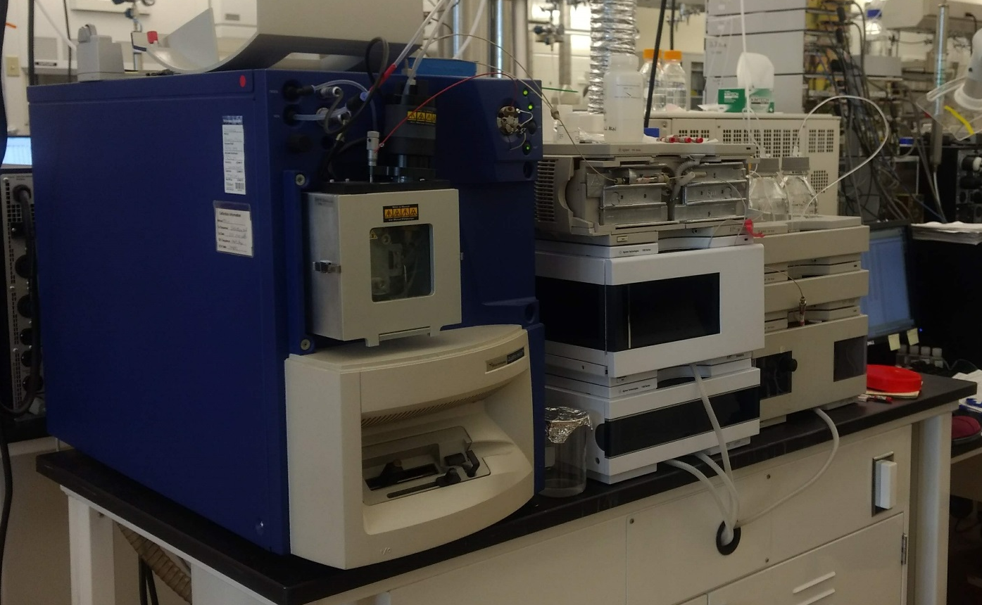
Water Analysis 2004-2017
Dilute water with Acetonitrile
Inject
PFBA, PFPeA, PFHxA, PFOA, PFBS, PFHxS, PFOS
Report level: 25-35ng/L
Quality control samples
  Matrix spikes/unknown sample
  Duplicates/batch
  Ongoing Proficiency Testing

Slide 5
New HBV in 2017
35ng/L PFOA & 27ng/L PFOS
  New report level needed
Additional analytes
  Add PFHpA, PFNA, PFDA, PFUnDA, PFDoDA, FOSA
Challenges:
  Long chained analytes can stick to plastic
    Extract entire sample
  Lower report level → concentration step

Slide 6
EPA 537: Determination of Selected PFAAs in Drinking Water by SPE LC/MS/MS
250 mL sample
Modifications not allowed
  Limited ISTDs used
  Does not include PFBA, PFPeA

Slide 7
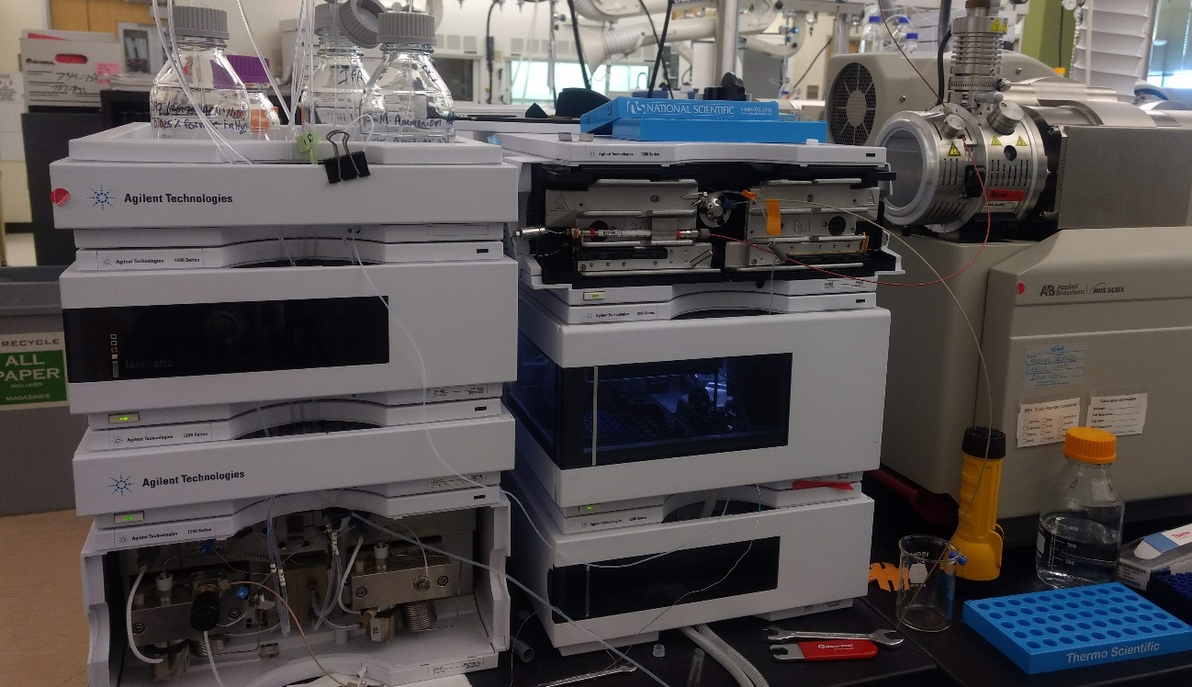
New Method: 2017-future
Analytes:
PFBA, PFPeA, PFHxA, PFHpA, PFOA, PFNA, PFDA, PFUnDA, PFDoDA, PFBS, PFHxS, PFOS, FOSA
Lower report level: 2.5 ng/L
Sorption container walls vs. long/labor intensive sample prep
Spike w/ ISTD, thoroughly mix, take aliquot and extract
Problems with subaliquotting, ISTD recovery

Slide 8
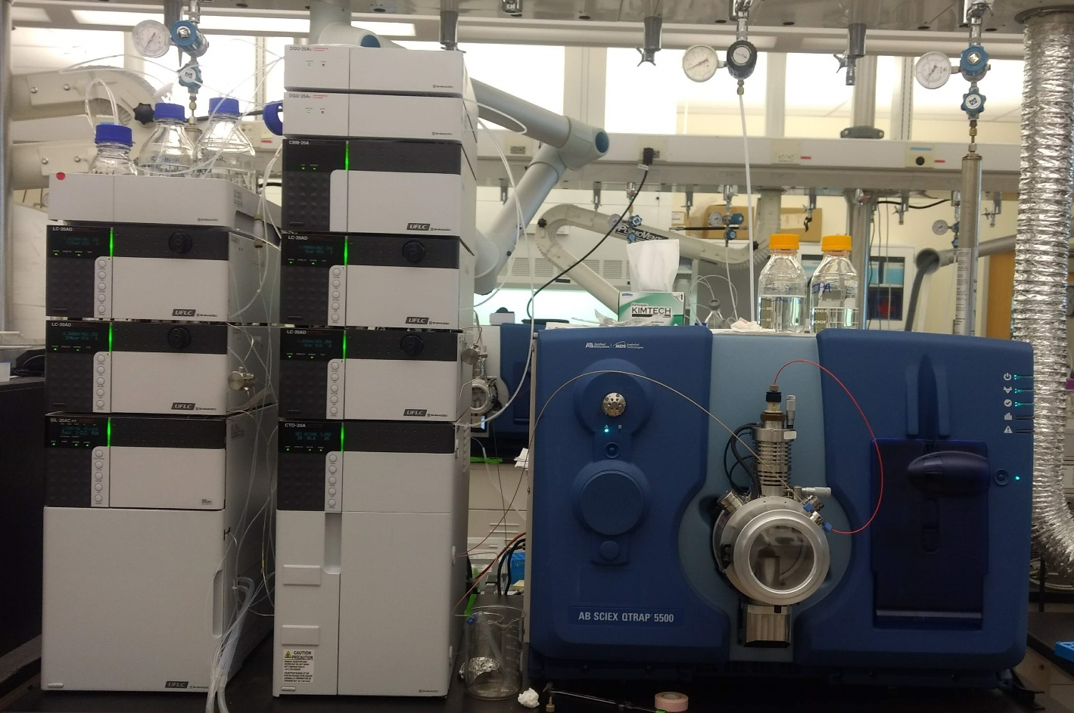
Biomonitoring Method
400ul serum or plasma
Protein precipitation
PFBA, PFPeA, PFHxA, PFOA, PFNA, PFBS, PFHxS, PFOS
Report level: 0.1ng/ml
Quality control
  NIST SRM
  QC pools
  Ongoing Proficiency Testing
Landsteiner, et al, Biomonitoring for perfluorochemicals in a Minnesota community with known drinking water contamination, Journal of Environmental Health, 2014

Slide 9
Other Matrices
Produce-
  Vegetables and fruits from home gardens in East Metro
Soil-
  Soil from home gardens in East Metro
Dust-
  Dust from homes in East Metro
Fish
Scher, et al. Occurrence of PFAS in garden produce at homes with a history of PFAS-contaminated drinking water, Chemosphere, 2018
Scher, et al. Does soil track-in contribute to house dust concentrations of PFAS in areas affected by soil or water contamination?, In preparation

Slide 10
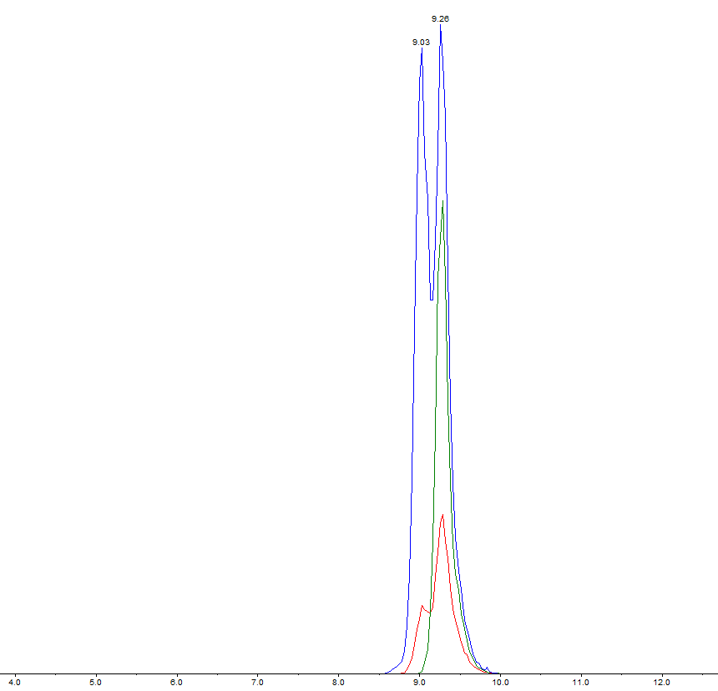
Analytical Challenges
Contamination
Interferences
Isomers
  499>80
  499>99

Slide 11
Fluorinated Alternatives
Wang, et al. Fluorinated alternatives to long-chained PFCAs, PFSAs and their potential precursors, Environment International, 2013

Slide 12
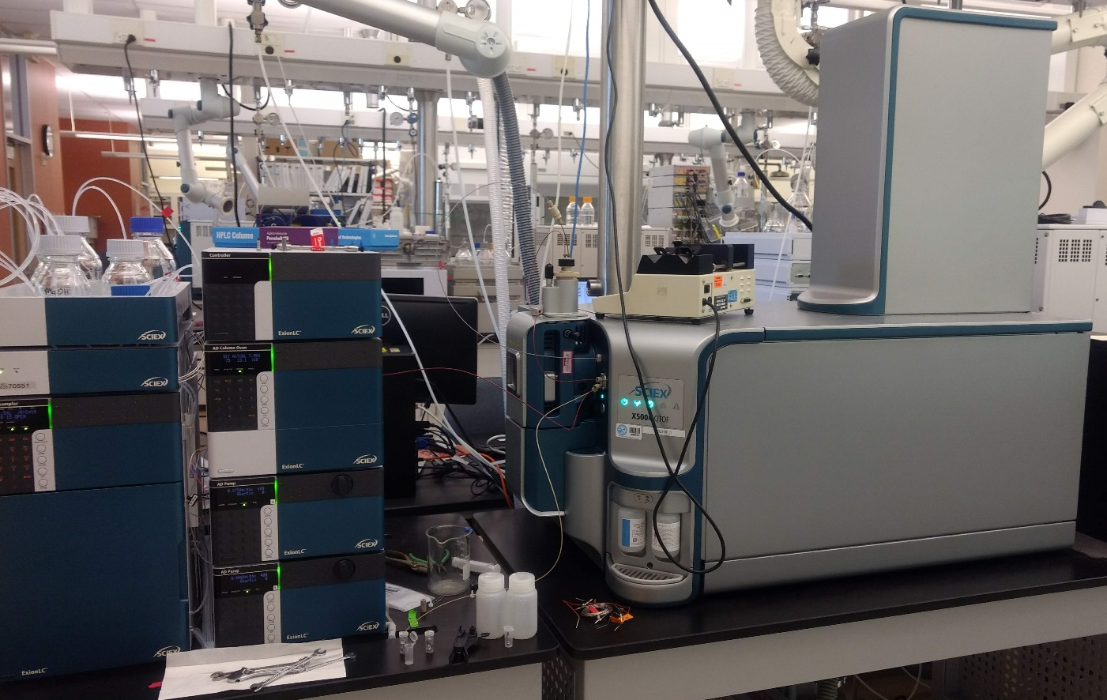
High Resolution Analysis
Recently acquired QTOF
  High resolution mass spectrometry
  Unknown identification
  Suspect screening through library use
  Similar to instrumentation used in other PFAS labs; collaborations

Slide 13


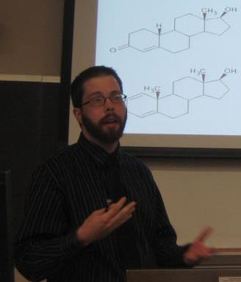

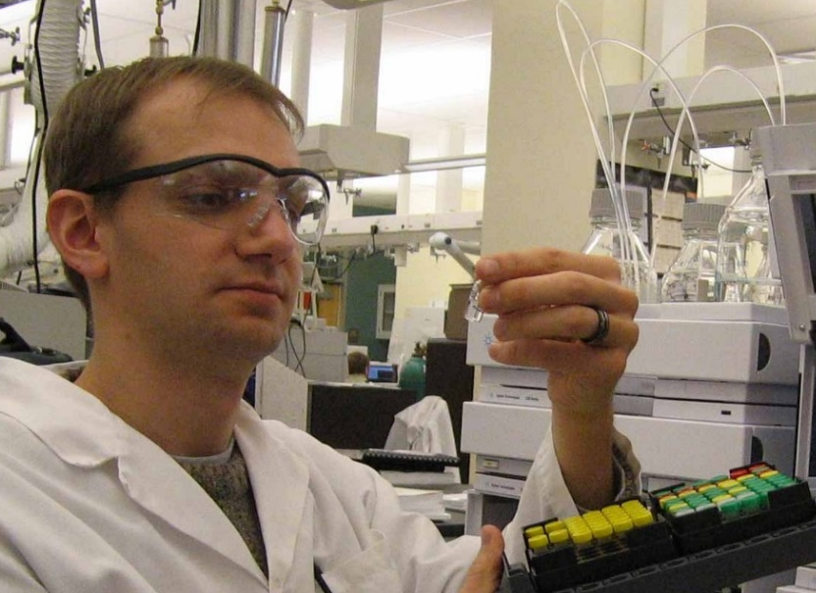

Acknowledgements
Will Backe
Stefan Saravia
Andrew Mittendorf
Betsy Edhlund
Kitrina Barry
Photo not available
Carin Huset
Carin.Huset@state.mn.us
651-201-5329
Hien Vo

