Slide 1
PFAS Sample Collection MPCA-MDH Staff PFAS Training June 25, 2018
Ginny Yingling | Hydrogeologist – Minnesota Dept. of Health

Slide 2
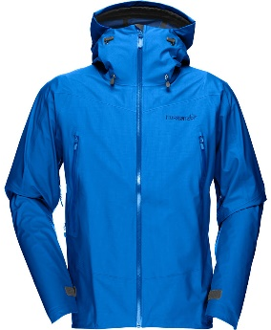
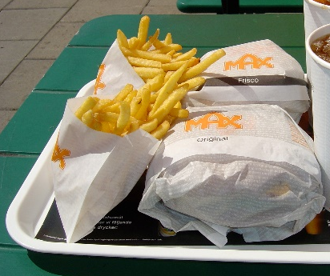
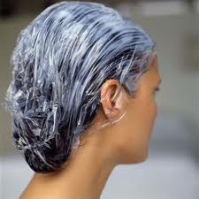
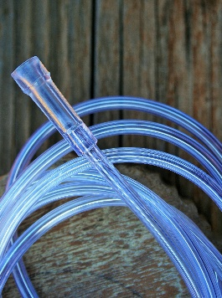
Possible Concerns for Cross-Contamination
PFAS are ubiquitous and have been used to manufacture items for personal uses and environmental site investigations
Much of our typical sampling equipment and items in the sampling environment contain or may contain PFAS
Lowering of screening criteria and detection limits in labs

Slide 3
What If You Aren’t Sure About Your Sampling Equipment?
Review the product information or consult with the manufacturer
Collect equipment blank(s) from a specific item in question
Send a section or piece of the equipment (if practical) to the laboratory for a more vigorous leachate analysis
BETTER TO ERR ON THE SIDE OF BEING OVERLY CAUTIOUS
THAN BEING UNSURE AND RISK CROSS-CONTAMINATION

Slide 4
Minnesota PFAS Sampling Precautions
Sampling staff should wear only old, well-laundered (at least 6 washings since purchase) clothing.
Avoid use of water- and/or stain-resistant clothing as much as possible.
Nitrile gloves should be worn at all times while collecting and handling samples.
Do not use blue ice or other freezer packs.
Use only HDPE sample bottles

Slide 5
Minnesota PFAS Sampling Precautions (continued)
“Sticky notes” of any kind should not be used at any time during the sampling trip.
Many food and snack products are packaged in wrappers treated with PFAS
Wash hands thoroughly after handling fast food, carryout food, or snacks.
Pre-wrapped foods or beverages in disposable cups should not be present on-site or in the field vehicle.
Indoor samples should not be collected in areas where fast food products or microwave popcorn are present or being prepared. If this cannot be avoided, it should be clearly indicated on the sampling form. Consider taking a field blank.

Slide 6
Minnesota PFAS Sampling Precautions (continued)
Avoid sampling from taps where Teflon tape or Teflon plumbing paste is present (if this cannot be avoided, make a note in the “sampler comments” field of COC form).
Do NOT field filter samples.
Avoid use of waterproof paper
Standard QA/QC effort is typically sufficient
Trip blanks for every sampling event
Duplicate sample every day or 1 per 10-20 samples
Note any possible cross-contaminants or deviations from protocol

Slide 7
Personal Protective Equipment (PPE) – Safety First!
PPE should be worn in any case during sampling to:
Protect health and safety
Prevent sunburn and insect bites
Avoid contact with the materials being sampled

Slide 8
Personal Protection Products
No published research on how certain materials may affect sample results. Therefore, a conservative approach is recommended during execution of the sampling plan
Safe to use
Synthetic or natural fibers, well laundered, cotton coveralls, PVC
Products specifically labeled “fluorine-free”
Try to avoid
Water-repellent textiles, insect repellent and sun screen (check labels or with
manufacturer, if possible)
Need verification
Non-brand name, water-resistant, waterproof, or stain-treated clothing
Tyvek suits and clothing that contains “Tyvek”

Slide 9
Personnel Hygiene & Protective Skin Products
Many sampling guidance documents recommend personal care products, sun screens, insect repellants should not be used prior to and on the day(s) of sampling
This may be excessive and unwarranted as long as products do not come into contact with sample
Alternatively, products may be avoided by wearing appropriate PPE (gloves, hard hats or hats and long sleeved pants and shirts etc.) when sampling or handling field equipment

Slide 10
Field Equipment
DO NOT USE | ACCEPTABLE ALTERNATIVES
Fluoropolymer bailers or pump bladders | Disposable Equipment Dedicated Equipment (no PTFE parts)
Fluoropolymer tubing, valves and other parts in pumps | High-density polypropylene, high-density polyethylene (HDPE) and silicon materials (i.e. tubing)
LDPE Hydra Sleeves | HDPE Hydra Sleeves
Glass containers (due to potential loss of analyte through adsorption) | Polypropylene or HDPE sample bottles fitted with an unlined (no PTFE), polypropylene or HDPE screw cap

Slide 11
QA/QC Sampling - Considerations
Use blanks to evaluate composition or suitable nature of sampling equipment/supplies and to assess possibility of cross-contamination during sampling/transport/storage
Pre-investigation equipment blanks (decon water, methanol, new equipment, plastic bags as sample containers, sun screen, insect repellents, anything you are unsure of)
Equipment blanks to assess adequacy of decontamination process and/or evaluate potential contamination from equipment.
Field blanks to assess contamination from field conditions.
Trip blank to assess cross‑contamination introduced from laboratory/during shipping procedures (1/cooler).
Duplicates to assess precision and repeatability of results (1/trip or 1 per 10-20 samples)

Slide 12
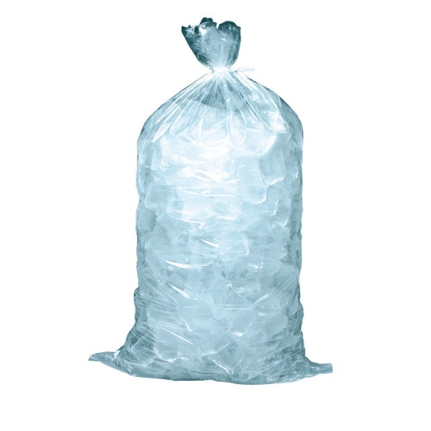
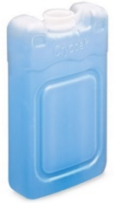
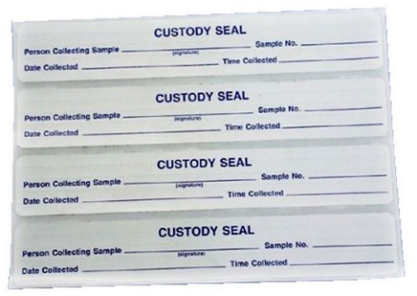
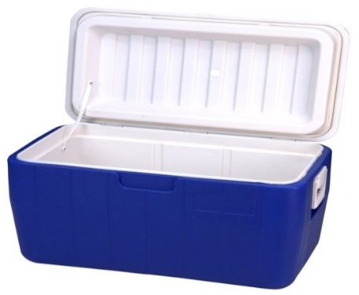
Shipping and Documentation
Coolers should be packed with the samples in wet ice (not blue or chemical ice) using double zip-style storage bags
The completed and relinquished CoC form should be taped to the inside of the cooler lid in a zip-style storage bag
The cooler should be taped closed with a custody seal and shipped by overnight courier to the appropriately accredited PFAS laboratory

Slide 13
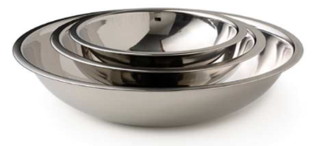
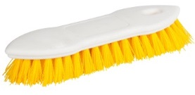
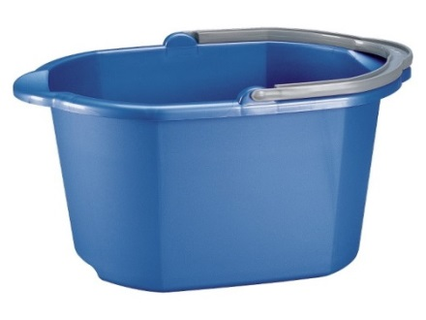
Recommended to use PFAS-free disposable equipment
If equipment re-use is required, decontaminate field sampling equipment between uses
Use PFAS-free decontamination solution
Prior to decon, blank samples should be collected from site water supplied to ensure it is PFAS-free
Pressure washers used for decon must be free of PFAS-bearing parts
Scrubbed sampling equipment will then be triple rinsed with laboratory certified PFAS-free water

