Slide 1

PFAS – Groundwater Fate & Transport
MPCA-MDH Staff PFAS Training
June 25, 2018
Ginny Yingling | Hydrogeologist – Minnesota Dept. of Health

Slide 2
General “Rules of Thumb” for PFAS in the Environment
Solubility:
  PFCAs > PFSAs
  Shorter-chain > Longer chain
  PFAAs > Precursors
Sorption:
  PFSAs > PFCAs
  Longer-chain > Shorter-chain
  Precursors > PFAAs
Water:
  PFCAs
  Shorter-chain
Soil & Sediment:
  PFSAs
  Longer-chain
Biota
  PFSAs
  Longer-chain
  Complicated
Partitioning / Fractionation

Slide 3
PFAS in Groundwater
You should expect:
  Very large plumes
  PFAAs may be much further downgradient than other contaminants from the same site
  Typically, shorter-chain and PFCAs will be transported further than longer-chain and PFSAs
  PFBA will act as a nearly perfect groundwater tracer

Slide 4
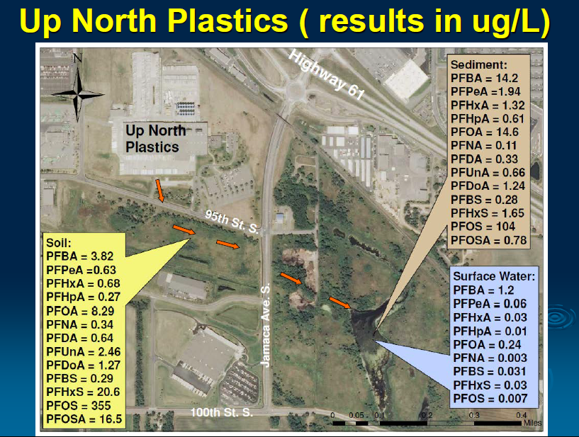
Case Study: Fractionation of PFAAs at AFFF Site

Slide 5
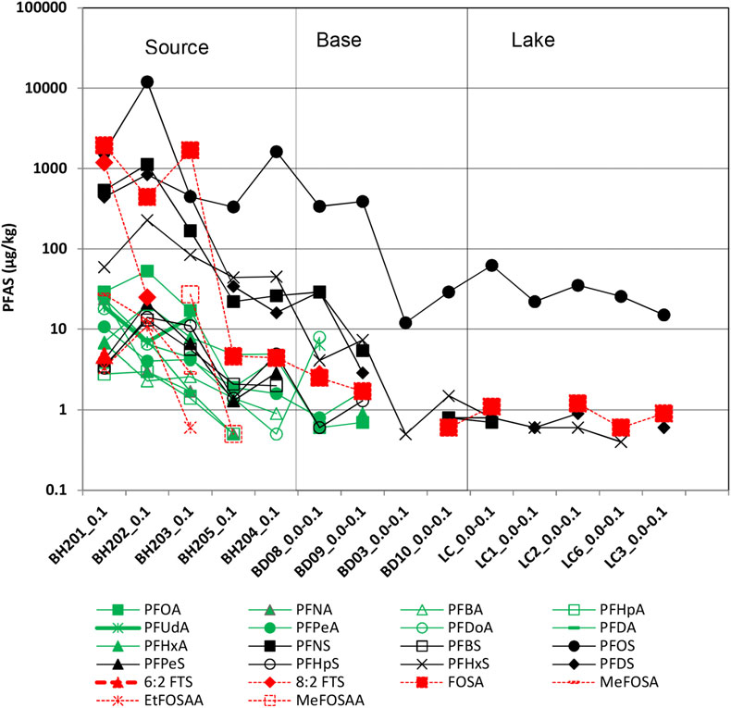
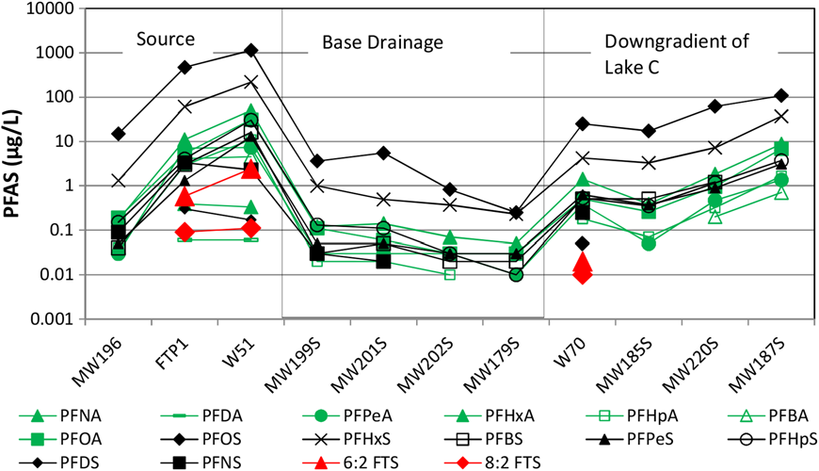
Case Study: Precursors and PFAAs at AFFF Site
PFAS in Soil
PFAS in Groundwater
Source:
Casson and Chiang, 2018, Exhibit 4

Slide 6
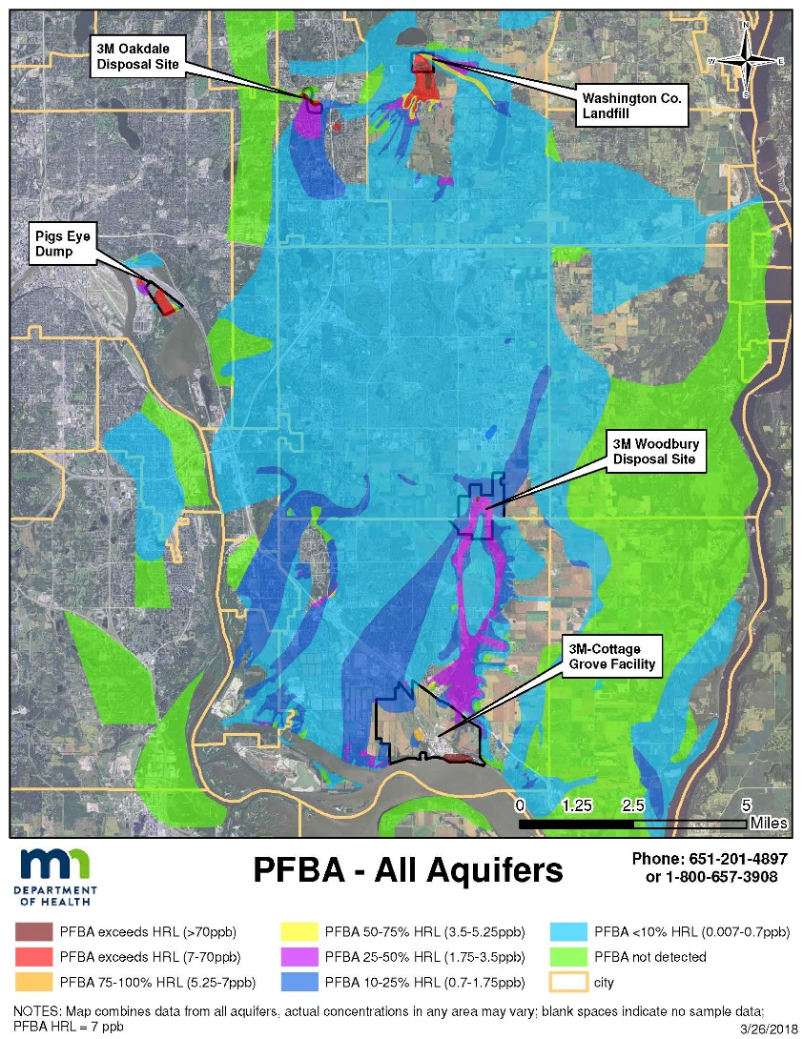
PFAS in Groundwater – East Metro
Over 130 sq. mi.
  4 major aquifers
  8 municipal systems
  >1,800 private wells
  Much larger than predicted by models
PFBA most widespread
  More PFBA in source areas
  More mobile
Distribution controlled by:
  Bedrock features
  Groundwater - Surface water interactions
  PFAS chemical properties
  Groundwater pumping

Slide 7
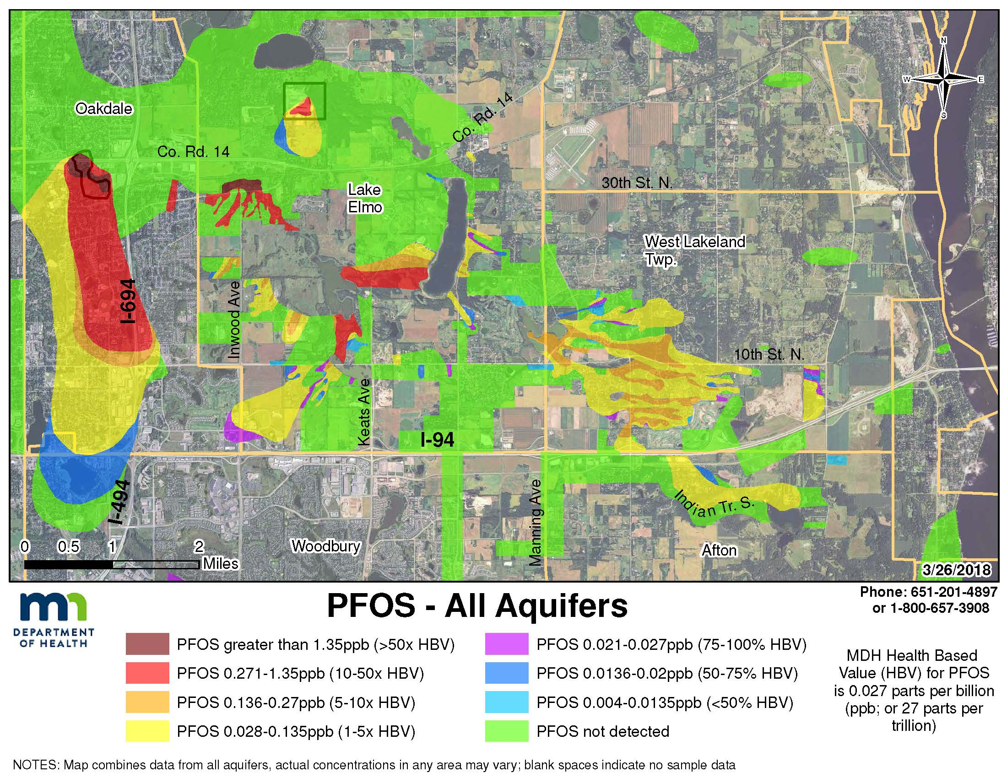
PFAS in Surface Water – Important Transport Pathway
Groundwater flow
Surface water or
stormwater flow

Slide 8
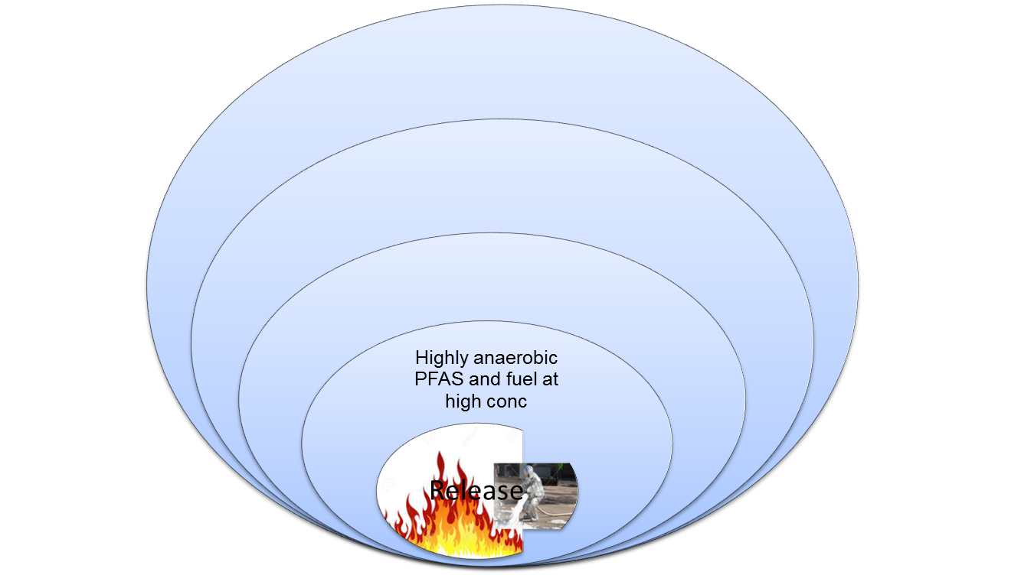
PFAS and Co-Contaminants in Groundwater
ORP
+200 mV
Also look for surface water features as potential shortcuts to transport PFAS into GW
GW Flow
Expansion of PFAS plume
Short chain PFASs migrate faster
More aerobic
Precursors biotransformed to PFAAs
PFAS plume expands
Hydrocarbons degrades rapidly
Hydrocarbons biodegraded
PFAS plume expands
Possible natural PFAS attenuation (sorption) due to high TOC sediment
Possible PFAS hot spot from redox manipulations via in-situ remediation
-200 mV
Source: ITRC PFAS training slides, Battelle, 2018

Slide 9
A Note About “Ambient” PFAS
PFOS and PFOA reported at 10s of ng/L levels in groundwater and surface water
PFBA may be as high as 0.3 ug/L in metro region groundwater
Are some “ambient” PFAS actually distal traces of an unknown source?
IT IS NOT “BACKGROUND”
Ambient
Method Detection Limits
Ambient in groundwater/surface waters: D’Agostino and Mabury, 2017; Li et al., 2011; Sinclair et al., 2004; Konwick et al., 2008; Eschauzier et al., 2012; ATSDR, 2015

