Slide 1
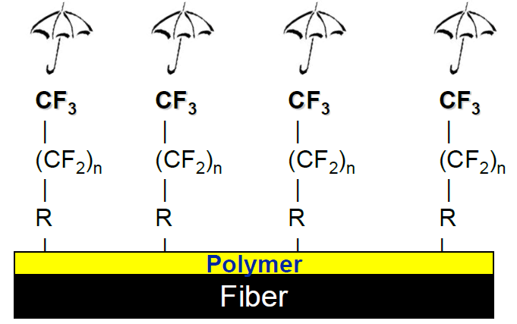
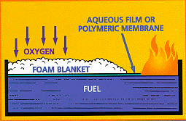

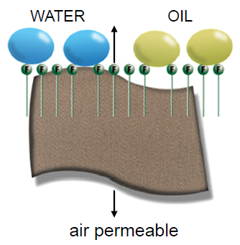
Finding the Path to PFAS Alternatives
MDH/MPCA Interagency PFAS Meeting | June 25, 2018
Al Innes, MPCA | Safer Product Chemistry Coordinator
alister.innes@state.mn.us | 651-757-2457

Slide 2

Outline
Program context – related work on products
Some alternatives
Challenges with alternatives
Available tools
What should our prevention priorities be?

Slide 3

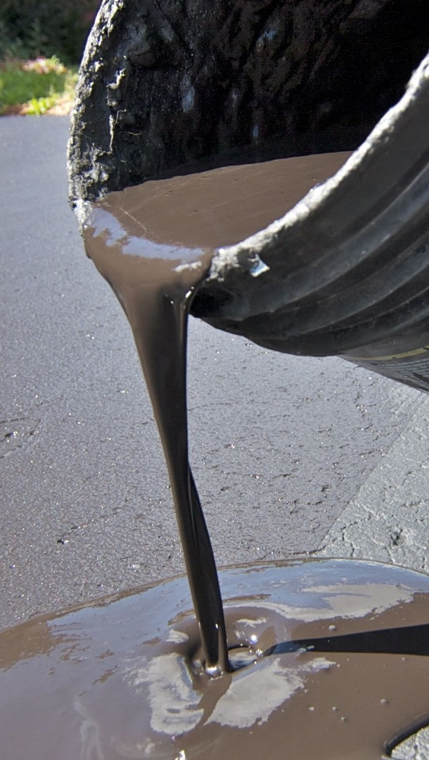
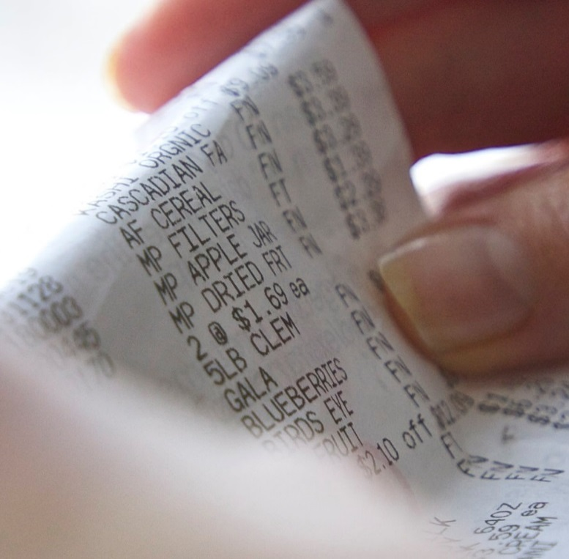
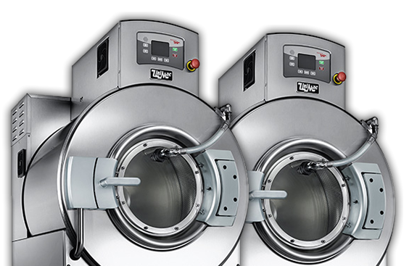
Related work on products
Regulated (statute-driven)
  Children’s jewelry – lead and cadmium
  Asphalt sealants – PAHs
Unregulated (voluntary)
  Thermal papers – BPA and BPS
  Commercial laundry detergents – NPE & NP
  Personal care – preservatives
In Development
  Chlorinated paraffins – machining fluids?
  PFAS – where to focus?

Slide 4
Some Alternatives
Repellent Treatments Stain-, soil-, oil-, water-repellent performance
Some PFAS Treatments (moving from C8 to C6 and C4) | Some Non-fluorinated Treatments (alternative polymer systems like paraffin- or silicone-based)
 | Aquapel™
Teflon™ | Crypton® Zero
Nanosphere® | NikWax®
Scotchguard™ | Zelan™ R3
Capstone® | EcoRepel®
Crypton®, Crypton® Green | Altopel F³
Nanotex® | Arkophob®
Nanotex® + Durablock® | Arroshield EVO
GreenShield® | SBI
 | Phobotex® WS
Chemical options
  PFAS: Some C6; C4
  Non-F silicone/siloxanes, waxes, urethanes, dendrimers, nanoparticles
Clinton Boyd, Steelcase (CalSAFER Workshop, 2017)
Notes:
https://bolgerohearn.com/our-products/f3-water-repellent/

Slide 5
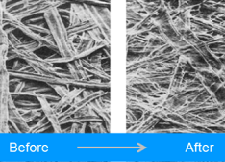
Some Alternatives
Chemical options
  Over 100 non-F Class B firefighting foams identified *
Barrier layers
  PLA-lined paper service ware
  Polyester membrane on jacket
Non-chemical
  Refining fibers produces mechanical holdout of oil for food contact papers
  Carpet fiber refinement can also help
Expera Speciality Solutions

Slide 6
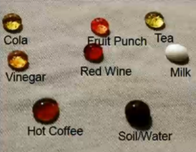
Challenges with Alternatives
Performance – re-examine requirements
Feasibility
Price
Can it recycle, compost, degrade – residuals?
Data withheld or not developed -
Many materials, purposes, products means many chemistries and suppliers
Toxics Reduction Program

Slide 7
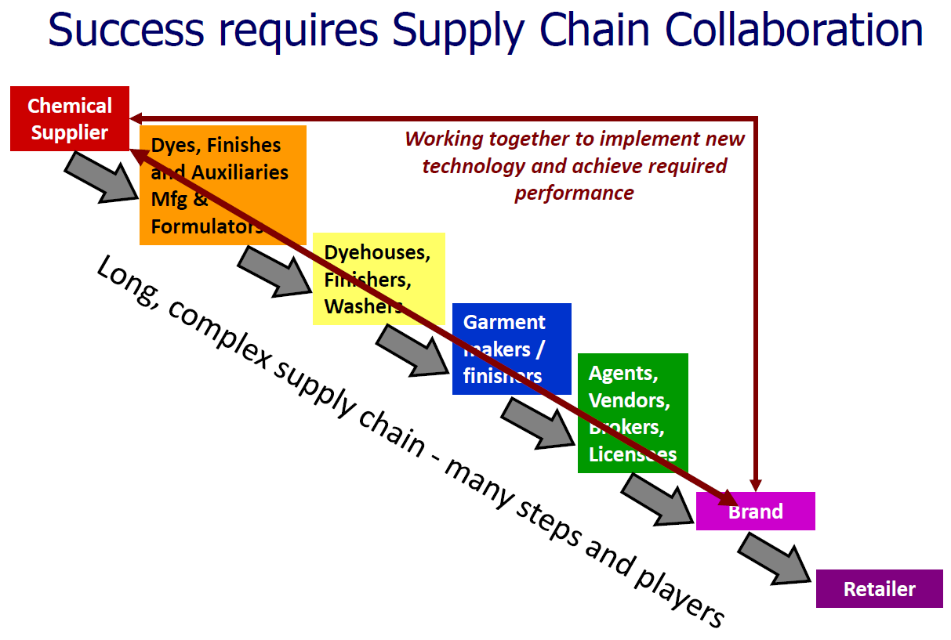
Challenges with Alternatives
Bob Buck, Chemours (GC3 presentation, 2012)
Toxics Reduction Program

Slide 8




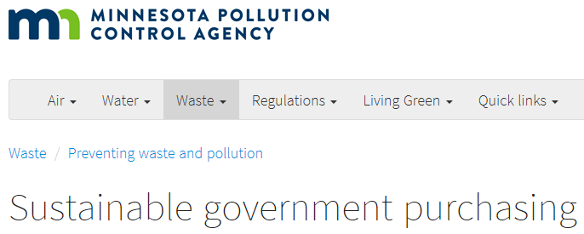
Tools
Business-to-business collaboration, leverage
3rd-party certification
Alternatives assessments – state, multi-state, public domain
Policy – state, local – limits, disclosure, assessment
Purchasing – government, private
Product surveillance
Notes:
of textile mills

Slide 9
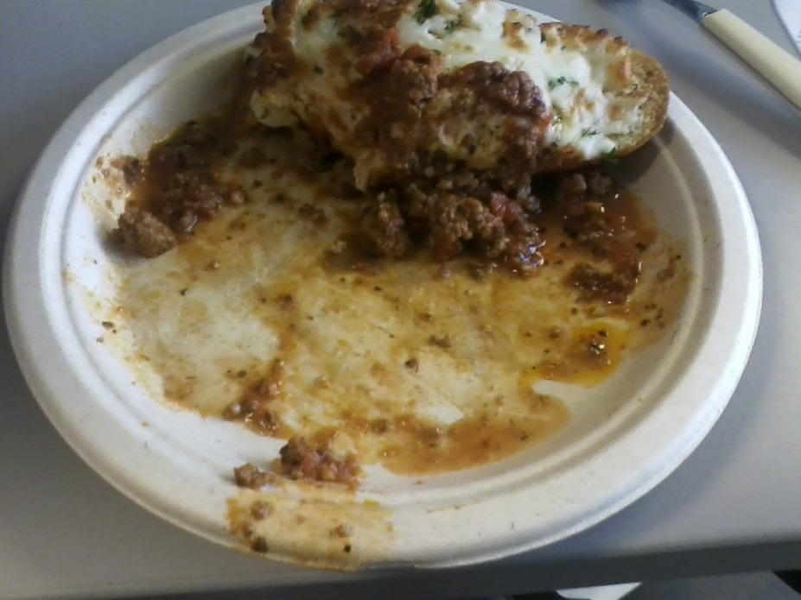
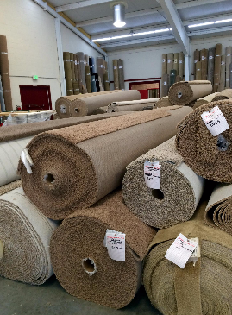
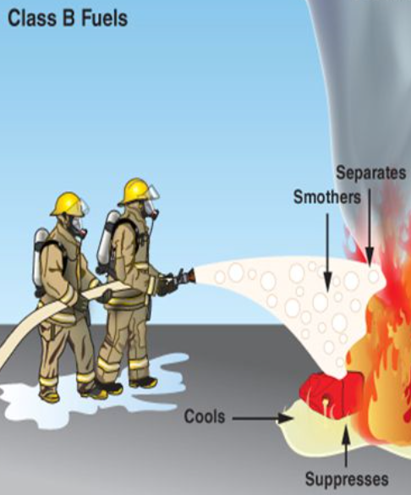
What should our priorities be?
Push on remaining uses of/contamination by PFOA, PFOS, PFHxS?
Is large-volume fluoropolymer use an issue?
Any stance on C6 and C4 substitutions?
Invest in research on non-fluorinated (safety review still needed) and non-chemical?
Particular product types?
Contact: Al Innes alister.innes@state.mn.us

