Slide 1
PFAS & Permitting: Wastewater Treatment Facilities
Randy Thorson, P.E. - Principal Engineer
June 25, 2018
Notes:
I work in the Municipal Wastewater Section, so my presentation today will focus on Municipal Wastewater Treatment Facilities.

Slide 2
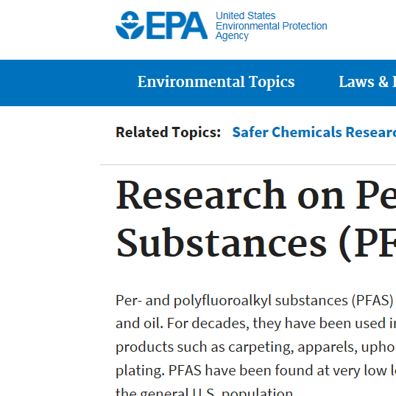
Why are PFAS found in WWTF influent and effluent?
Why are PFAS (Per-and Polyfluoroalkyl Substances) found in wastewater (used water)?
Have been used in hundreds of industrial applications and consumer products such as:
Carpeting, apparels, upholstery, food paper wrappings, fire fighting foams and metal plating.
https://www.epa.gov/chemical-research/research-and-polyfluoroalkyl-substances-pfas
Notes:
According to an EPA 2017 website posting.
PFAS have been found at very low levels both in the environment and in the blood samples of the general U.S. population.

Slide 3
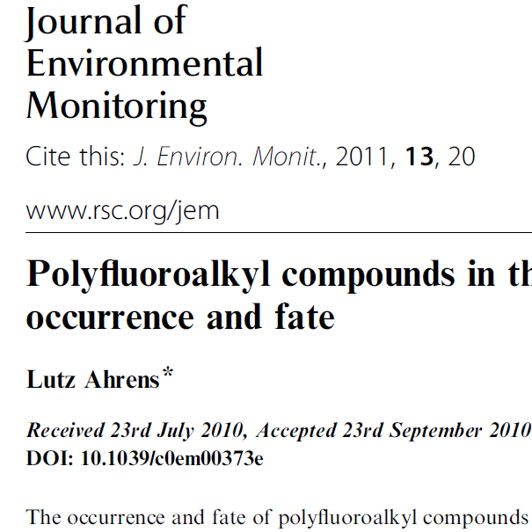
Current WWTF effective at removing?
“….conventional WWTP’s are not effective for removal of PFC’s and biodegradation of precursor compounds can led to increasing concentrations” – Ahrens 2011.
http://pubs.rsc.org/en/content/articlepdf/2011/em/cOem00373e
Notes:
Ahrens 2011.

Slide 4
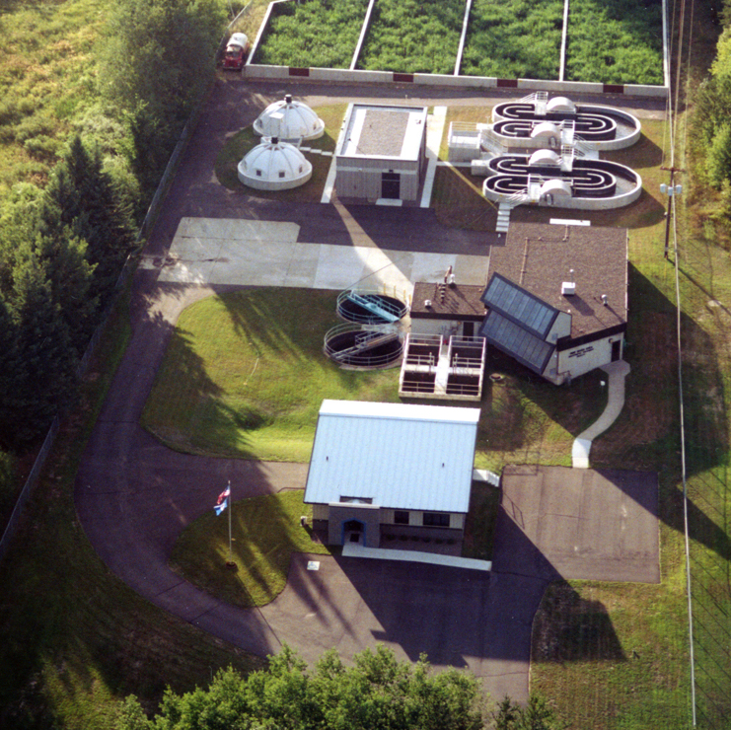
MPCA 2008 Sampling at WWTF
Influent ranged from <2.52 to 476 ng/L.
Effluent ranged from <2.48 to 541 ng/L.
Sludge ranged from 1.12 to 442 ng/g (ppb).
Notes:
Sampled for PFBA, PFPeA, PFHxA, PFOA, PFNA, PFDA, PFUnA, PFDoA, PFBS, PFHxS, PFOS, PFOSA.
540 samples of Influent, 585 Effluent samples and 266 Sludge samples collected from a total of 38 Municipal and Industrial WWTF’s (36 Municipal and 2 Industrial).

Slide 5
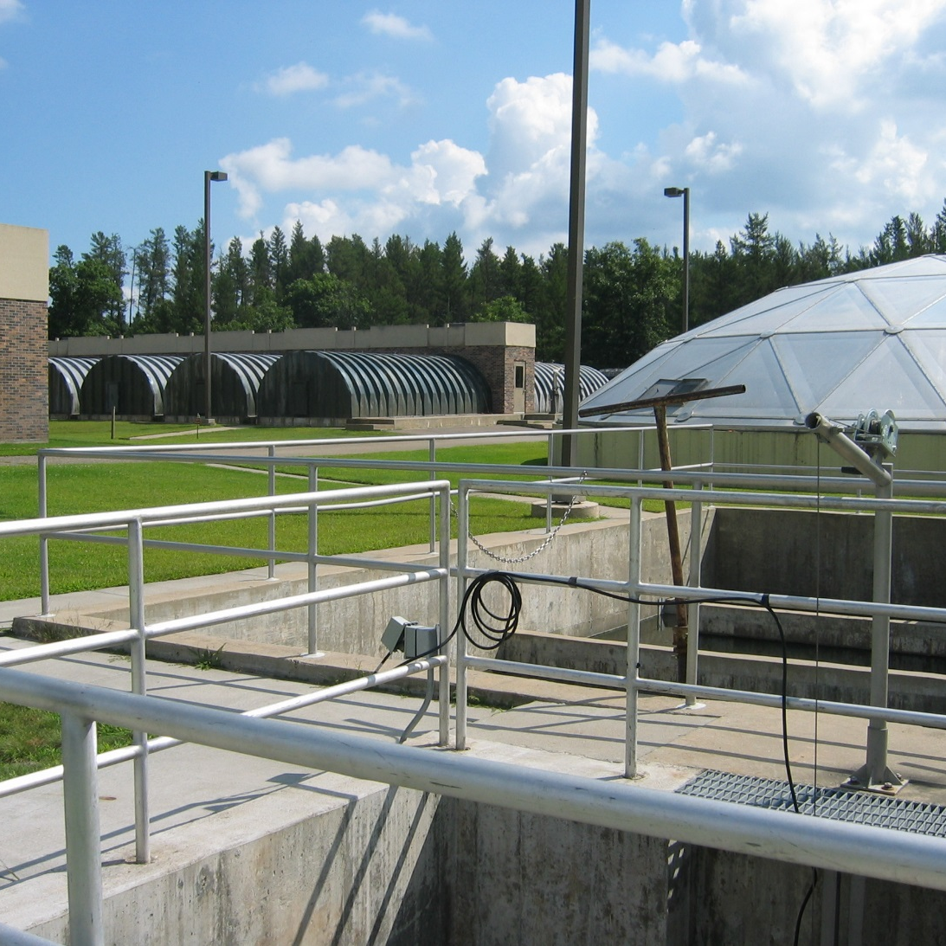
Brainerd MN WWTF
The Brainerd WWTF is currently the only municipal NPDES permittee with effluent limits for a PFC.
The effluent limit is for PFOS (Perflurooctane sulfonate).
Sampling identified PFOS that triggered a reasonable potential analysis for developing an effluent limit.
Traced to a metal plating user in Brainerd, changed to an alternative.

Slide 6
Brainerd MN WWTF Permit Sampling Effluent Data
The Brainerd WWTF effluent limits issued in January 2014 NPDES permit.
PFOS Quarterly Average = 287 ng/L and Daily Maximum = 497 ng/L.
Sampling results since 2015 range from 0.044 to 34 ng/L.

Slide 7
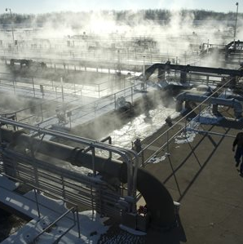
MCES Metro WWTF Sampling Only Effluent Data
MCES Metro WWTF has no effluent limits.
Effluent sampling for PFBA, PFHxS, PFOS, PFOA.
Effluent sampling results since 2016 range from 7.56 to 106 ng/L (for 16 samples).

Slide 8
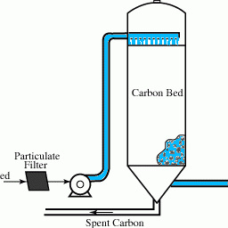
Options for Adding WWTF Units?
Expensive.
Not currently practiced in Minnesota at Municipal WWTF’s.
2 options possible:
Reverse Osmosis,
Granular Activated Carbon Filters.
Notes:
Both RO and GAC create a new issue. Dealing with the RO brine that needs to be wasted frequently. For GAC, regenerating the carbon so it is effective, and dealing with the filter waste.

Slide 9
Thank you!
Randy Thorson, P.E.
randy.thorson@state.mn.us
651-757-2779

