Slide 1
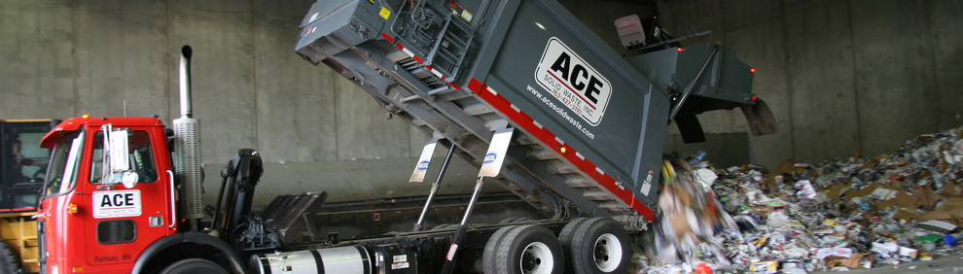
PFAS in Solid Waste
Mark Rust & Steve Giddings
July 25 2018

Slide 2
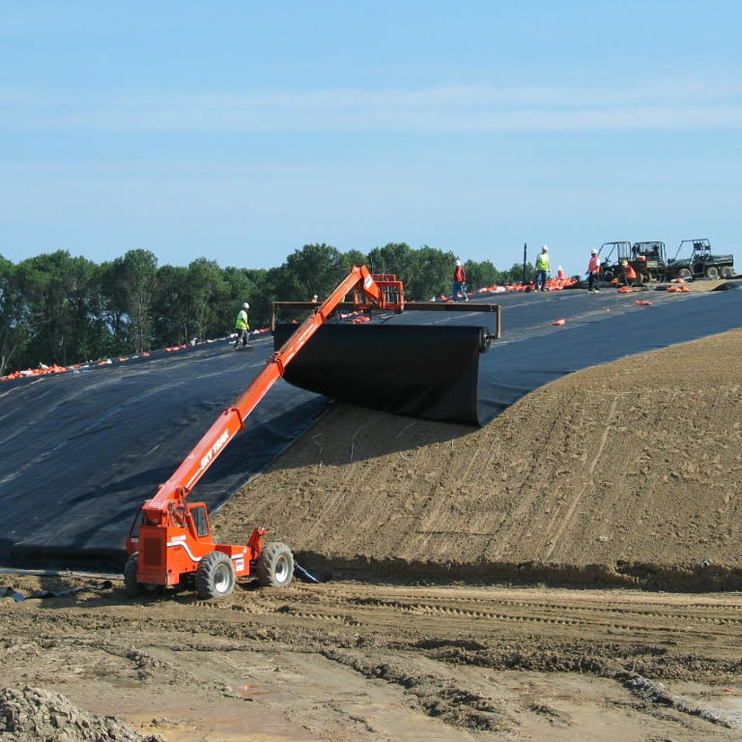
When Waste Meets Water…
PFAS exceeds MDH health based values in landfill leachate & compost contact water
Leachate is taken to WWTPs or land applied
WWTPs don’t treat PFAS, but is viewed as preferable to ground water impacts resulting from land app
MPCA is searching for alternative solutions to manage this water
Notes:
PFAS exceeds MDH health based values in landfill leachate & compost site contact water
With MDH tightening their standards for PFAS in May, 2016. MDH lowered health based values (HBV) for PFOA and PFOS. Both were at 0.3 ppb. Now, PFOA is at 0.035 ppb and PFOS is at 0.027 ppb. The MPCA SW rules sets Intervention Limits (ILs) – which require facilities to take action if exceeded. The MPCA’s IL is ¼ of the MDH HBV.
Leachate is commonly taken to WWTPs or land applied while compost sites have commonly land applied contact water in the past with some sending it to WWTPs.
The data submitted by SET suggests that the contact water in the pond at their site has levels of PFOA above the recently adopted groundwater HBV.
Problem with WWTPs is they don’t treat PFAS but does treat other pollutants and is therefore preferable to land app
WWTPs do not specifically treat for PFAS, it has been determined that some PFAS remain in the biosolids and some are discharged with the effluent. PFAS concentrations may be entrained in biosolids which are either incinerated (Metro area) or land applied. Solid waste permitting staff view treatment in a WWTP as preferable over direct land application because a groundwater aquifer is a more vulnerable resource.
Neither WWTPs or Land App treat PFAS - Searching for alternative strategies to handle this – is there a need to pre-treat leachate and pre-treat contact water prior to sending to a WWTP or land applying?

Slide 3
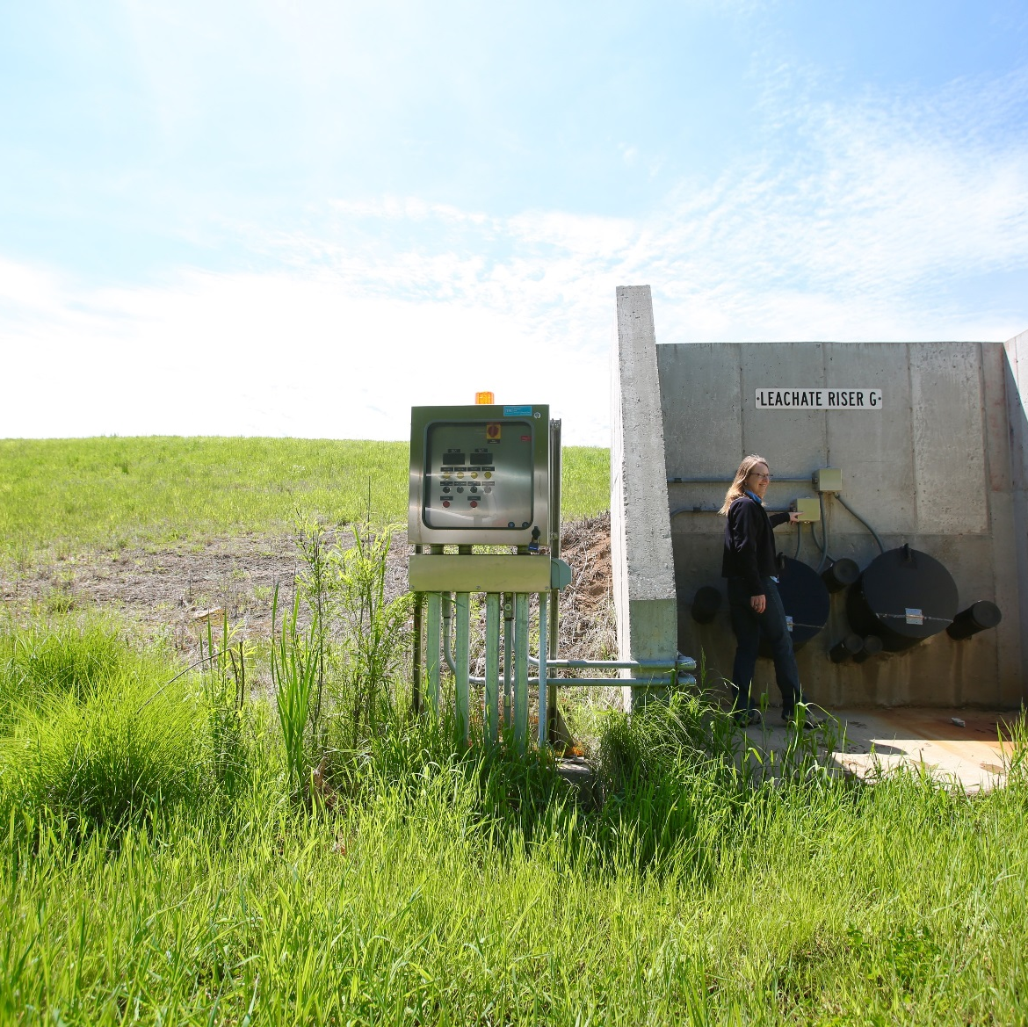
LANDFILLS
80% leachate to WWTPs nationally
8 of 21 MMSW landfills land apply in MN
Not all landfills monitor for PFAS
All landfills that monitor leachate exceed MDH standard for PFAS
All landfills that land apply leachate monitor groundwater
  2 exceed MPCA IL and 2 exceed MDH standard (4 total)
Notes:
80% to WWTPs – States are looking at setting limits for PFAS for WWTP effluent (Michigan). WWTPs looking upstream at sources. WWTPs may stop accepting LF leachate or require pre-treatment before accept in the future.
Landfills that Land Apply Leachate: 8
Not all landfills monitor leachate for PFAS – All of those that do, measure concentrations greater than the MDH Standard
Groundwater Monitoring of Land App site:
MPCA IL exceedance: 2
MDH Standard exceedance: 2
It appears that those facilities that are not reporting exceedances of the ILs and/or standards are not achieving the required reporting limit (RL) to determine if the land application site is in compliance with MPCA intervention limit for PFAS

Slide 4
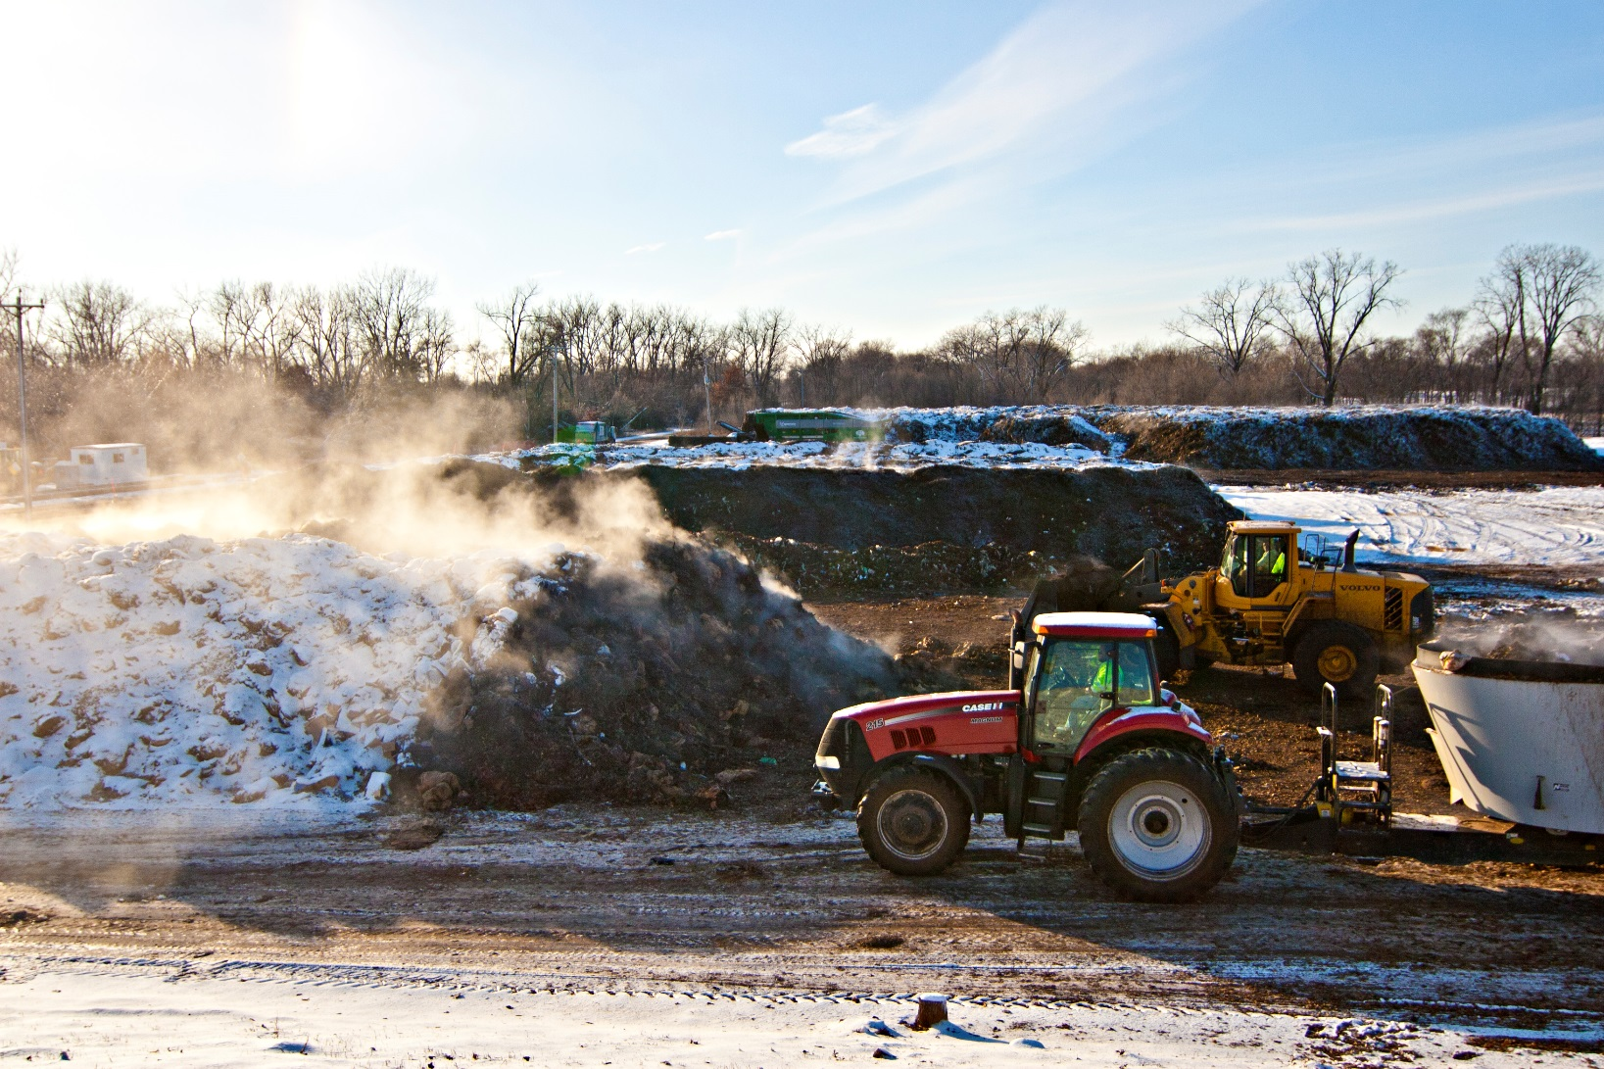
COMPOST SITES
Compost sites manage contact water several different ways
  WWTP
  Land application
  Discharge to surface water
PFAS exceeded HRLs in contact water at one compost site in MN
PFAS could be from compostable paper products, grease barriers, pesticides, contaminants, etc.
Notes:
Testing will take place at 5 compost sites this summer to determine whether or not elevated PFAS levels exist at other sites- we expect them to. Cost of managing contact water is a burden and many sites want to land apply
TriCounty and MFS have been allowed to land apply contact water in the past but are expected to haul contact water to a WWTP. Two compost facilities WLSSD and Hutchison are located in close proximity to and a plumbed to WWTPs. Carver County discharges contact water to a wetland. Specialized Environmental Technologies (SET) — a large composter that manages a substantial portion of the SSOM collected in the Twin Cities metropolitan area — submitted a draft contact water management plan to the agency in early 2018. The plan was denied ultimately because we could not approve land app without treatment or PFAS.
The Agency has already begun work in addressing existing research questions regarding PFAs. The Agency initiated a project to test compost sites for PFCs brought in with SSOM.
Also, the Biodegradable Products Institute (BPI) is developing a protocol to test for PFAs. Starting in 2020 their products certifications will be for products that are compostable and contain no PFCs. In the interim, the Agency is adjusting our state compostable products contracts to reflect the current market, effectively removing any compostable service ware product which tested positive for fluorine (an indicator of PFAs).
Other strategies include building a roof or using Leachbuster (granular activated carbon technology).

Slide 5
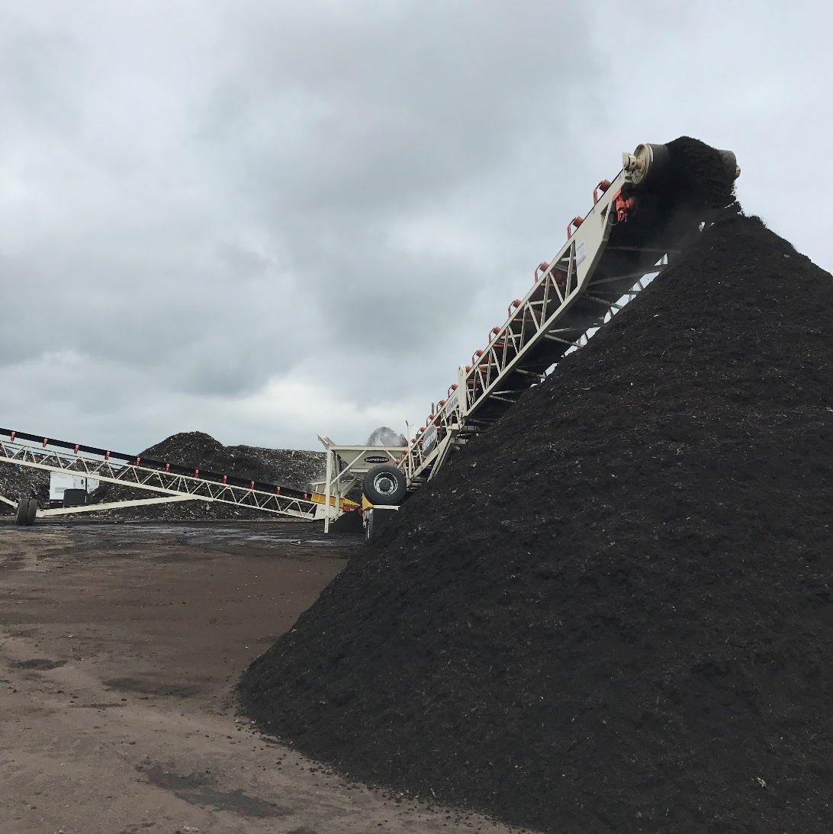
Solutions
PREVENTION:
  Prevent contact water at compost sites
  Phase out PFAS in manufacturing process
    State contract for compostables
    BPI cert. will be PFAS-free
MANAGEMENT:
  Granular Activated Carbon/Others
  More research needed
REMEDIATION:
  3M settlement, Lake Elmo
Notes:
The first way to prevent PFAS is to stop them from entering the waste stream in the first place.
Options for managing them in landfills are limited
The Center for Environmental Health released a study on PFAS saying that PFAS is in plenty of certified compostable serviceware products. It’s especially common in recycled fiber molded serviceware. https://www.ceh.org/wp-content/uploads/CEH-Disposable-Foodware-Report-final-1.31.pdf
·In compost sites, there should be a focus on preventing contact water generation. This may include a cover over the compost site or implementing systems to encourage more evaporation of contact water. This might also include a ban on PFAS in Minnesota manufacturing.
· Exploring the utility of alternative on-site contact water pre-treatment options, like granular activated carbon systems or the Leachbuster (T) system that is currently being piloted in Kandiyohi County. These are expensive methods of treatment and cost will be an issue
·

Slide 6
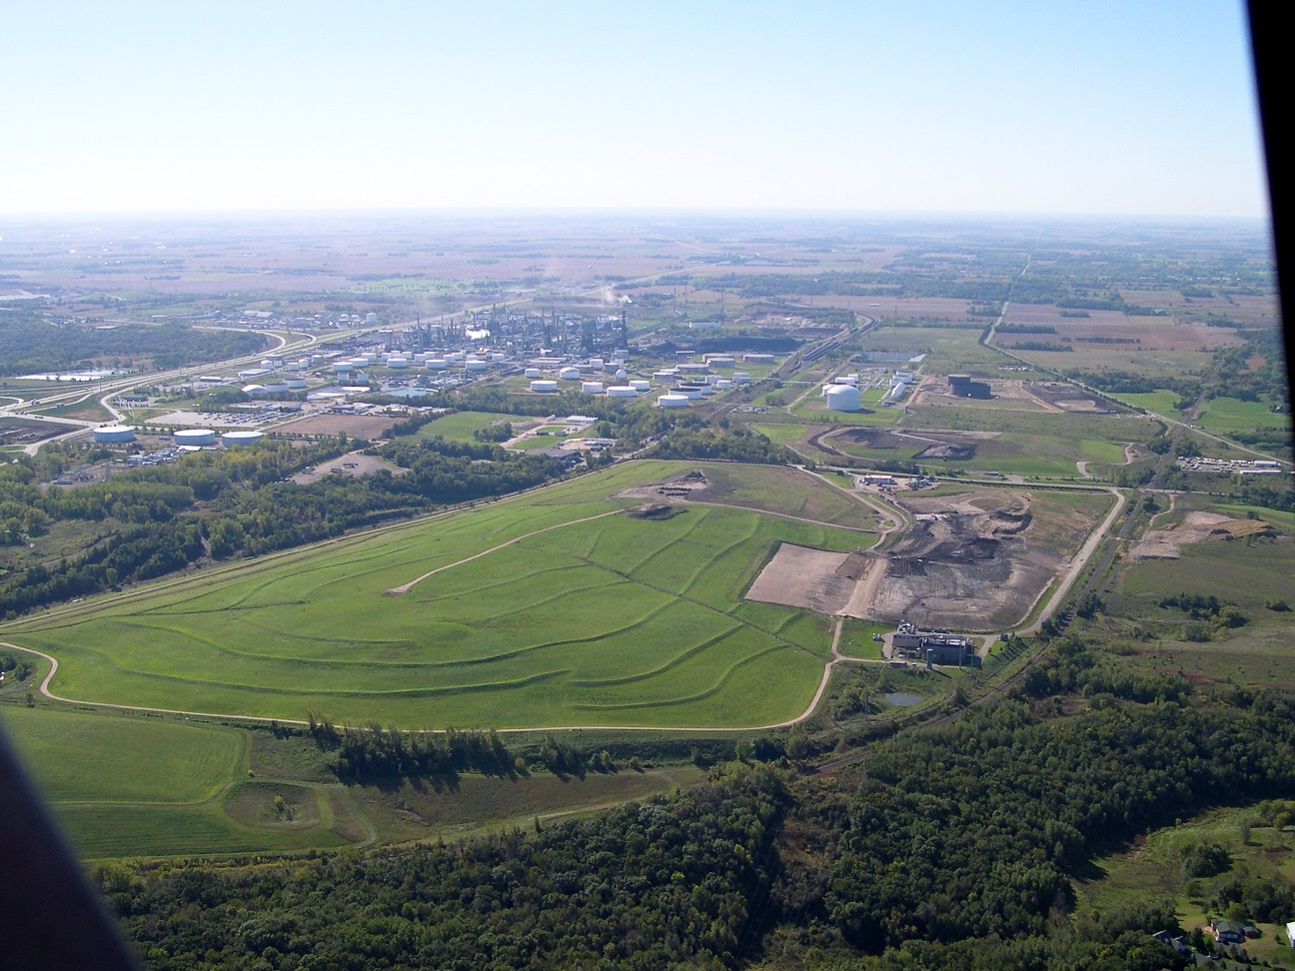
Opportunities for Collaboration & Research
How ubiquitous are PFAS?
Where is PFAS in compost sites coming from?
  Contamination; Pesticides; Food Wrappers?
Should landfills or compost sites take PFAS to WWTPs?
What are pre-treatment options for landfill leachate and compost contact water?
What alternatives are there to Granular Activated Carbon systems, if any?
What policy levers can we use to mitigate PFAS in landfills and compost sites?

Slide 7
Thanks!
Steve Giddings / Mark Rust
steve.giddings@state.mn.us / mark.rust@state.mn.us

