Slide 1
Safe Drinking Water in Minnesota
Environmental Health Division
Drinking Water Protection Section
July 12, 2018

Slide 2
Minnesota Means Water
“Minnesota” is Sioux for “sky tinted water”
Minnesota has 90,000 miles of shoreline, more than California, Florida and Hawaii combined.

Slide 3
Challenges
Complacency
Infrastructure is under ground
Contaminants are invisible
Water has always been safe everywhere in MN
The federal Safe Drinking Water Act does not readily adapt to new conditions or chemicals
State capacity is critical to ensure protection
Aging infrastructure
Need $7 billion in MN over next 20 years
New compounds found in water
80,000 chemicals exist

Slide 4
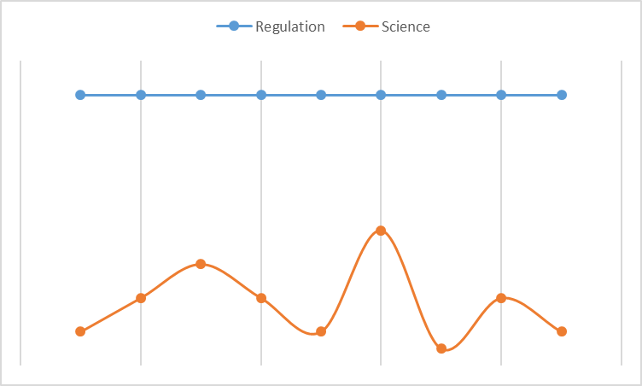
Regulatory Consistency vs. Scientific Discovery
Implementation of regulations requires consistency
Science is always learning new facts
Need space between the two
4-quarter average concentration used

Slide 5
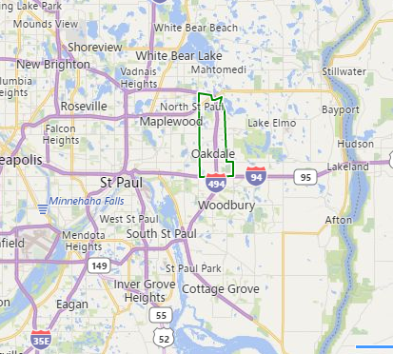
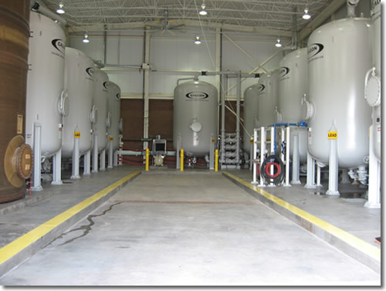
Oakdale (28,073)
Has 9 wells; PFAS exceeds MDH health limits in 7
PFAS concentrations highest in the state for community systems; peak of 440 ppt PFOA and 610 ppt PFOS
Treatment (GAC) installed in 2006 for 2 wells; change carbon annually
Primarily rely on 2 treated well and 2 “clean” wells for water supply

Slide 6
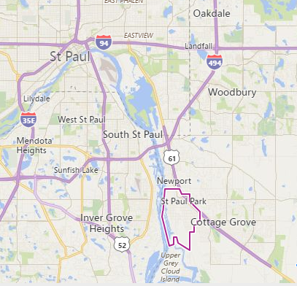
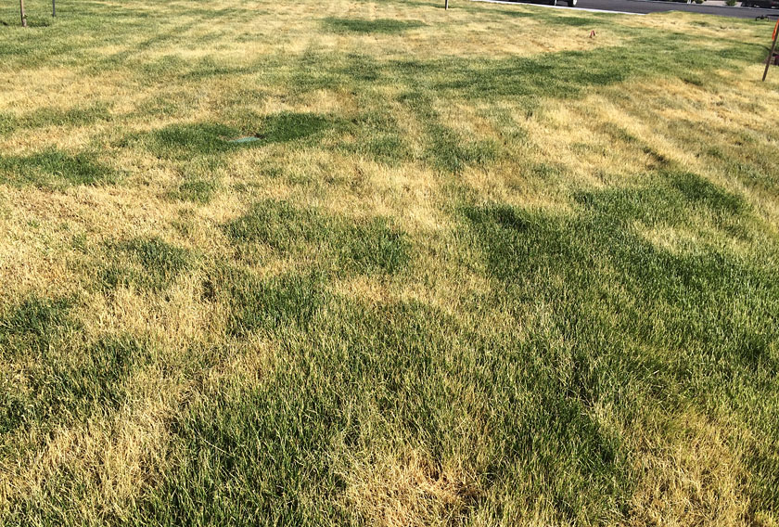
Saint Paul Park (5,279)
Has 3 wells with 2 exceeding MDH health limits
PFAS concentrations: No PFOS, 43 ppt PFOA; impacted when health limits lowered
Want to install treatment on wells
Managing pumping so clean well is used the most and adding watering restrictions

Slide 7
Public Water System Observations
Everything in a drinking water system is interdependent and very complex
Communication must include the public, regulators/regulatees, and elected officials
Systems do not have the luxury of waiting; people drink water every day

Slide 8
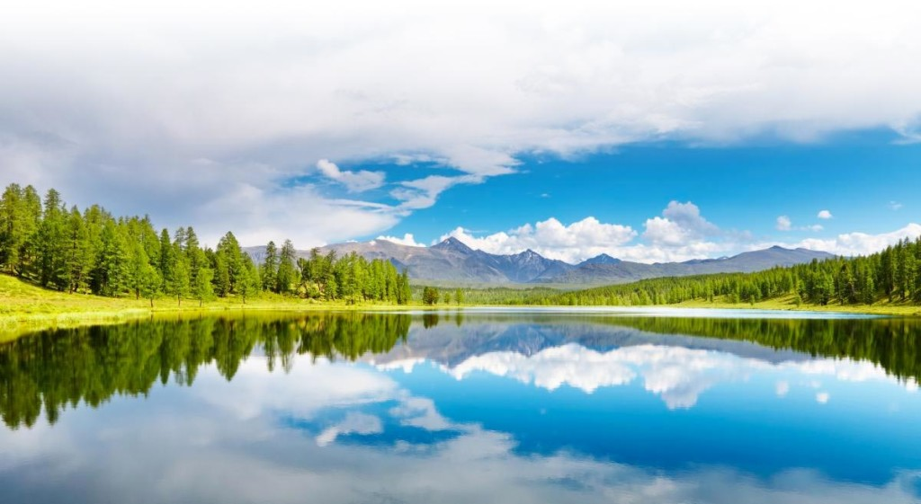
Anything else you are interested in is not going to happen if you can’t breathe the air and drink the water. Don’t sit this one out. Do something.
Carl Sagan

