Slide 1
PFAS Plume Tracking in the East Metro Minnesota – Michigan PFAS meeting July 12, 2018
Ginny Yingling | Hydrogeologist – Minnesota Dept. of Health

Slide 2
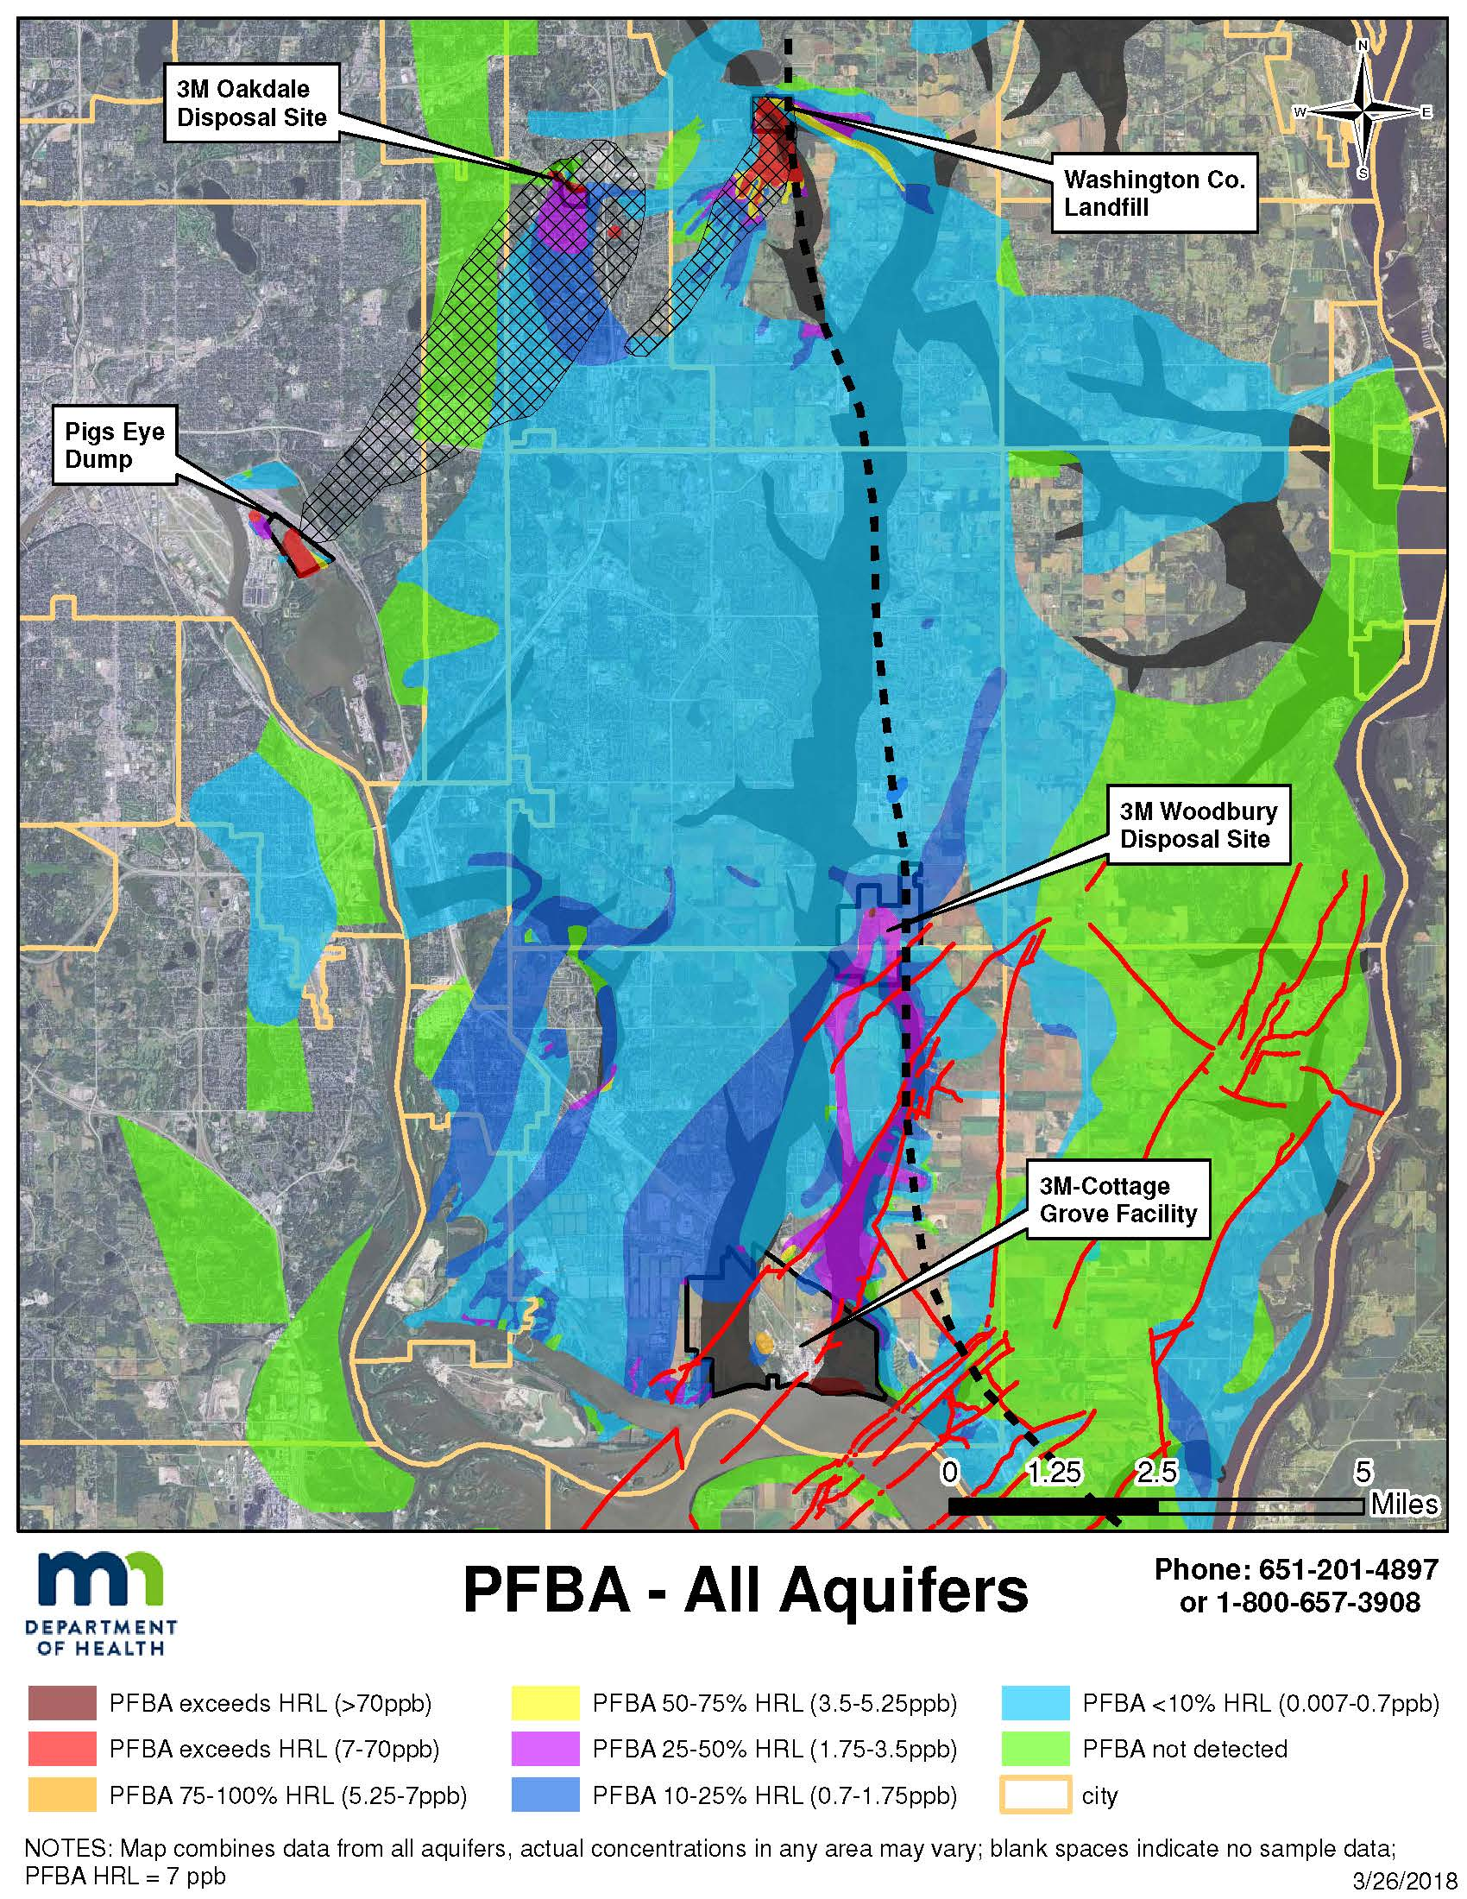
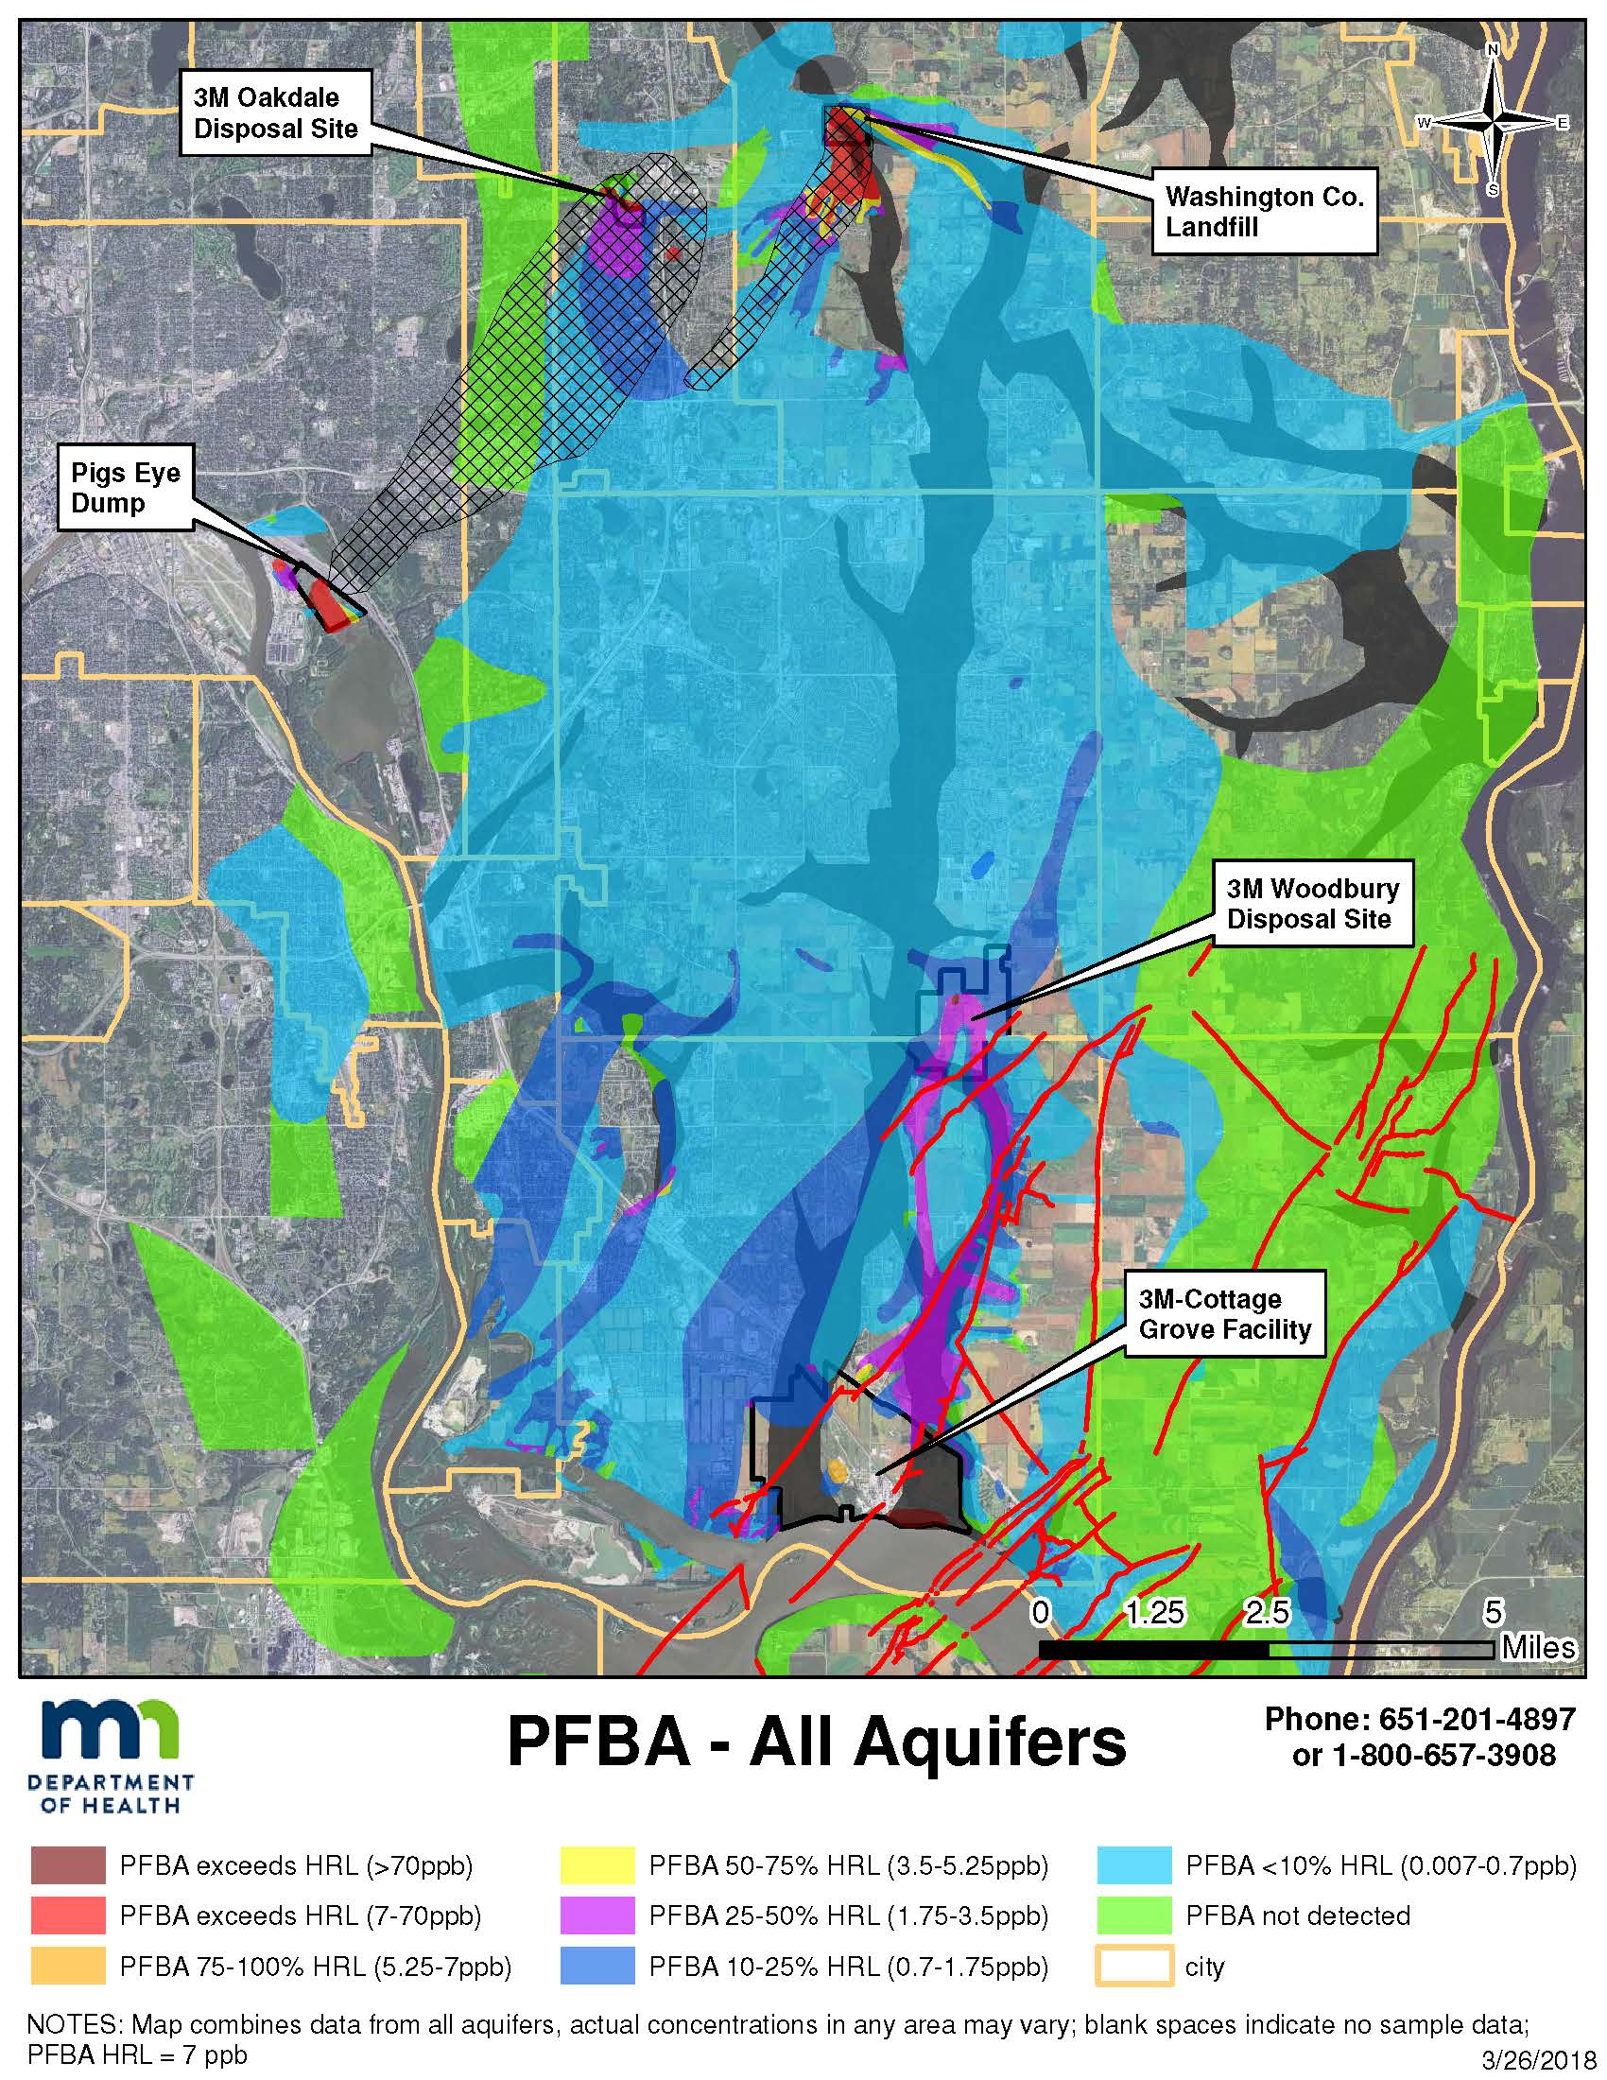
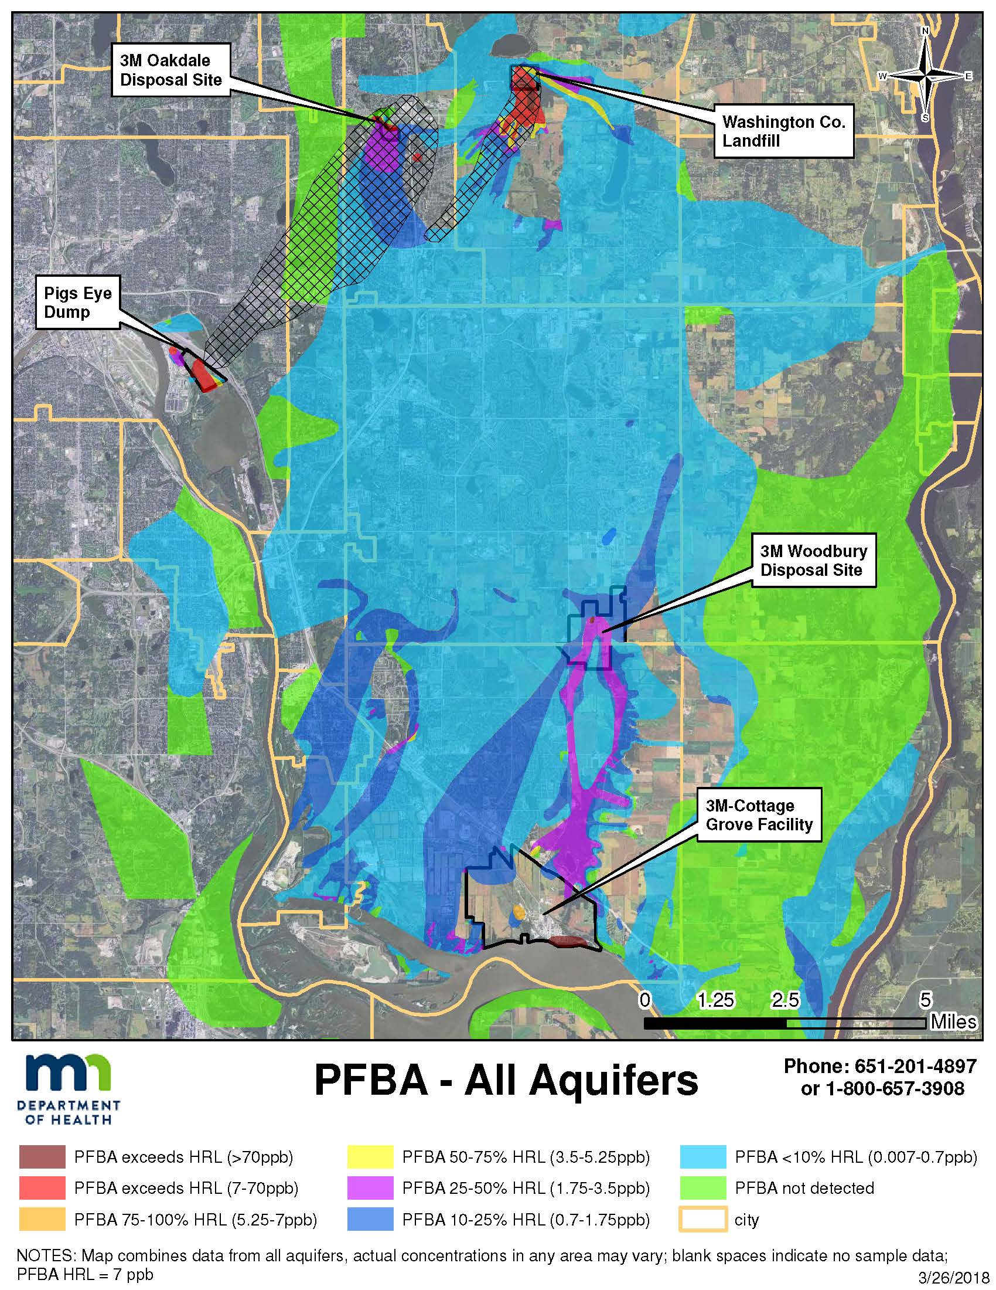
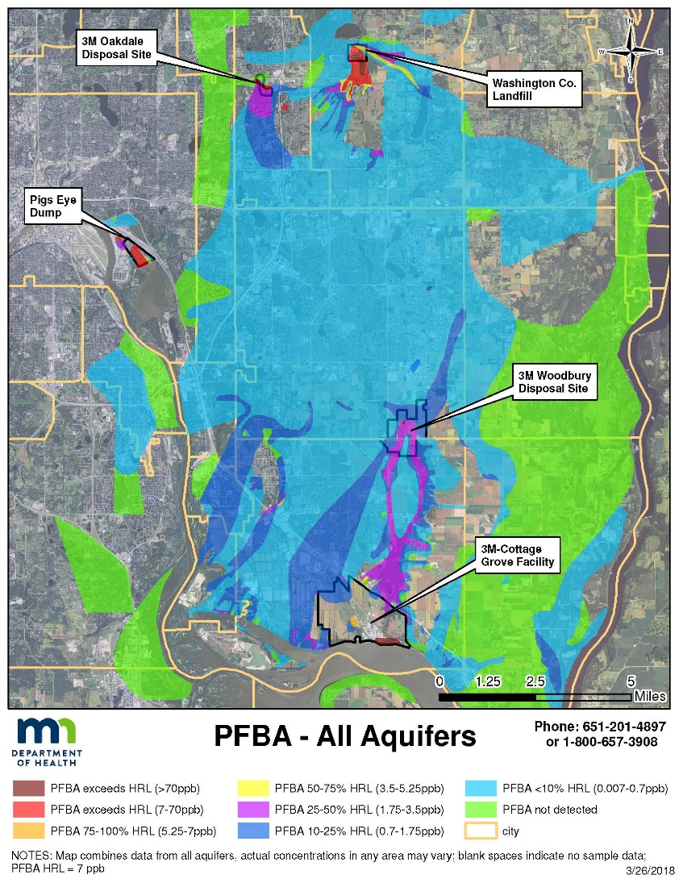
PFAS in Groundwater – East Metro
Over 130 sq. mi.
4 major aquifers
8 municipal systems (140,000+ pop.)
>2,100 private wells
Much larger than predicted by models
PFBA most widespread
More PFBA in source areas
More mobile
Distribution controlled by:
Bedrock features (buried valleys faults )
Groundwater divide (Mississippi & St. Croix R. )
Groundwater - Surface water interactions
PFAS chemical properties
Groundwater pumping

Slide 3
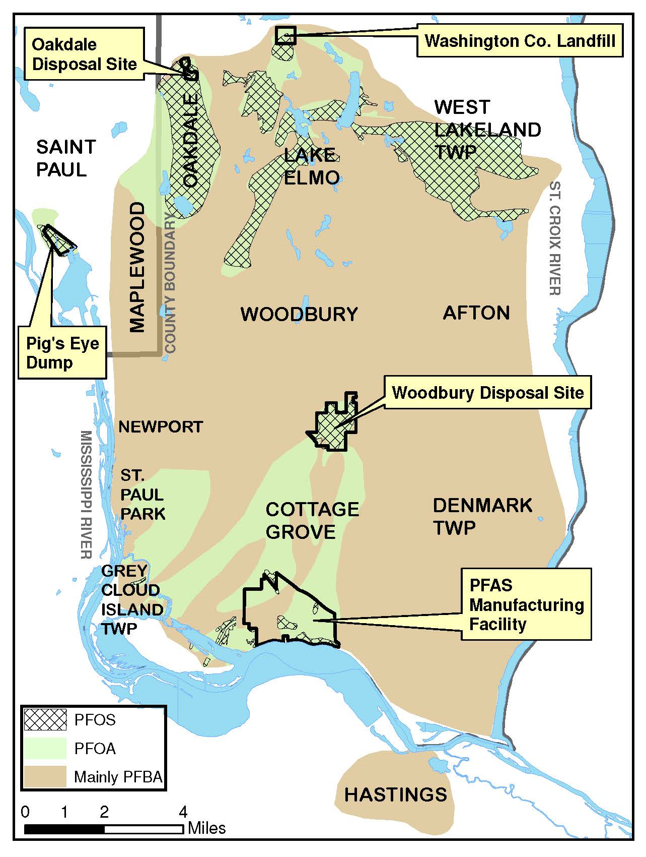
PFOS and PFOA Less Widespread
PFOS and PFOA present at high concentrations in source areas
Groundwater concentrations decrease rapidly with distance from source
Surface water concentrations
Different PFAS “signatures” in each site based on chemistry at time of disposal
Washington Co. landfill & Woodbury Disposal Sites dominated by PFCAs
Helped to identify transport pathways

Slide 4
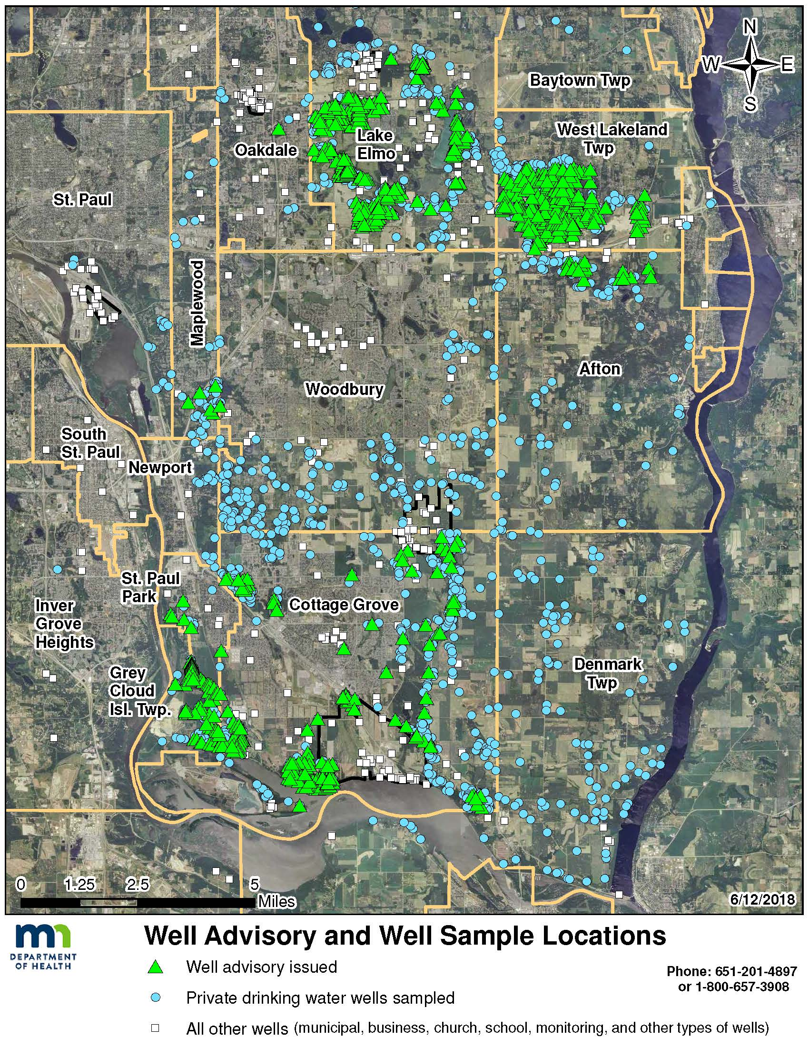
Well Sampling Effort & Drinking Water Advisories
~2,500 wells sampled since 2003
Frequent, intensive monitoring of private wells:
Near source areas
Areas with high or changing PFAS concentrations
Areas with complex geology
Less frequent monitoring of “sentry” private wells:
Distal portions of plumes
Areas with low and stable PFAS concentrations
Areas with relatively simple geology
>800 drinking water advisories issued

Slide 5
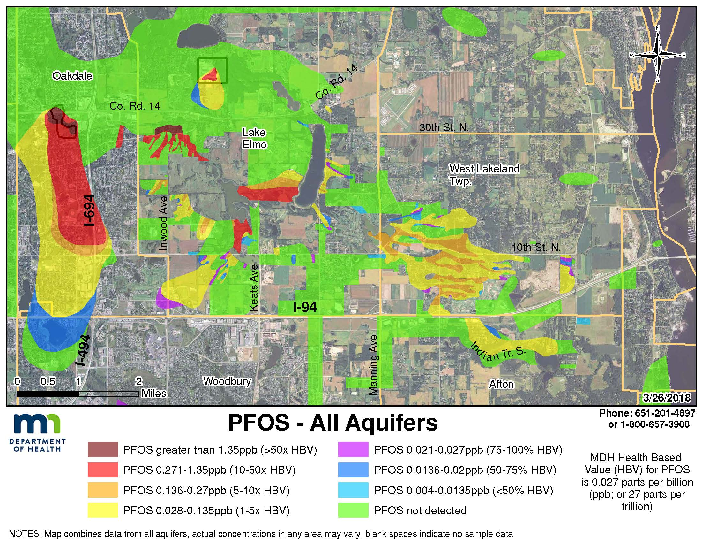
PFAS in Surface Water – Important Transport Pathway
Groundwater flow
Surface water or
stormwater flow

