Slide 1
Safe Drinking Water in Minnesota
Environmental Health Division
Drinking Water Protection Section
July 12, 2018

Slide 2
Minnesota Means Water
“Minnesota” is Sioux for “sky tinted water”
Minnesota has 90,000 miles of shoreline, more than California, Florida and Hawaii combined.

Slide 3
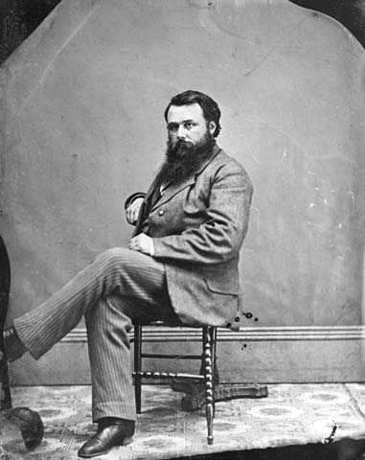
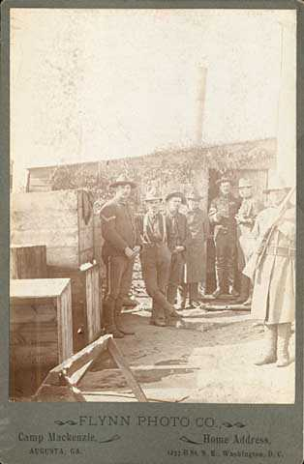
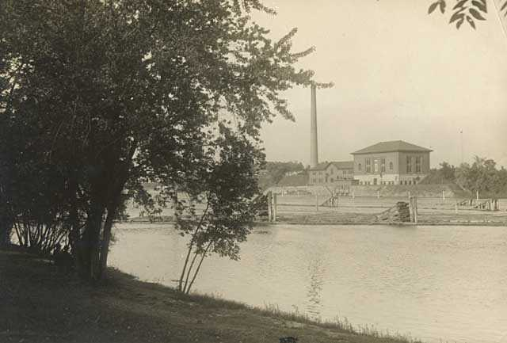
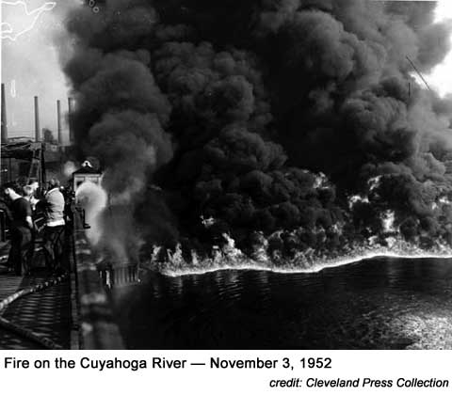
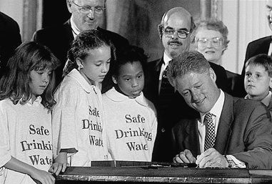
Drinking Water in Minnesota
1872 – First Minneapolis drinking water pump station; State Board of Health created
1897 – 3000 cases of Typhoid in Minneapolis (300 deaths)
1909 – City finds fecal matter in every cm³ of city water
1910 – Chlorination plant greatly reduces outbreaks
1948 – Federal Water Pollution Control Act
1949 - MDH formed from State Board of Health
1974 - Federal Safe Drinking Water Act; amended 1986, 1996, 2005, 2011, 2015

Slide 4
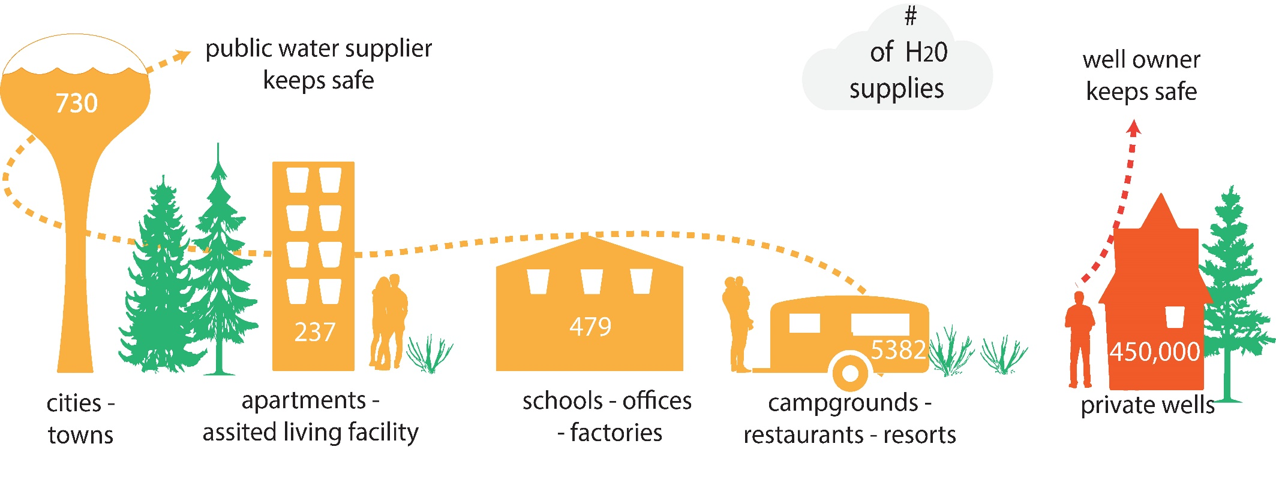
How Our Drinking Water is Supplied
Insert Emmy’s infographic
Notes:
About 80 percent of Minnesotans ( 4 ½ million people) get drinking water from a public water system. Public water supplies are systems that serve water to the public and can be publicly or privately owned.
Community systems serve water to people in their homes; non-community systems are smaller systems that serve the public where they work or play, like offices, schools or resorts.
The remaining 20 percent of Minnesotans (or 1 million people) get their drinking water from a private well.

Slide 5
Challenges
Complacency
Infrastructure is under ground
Contaminants are invisible
Water has always been safe everywhere in MN
The federal Safe Drinking Water Act does not readily adapt to new conditions or chemicals
State capacity is critical to ensure protection
Aging infrastructure
Need $7 billion in MN over next 20 years
New compounds found in water
80,000 chemicals exist

Slide 6
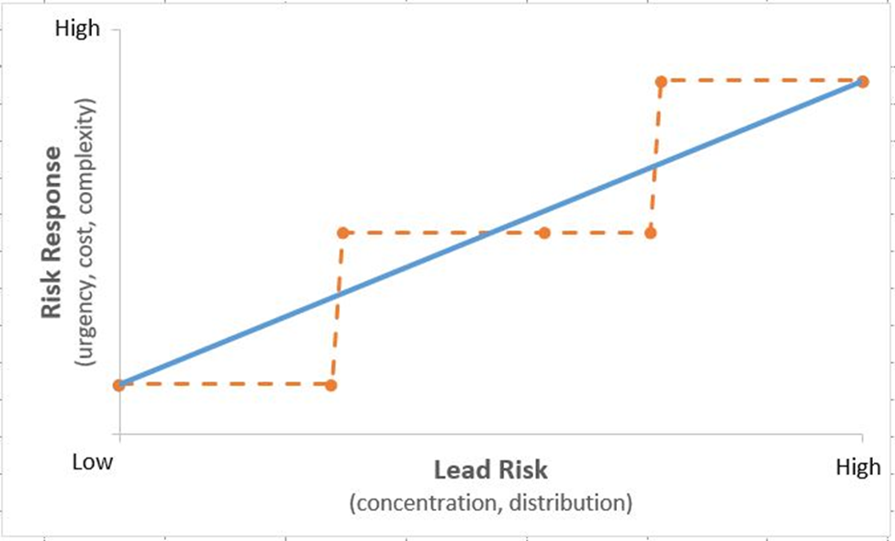
Health Risk and Regulation
Health risks are incremental
Standards are discreet segments
Public perception varies

Slide 7
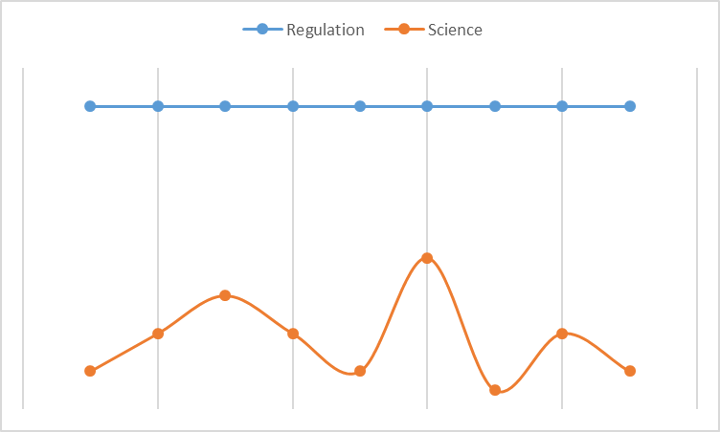
Regulatory Consistency vs. Scientific Discovery
Implementation of regulations requires consistency
Science is always learning new facts
Need space between the two
4-quarter average concentration used

Slide 8
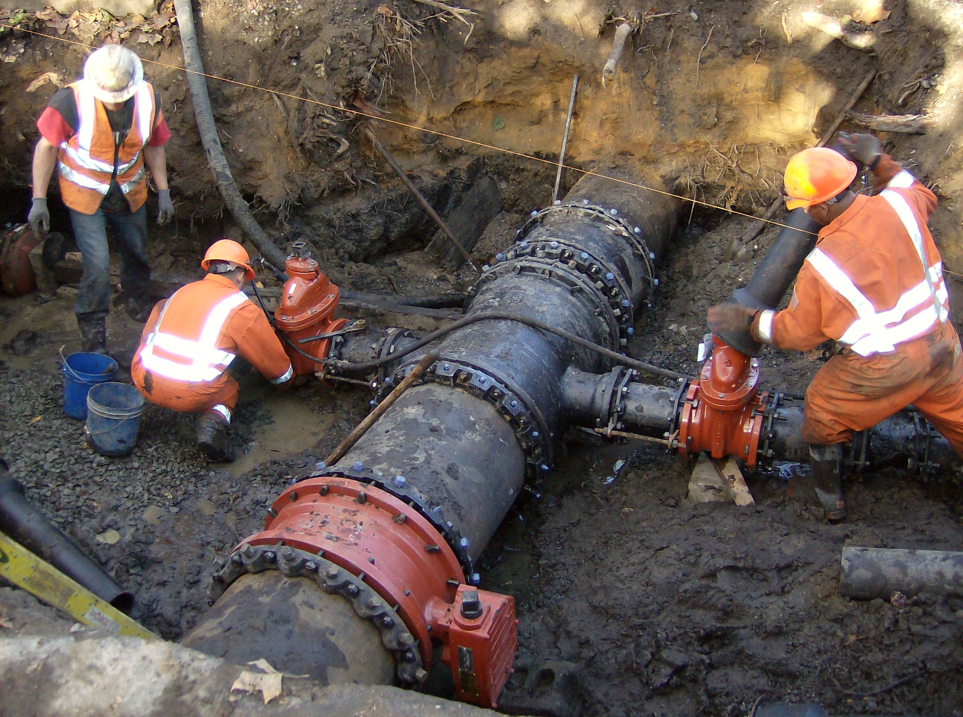
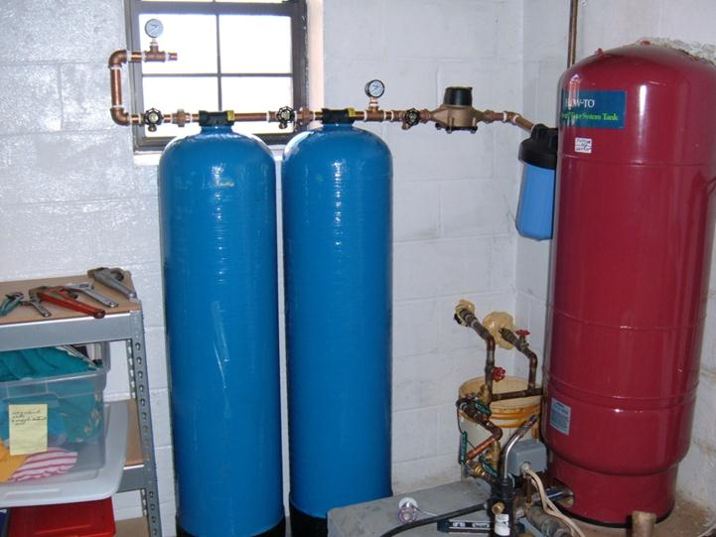
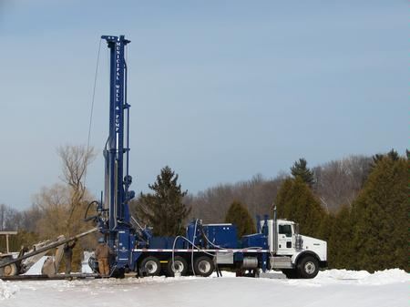
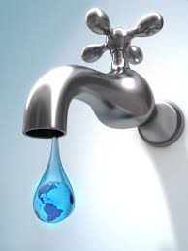
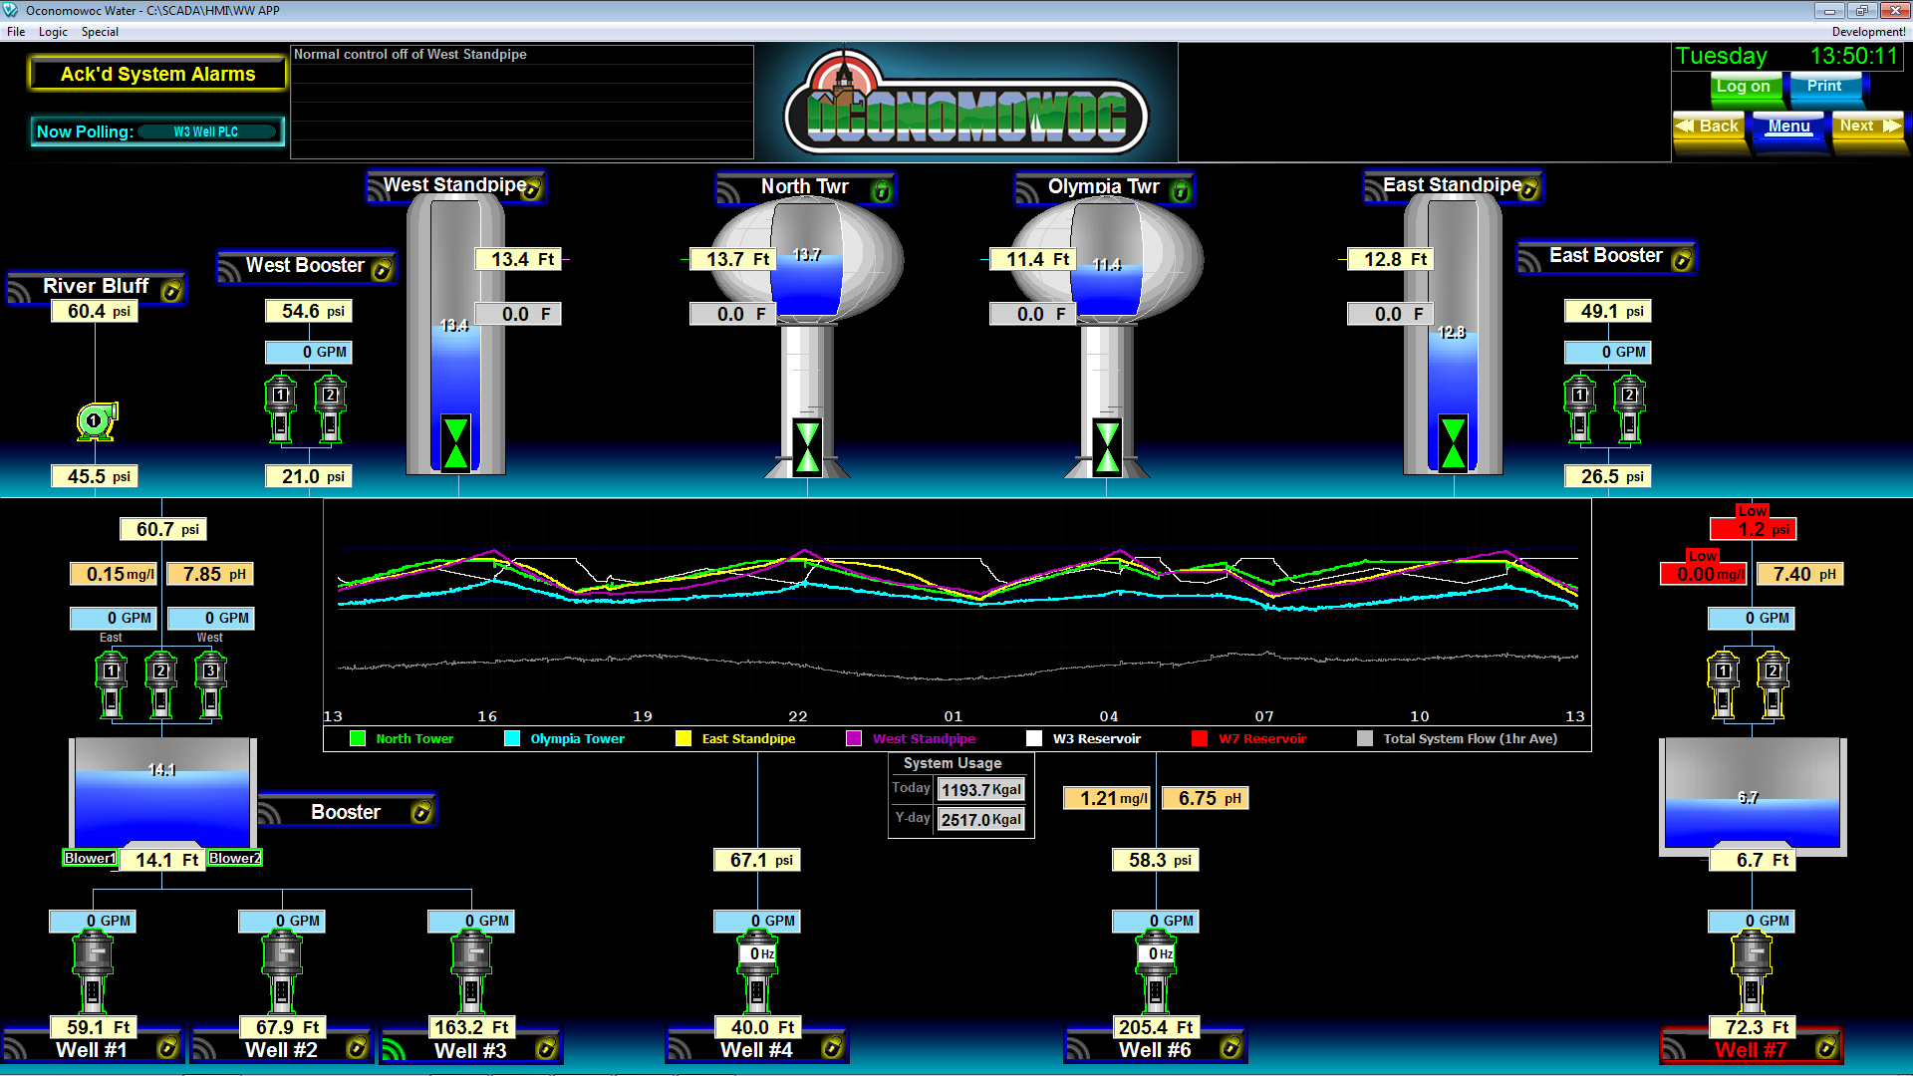
Response options
Regional interconnect
New treatment facilities
New wells
Water conservation; limit use us contaminated wells
Adapted blending scheme
Others?

Slide 9
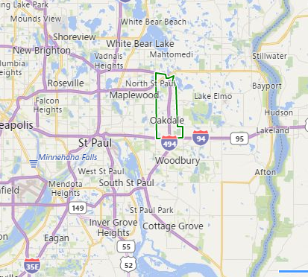
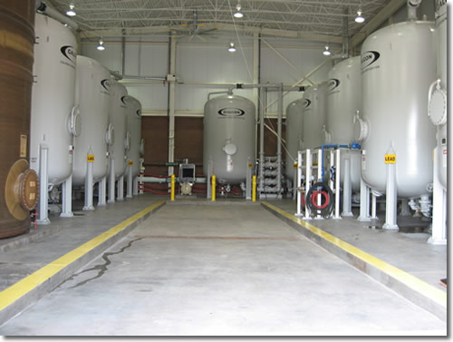
Oakdale (28,073)
Has 9 wells; PFAS exceeds MDH health limits in 7
PFAS concentrations highest in the state for community systems; peak of 440 ppt PFOA and 610 ppt PFOS
Treatment (GAC) installed in 2006 for 2 wells; change carbon annually
Primarily rely on 2 treated well and 2 “clean” wells for water supply

Slide 10
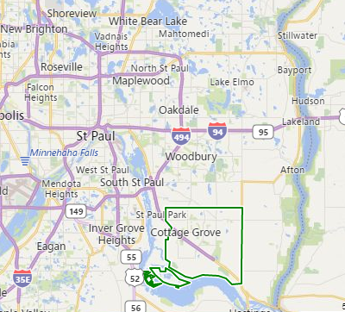
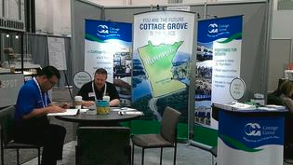
Cottage Grove (36,029)
Has 12 wells with 8 with PFAS exceeding MDH health limits
PFAS concentrations: no PFOS, 66 ppt PFOA; impacted when health limits lowered
Installed GAC treatment on 2 wells in 2017
Have a direct blending point for 7 wells that can manage concentrations
Temporary watering ban in 2017 after receiving health advisory letter from MDH and prior to treatment

Slide 11
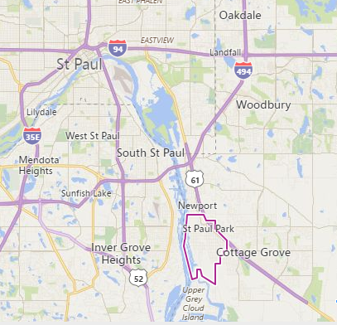
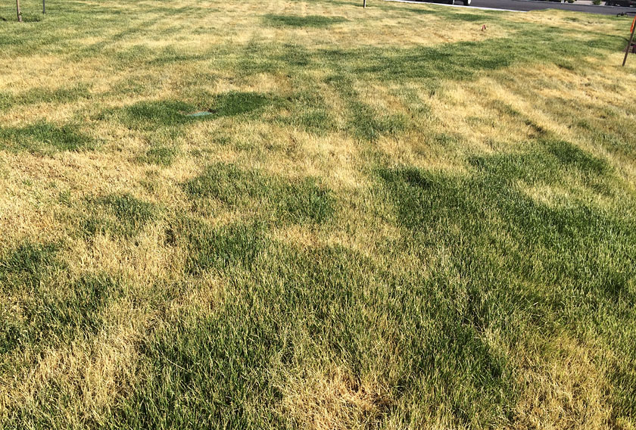
Saint Paul Park (5,279)
Has 3 wells with 2 exceeding MDH health limits
PFAS concentrations: No PFOS, 43 ppt PFOA; impacted when health limits lowered
Want to install treatment on wells
Managing pumping so clean well is used the most and adding watering restrictions

Slide 12
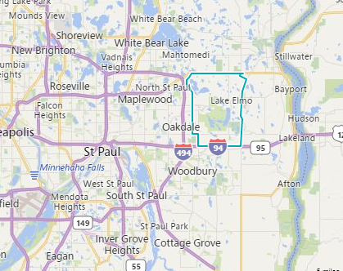
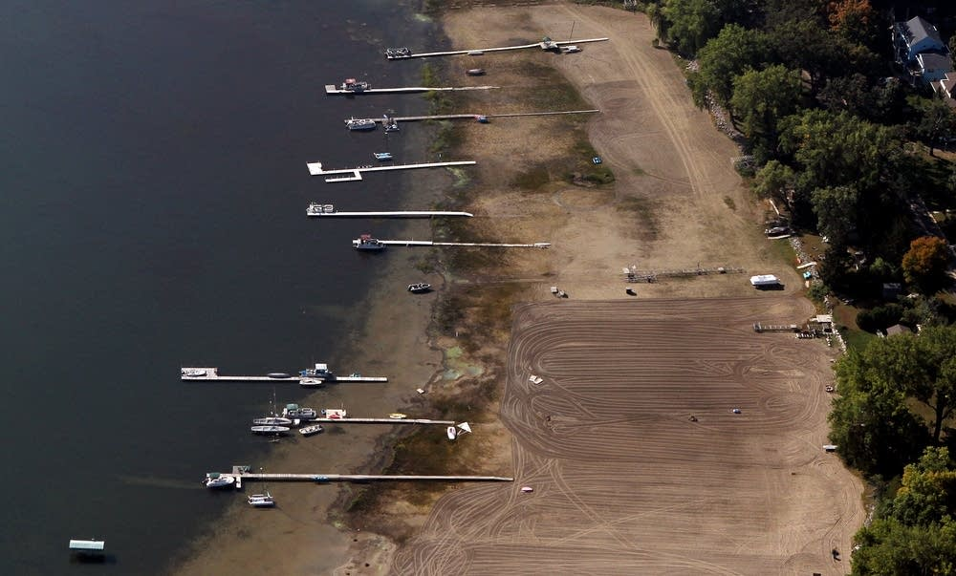
Lake Elmo (8,069)
Has 3 wells with 1 exceeding MDH health limits
PFAS concentrations: No PFOS, 46 ppt PFOA; impacted by lower health limits
Many private wells in the City
Options for new well limited by White Bear Lake water level situation (5 mile radius)

Slide 13
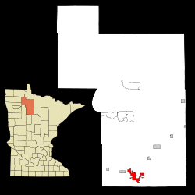
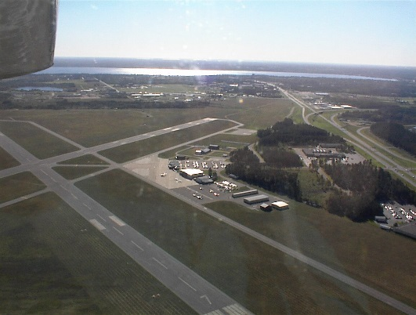
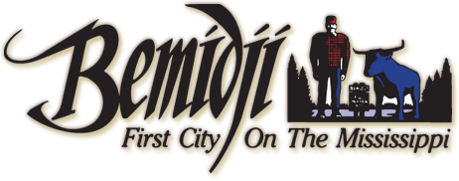
Bemidji (14,942)
Has 5 wells with 4 exceeding MDH health limits
PFAS concentrations: 190 ppt PFOS, 42 ppt PFOA, 570 ppt PFHxS.
Wells are all within municipal airport property and go to combined discharge
PFAS from fire fighting foam use

Slide 14
Public Water System Observations
Everything in a drinking water system is interdependent and very complex
Communication must include the public, regulators/regulatees, and elected officials
Systems do not have the luxury of waiting; people drink water every day

Slide 15
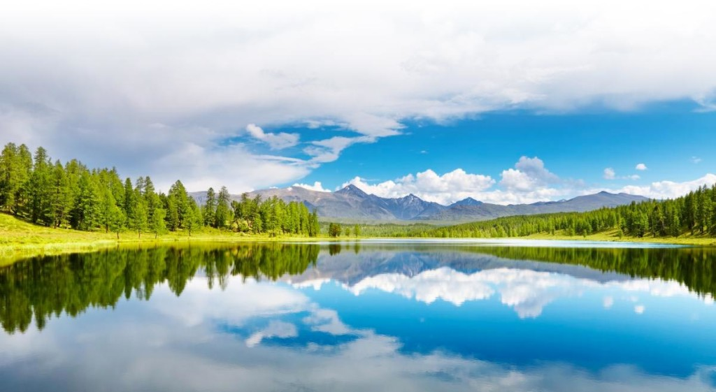
Anything else you are interested in is not going to happen if you can’t breathe the air and drink the water. Don’t sit this one out. Do something.
Carl Sagan

