Slide 1
3M Natural Resource Damage Settlement
Kirk Koudelka| Assistant Commissioner — MPCA
July 12, 2018
Notes:
It allows us to fundamentally change how we approach PFC contamination and the east metro area when it comes to provide clean drinking water. Until now, we have had to focus on a band-aid approach to address the immediate risk. Moving from drinking water well advisory to drinking water well advisory and changing standards. It is how Superfund works. We have an opportunity with the natural resource damage settlement to look at the issue with a longer term, holistic approach.

Slide 2
Brief history of PFAS in the east metro area
2002: 3M informs MPCA of PFAS in production wells at Cottage Grove facility
2007: MPCA and 3M agree to consent order outlining 3M is responsible for:
Providing safe drinking water to affected residents
Cleaning up PFAS waste disposal sites
Monitoring groundwater
2010: Attorney General files Natural Resource Damage lawsuit on behalf of State, with MPCA and DNR as trustees
Notes:
Important to define a few terms:
PFCs: PFCs are a chemical developed and produced by 3M since the 1940’s. They were used to make products like scotch-gard and Teflon. The thing about PFCs is they are VERY persistent in the environment, they do not break down. There is also increasing research on their potential risk to animals and humans.
East Metro Area: Afton, Cottage Grove, Lake Elmo, Newport, Oakdale, St. Paul Park, Woodbury and townships of Grey Cloud Island
We have been working on providing clean drinking water to residents of these communities for over a decade…

Slide 3
NRDA Litigation – Procedural History
December 2010 - State sued 3M for natural resource damages.
April 2012 - 3M brought disqualification motion of State’s outside counsel.
October 2012 - District Court granted 3M’s motion.
July 2013 - Minnesota Court of Appeals affirmed district court.
April 2014 - Minnesota Supreme Court affirmed in part, reversed in part and remanded.
February 2016 – District court denied 3M’s disqualification motion.
February 20, 2018 - Trial date scheduled to begin.

Slide 4
What’s been done recently
By 2016, MPCA had installed 100 carbon treatment systems at residences
Keeping an eye on more than 200 additional residential wells
Since EPA and MDH lowered drinking water health values in 2016 and 2017:
Over 1,200 additional residential wells sampled
Nearly 600 additional wells tested over MDH health values (drinking water well advisories)
All of these residents were offered bottled water
Almost 470 of these agreed to carbon treatment systems (385 installed already)
Notes:
We have been focusing on immediate risk through our Superfund authorities….
MERLA - MN ENVIRONMENTAL RESPONSE AND LIABILITY ACT 115B
August 2016, EPA issued drinking water guidance for 2 primary PFCs of concern (PFOS and PFOA) which were lower than MDH health based values at that time (notes - EPA value 70 ppt for each, MDH values 300 ppt for each)
May 2017, MDH issued updated health guidelines for PFOS and PFOA at levels 10 times less than previous MDH health based values (notes - 27 ppt for PFOS, 35 ppt for PFOA)
MPCA and MDH will continue to sample residential wells to evaluate if additional drinking water well advisories should be issued, will continue to install carbon treatment systems were residents agree to provide access for installation and will continue to maintain carbon treatment systems through annual change-out of carbon filters.
Under terms of SACO, 3M remains responsible to reimburse MPCA for these costs. (the $40 million part)
(notes - MDH issues well advisory to home owner, MPCA follows up with offer to provide bottled water and install carbon treatment system. Bottled water provided until carbon treatment system is installed. Home owners receiving well advisory are not required to accept either bottled water or treatment system)
One point I should clarify, by 2016 we reduced the number of residential wells monitored/sampled per year to 200. We had set up a schedule on number to be sampled each year based on levels of PFC compared to the HBVs. Some wells were scheduled for every year, some every other year and some planned for every three years. So we were keeping on eye on more than 200, but the number sampled each year was around 200. Off hand, I do not know the total number.

Slide 5
What is Natural Resource Damage?
Natural resource damage is compensation for impacts to natural resources such as:
Groundwater
Surface waters (lakes, streams, and wetlands)
Fisheries
Wildlife
Natural habitats
Natural resource damage is not addressed under the 2007 consent order.
2010: Attorney General files Natural Resource Damage lawsuit on behalf of State, with MPCA and DNR as trustees
Notes:
Talked about immediate risk and addressing it through Superfund, however there are still long-term damages to our natural resources. It is where Natural Resources Damages comes in and allows us to start addressing these larger issues.
The Legislature created this framework and tools of Superfund and Natural Resources Damages (115B.04)

Slide 6
2018 Settlement: major components
$850 million grant to the State
$720 million immediately available to provide long-term solutions in the east metro area for:
Clean and sustainable drinking water
Restoration and enhancement of natural resources
Restrictions about how the grant can be used
Expectations for community participation
Preserves 3M’s obligations under the 2007 consent order
Notes:
It is within this framework that the Legislature created that we pursued the Natural Resources Damages lawsuit and informed how we crafted the settlement agreement with 3M

Slide 7
Priority one — safe drinking water
Ensure clean drinking water to meet current and future needs
Including, but not limited to Afton, Cottage Grove, Lake Elmo, Maplewood Newport, Oakdale, St. Paul Park, Woodbury and townships of Denmark, Grey Cloud Island, West Lakeland
Alternative sources of drinking water for cities and private well owners
Treat existing contaminated drinking water wells
Potentially connect homes with private wells to municipal drinking water systems
Promote water conservation
Preserve open spaces that recharge drinking water sources

Slide 8
Priority two — enhance natural resources
Restore and enhance natural resources in the east metro area and downstream on the Mississippi and St. Croix Rivers
Restore and protect fish and wildlife habitat
Restore access to outdoor recreation
MPCA and DNR have immediate access to $20 million in grant funds

Slide 9
Other expenses
$125 million from settlement for outside counsel
$4.5 million reimbursement for Cottage Grove’s and MPCA’s 2017 costs under the 2007 consent order
Notes:
Covington & Burling
2017 expenses: 4,517,197.52 – about $2 million goes to Cottage Grove to prep the area (e.g. structure) for temporary drinking water system; MPCA covers rental and carbon change outs
$300,441.95 assessing MPCA and DNR Damages

Slide 10
Financial framework
Settlement requires grant to be deposited in Remediation Fund
Funds statutorily appropriated to MPCA & DNR from Remediation Fund
Use of dollars governed by agreement and overseen by District Court
Financial framework established by M.S. 116.155, 115B.20, and 115B.17
Notes:
Created distinct accounting measures to make sure the money is dedicated and protected
115b.17 § Subd. 7.Actions relating to natural resources.
For the purpose of this subdivision, the state is the trustee of the air, water and wildlife of the state. An action pursuant to section 115B.04 for damages with respect to air, water or wildlife may be brought by the attorney general in the name of the state as trustee for those natural resources. Any damages recovered by the attorney general pursuant to section 115B.04 or any other law for injury to, destruction of, or loss of natural resources resulting from the release of a hazardous substance, or a pollutant or contaminant, shall be deposited in the remediation fund.
Q: Is the settlement accounted for in yesterday’s economic forecast? Or will we see that surplus number increase?
A: The 3M settlement is accounted for in the budget forecast. Because the settlement will be deposited into the remediation fund, it does not show up as part of the general fund, but will appear in the consolidated funds statement that MMB will release in the near future.

Slide 11
Public input, communication, and reporting
Open houses/listening sessions held in April
Variety of tools to communicate progress:
Webpage: 3MSettlement.state.mn.us
Email list: progress and upcoming events
Regular fiscal and progress reports
Regular legislative updates

Slide 12
Local participation
MPCA and DNR will work collaboratively to develop and prioritize drinking water and natural resources projects
Government and 3M Working Group & Citizen-Business Work Group created to identify and recommend projects
Aided by technical subgroups
Three goals:
Broad participation
Transparency
Balance
Notes:
The proposed structure tries to achieve three goals:
Broad participation — Each group will have representatives from all affected communities as well as members from state agencies. The Working Group also includes at-large citizen and business members.
Transparency — All meetings will be open to the public, and time will be reserved at the end of each meeting for questions or comments.
Balance — The workgroup structure will work to balance the need for multiple perspectives along with the ability to make decisions quickly and efficiently.

Slide 13
Working group structure
Government and 3M Working Group and Citizen and Business Work Group that will provide recommendations on projects and priorities to the MPCA and DNR.
Final decisions made by MPCA and DNR
A Drinking Water Supply subgroup that will analyze options and deliver recommendations to the Working Group for long-term solutions for alternative drinking water sources and/or treatment of existing water supplies for affected communities.
A Groundwater Protection, Sustainability, Conservation and Recharge subgroup that will analyze options and deliver recommendations to the Working Group for long-term solutions for groundwater protection, recharge, conservation, sustainability, and for groundwater studies and modeling needs in the East Metropolitan Area.
Notes:
We have received some good feedback on the local gov’t calls and about them.

Slide 14
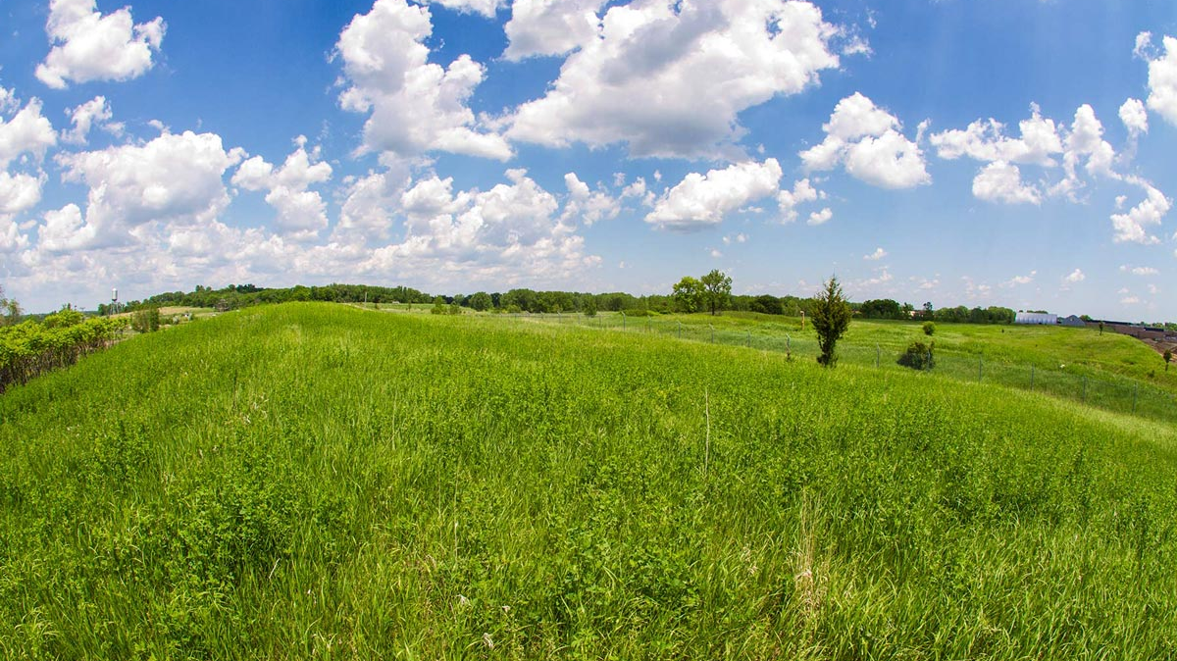
Questions?
Settlement website:
3MSettlement.state.mn.us
Email for questions, comments:
pfcinfo.pca@state.mn.us
Notes:
This is a picture of the Twin City Army Ammunition Plant Superfund Site in Arden Hills/New Brighton

