Slide 1
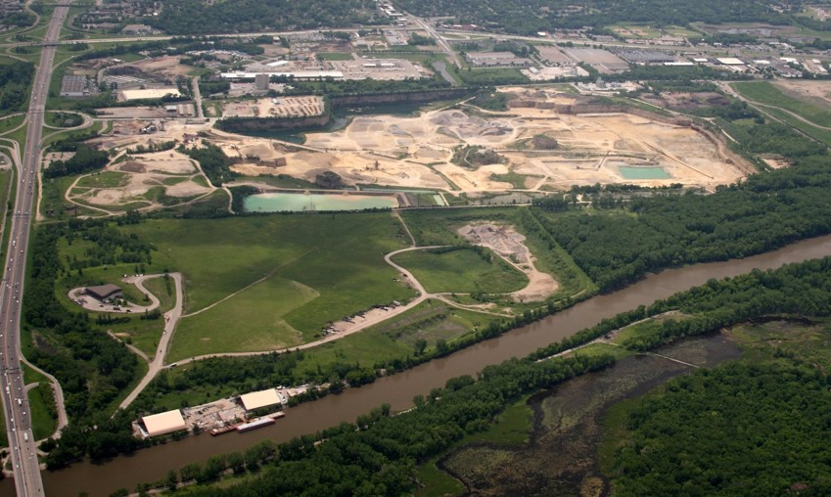
Freeway Landfill/Dump Summary
February 12, 2019
Notes:
Freeway Landfill/Dump (20 minutes presentation/10 minutes Q&A)
Kirk
Waste Management
CLP
Jamie
1. History of Freeway Landfill and Dump with the MPCA programs
3. Current status of investigations and conceptual designs
Kirk
Possible pathways for redevelopment
Next steps

Slide 2
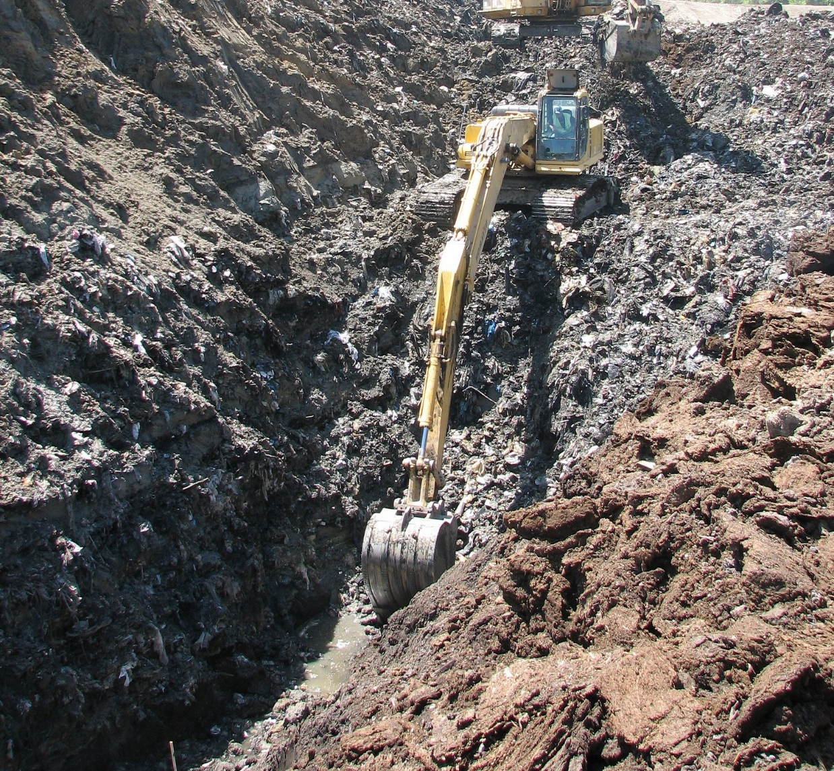
Three approaches to handling pollution
Prevent it
Manage it
Clean it up
Notes:
We address contamination from three different perspectives:
Pollution prevention means eliminating waste and pollution at its source. For example, our small business environmental assistance program helps companies reduce costs and increase efficiency. Another example is training road salt applicators to help prevent chloride pollution.
Managing pollution is the bulk of our work – which we accomplish through our water and air permits and the traditional regulation framework. But we also help manage pollution through efforts such as:
Capital Assistance Program projects and grants to local government for setting up infrastructure for recycling and waste reduction
Training for wastewater treatment plant operators to ensure proper management of municipal wastewater.
Cleaning up Past Pollution is key to protecting and enhancing human health. This is the most costly of the three options. This is where both the Closed Landfill and Superfund programs complete their work. We do this in may ways, most visibly:
Closed Landfill Program
Superfund Program

Slide 3
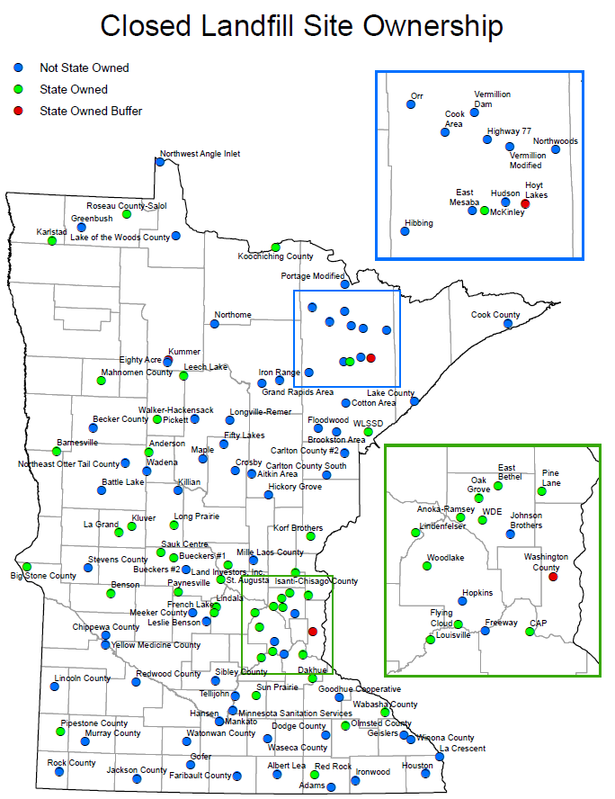
Closed Landfill Program
The Legislature created the Closed Landfill Program in 1994.
MPCA is responsible for managing closed landfills that were permitted to hold mixed municipal solid waste that are enrolled in the program.
Goal: Mitigate risks to the public and the environment.
Today: 112 enrolled closed landfills statewide. Freeway Landfill entered into program in 2017.
Notes:
We manage each of these 110 landiflls by: (114 eligible)
monitoring environmental impacts and site conditions at each landfill
determining the risk each landfill poses to public health, safety and the environment
implementing cleanups and maintaining landfill covers, caps and property
working with local governments to incorporate land-use controls at and near the landfills to protect human health and safety,
measuring how well the CLP is managing the risk at the landfills
The MPCA is responsible for these Closed Landfills in perpetuity.

Slide 4
Closed Landfill Program Priorities
Closed landfills are scored based on:
  presence and degree of hazards at each site - groundwater, surface water, and methane gas
  conditions that exacerbate those hazards (fractured bedrock, drinking water impact)
  the likelihood the public will be exposed to those hazards (distance to wells, homes)
  other risk factors (volume of waste, history of trespass, etc.)
Numerical values are assigned to each of these risks and are totaled to calculate a site’s risk priority score.
This ranking process is completed annually. In recent years, Freeway Landfill has been the highest or the 2nd highest priority closed landfill in the State.
Notes:
Landfills are scored based on:
presence and degree of groundwater, surface water, and methane gas hazards at each site (based on monitoring data and field observations)
conditions that exacerbate those hazards (ex: fractured bedrock, aquifer used for drinking water, ability for methane to migrate)
the likelihood the public will be exposed to those hazards (number of and distance to wells and buildings)
other risk factors (ex. volume of waste, history of trespass, control of land uses)
Numerical values are assigned to each of these risks and are totaled to calculate a site’s risk priority score – landfills with high risk scores receive a high ranking or priority. (done annually)
In January 2018, risk scores ranged from 1 (lowest risk) to >75,000 (highest risk).
Freeway has been either No. 1 or No. 2 for the past couple of years. Following the 2017 legislation, we are now scoring the Freeway Dump with the Landfill, so this year it is anticipated that Freeway will be the highest ranking priority.

Slide 5
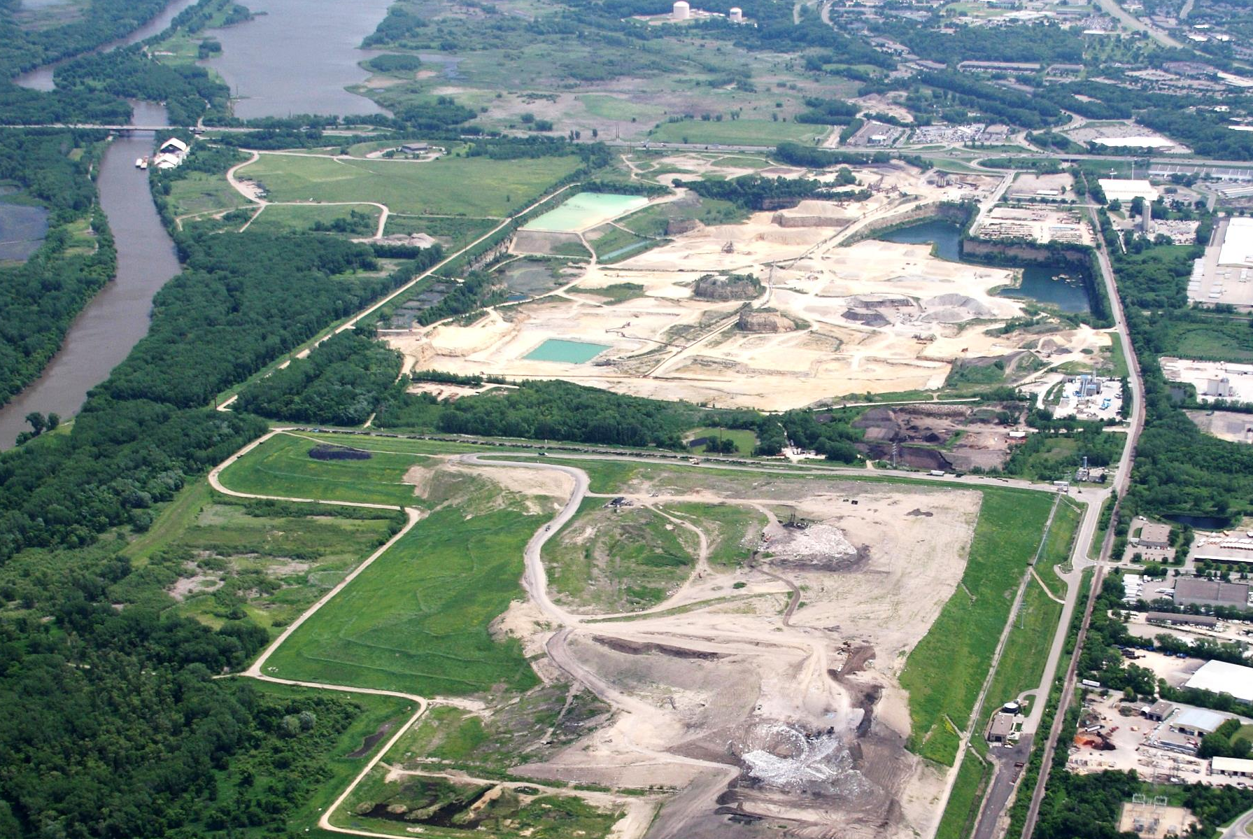

Area Overview
Freeway Landfill
Freeway Dump
Burnsville Drinking Water Supply Area
Bloomington
Burnsville
Kramer Quarry
Burnsville Landfill
(Waste Management)
Notes:
North is to the left.
Minnesota River on the left.
Freeway Landfill and Dump on the top left.
Kraemer Quarry at the top middle with the Burnsville water supply to the top right – both the quarry withdrawal and the water supply wells.
Burnsville Landfill owned by Waste Management is on the bottom.

Slide 6
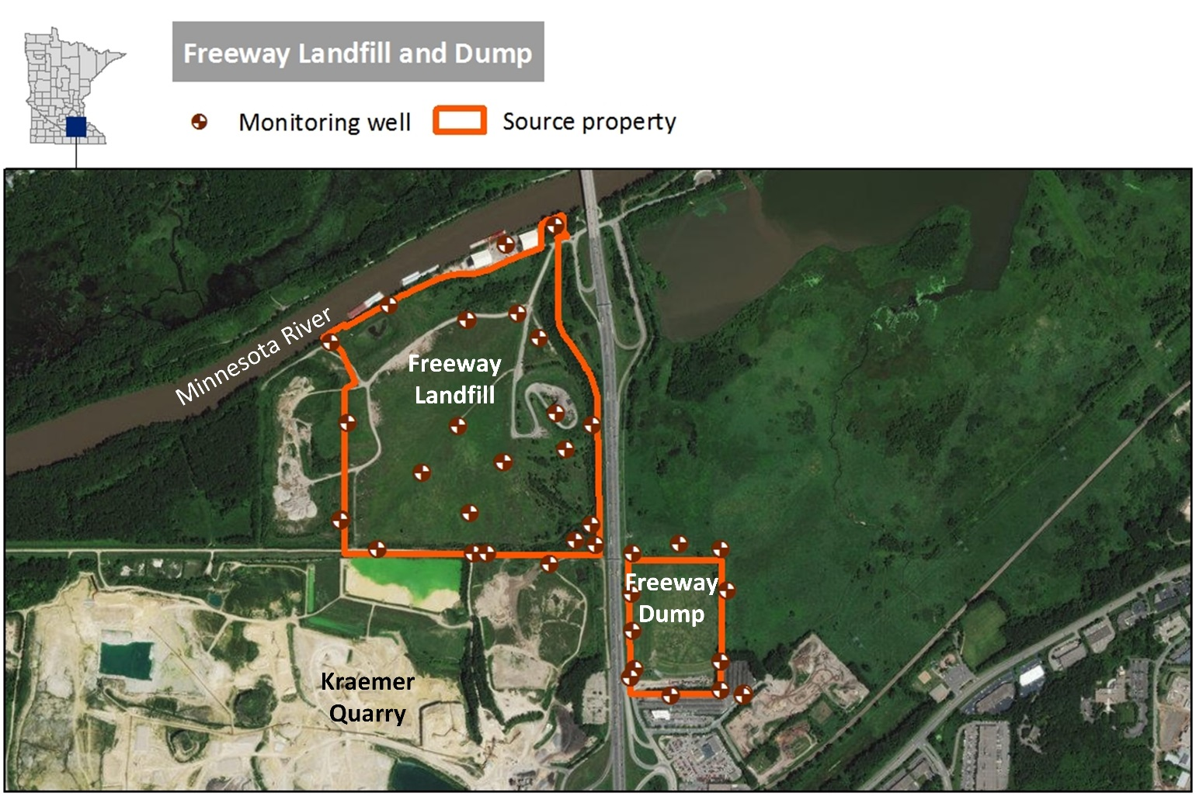
Freeway Landfill & Dump
Freeway Dump
  Operated 1961-69
  28 acres
  760,000 cubic yards
Freeway Landfill
  Operated 1969-90
  146 acres
  5,310,000 million cubic yards
Both are unlined
Located above drinking water source for Burnsville and Savage
Built on former wetland south of and adjacent to Minnesota River
Notes:
Landfill and Dump are located above both the City’s water intake from the Quarry lake and from the well field located to the south of the Dump.

Slide 7
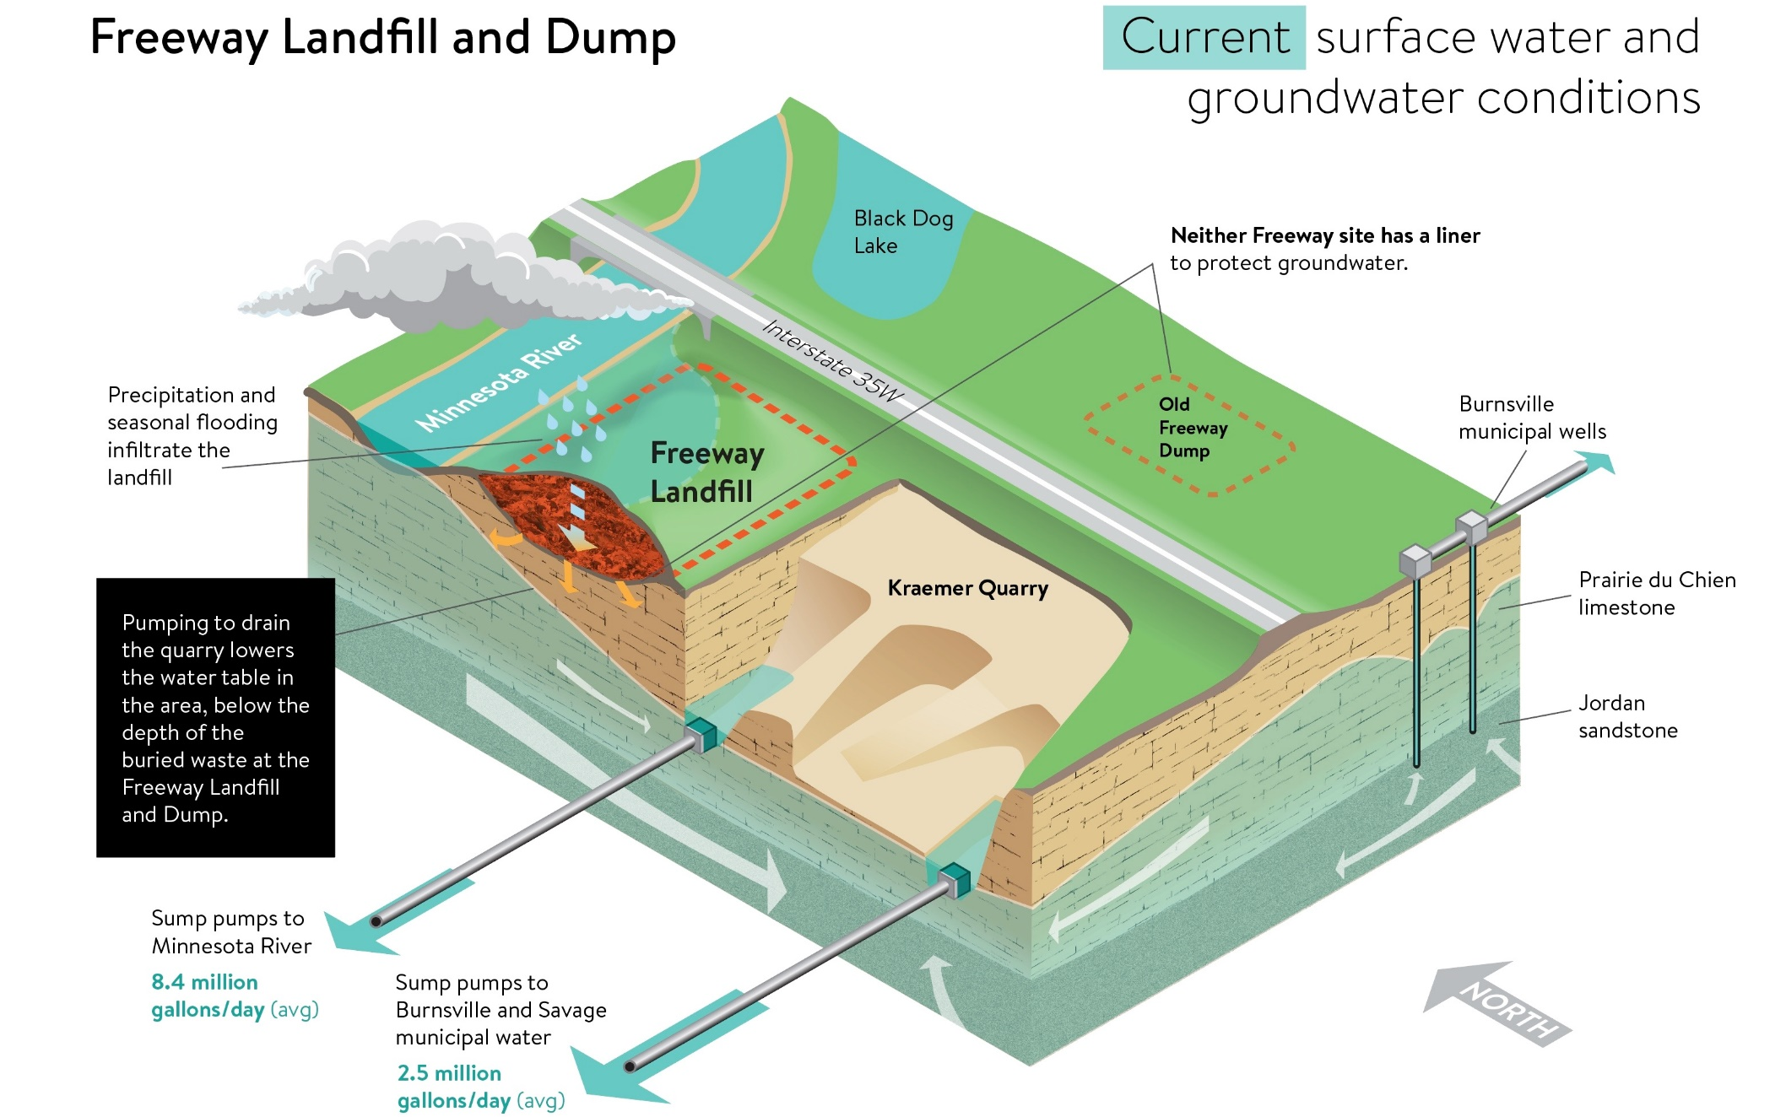
Current Site Conditions
Notes:
The next few slides will talk about the groundwater flow at the landfill site.
Slide is current conditions with Kraemer Quarry pumping for their dewatering actions.
Again, north is to the top left.
Currently the waste is not in groundwater - Kraemer’s dewatering operations between what is discharged to the river and what is used by the Cities of Burnsville and Savage lower the groundwater to prevent the waste from being in the water.
However, as rain infiltrates the ground and during seasonal flooding, water runs through the waste and it is suspected that the groundwater directly in the vicinity of the landfill and dump is contaminated from the waste. We are currently completing an investigation to confirm this.
We have sampled the City’s water intake at Kraemer’s Quarry and the nearby municipal wells and there was no contamination found at this time.

Slide 8
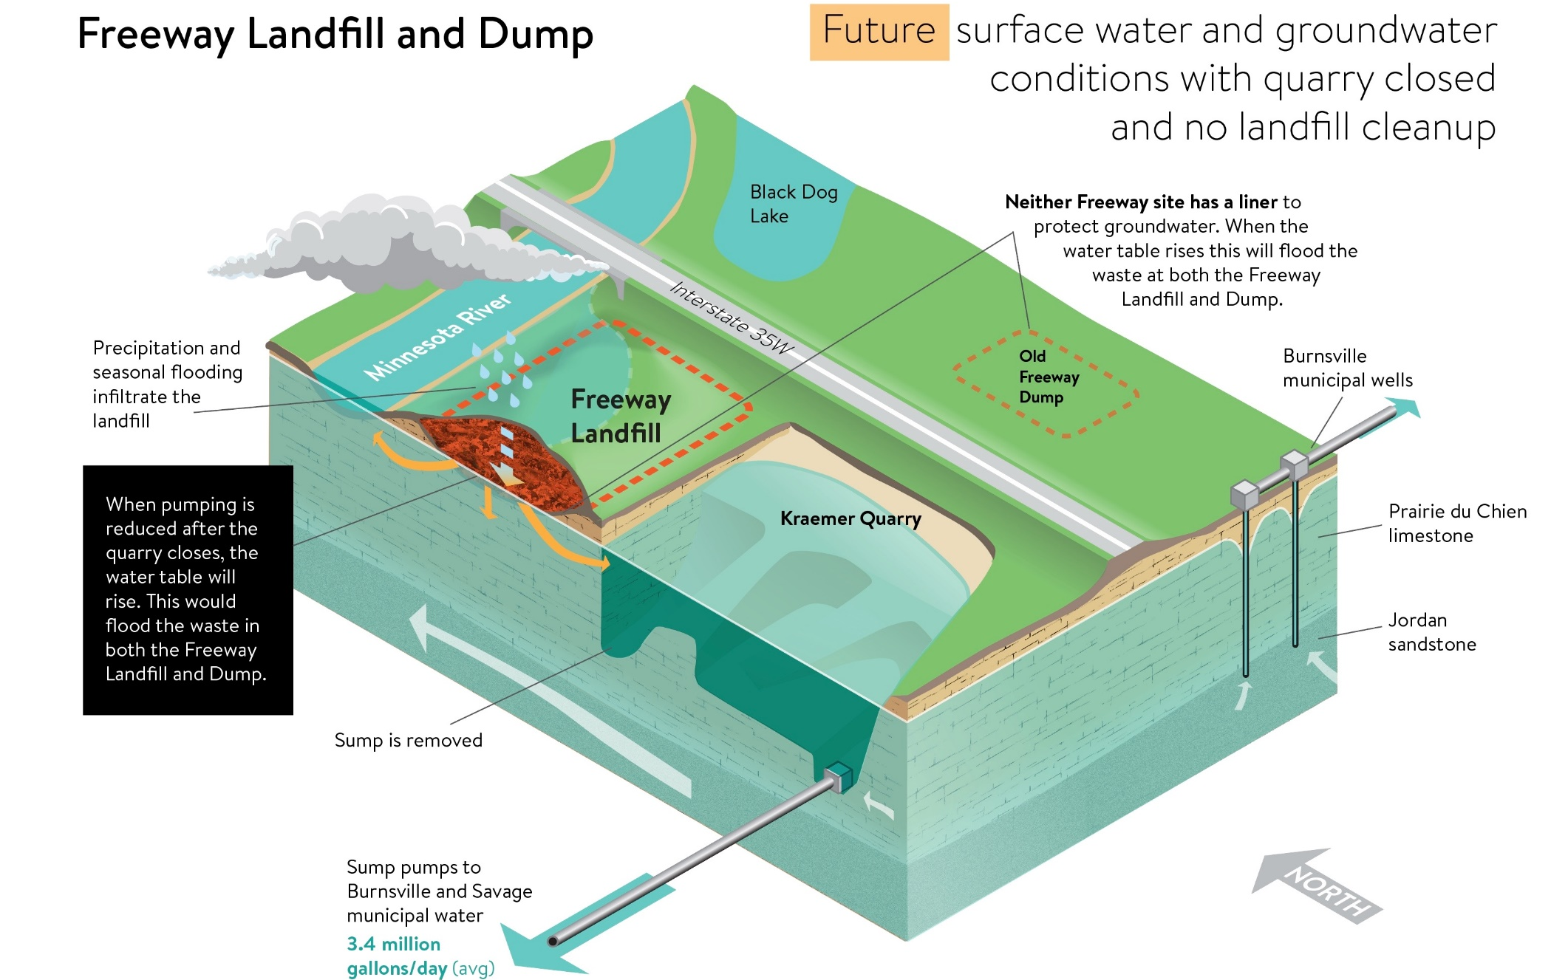
Groundwater Flow: FUTURE
Notes:
This second slide shows the future condition based on modeling. Once Kreamer Quarry stops pumping, the water table will rise to form the Quarry Lake.
Burnsville and Savage will still be getting their water from the quarry lake with Burnsville supplementing their drinking water source with municipal wells south of the Dump.
The waste and BOTH the landfill and Dump will be in direct contact with the groundwater at this time.
There will continue to be rain water infiltration and seasonal flooding as well that will create more movement in the contamination during certain times of the year.
As such, the contamination at the Freeway Dump and Landfill will move towards:
The Minnesota River
The Quarry Lake and the Burnsville and Savage drinking water intake; and
The Burnsville municipal wells south of the Freeway Dump.

Slide 9
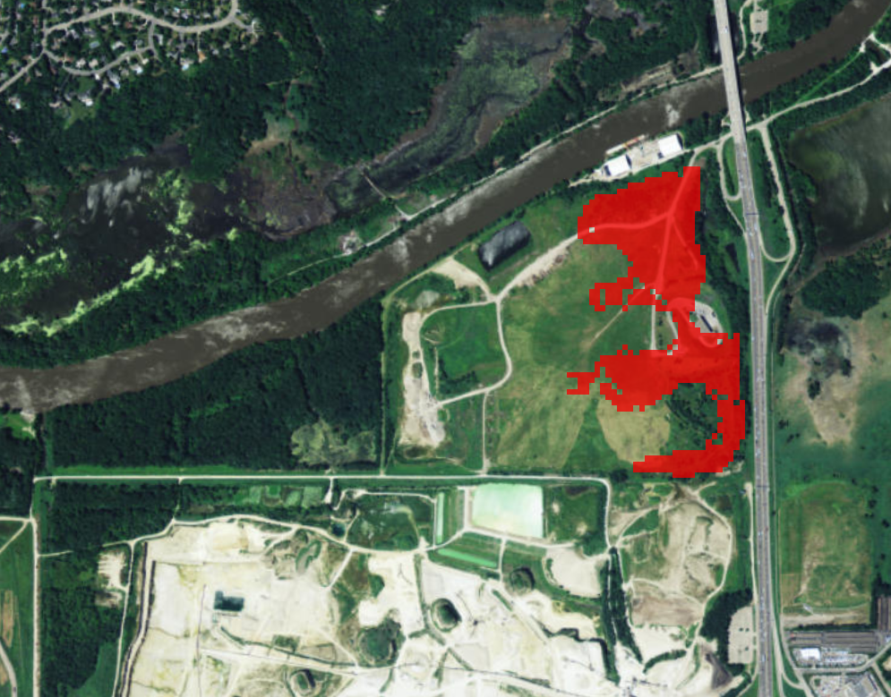
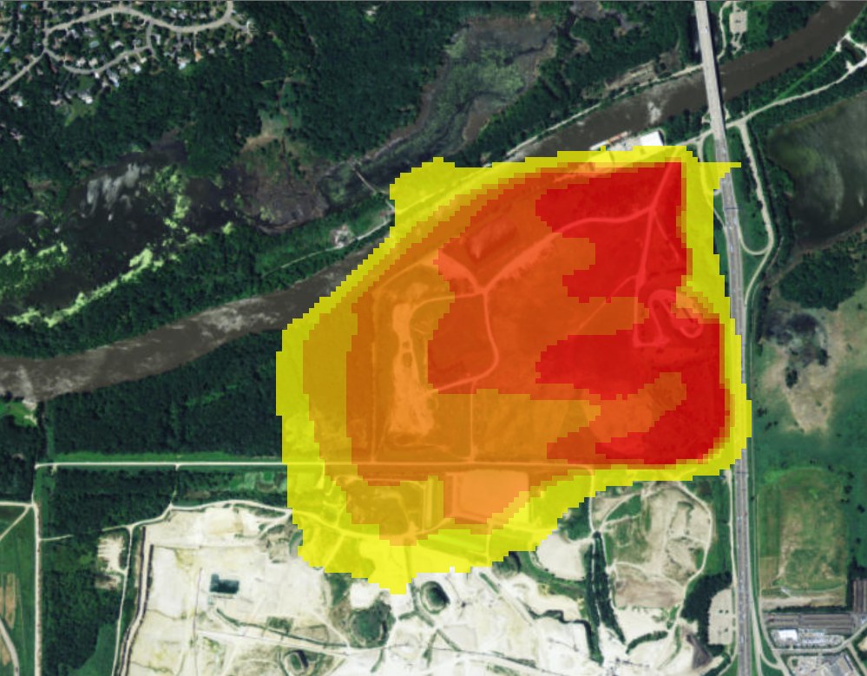
Future Threat to Groundwater
Waste in direct contact with groundwater after pumping ceases:
Estimated area of groundwater impacts after pumping ceases:
Notes:
The groundwater level will also rise in the months after Kraemer Quarry stops pumping: Plan view on the modeled scenario.
When this happens, the waste and leachate at the bottom of the landfill will be in direct contact with groundwater.
Left – Waste in direct contact with the groundwater after Kraemer stops pumping
Right – is the area of groundwater impacts directly after the pumping ceases. Contamination will then continue to spread with the groundwater flow.

Slide 10
Preliminary Results of 2018 Investigation
Waste boundaries still under investigation
Methane detected above the lower explosive limit
Groundwater contamination above health values for:
  1,4-Dioxane
  PFAS (PFOS, PFOA)
  VOCs (BTEX, TCE)
  Metals
Groundwater contamination above surface water criteria:
  VOCs (BTEX, Vinyl Chloride)
  Metals
Notes:
2018 Investigation – Didn’t delineated the entire waste footprint.
Compared the groundwater samples to 2 criteria – health risk criteria for drinking water and surface water criteria for any futures impacts to the Minnesota River.
Phase B investigation starting in February, including bedrock water sample from Kramer Quarry.
Access agreements challenge – parties are concerned about the previous letters from EPA regarding potential responsible party.
Our intent is to just review extent and magnitude but if we find something we would need to follow up.

Slide 11
Conceptual Design Options
Feasibility Study and Conceptual Design (<30%)
Dig and Line Options Evaluated:
  Smallest Footprint (Tallest)
  Largest Footprint (Lowest)
  Balanced (Hybrid of 1 and 2)
  Expand West – No Longer Under Consideration
Dig and Haul Options:
  Landfill (off site)
  Incinerate (off site or with mobile incinerator)

Slide 12
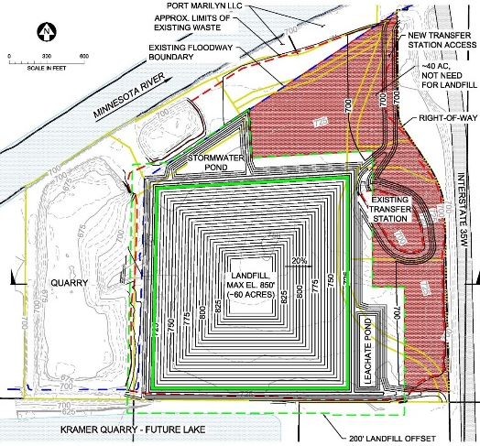
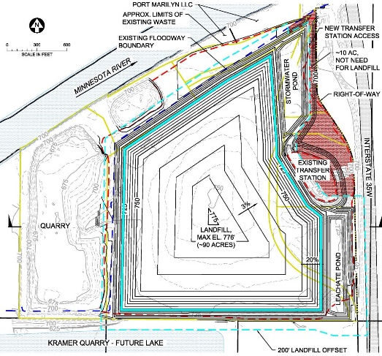
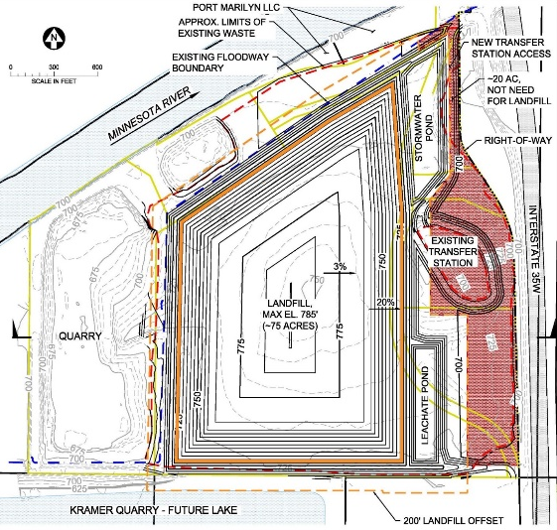
Dig & Line Option Comparison
Concept Option: | 0 – Existing Conditions | 1 – Smallest Footprint (tallest) | 2 – Largest Footprint (lowest) | 3 – Balanced Footprint (Hybrid of 1 and 2)
Landfill Footprint | ~150 acres | 60 acres | 90 acres | 75 acres
Area Not Needed for Landfill** | - | 40 acres | 10 acres | 25 acres
Maximum Height | 750’ | 850’ | 776’ | 785’
Estimated Construction Duration | - | 3 years | 4 years | 3.5 years
Estimated Construction Cost* | - | $85 M | $107 M | $97 M
*Cost estimates from 2019 and assume single-layer bottom liner. Construction costs only.
**The remaining property acreage is reserved as buffer area for the waste footprint.
Notes:
No longer considering Option 4 (Expand West) because of construction and development challenges (floodplain, waste outside of permitted boundary, etc).
All current options allow for transfer station to remain.
Height listed includes Freeway Dump.
Waste Management Burnsville Landfill Height = 820’

Slide 13
Estimated Cleanup Costs
2017 Funding History
$3 million appropriated from Closed Landfill Investment Fund (CLIF)
Requested bond not received
Costs are increasing because:
  1,4-Dioxane and PFAS detected;
  Waste at dump must be moved to the landfill; and
  Unanticipated legal costs to gain
    access to site.
Estimated total project cleanup cost is at least $85 million (as of today)

Slide 14
Cost Uncertainties
  Key Uncertainties
    Volume of Waste (Landfill and Dump)
    Existing Cover Soils
    Earthwork Double Handling
    Liner Design
    Restoration
    Leachate Treatment
    Site Congestion / High Visibility Project
Other
Leachate Mgmt
Waste Transfer
Liner
Earthwork
Cover

Slide 15
Next Steps
Complete 2019 Field Investigation and Sampling to:
  Define how far the waste extends off-site on the landfill and dump
  Sample the water underneath the landfill and dump
  Sample the bedrock underneath the landfill and dump
  Sample for vapor intrusion
  Evaluate suitability for waste-to-energy incineration
Complete the EPA-required remedial investigation and feasibility study
Complete the design for the landfill and dump response action
Public meeting – Summer 2020
Notes:
“due to incomplete investigation and design work and delays in receiving access to the site.”
· Delays in receiving access to the site from the present owner.
· Data collected during the environmental investigations is resulting in additional data needs.
· The site is an EPA National Priorities List (NPL) site which requires a remedial investigation/feasibility study and a record of decision in accordance with an agreement between the EPA and the MPCA. The Closed Landfill Program has not previously had to complete the EPA NPL process as the closed landfills that were brought into the program had previously had the EPA process completed prior to enrollment into the program.

Slide 16
Dig & Line Options
Need feedback from the City of Burnsville and Dakota County on the dig & line options to help narrow them down
  Difficult to keep moving forward with 4 different options
MPCA is still looking at a dig & haul option (bringing the materials to an existing landfill)
Notes:
KIRK STARTS HERE

Slide 17
Financial Challenges
Need to know the “true cost” of a dig & haul option
  Rough estimate for a dig & haul option is nearly $588 million
  Understand difficulty for a third party to share a number; disadvantages them during a bidding process
  However, an amount is needed to request from the Legislature
Potential option: Dual bid process with dig & line and dig & haul options

Slide 18
Financial Challenges
Needs a different funding source than normal bonding or a use restriction is applied
  General obligation bonds carry a 37.5-year restriction on private use of the property
  Use of non-taxable general obligation bonds or revenue/appropriation bonds cost more
  Cash unlikely, unless a new revenue source is connected to it (both difficult to achieve)

Slide 19
Financial Challenges
Legislative concerns over potential windfall
  Legislators from both parties questioned why the State would pay for the cleanup of a property; then landowner gets to eventually develop the property
    Do not believe the concerns change with whoever is the owner
Potential option: Windfall lien on property
  Would capture the increase in market value for the property due to the cleanup
    Federal government and Washington State use forms of the windfall lien

Slide 20
Process moving forward
The previous questions (and others) will help determine how to move forward
Options:
  Standard closed landfill process where one remedy goes out for bid
  Dual bid process with a dig & haul and dig & line options*
  Brownfield grant to third party that does the work*
*concepts at this time; additional work is need to determine feasibility

Slide 21
Questions?
Kirk Koudelka
kirk.koudelka@state.mn.us
651-757-2241
Jamie Wallerstedt
jamie.wallerstedt@state.mn.us
651-757-2094

Slide 22
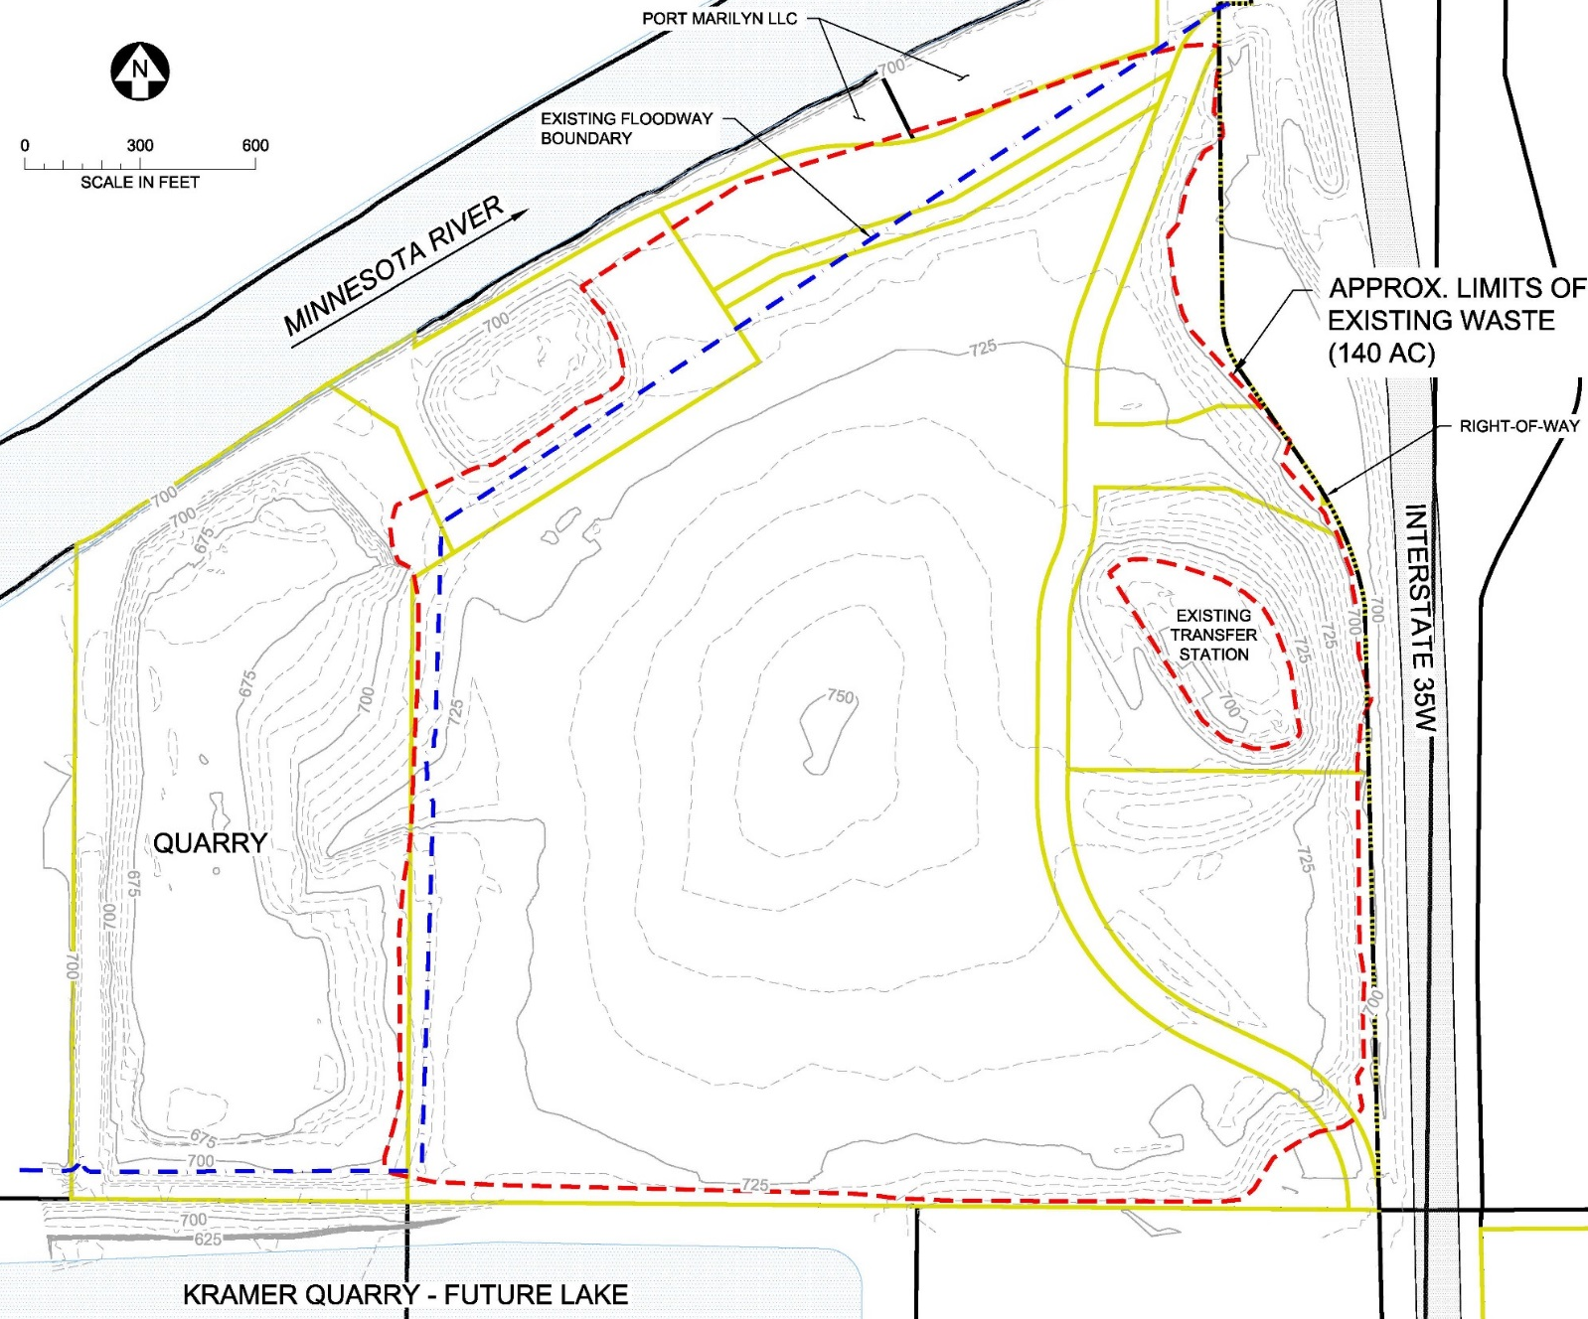
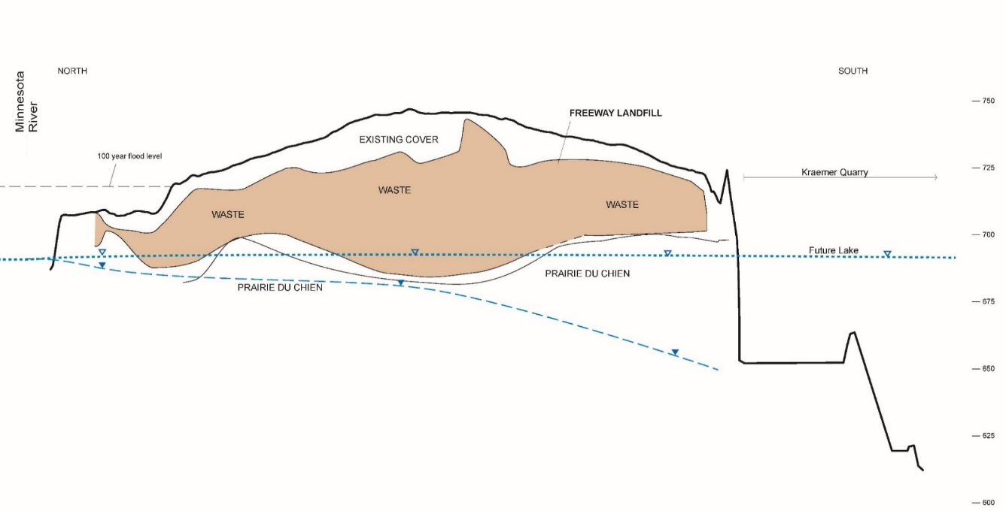
Existing Conditions
Landfill
Waste Area ~140 acres
Waste Volume ~5 million CY
Cross Section (N-S)

Slide 23
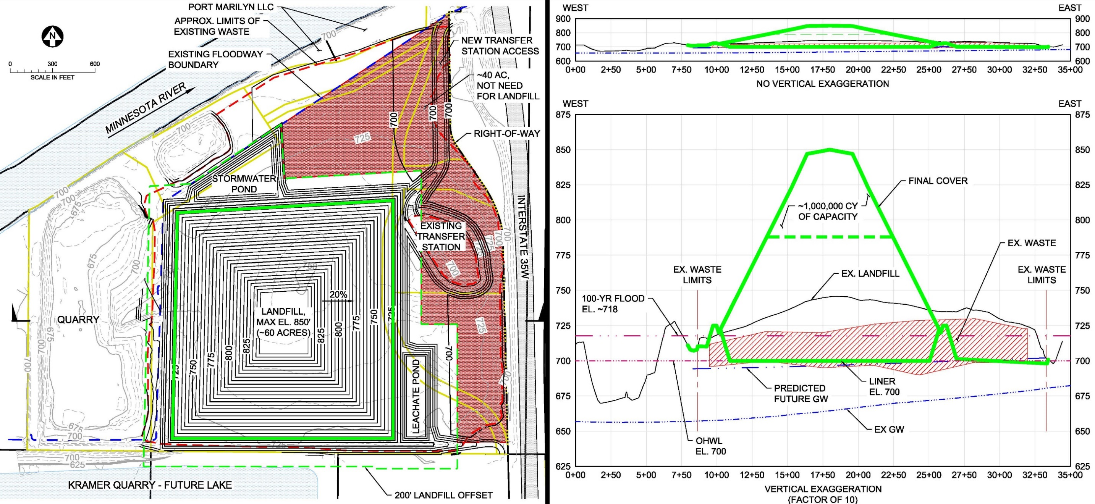
D&L Option 1: Smallest Footprint (Tallest)

Slide 24
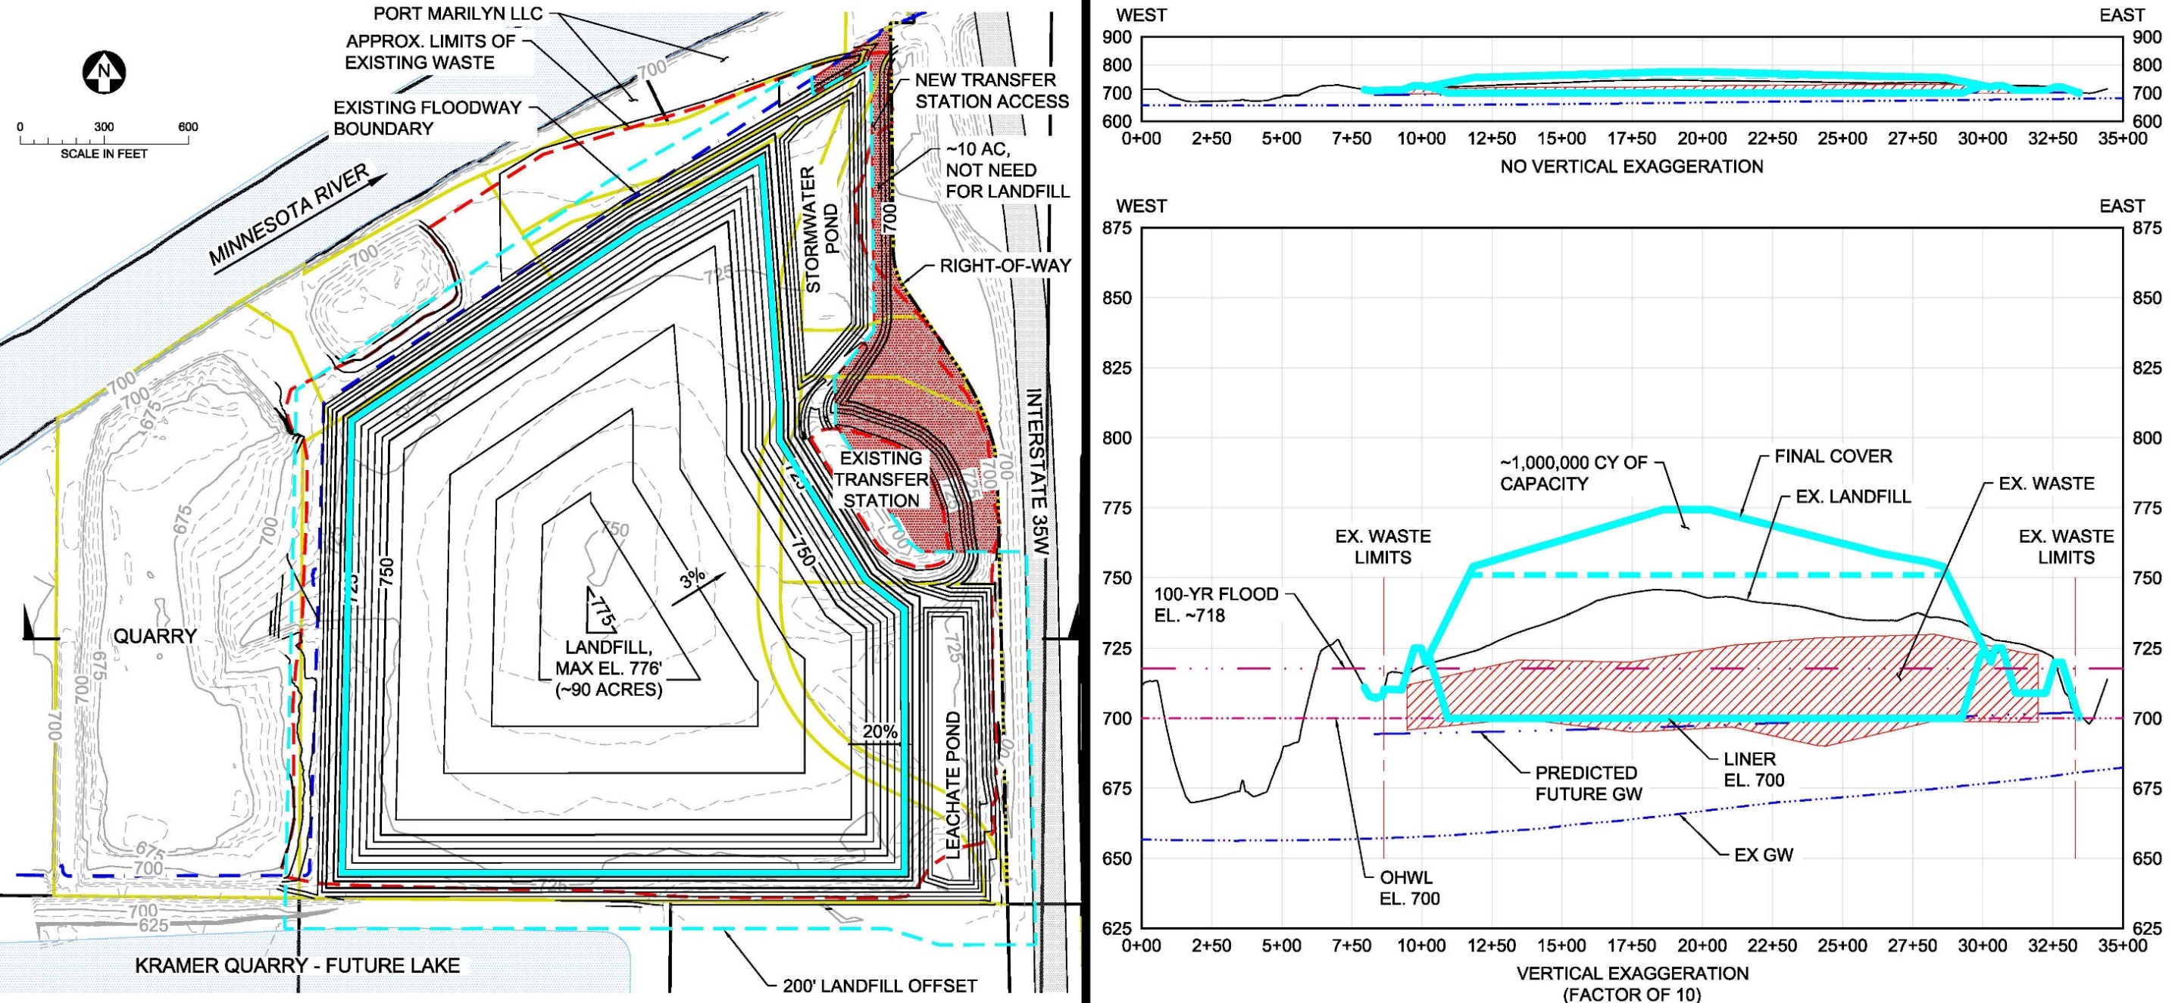
D&L Option 2: Lowest Height (Smallest Development Area)
Objectives
Confirm extent of waste
Evaluate conditions adjacent to potential receptors

Slide 25
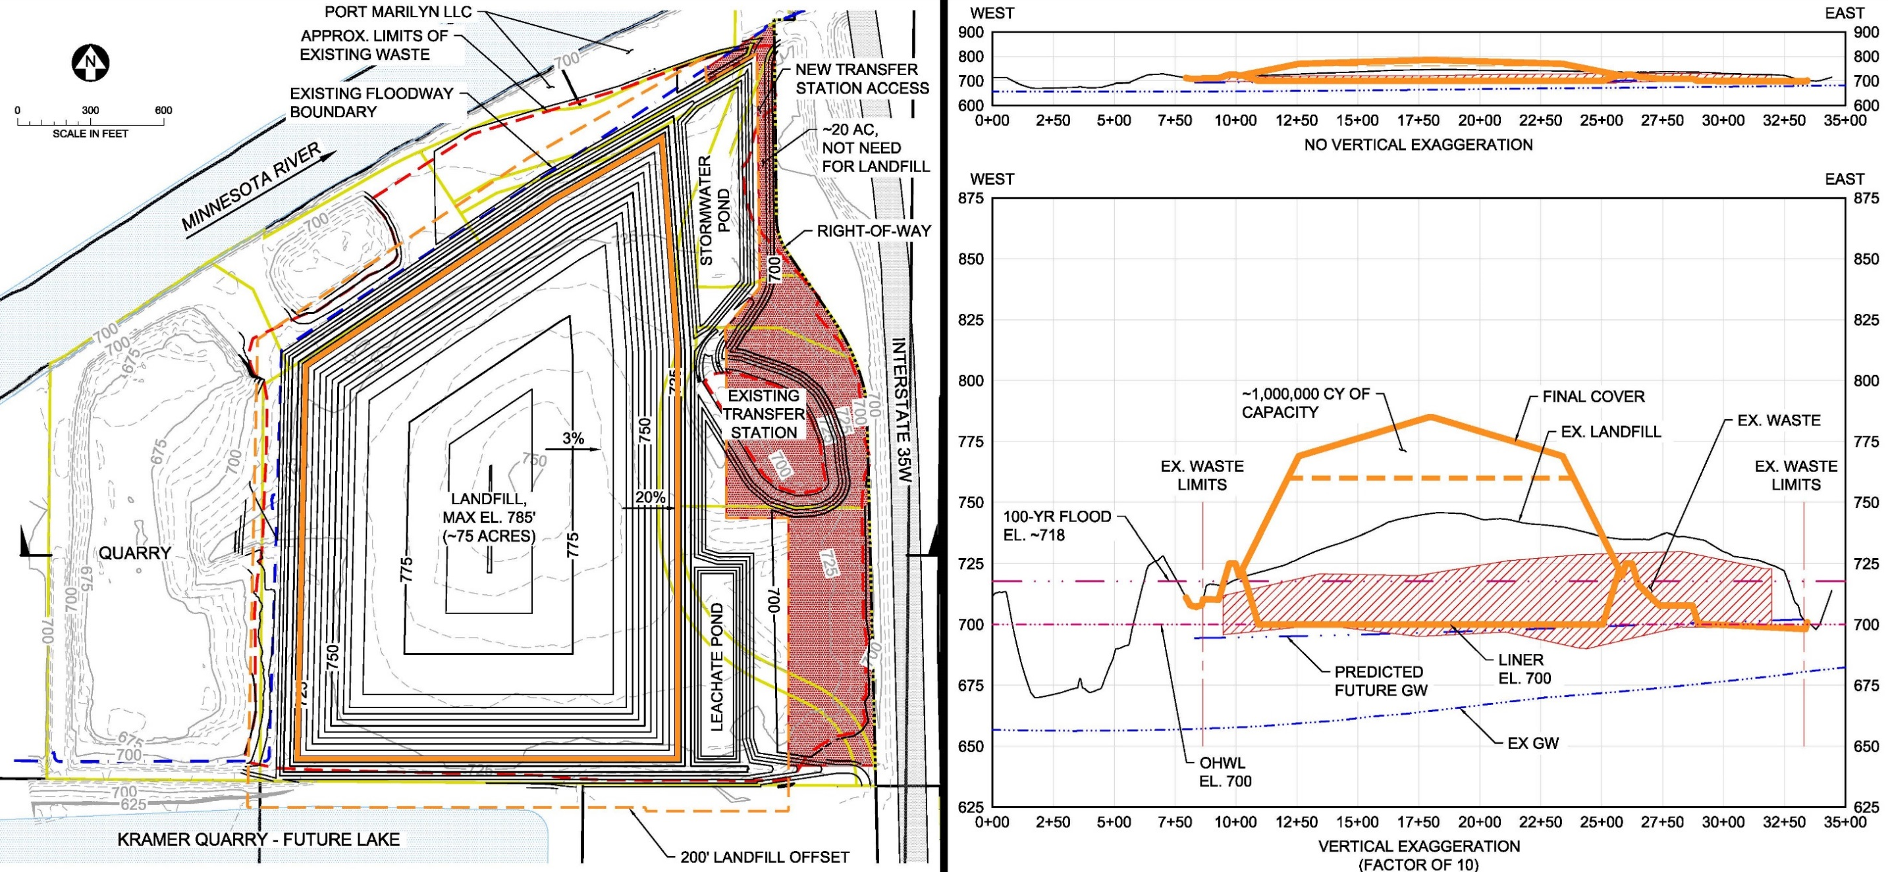
D&L Option 3: Balanced (Hybrid of 1 and 2)
Objectives
Confirm extent of waste
Evaluate conditions adjacent to potential receptors

Slide 26
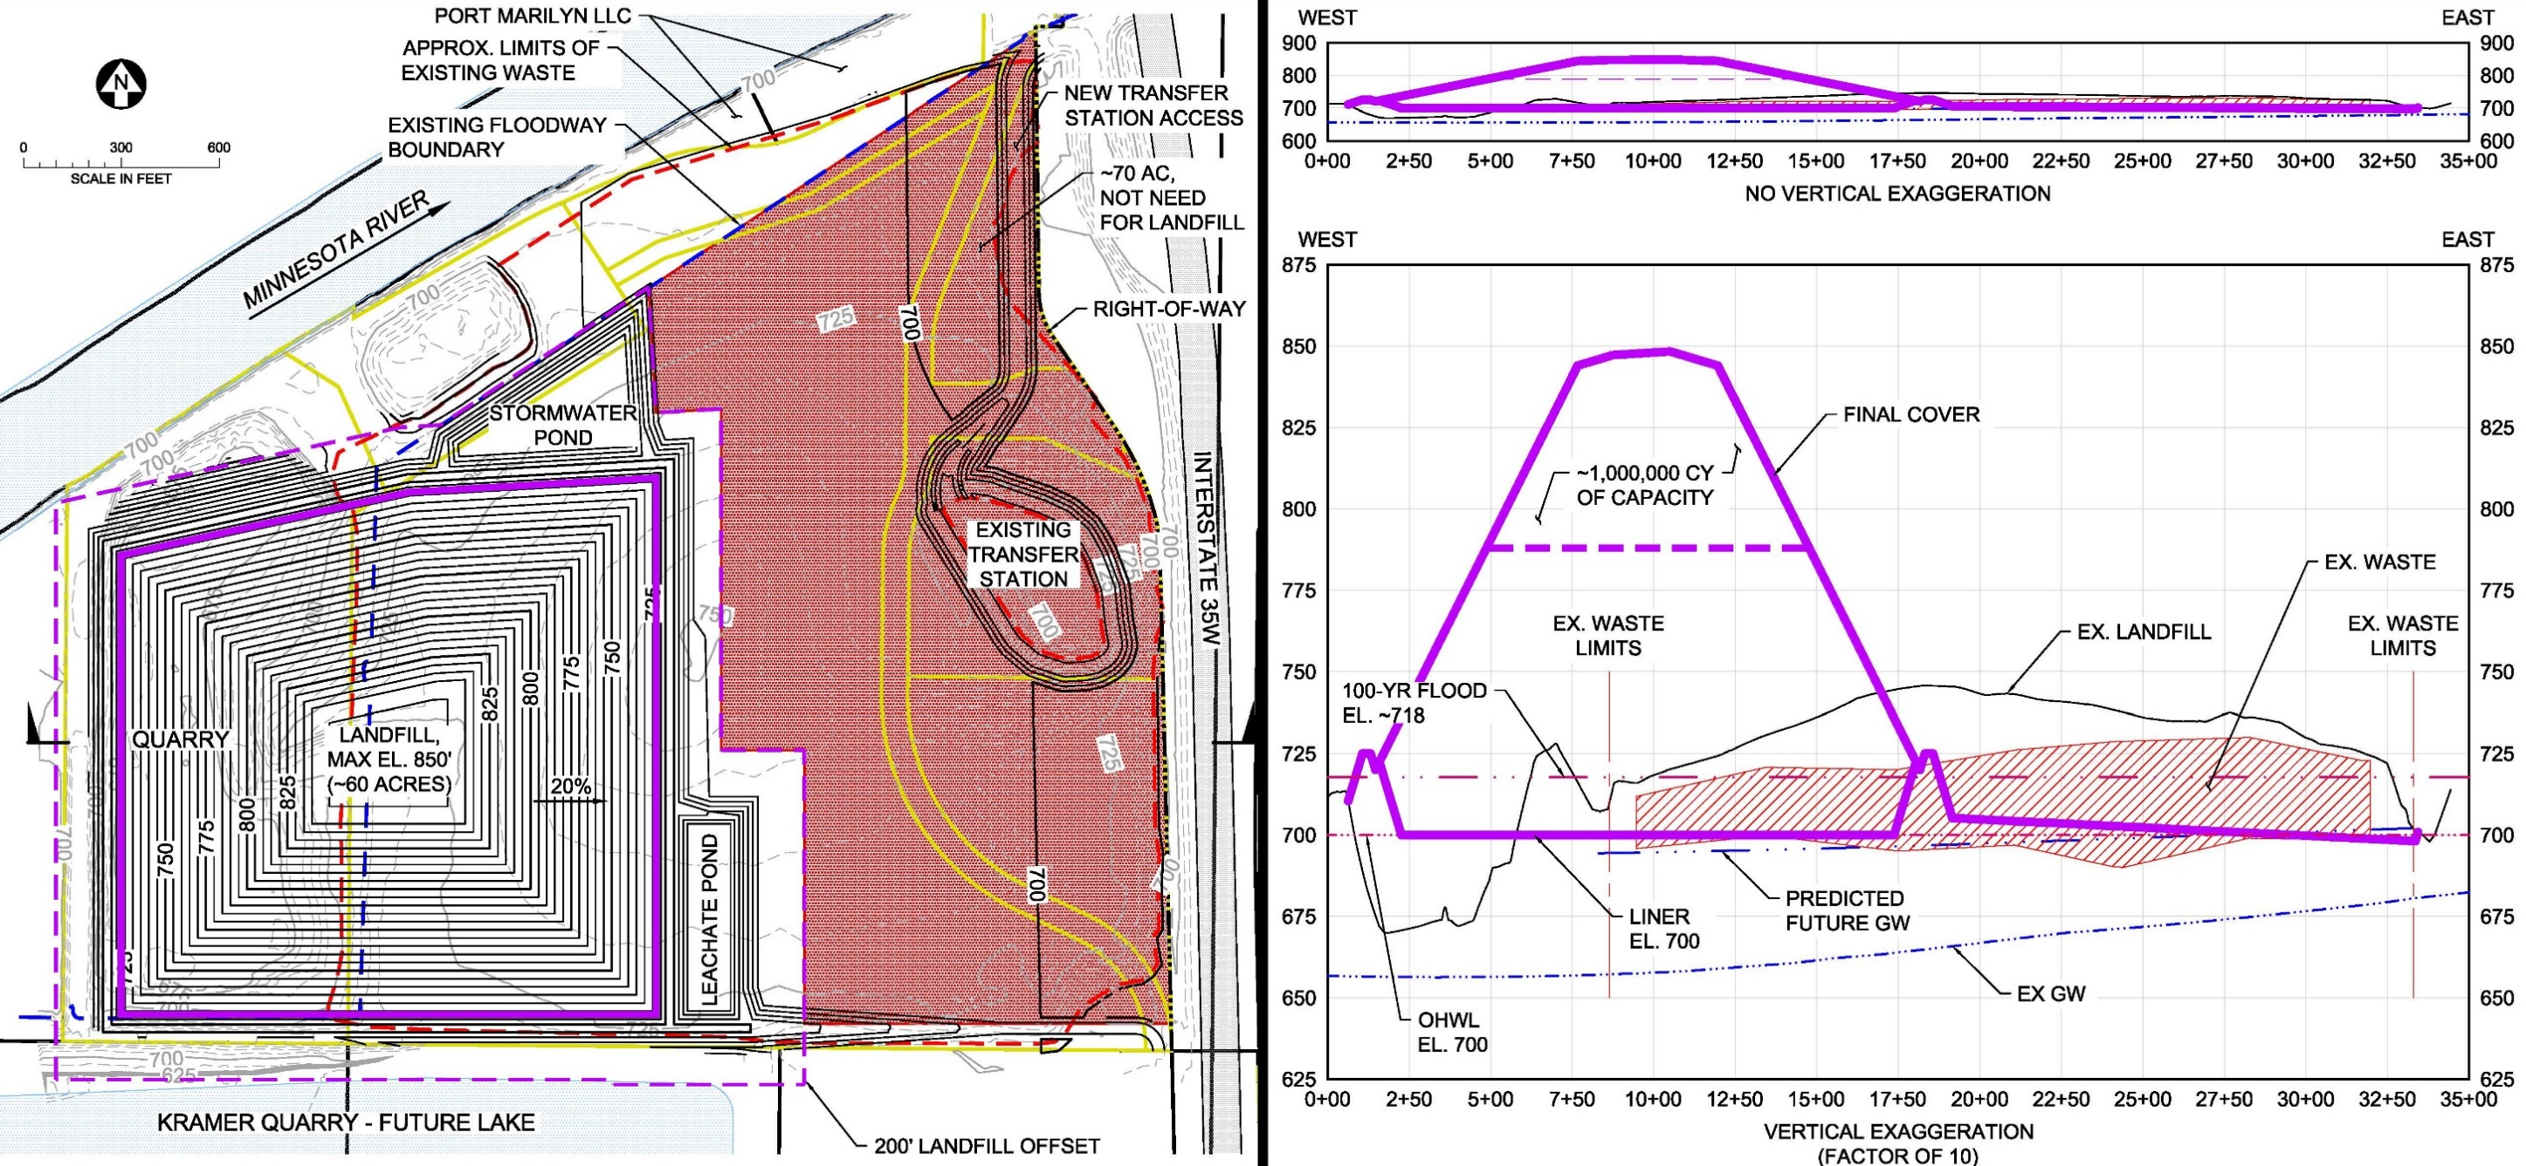
D&L Option 4: Expand West (Largest Development Area)

