Slide 1
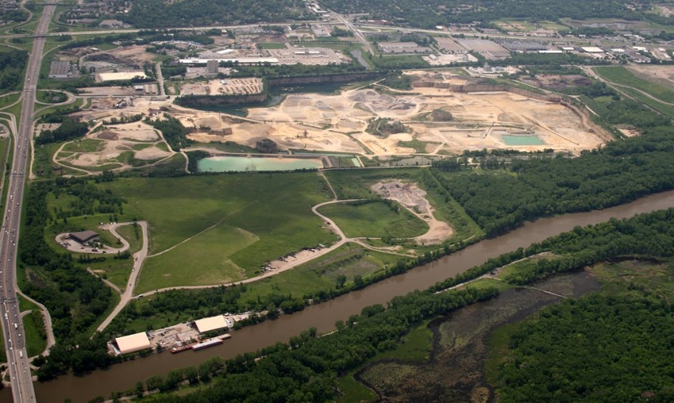
Freeway Landfill/Dump Summary
Dakota County Physical Development Committee
February 11, 2020

Slide 2
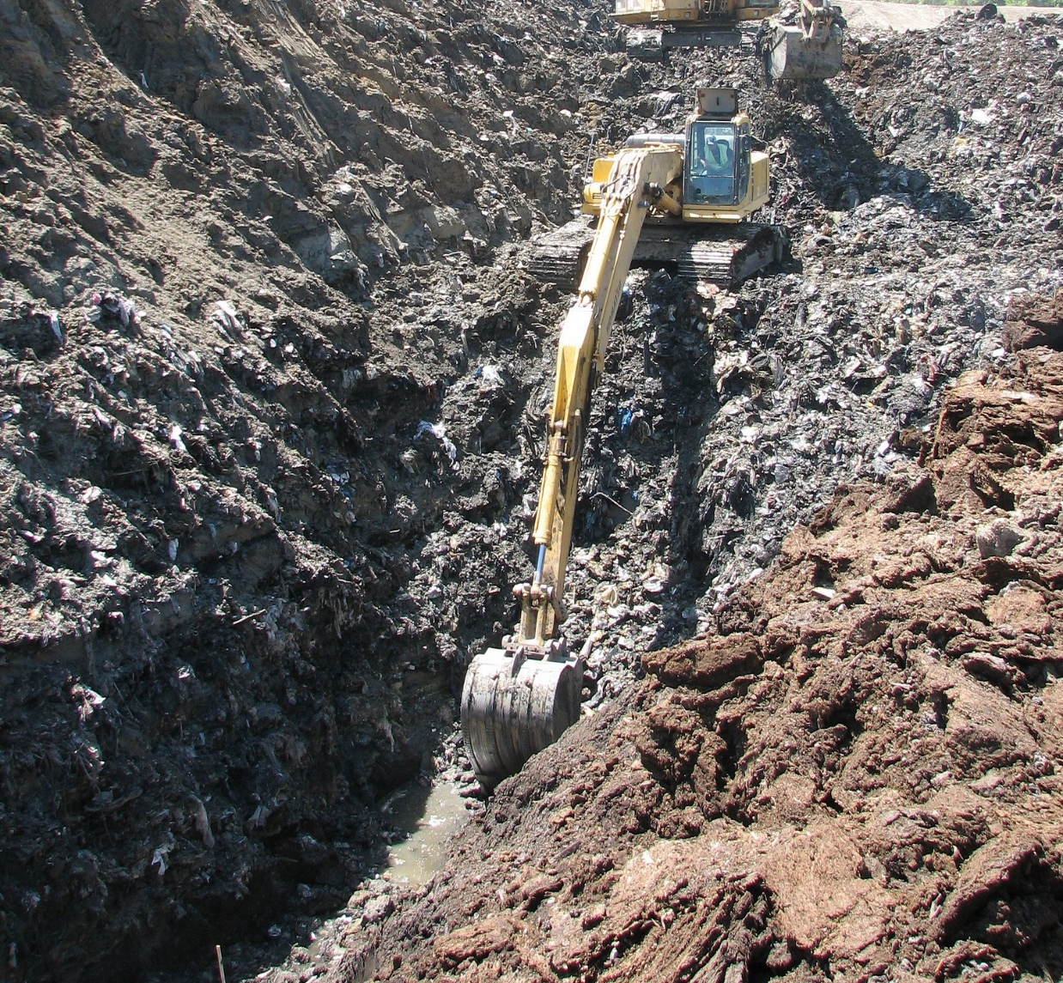
Three approaches to handling pollution
Prevent it
Manage it
Clean it up
Notes:
We address our mission from three different perspectives:
Pollution prevention means eliminating waste and pollution at its source. For example, our small business environmental assistance program helps companies reduce costs and increase efficiency. Another example is training road salt applicators to help prevent chloride pollution.
Managing pollution is the bulk of our work – which we accomplish through our water and air permits and the traditional regulation framework. But we also help manage pollution through efforts such as:
Capital Assistance Program projects and grants to local government for setting up infrastructure for recycling and waste reduction
Training for wastewater treatment plant operators to ensure proper management of municipal wastewater.
Cleaning up Past Pollution is key to protecting and enhancing human health. We do this in may ways, most visibly:
Closed Landfill Program
Superfund Program

Slide 3
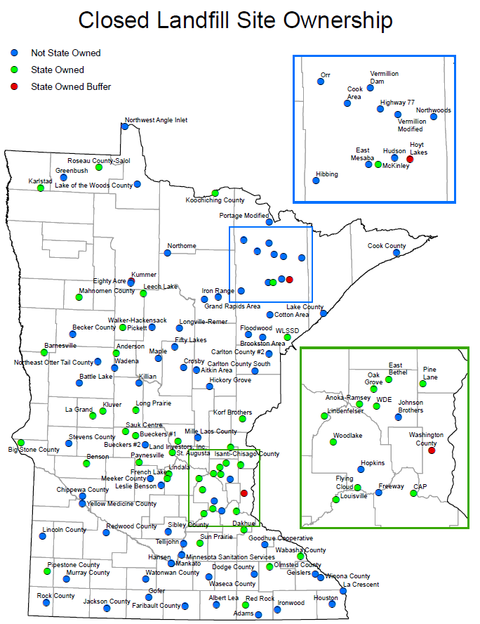
Closed Landfill Program
The Legislature created the Closed Landfill Program in 1994.
MPCA is responsible for managing closed landfills that were permitted to hold mixed municipal solid waste that are enrolled in the program.
Goal: Mitigate risks to the public and the environment.
Today: 110 enrolled closed landfills statewide. Freeway Landfill entered into program in 2017.
Notes:
GRETA
Please see handout titled “Closed Landfill Site Ownership”
We manage each of these 110 landiflls by: (114 eligible)
monitoring environmental impacts and site conditions at each landfill
determining the risk each landfill poses to public health, safety and the environment
implementing cleanups and maintaining landfill covers, caps and property
working with local governments to incorporate land-use controls at and near the landfills to protect human health and safety,
measuring how well the CLP is managing the risk at the landfills
The MPCA is responsible for these Closed Landfills in perpetuity.

Slide 4
Closed Landfill Program Priorities
Closed landfills are scored based on:
  presence and degree of hazards at each site - groundwater, surface water, and methane gas
  conditions that exacerbate those hazards (fractured bedrock, drinking water impact)
  the likelihood the public will be exposed to those hazards (distance to wells, homes)
  other risk factors (volume of waste, history of trespass, etc.)
Numerical values are assigned to each of these risks and are totaled to calculate a site’s risk priority score.
This ranking process is completed annually. Freeway Landfill is currently the highest ranked site.
Notes:
Landfills are scored based on:
presence and degree of groundwater, surface water, and methane gas hazards at each site (based on monitoring data and field observations)
conditions that exacerbate those hazards (ex: fractured bedrock, aquifer used for drinking water, ability for methane to migrate)
the likelihood the public will be exposed to those hazards (number of and distance to wells and buildings)
other risk factors (ex. volume of waste, history of trespass, control of land uses)
Numerical values are assigned to each of these risks and are totaled to calculate a site’s risk priority score – landfills with high risk scores receive a high ranking or priority. (done annually)
In January 2017, risk scores ranged from 1 (lowest risk) to 50,605 (highest risk).

Slide 5
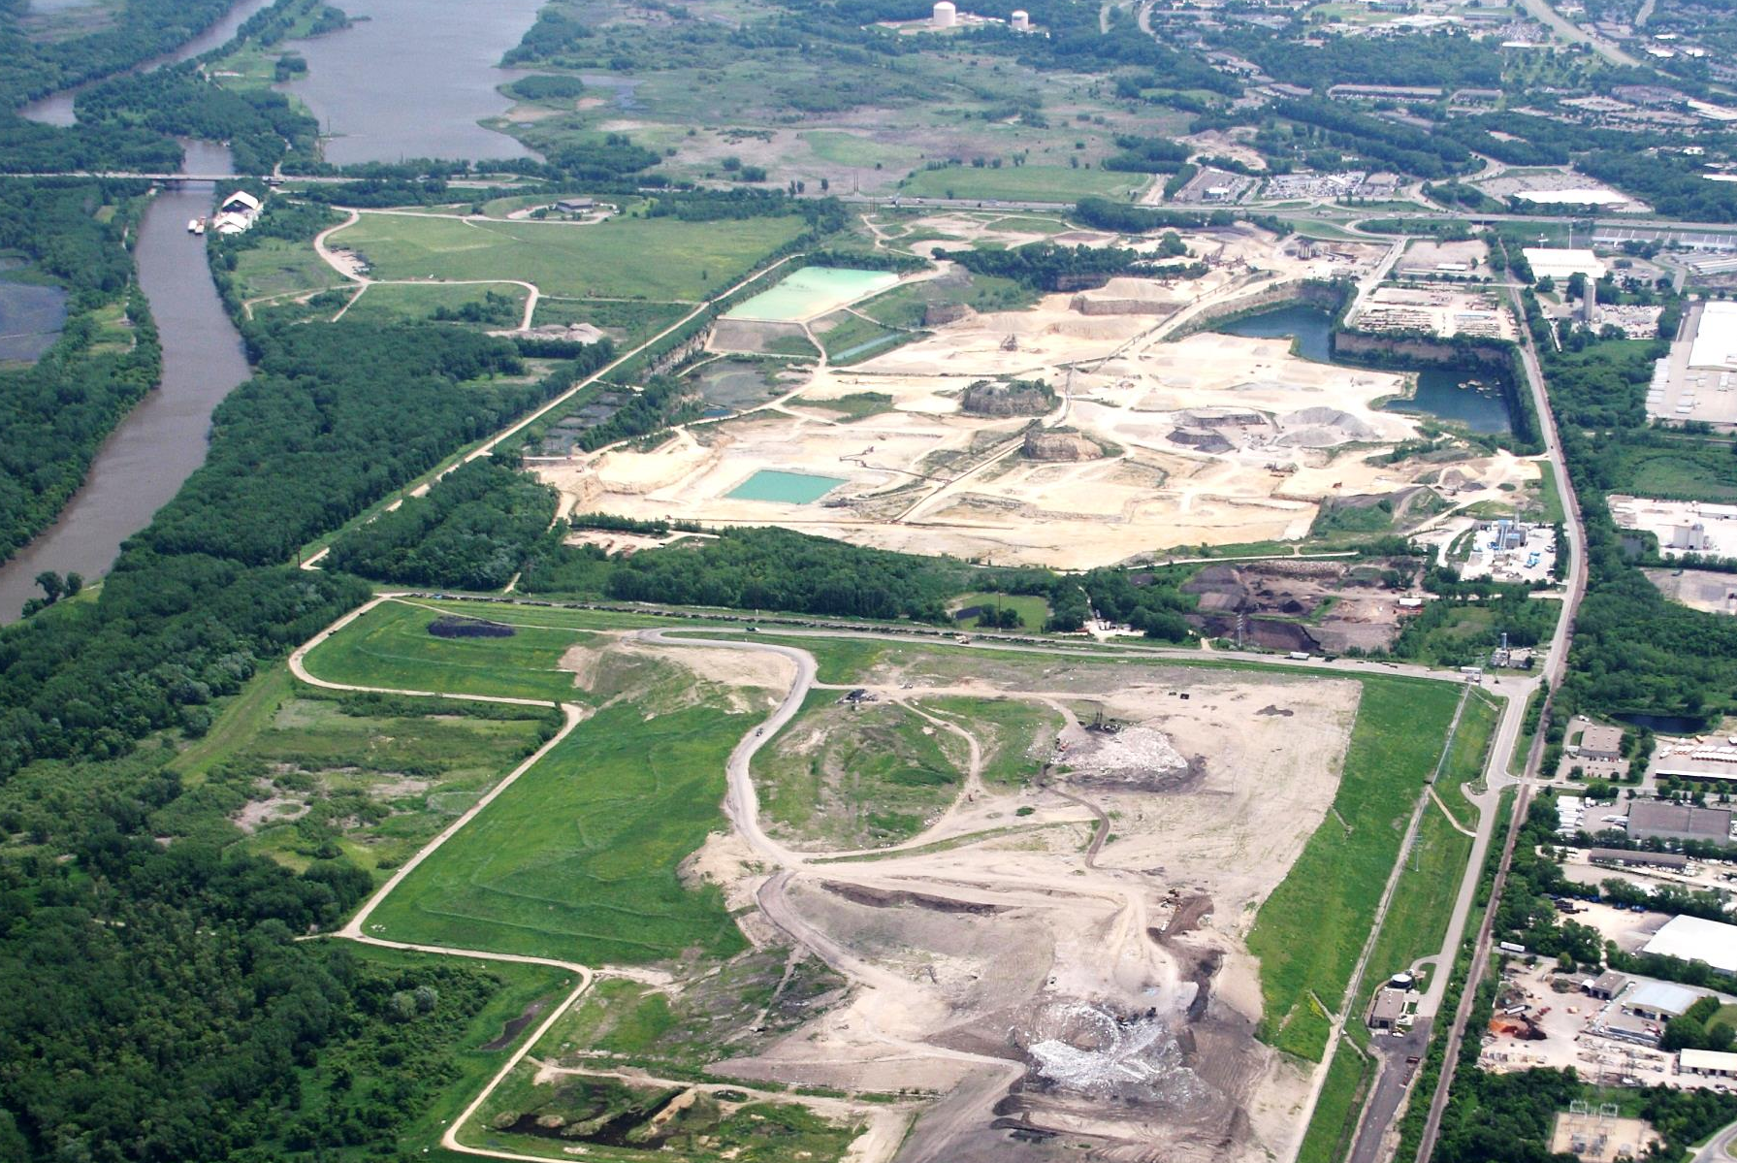
Freeway area at a glance
Freeway Landfill
Freeway Dump
Burnsville Drinking Water Supply Area
Bloomington
Burnsville
Kraemer Quarry
Burnsville Landfill
(Waste Management)
Notes:
Landfills are scored based on:
presence and degree of groundwater, surface water, and methane gas hazards at each site (based on monitoring data and field observations)
conditions that exacerbate those hazards (ex: fractured bedrock, aquifer used for drinking water, ability for methane to migrate)
the likelihood the public will be exposed to those hazards (number of and distance to wells and buildings)
other risk factors (ex. volume of waste, history of trespass, control of land uses)
Numerical values are assigned to each of these risks and are totaled to calculate a site’s risk priority score – landfills with high risk scores receive a high ranking or priority. (done annually)
In January 2017, risk scores ranged from 1 (lowest risk) to 50,605 (highest risk).

Slide 6
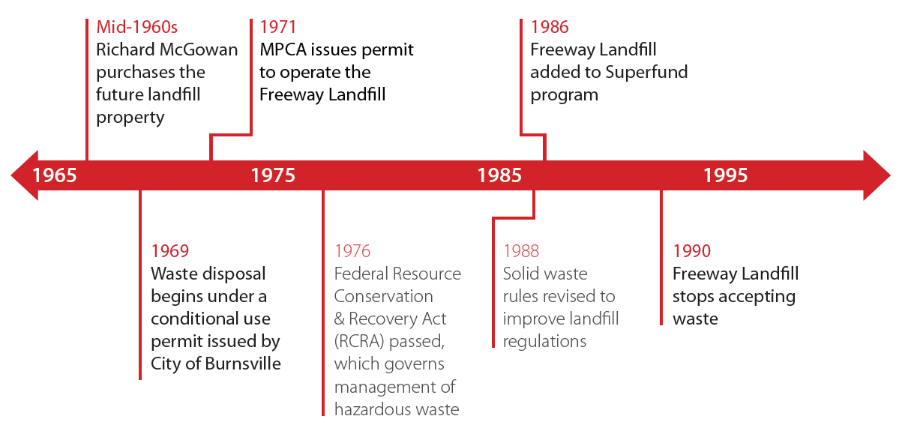
History of Freeway Landfill
Notes:
This is the timeline history for the Freeway Landfill.

Slide 7
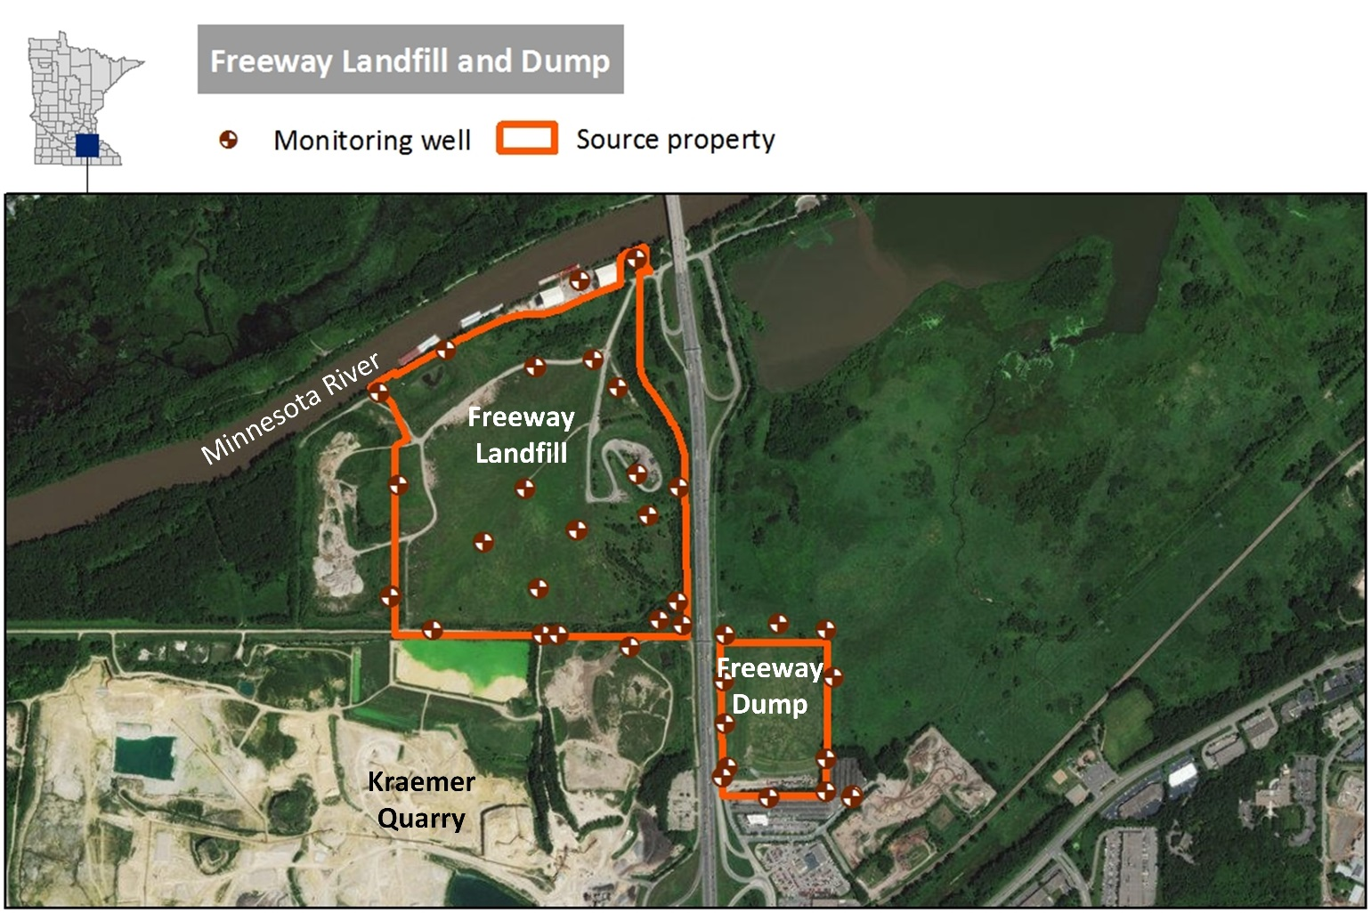
Freeway Landfill & Dump
Freeway Dump
  Operated 1961-71
  34 acres of waste
  760,000 cubic yards waste
Freeway Landfill
  Permitted for waste 1969-90
  140 acres of waste
  5.3 million cubic yards waste
Both are unlined
Located above drinking water source for Burnsville and Savage
Built on former wetland south of and adjacent to Minnesota River
Notes:
Burnsville City Well Field and Kramer Quarry
Burnsville water is drawn from a wellfield and is also from Kramer Quarry dewatering. Testing of these sources of water found low levels of two chemicals. The two chemicals belong to a class of PFAS chemicals. The two PFAS chemicals were found in both the well field and water from the quarry. These are low level detections, they are well below drinking water guidance values and are considered background concentrations. It is also important to note that the water was tested at the wells, not at a drinking water tap after going through the distribution system.
Contamination in Groundwater under Freeway Landfill and Freeway Dump
The list of chemicals comprising the chemical contamination found in groundwater below the Freeway Landfill and Dump is a much longer list. As we would expect for contamination in groundwater beneath an unlined landfill, the list of contaminants includes a wide range of different chemicals including PFAS chemicals, volatile organic compounds and metals. Some of the chemicals are present in amounts 100 to 1000 times what would be acceptable for drinking water.

Slide 8
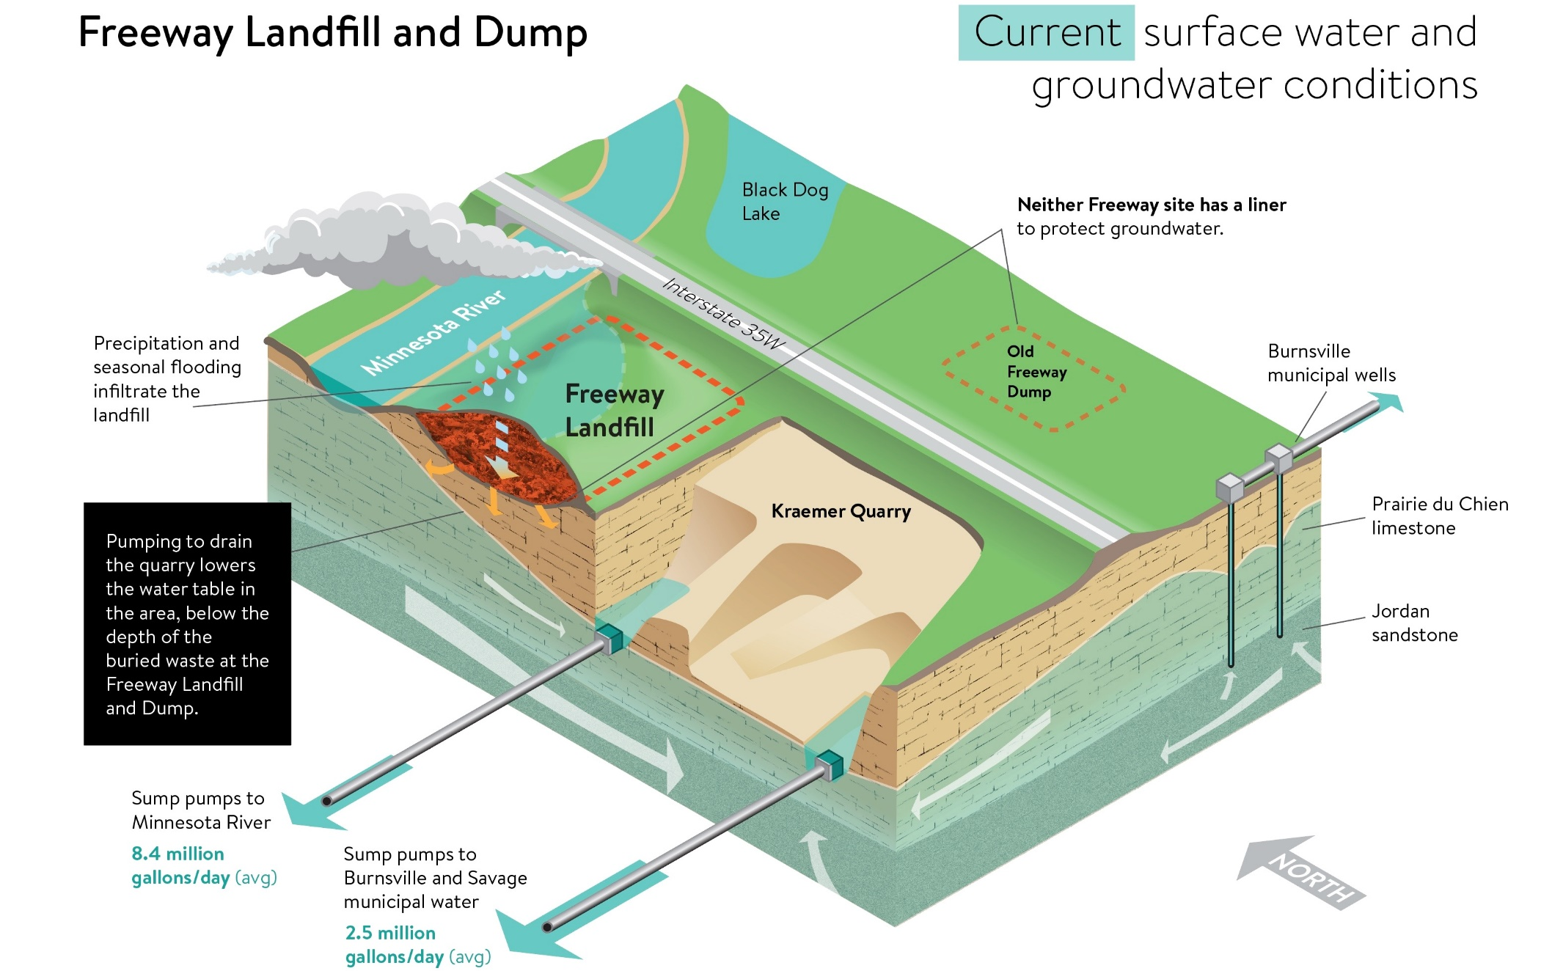
Notes:
The next few slides will talk about the groundwater flow at the landfill site.
Slide is current conditions with Kraemer Quarry pumping for their dewatering actions.
Again, north is to the top left.
Currently the waste is not in groundwater - Kraemer’s dewatering operations between what is discharged to the river and what is used by the Cities of Burnsville and Savage lower the groundwater to prevent the waste from being in the water.
However, as rain infiltrates the ground and during seasonal flooding, water runs through the waste and it is suspected that the groundwater directly in the vicinity of the landfill and dump is contaminated from the waste. We are currently completing an investigation to confirm this.
We have sampled the City’s water intake at Kraemer’s Quarry and the nearby municipal wells and there was no contamination found at this time.

Slide 9
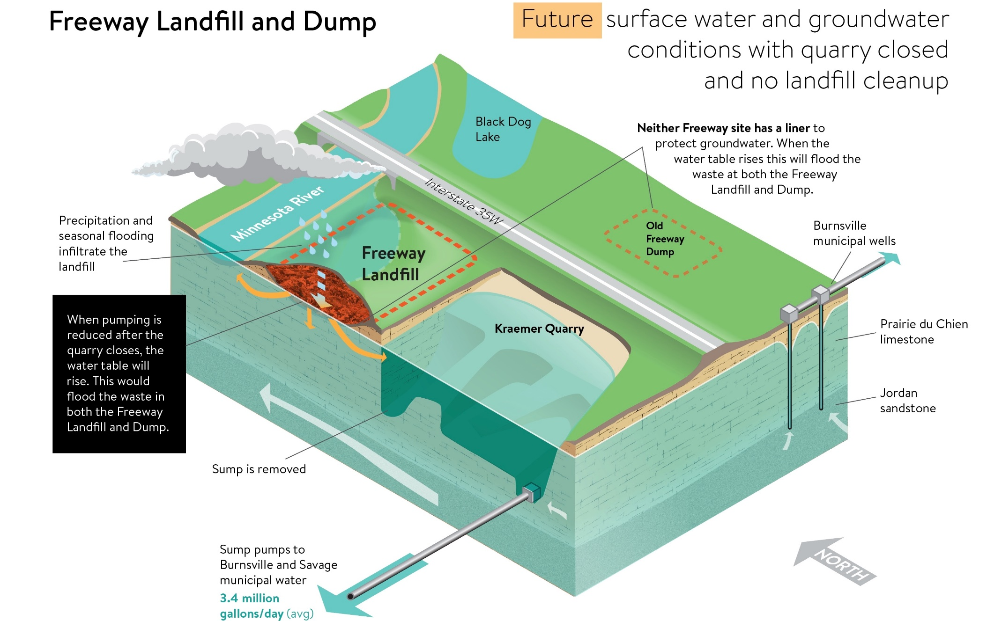
Notes:
This second slide shows the future condition based on modeling. Once Kreamer Quarry stops pumping, the water table will rise to form the Quarry Lake.
Burnsville and Savage will still be getting their water from the quarry lake with Burnsville supplementing their drinking water source with municipal wells south of the Dump.
The waste and BOTH the landfill and Dump will be in direct contact with the groundwater at this time.
There will continue to be rain water infiltration and seasonal flooding as well that will create more movement in the contamination during certain times of the year.
As such, the contamination at the Freeway Dump and Landfill will move towards:
The Minnesota River
The Quarry Lake and the Burnsville and Savage drinking water intake; and
The Burnsville municipal wells south of the Freeway Dump.

Slide 10
Funding History
Funding History 2017
$3 million appropriated from Closed Landfill Investment Fund (CLIF)
Available through FY2021
Funds for investigation and design

Slide 11
Results of 2018 Investigation
Methane detected above the lower explosive limit
Contamination in groundwater above health values for:
  1,4-Dioxane
  PFAS
  VOCs
  Metals
Contamination above surface water criteria:
  VOCs
  Metals
Notes:
Burnsville City Well Field and Kramer Quarry
Burnsville water is drawn from a wellfield and is also from Kramer Quarry dewatering. Testing of these sources of water found low levels of two chemicals. The two chemicals belong to a class of PFAS chemicals. The two PFAS chemicals were found in both the well field and water from the quarry. These are low level detections, they are well below drinking water guidance values and are considered background concentrations. It is also important to note that the water was tested at the wells, not at a drinking water tap after going through the distribution system.
Contamination in Groundwater under Freeway Landfill and Freeway Dump
The list of chemicals comprising the chemical contamination found in groundwater below the Freeway Landfill and Dump is a much longer list. As we would expect for contamination in groundwater beneath an unlined landfill, the list of contaminants includes a wide range of different chemicals including PFAS chemicals, volatile organic compounds and metals. Some of the chemicals are present in amounts 100 to 1000 times what would be acceptable for drinking water.

Slide 12
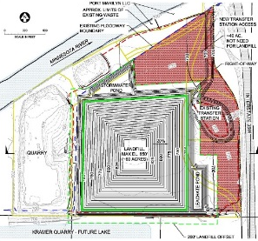
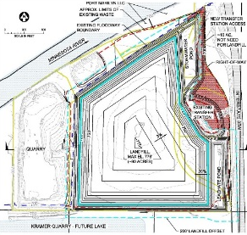
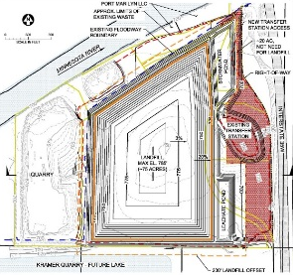

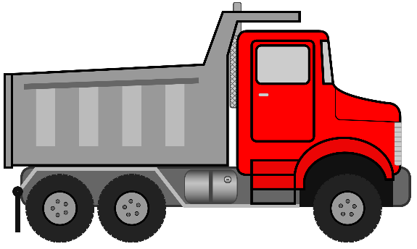
Conceptual Design Options
Build a Modern Landfill on Property
“Dig and Line” (3 designs)
  Smallest Waste Footprint
  tallest
  Lowest Landfill Height
  largest landfill footprint
  smallest development area
  Balance
  of height
  and footprint
Move the Waste to Another Landfill
“Dig and Haul”

Slide 13
Option Comparison (Preliminary)
Concept Option | Landfill Footprint on property | Potentially Available Acres on property (Acres) Not Wetland and No Waste | Maximum Cover Elevation (feet) | Current Cost Estimate (in millions) | Additional Cost for Enhanced Liner (in millions)
No Action Not Protective | 166 Acres | - | 750’ | $1 | -
Smallest Footprint (Tallest) | 60 Acres | 40 Landfill 12 Dump | 850’ | $68-110 | $3-8
Lowest Height (Smallest Development Area) | 90 Acres | 10 Landfill 12 Dump | 778’ | $86-139 | $4-12
Balanced (Hybrid) | 75 Acres | 25 Landfill 12 Dump | 785’ | $77-126 | $3-10
Dig and Haul (Low Range) | 0 Acres | 100 Landfill 12 Dump | N/A | $145-235 | N/A
Dig and Haul (High Range) |  |  |  | $489-795 | N/A
Cost estimate represents American Association of Cost Estimators Class 4 classification (-20% to +30%) for a project less than 30% complete.
Estimates for dig and line options assume a traditional municipal solid waste facility liner.
Potentially available area is based on 700’ fill elevation likely 42 acres of wetland (16 acres dump, 26 acres Landfill). Existing transfer station is 12 acres.
Total waste area is 174 acres, 8 acres are outside the property boundaries- two acres at Landfill and six acres at Dump

Slide 14
Path Forward
Superfund Feasibility Study
Bottom Liner Designs
Three Dig and Line designs
Dig and Haul to an existing landfill
Access
Bid Two Cleanup Plans
Bid Dig and Haul
Bid Dig and Line
Funding Bill
Construction
Standard liner option
Enhanced liner option
Obtain access to property for cleanup
Legislation funds one cleanup plan
Bid bottom liner enhancement for Dig and Line
3 or 4 year construction project depending on bottom liner design
Public Meeting
Arrive at one Dig and Line design
Keep Dig and Haul option

Slide 15
Schedule
1. Superfund Feasibility Study
Draft Investigation/Feasibility Study June 2019
Final Investigation/Feasibility Study Aug 2019
EPA Feasibility Study Approval Oct 2019
2. Property Access
Work on property access Oct 2019
Need access before construction
3. Design
30% Remedial Design Dec 2019
60% Remedial Design Mar 2020
Public Meeting Apr 2020
Interim Record of Decision (ROD) Aug 2020
Final Design Plans and Specifications Sept 2020
4. Permitting
Pre-Construction Permit Approval Sept 2020
5. Bidding
Bidding Document Posted Oct 2020
Construction Bids Received Dec 2020
6. Legislative Process to Fund Project
Funding Bill 2021 Session
7. Construction
Construction Start Spring 2021
Construction Complete Summer 2024
or 2025

Slide 16
Decisions to go before the Legislature
Level of funding provided by Legislature will determine what option is pursued.
  The feasibility study covers the leading options. MPCA will only put forward projects to the Legislature that are protective of human health and the environment.
Funding source will determine what can be done on the property afterwards.
  General obligation bonds: 37.5 year restriction on revenues generated from property use
  Taxable bonds (general, revenue or appropriation bonds) – potential increased cost and ownership interest still needed
Financial benefits: Will those that benefit from the cleanup contribute?
Notes:
There may be some ways to partially offset expenses
Cover the cleanup costs
Tax increment financing
Use fees (e.g. aggregate fees)
Windfall lien

Slide 17
Questions?

Slide 18

Dig and Line- Smallest Footprint (tallest)

Slide 19
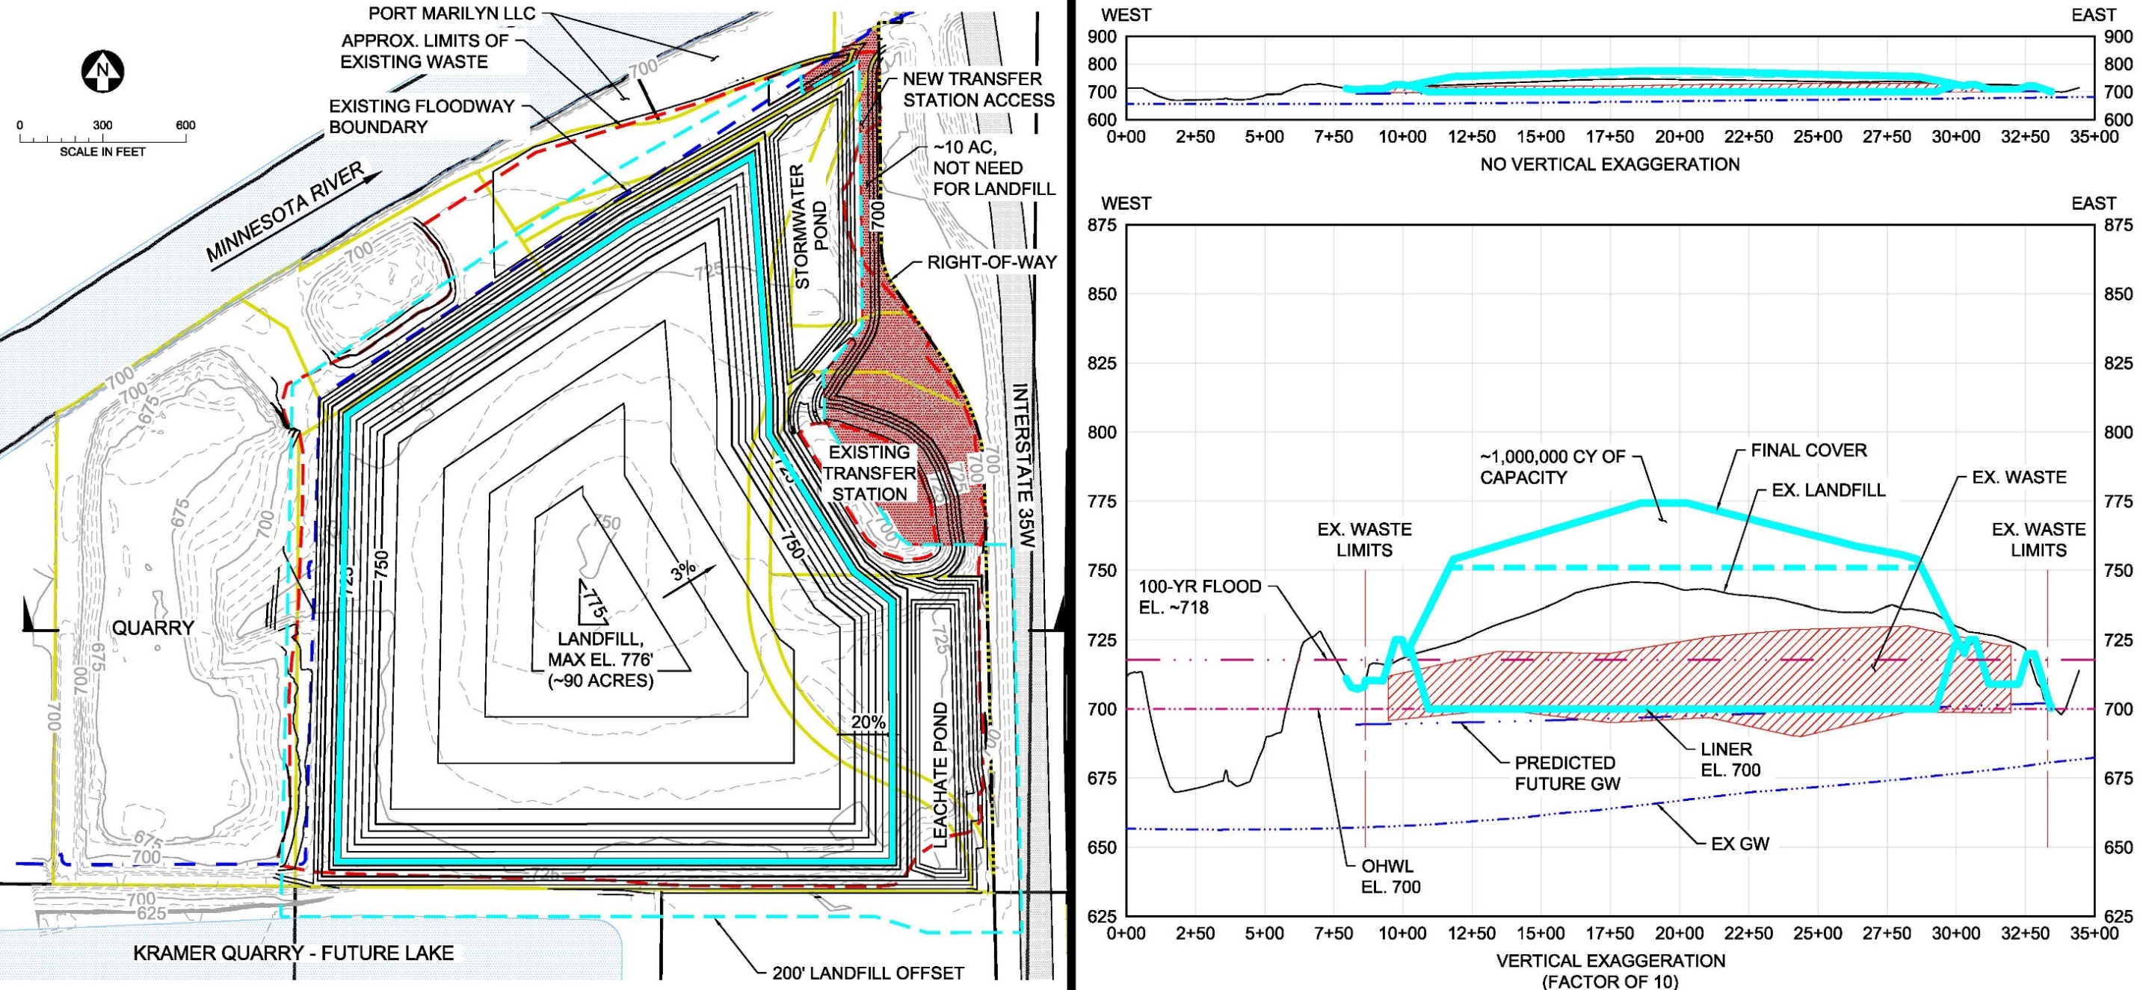
Digg and Line- Lowest Height (smallest development area)

Slide 20
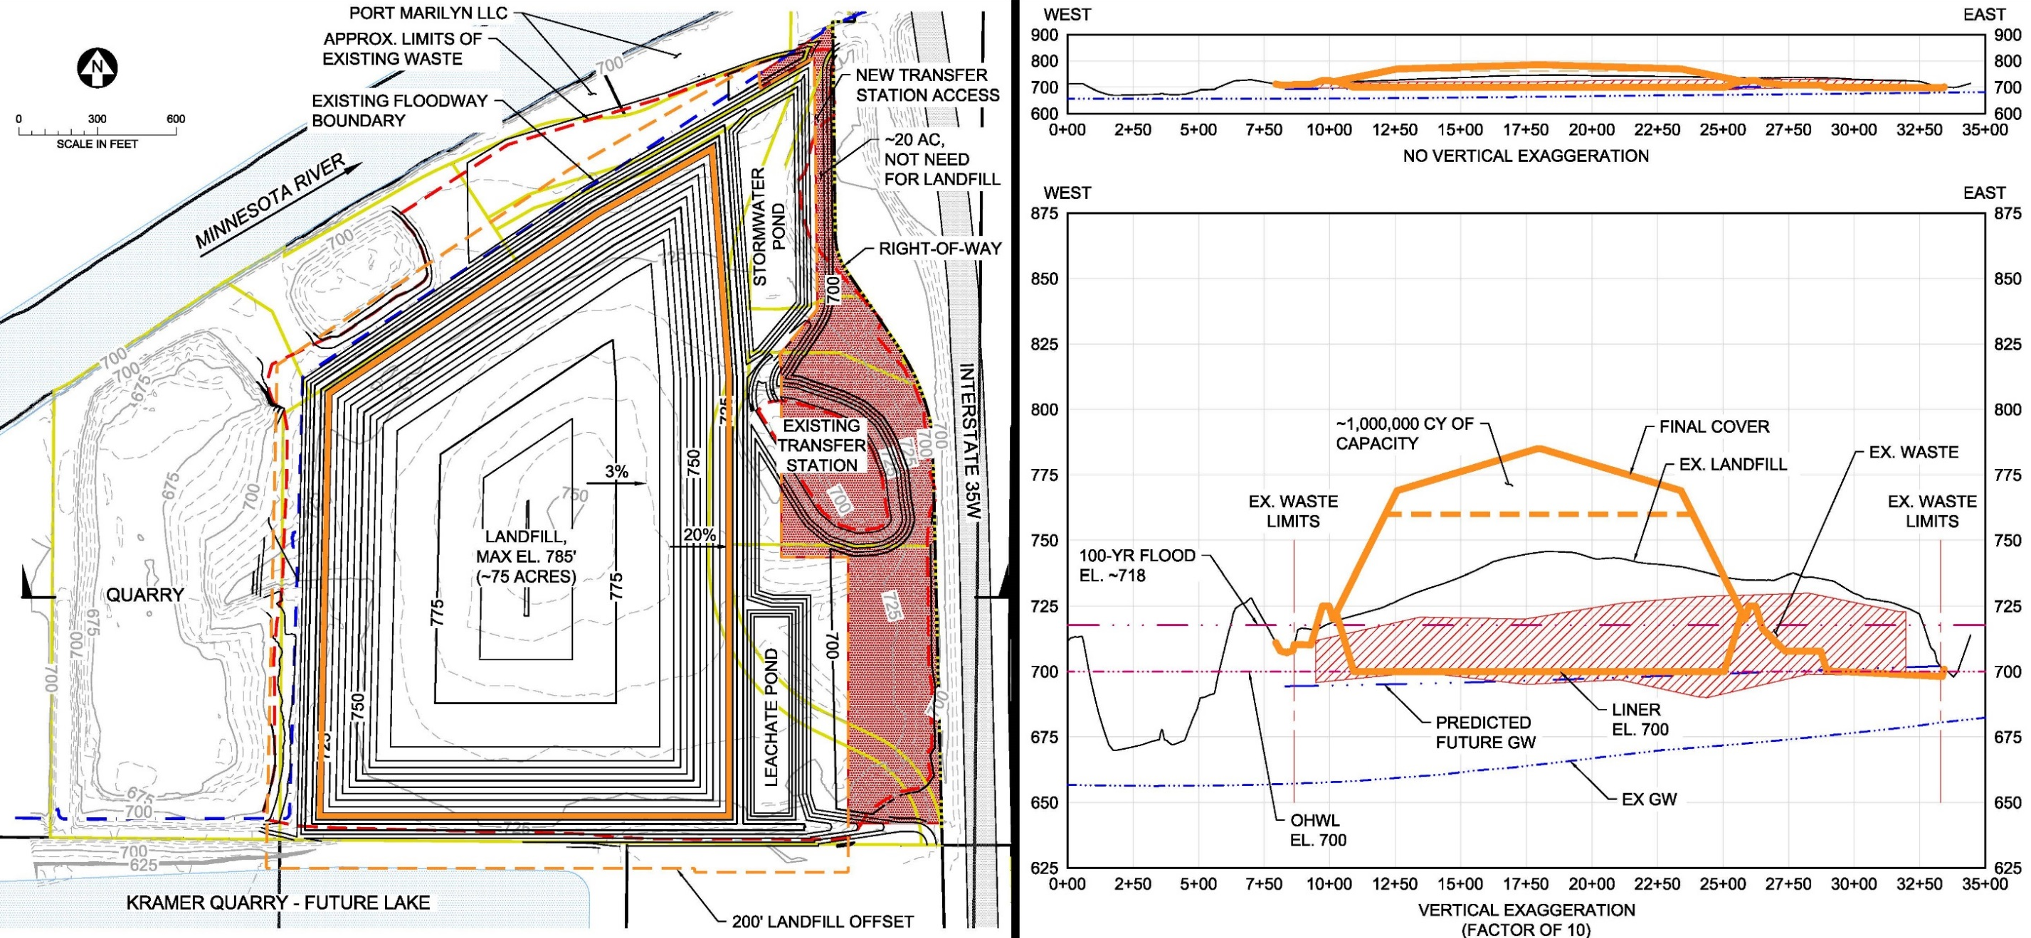
Dig and Line- Balanced (hybrid option)

Slide 21
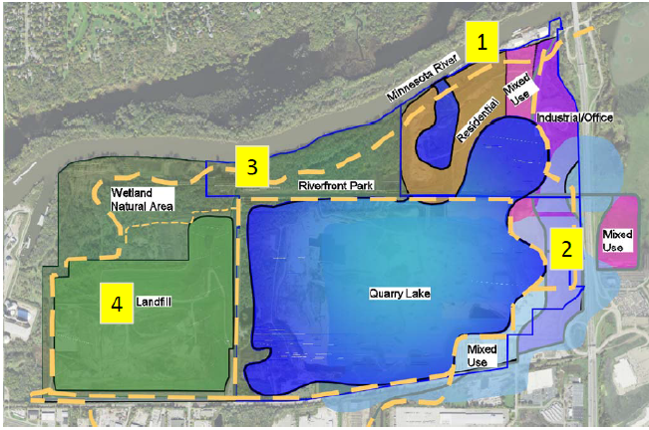
Dig and Haul
Slide From City of Burnsville
One Vision for Redevelopment
presented to
Burnsville Planning Commission
Waterfront residential/ mixed use development
Commercial/Industrial Development
Open space, parks, trails, connecting public to riverfront and quarry lake
Landfill

Slide 22
Final Height Comparison
Slide From Dakota County
Elevation 720 feet
Notes:
All current options allow for transfer station to remain.
Height listed includes Freeway Dump.
Waste Management Burnsville Landfill Height = 814’

