Slide 1
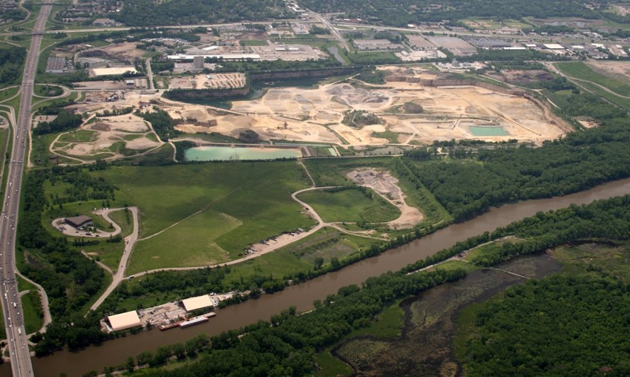
Freeway Landfill/Dump Design Options
April 23, 2020
Notes:
Freeway Landfill/Dump (20 minutes presentation/10 minutes Q&A)
History of the site as a landfill and with the closed landfill program
What is the current environmental condition and future concern for the site
What options are we looking at to address the issue, “dig and line” and “dig and haul,” and what is the timeline
What are the benefits, drawbacks, and uncertainties for the options
What is the role for the city (e.g. decision on host fees, continue to work together, support for dollars amount and source, if they do not want bonding)

Slide 2
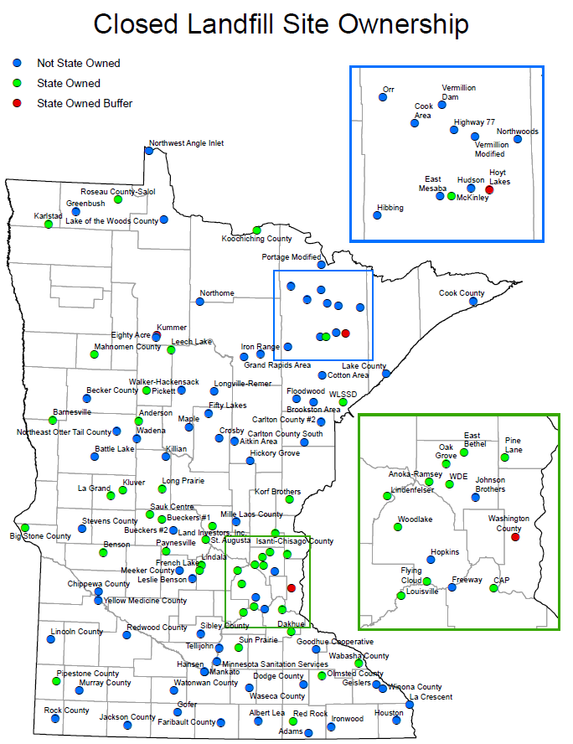
Closed Landfill Program
The Legislature created the Closed Landfill Program in 1994.
MPCA is responsible for managing closed landfills that were permitted to hold mixed municipal solid waste that are enrolled in the program.
Goal: Mitigate risks to the public and the environment.
Today: 110 enrolled closed landfills statewide. Freeway Landfill entered into program in 2017.
Notes:
GRETA
Please see handout titled “Closed Landfill Site Ownership”
We manage each of these 110 landiflls by: (114 eligible)
monitoring environmental impacts and site conditions at each landfill
determining the risk each landfill poses to public health, safety and the environment
implementing cleanups and maintaining landfill covers, caps and property
working with local governments to incorporate land-use controls at and near the landfills to protect human health and safety,
measuring how well the CLP is managing the risk at the landfills
The MPCA is responsible for these Closed Landfills in perpetuity.

Slide 3
Closed Landfill Program Priorities
Closed landfills are scored based on:
  presence and degree of hazards at each site - groundwater, surface water, and methane gas
  conditions that exacerbate those hazards (fractured bedrock, drinking water impact)
  the likelihood the public will be exposed to those hazards (distance to wells, homes)
  other risk factors (volume of waste, history of trespass, etc.)
Numerical values are assigned to each of these risks and are totaled to calculate a site’s risk priority score.
This ranking process is completed annually. Freeway Landfill is currently the highest ranked site.
Notes:
Landfills are scored based on:
presence and degree of groundwater, surface water, and methane gas hazards at each site (based on monitoring data and field observations)
conditions that exacerbate those hazards (ex: fractured bedrock, aquifer used for drinking water, ability for methane to migrate)
the likelihood the public will be exposed to those hazards (number of and distance to wells and buildings)
other risk factors (ex. volume of waste, history of trespass, control of land uses)
Numerical values are assigned to each of these risks and are totaled to calculate a site’s risk priority score – landfills with high risk scores receive a high ranking or priority. (done annually)
In January 2017, risk scores ranged from 1 (lowest risk) to 50,605 (highest risk).

Slide 4
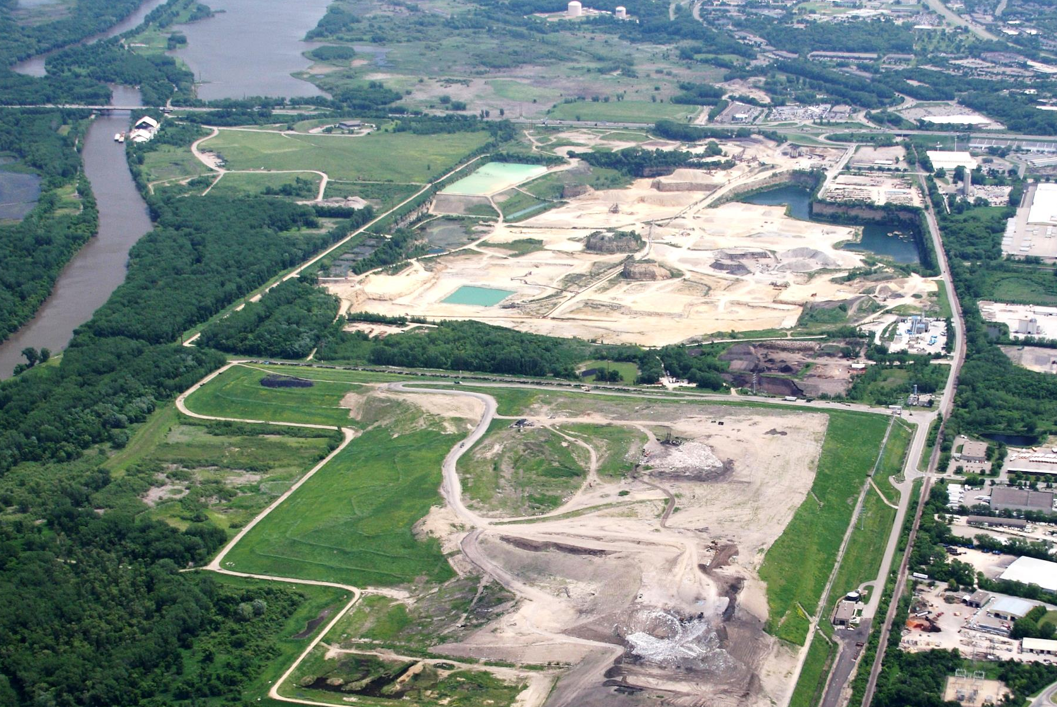

Area Overview
Freeway Landfill
Freeway Dump
Burnsville Drinking Water Supply Area
Bloomington
Burnsville
Kraemer Quarry
Burnsville Landfill
(Waste Management)

Slide 5
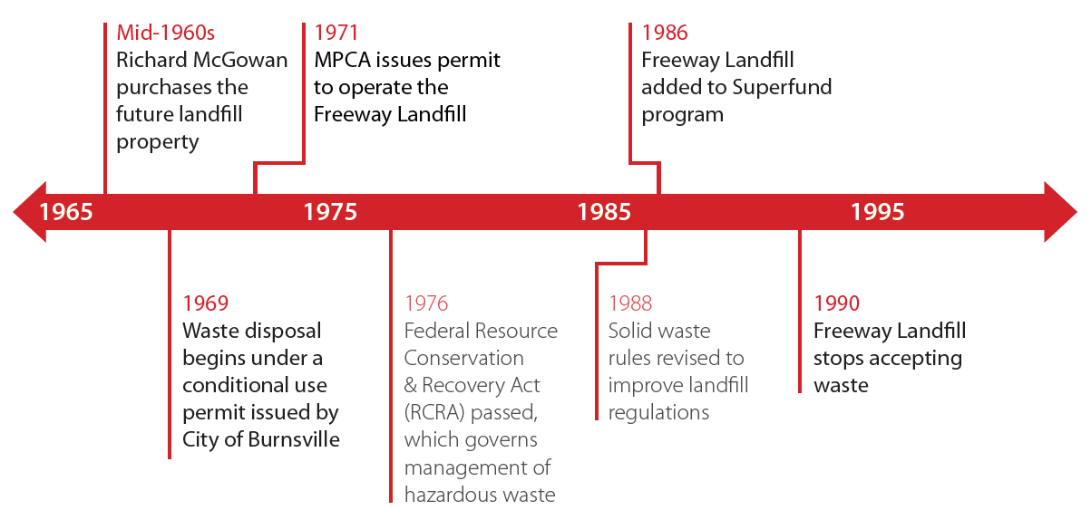
History of Freeway Landfill
Notes:
This is the timeline history for the Freeway Landfill.
The landfill stopped accepting waste in 1986.

Slide 6
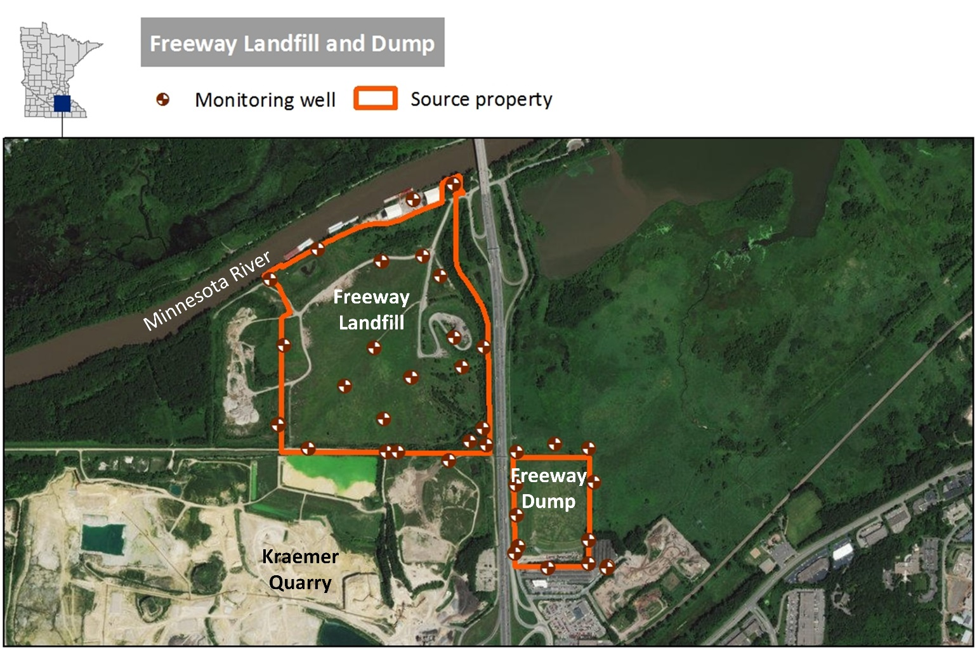
Freeway Landfill & Dump
Freeway Dump
  Operated 1961-71
  28 acres
  600,000 – 1 million cubic yards
Freeway Landfill
  Permitted for waste 1969-90
  150 acres
  5 million cubic yards
Both are unlined
Located above drinking water source for Burnsville and Savage
Built on former wetland south of and adjacent to Minnesota River

Slide 7
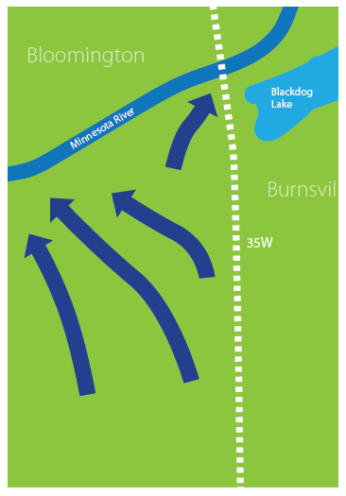
Groundwater Flow: PAST
Before the landfill existed, this site was a wetland.
Groundwater flowed mainly to the Minnesota River.
Today’s regulations would never allow a landfill to be placed on such a site.
Notes:
The next few slides will talk about the groundwater flow at the landfill site.

Slide 8
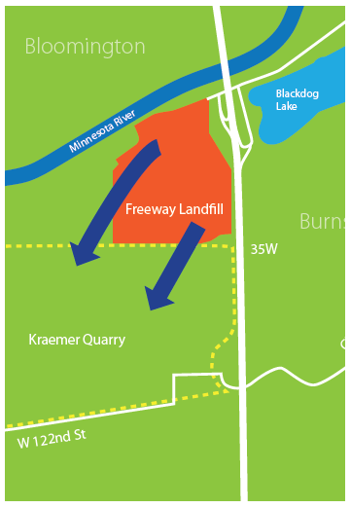
Groundwater Flow: PRESENT
Kraemer Quarry pumps 10 million gallons of groundwater per day away from the landfill and the river.
This lowers the water table, preventing the waste in Freeway Landfill from sitting directly in groundwater.

Slide 9
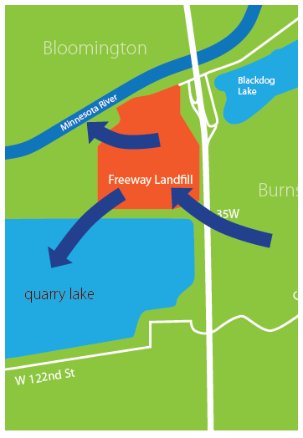
Groundwater Flow: FUTURE
When Kraemer Quarry stops pumping, groundwater will again flow toward the Minnesota River, through Freeway Landfill.
The Quarry will fill with water and become a lake.
Both the river and the lake will be at risk for contamination from the landfill.

Slide 10
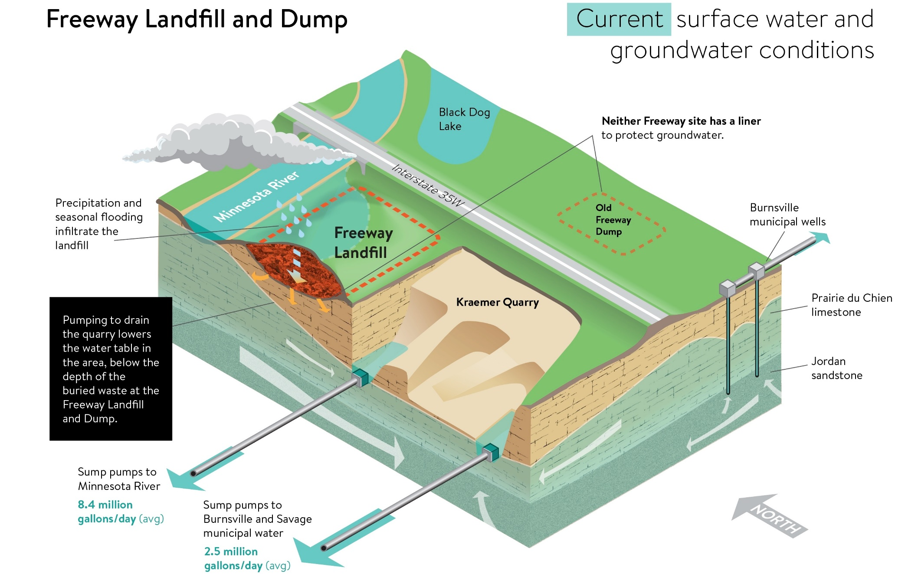
Notes:
The next few slides will talk about the groundwater flow at the landfill site.
Slide is current conditions with Kraemer Quarry pumping for their dewatering actions.
Again, north is to the top left.
Currently the waste is not in groundwater - Kraemer’s dewatering operations between what is discharged to the river and what is used by the Cities of Burnsville and Savage lower the groundwater to prevent the waste from being in the water.
However, as rain infiltrates the ground and during seasonal flooding, water runs through the waste and it is suspected that the groundwater directly in the vicinity of the landfill and dump is contaminated from the waste. We are currently completing an investigation to confirm this.
We have sampled the City’s water intake at Kraemer’s Quarry and the nearby municipal wells and there was no contamination found at this time.

Slide 11
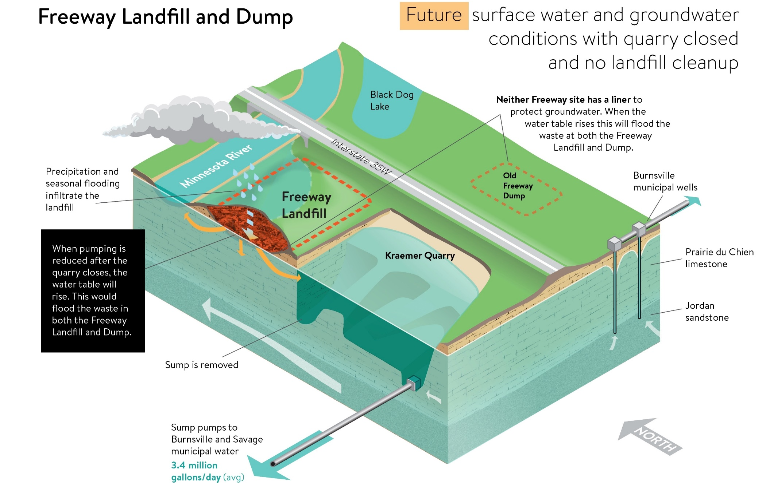
Notes:
This second slide shows the future condition based on modeling. Once Kreamer Quarry stops pumping, the water table will rise to form the Quarry Lake.
Burnsville and Savage will still be getting their water from the quarry lake with Burnsville supplementing their drinking water source with municipal wells south of the Dump.
The waste and BOTH the landfill and Dump will be in direct contact with the groundwater at this time.
There will continue to be rain water infiltration and seasonal flooding as well that will create more movement in the contamination during certain times of the year.
As such, the contamination at the Freeway Dump and Landfill will move towards:
The Minnesota River
The Quarry Lake and the Burnsville and Savage drinking water intake; and
The Burnsville municipal wells south of the Freeway Dump.

Slide 12
Results of 2018/2019 Investigation
Methane detected above the lower explosive limit
Contamination in groundwater above health values for:
  1,4-Dioxane
  PFAS
  VOCs
  Metals
Contamination above surface water criteria:
  VOCs
  Metals
Notes:
Phase B investigation starting in February, including bedrock water sample from Kramer Quarry.
Water Table Monitoring Results
1,4-dioxane - Concentrations of 1,4-dioxane exceeding the HRL of 1.0 μg/l were reported for 8 of 11
water table wells at the Landfill ranging from 1.2 to 40 μg/l. The concentration of 1,4-dioxane
reported in the seep sample was 19 μg/l. 1,4-dioxane was not reported in any of the samples from the
Dump wells at a concentration that exceeds the criteria.
PFAS - PFAS compounds were reported at nearly all water table well locations at the Dump and
Landfill, as well as in the seep sample, with the exception of wells MW-97-2, MW-97-3, and MW-97-4.
PFOS and PFOA were the compounds most commonly reported at concentrations exceeding their
HRLs. Generally, the concentrations of these compounds were one order of magnitude or less higher
than their HRLs.
Access agreements challenge – parties are concerned about the previous letters from EPA regarding potential responsible party.
Our intent is to just review extent and magnitude but if we find something we would need to follow up.

Slide 13
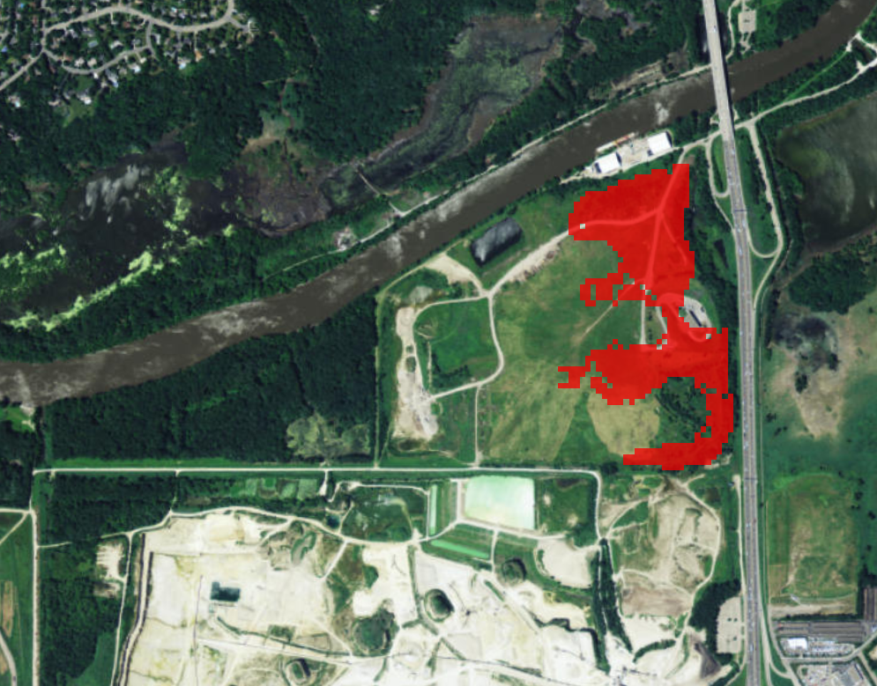
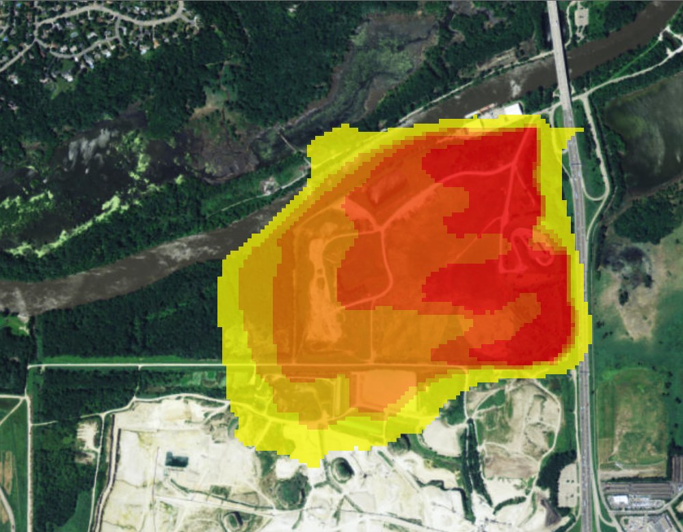
Predicted Groundwater Impacts Above Standards
Waste in contact with groundwater after quarry pumping ceases:
Estimated plume extent after quarry pumping ceases:
Notes:
The groundwater level will also rise in the months after Kraemer Quarry stops pumping:
When this happens, the waste and leachate at the bottom of the landfill will be in direct contact with groundwater.

Slide 14
Conceptual Design Options
Dig and Line Options:
  Smallest Footprint (Tallest)
  Lowest Height
  Balanced (Hybrid of 1 and 2)
Dig and Haul Options:
  Landfill (off site)

Slide 15
D&L Option Comparison
Concept Option | Landfill Footprint | Potentially Available Area | Maximum Cover Height | Current Cost Estimate (in millions)
1 – No Action | 174* Acres | Unk | 750’ | $1
2a– Smallest Footprint (Tallest) | 60 Acres | 52 Acres** | 850’ | $80***
2b – Lowest Height (Smallest Development Area) | 90 Acres | 22 Acres** | 776’ | $101***
2c – Balanced (Hybrid of 2a and 2b) | 75 Acres | 37 Acres** | 785’ | $91***
4 – Dig and Haul | 0 Acres | 147 Acres** | N/A | $179-586****
*Sixteen acres of Freeway Landfill/Dump waste area is located outside of property boundaries- 159 acres of waste area on owner’s property.
** Other Federal, State, City regulations may restrict this further.
***Assumes traditional MSW liner. More protective liners estimated to be 33-100% more per acre.
****Assumes trucking and tipping fees range from $23-80 per ton.
Notes:
(~820’ Burnsville Landfill)
(expands into quarry)
(Includes 3 Acres for Transfer Station)

Slide 16
Final Height Comparison
Notes:
No longer considering Option 4 (Expand West) because of construction and development challenges (floodplain, waste outside of permitted boundary, etc).
All current options allow for transfer station to remain.
Height listed includes Freeway Dump.
Waste Management Burnsville Landfill Height = 820’

Slide 17
Path Forward
Superfund Feasibility Study
Public Meeting
Bottom Liner Designs
No Action
Three Dig and Line designs
Dig and Haul to Existing Landfill
Arrive at one Dig and Line Design
Access
Contract Bidding
Bid Dig and Haul
Bid Dig and Line
Funding Bill
Construction
Standard liner option
Enhanced liner option
Obtain access to property for cleanup
Legislation funds one cleanup plan
Bid liner enhancement for Dig and Line

Slide 18
Schedule
1. Superfund Feasibility Study
Draft Investigation/Feasibility Study June 2019
Final Investigation/Feasibility Study Aug 2019
EPA Feasibility Study Approval Oct 2019
Public Meeting Nov 2019
2. Property Access
LSU to provide step and dates
3. Design (Two Options)
30% Remedial Design Dec 2019
60% Remedial Design Mar 2020
Public Meeting July 2020
Interim Record of Decision (ROD) Aug 2020
Final Design Plans and Specifications Sept 2020
4. Permitting
Pre-Construction Permit Approval Sept 2020
5. Bidding
Bidding Document Posted Oct 2020
Construction Bids Received Dec 2020
Add Legislative Process & Funding?
6. Construction
Construction Start Spring 2021
Construction Complete Summer 2024
or 2025

Slide 19
Estimated Cleanup Costs
2017 Funding History
$3 million appropriated from Closed Landfill Investment Fund (CLIF)
Requested bond not received
Costs are increasing because:
  1,4-Dioxane and PFAS detected;
  Waste at dump must be moved to the landfill; and
  Unanticipated legal costs to gain
    access to site.
Estimated cleanup cost is at least $100 million (as of today)

Slide 20
Dig & Line Cost Summary
  Key Cost Uncertainties
    Volume of Waste (Landfill and Dump)
    Existing Cover Soils
    Earthwork Double Handling
    Liner Design
    Restoration
    Leachate Treatment
    Site Congestion / High Visibility Project
Other
Leachate Mgmt
Waste Transfer
Liner
Earthwork
Cover

Slide 21
Next Steps
Complete field sampling to:
  Define how far the waste extends off-site on the landfill and dump
  Sample the water underneath the landfill and dump
  Sample the bedrock underneath the landfill and dump
  Sample for vapor intrusion
  Evaluate suitability for waste-to-energy incineration
Complete the EPA-required remedial investigation and feasibility study
Complete the design for the landfill and dump response action
Public meeting
Notes:
“due to incomplete investigation and design work and delays in receiving access to the site.”
· Delays in receiving access to the site from the present owner.
· Data collected during the environmental investigations is resulting in additional data needs.
· The site is an EPA National Priorities List (NPL) site which requires a remedial investigation/feasibility study and a record of decision in accordance with an agreement between the EPA and the MPCA. The Closed Landfill Program has not previously had to complete the EPA NPL process as the closed landfills that were brought into the program had previously had the EPA process completed prior to enrollment into the program.

Slide 22
Dig & Line Options
Need feedback from the City of Burnsville and Dakota County on the dig & line options to help narrow them down
  Difficult to keep moving forward with 4 different options
  MPCA preference is concept option #1 (reduced cost upfront and long-term, potential land available for other uses)
MPCA is still looking at a dig & haul option (bringing the materials to an existing landfill)

Slide 23
Financial Challenges
Need to know the “true cost” of a dig & haul option
  Rough estimate for a dig & haul option is nearly $200 million
  Understand difficulty for a third party to share a number; disadvantages them during a bidding process
  However, an amount is needed to request from the Legislature
Potential option: Dual bid process with a dig & line and dig & haul options

Slide 24
Financial Challenges
Needs a different funding source than normal bonding or use restriction applied
  General obligation bonds carries a 37.5 year restriction on private use of the property
  Use of non-taxable general obligation or revenue/appropriation bonds cost more
  Cash unlikely, unless a new revenue source is connected to it (both difficult to achieve)

Slide 25
Financial Challenges
Legislative concerns over potential windfall
  Legislators from both parties questioned why the State would pay for the cleanup of a property; then landowner gets to eventually develop the property
    Do not believe the concerns change with whoever is the owner
Potential option: Windfall lien on property
  Would capture the increase in market value for the property due to the cleanup
    Federal government and Washington State uses forms of the windfall lien

Slide 26
Process moving forward
The previous questions (and others) will help determine how to move forward
Options:
  Standard closed landfill process where one remedy goes out for bid
  Dual bid process with a dig & haul and dig & line option*
  Brownfield grant to third party that does the work*
*concepts at this time; additional work is need to determine feasibility

Slide 27
Anticipated Role for the City of Burnsville
Narrow down the dig and line options
Decision on Host Fees
Continued dialogue with MPCA & other stakeholders
Identification of potential funding sources

Slide 28
Questions?

