Slide 1
Permit Processing Milestones
Annual Averages, All Priority Projects – include ethanol

Slide 2
Number of Priority Permits

Slide 3
Permit Processing Milestones
Annual Averages, Ethanol Priority Projects

Slide 4
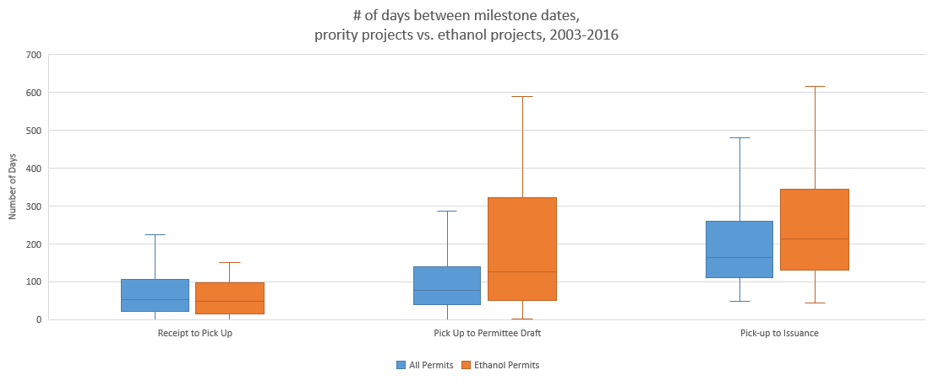
Ethanol vs. All Priority Permits, 2003-2017
Average Days by Permit Process Milestone

Slide 5
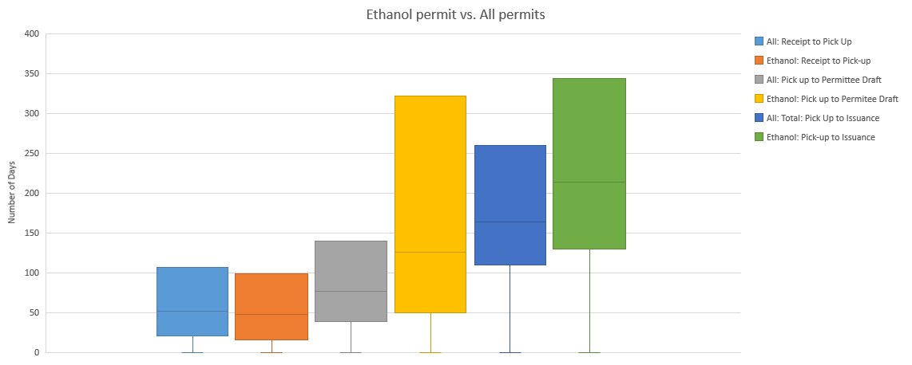
Ethanol vs. Other Priority Permits, 2003-2016
Average Days by Permit Process Milestone

Slide 6
Ethanol vs. All Priority Permits, 2003-2017

Slide 7
Ethanol vs. All Priority Permits, 2003-2017

Slide 8
Ethanol vs. All Priority Permits, 2003-2017

Slide 9
Ethanol vs. Other Priority Permits 2003 - 2017

Slide 10

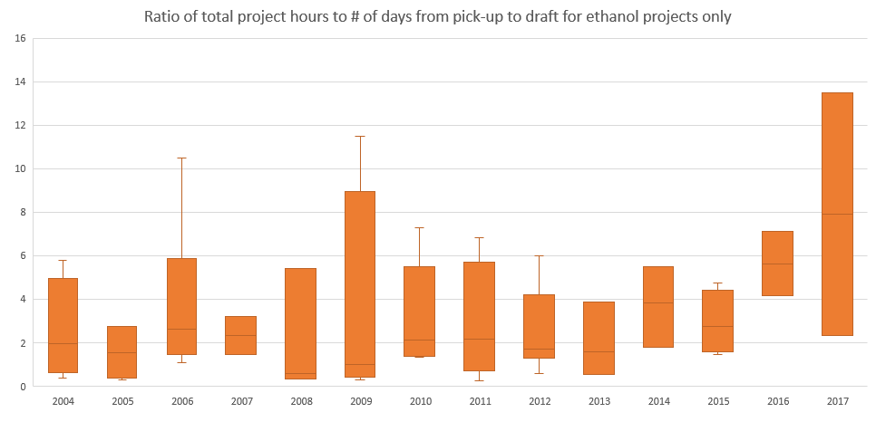
Permit Processing Efficiency
Ethanol Priority Projects

Slide 11
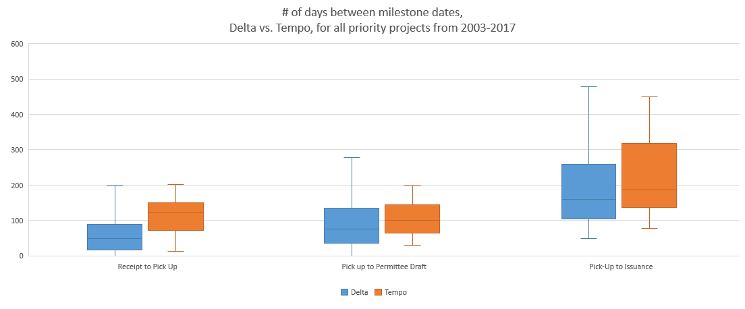
Delta vs Tempo
All Priority Projects 2003 - 2017

Slide 12
Delta vs Tempo
All Priority Projects 2003 - 2017

Slide 13
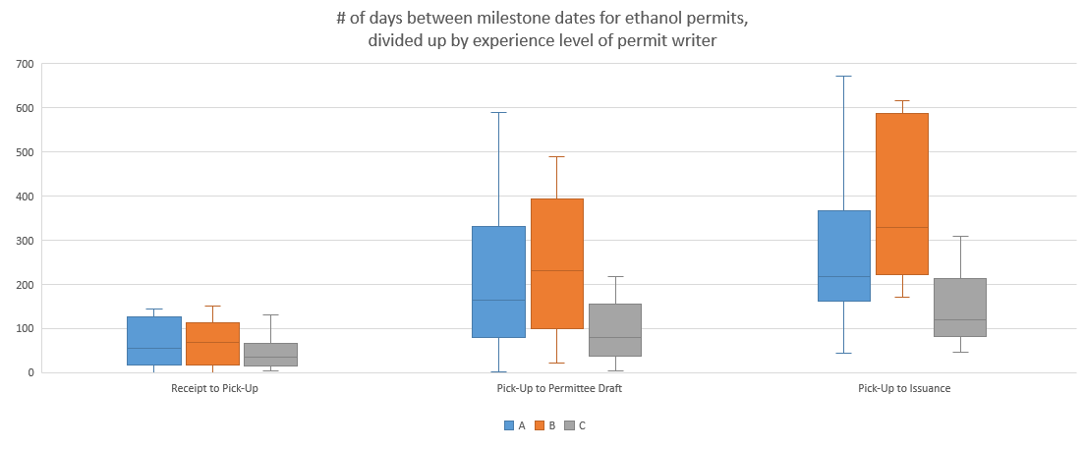
Ethanol Permit Processing
Comparison by Staff Experience

Slide 14
Ethanol Priority Projects by Facility

Slide 15
Ethanol Priority Projects by Facility Since 2003

Slide 16
Ethanol Priority Projects by Facility Since 2003

Slide 17
Ethanol Priority Projects by Facility Since 2003

Slide 18
Ethanol Priority Projects by Facility Since 2003

Slide 19
Ethanol Priority Projects by Facility Since 2003

Slide 20
Ethanol Priority Projects by Facility Since 2003

