Slide 1
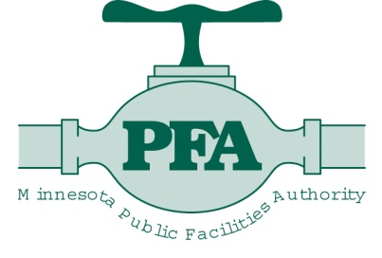
Interagency Clean Water Fund Update
Legacy Funding Division
January 19, 2011

Slide 2
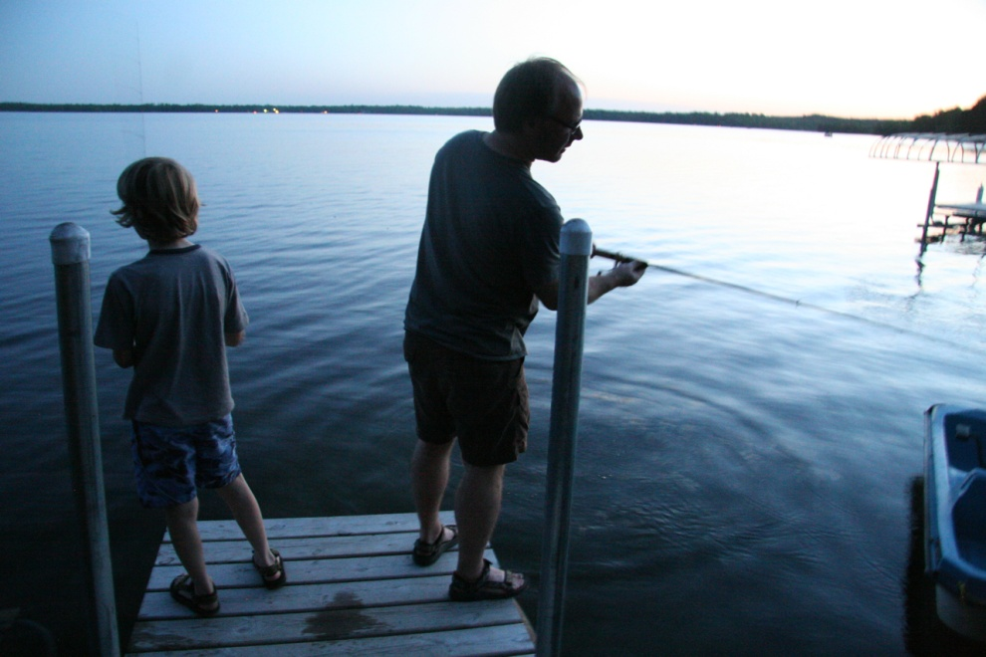
Presentation Overview
Clean Water Legislation
Overview of Federal and State actions
Clean Water, Land and Legacy Amendment
Clean Water Fund
FY10-11 Allocations
Agency Outcomes
Notes:
Thank you for the opportunity to speak with you today
Here is a brief overview of what we would like to cover
I’ll start with a quick review of both state and federal Clean Water legislation that affects water programs here in Minnesota
Then, each agency will share an update on Clean Water Fund activities and outcomes during FY10-11

Slide 3
Clean Water Legislation
Clean Water Act: 1972
Goal – restore and maintain the chemical, physical and biological integrity of Nation’s waters
Establishes regulatory framework to restore WQ
Water quality standards established to protect:
Aquatic Life
Recreation
Consumption
Notes:
Let me start off with the foundation of our Clean Water work, which is the Federal Clean Water Act of 1972
The goal of the 1972 Federal Clean Water Act is to “restore and maintain the chemical, physical and biological integrity of the Nation’s waters.” This includes the very ambitious goal of making all waters fishable and swimmable by 1983. Although that goal was not met, progress has been made, and there is still a lot of work to be done.
In addition, the act establishes a regulatory framework to restore water quality, which has been primarily focused on controlling point sources of pollution, the discharges from wastewater treatment plants and factories primarily through permitting, compliance and enforcement activities. Agricultural nonpoint sources of pollution are specifically exempted from this regulatory approach.
The act also requires that water quality standards be developed to protect aquatic life, recreation and water consumption.
MPCA is required to monitor and assess our waters and where they fail to meet standards - where they are impaired - we are required under federal law to develop what is called a “Total Maximum Daily Load” – or TMDL – plan that specifies how much the pollution has to be reduced in order to bring that water back to meeting standards. Essentially putting that water body on a pollution diet. Then implementation occurs so that the water body meets standards again.
Failure to comply with the requirements of the Clean Water Act could have long-lasting affects on human health, the environment and our economic well-being. There have been instances in the past where a new or expanded facility had planned to discharge to an impaired water, but was prohibited, until the TMDL – or pollution diet - was in place. This effectively stopped economic development where that new or expanded discharge needed to occur.

Slide 4
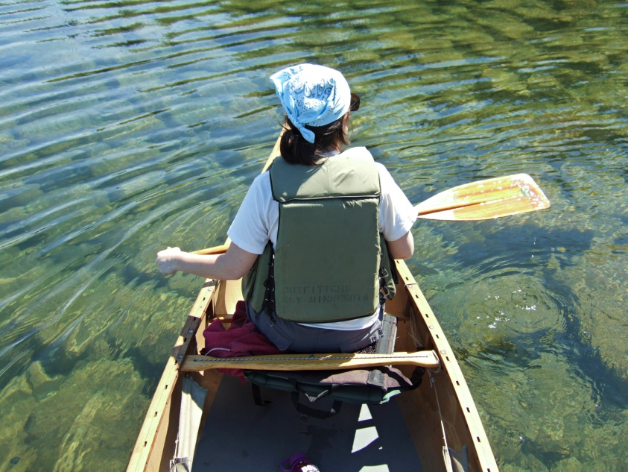
Clean Water Legislation
Clean Water Legacy Act: 2006 (MS 114D)
Restore Impaired Waters only
Clean Water, Land & Legacy Amendment: 2008
Expanded charge to include
Protect/Enhance waters
Drinking water
Notes:
Fast forward from the 1972 act to more recent events in the State of Minnesota –
In 2006, the Clean Water Legacy Act was passed by the Minnesota Legislature. This act focuses efforts to monitor and assess the conditions of our waters and on restoring impaired waters – those waters that do not meet water quality standards - and provided one-time funding to kick-start that effort. It required that the state develop an approach to monitor and assess the waters of the State within 10 years. We have developed, piloted and are operating under this watershed approach. In addition, the law also created the Clean Water Council. This 2006 law is still in force and effect.
In 2008, the citizens of our state passed a constitutional amendment called the Clean Water, Land and Legacy Amendment. In addition to setting up the Outdoor Heritage fund, it set up a Clean Water Fund, and the amendment expanded the clean water responsibilities of the Legacy Act beyond just restoring impaired waters, to include protection and enhancement of our unimpaired waters as well as dedicating at least 5% of the Clean Water Fund sales tax receipts to drinking water protection.
One of the primary differences between the Clean Water Fund and the Lessard-Sams Outdoor Heritage Fund is that we had legislation authorized work a couple of years before the amendment passed, as well as a history dating back to 1972 to address these issues.

Slide 5
Clean Water Fund
Total for All Agencies: $152.2 million for FY 2010-11
Notes:
Clean water is a priority for Minnesota and protecting our waters is a joint effort of the MPCA and six state partner agencies including:
Minnesota Department of Natural Resources
Minnesota Department of Agriculture
Minnesota Department of Health
Minnesota Board of Water and Soil Resources
Minnesota Public Facilities Authority
Metropolitan Council
The partners have developed a coordinated, efficient approach for protecting and restoring the state’s waters and funds have been allocated among these agencies to support many types of activities and projects
As you can see from this chart, $152M in CW funds have been allocated for:
Water quality monitoring and assessment: $21.0M / 14% of total request
Water quality studies and the development of restoration (TMDL) plans and protection strategies: $21.7M / 14% of total request
Drinking water protection: $13.1M/9% of total request
Water quality protection and restoration activities: $96.5M / 63% of total – the lion’s share of these CWF dollars go to PFA to improve municipal wastewater treatment plants and BWSR for on the ground protection or restoration projects

Slide 6
Clean Water Fund
MPCA: $47.11 million for FY 2010-11
Monitoring and Assessment $16.74 M
TMDL Development $19.10 M
Protection/Restoration $ 9.02 M
Drinking Water Protection $ 2.25 M
Notes:
Turning now to specific agencies appropriations and outcomes:
Approximately $47.11M has been appropriated to the MPCA for 4 major program areas
Monitoring and Assessment: $16.74M
Intensive monitoring on a 10-year cycle (Watershed Approach)
Systematic method to identify impaired and unimpaired waters
Good coverage of stream and lake sites within each major watershed
Opportunity to coordinate with other agencies/local government and volunteers
Results
Through 2010: will have cumulatively monitored more than 1,100 stream sites (25%); 68% of lakes greater than 500 ac and 35% of lakes 100-500 ac
By end of FY11: 35 of state’s 81 major watersheds will be assessed (43%)
By end of FY12-13: intensive monitoring completed on 62% of watersheds
On track to intensively monitor all 81 watersheds by 2017
TMDL Development: $19.10M
We study sources of impairment s and develop restoration (TMDL) plans . Also, developing protection strategies for waters not impaired
Results
More than 70% of impairments identified so far have TMDLs completed or underway
15% of the state’s watersheds have projects in progress – approximately 43% by FY2013
Protection and Restoration: $9.02M - these dollars are going primarily to deal with legacy contamination of the St. Louis River
Drinking Water Protection: $2.25M
Enhancement of Ambient Groundwater Monitoring network: Program is on track to meet the goal of installing/acquiring 60 wells over the biennium. (Contracts have been executed to obtain landowner access agreements and install additional monitoring wells).
Emerging contaminants groundwater monitoring (Agreement executed with USGS to conduct emerging contaminants in shallow groundwater monitoring; sampling underway for 40 wells).
Groundwater-Surface Water modeling. Five groundwater-surface water models will be completed by the end of FY 2011, as set out in the biennial appropriation. These models are used to identify and quantify the impacts and relationships of groundwater to stream water quality studies, such as TMDL studies.
Results
Monitored 46 wells for contaminants of emerging concern in cooperation with USGS in 2010
Installed 17 monitoring wells in 2010 for the Ambient Groundwater Monitoring network, with fully/partially-executed access agreements to install another 15 wells; acquired 10 monitoring wells from DNR and others.
Contracts were executed to obtain landowner access to install the remaining Ambient Network monitoring wells. Contractors have identified 18 additional monitoring well sites as of Jan 2010.
Groundwater-Surface Water models have been completed for the Little Rock Creek, the Amity River (near Duluth), Jessie Lake, and for streams in the Bonanza Valley. The models are showing that groundwater can play a major role in stream quality

Slide 7
Clean Water Fund
BWSR: $39.324 million for FY 2010-11
Protection/Restoration
186 Permanent easements $ 7.0 M
Wellhead protection $ 2.3 M
Water Protection activities $20.0 M
97 Feedlot upgrades $ 4.0 M
Septic inventories on
Nearly 40 lakes and 5 rivers $ 3.5 M
Address 168 Imminent
Health Threat Systems $ 1.8 M
Notes:
On the ground implementation through local delivery system: SWCD, WD, County, City and JPB
Permanent Easements in high priority riparian areas
Wellhead protection – permanently protect highly vulnerable wellhead areas
Water Protection activities include keeping water on the land, reducing pollutants in ground and surface water and restoring stream integrity
Feedlot upgrades – in riparian areas
Septic inventories on nearly 40 lakes and 5 rivers – improved program administration
Imminent Health Threat systems

Slide 8
Clean Water Fund
DNR: $18.53 million for FY 2010-11
Monitoring and Assessment $3.70 M
TMDL Development $2.10 M
Protection/Restoration $7.60 M
Drinking Water Protection $5.13 M
Notes:
The FY10-11 legislation for DNR’s clean water funds included 7 areas of work and appropriated a total of $18.53 million for the biennium.
Monitoring and Assessment (3.70 M) Stream monitoring, watershed delineation, drainage/hydrology modeling, fish contaminant assessments, fish IBI
RESULTS:
Increased state operated real time gages by over 40% and increased the total number of gages in the state by about 20%
Mapped drainage areas of 257 lakes
Used state of the art models to assess drainage impacts in 3 subwatersheds
Increased fish contaminant sampling from 70 to 150 lakes
TMDL Development (2.10 M) Regional technical assistance for TMDL planning (stressor identification), statewide coordination, and the Watershed Assessment Tool
RESULTS:
Provided field reconnaissance and technical assistance to support MPCA’s stressor identification for 20 TMDL studies
Scored the overall health of the state’s 81 major watersheds
Protection and Restoration (7.60 M) Local community assistance, LiDAR, County Geologic Atlases, MRCCA Rulemaking
RESULTS:
Technical assistance for local clean water strategies, including 32 outreach events and 8 clean water implementation projects
Collected LiDAR digital elevation data for 25 counties in the Minnesota River Basin
Improved county geologic atlas data collection by expanding water chemistry and geology sampling
Engaged the public and key stakeholders in a comprehensive process to write draft rule language
Drinking Water (5.13 M) Water supply planning, groundwater monitoring network, electronic appropriation permits
RESULTS:
Accelerated groundwater monitoring and held stakeholder meetings for aquifer management plans in two areas of the state (Moorhead, Brooten/Belgrade Area)
Visited 253 observation well sites in 8 counties, drilled 7 new observation wells and sealed 16 abandoned wells

Slide 9
Clean Water Fund
PFA: $32.70 million for FY 2010-11
Point Source Protection/Restoration
TMDL Grant Program $21.65 M
Phosphorus Reduction Grant Program $ 8.55 M
Small Community WWT Program $ 2.50 M

Slide 10
Clean Water Fund
MDA: $8.96 million for FY 2010-11
Monitoring and Assessment $1.07 M
Protection/Restoration $6.77 M
Drinking Water Protection $1.12 M
Notes:
Root River Study: $0.395
Pesticide Monitoring: $0.675
Groundwater and Drinking Water Protection : $1.125
Research, Pilot Projects and Technical Assistance: $2.26
Ag BMP Loan Program: $4.500
TOTAL $8.960

Slide 11
Clean Water Fund
MDH: $3.75 million for FY 2010-11
Drinking Water Protection
Accelerated source water
protection activities $2.415 M
Characterization of
unregulated drinking
water contaminants $1.335 M

Slide 12
Clean Water Fund
MC: $0.80 million for FY 2010-11
Drinking Water Protection
Local Water Resource Planning $0.29 M
Management Tool Development $0.18 M
Regional Mapping and Assessment $0.29 M

Slide 13
Questions?
Comments?
Notes:
First, on behalf of all the partner agencies, I’d like to thank you for the opportunity to talk with you today.
To sum up, I have just a few quick notes:
As you know, we are in the process of completing the first biennium of a 25-year Amendment, we are making progress toward the long-term goal of protecting and restoring Minnesota’s waters - there is still a lot to be done
The partner agencies have been working together to develop system-wide coordinated strategies to address water quality
This coordinated approach helps ensure
That complimentary actions support the broader strategies
That the appropriate agencies are working toward their strengths
That we are adequately identifying problems before taking steps to fix them
And that we properly target federal and state funding where it can do the greatest good
Minnesota citizens passed the Amendment , in part, because they value our state’s water resources
The agencies represented here today work together to ensure that those resources are managed to protect Minnesota’s environmental and economic well-being

