Slide 1
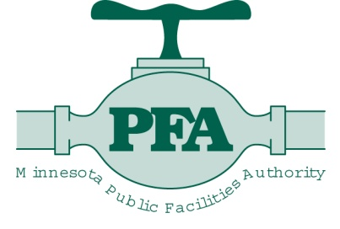
Clean Water Fund
Interagency Leadership and Coordination
Rebecca Flood
MPCA Assistant Commissioner
Stormwater Steering Committee October 21, 2010
Notes:
Good afternoon…
I’d like to tell you about how the agencies are working together to efficiently and effectively deliver on the trust and confidence that the citizens of the State of Minnesota have placed in us to protect and restore the states’ waters through delivery of constitutional amendment dollars appropriated to us by the Legislature from the Clean Water Fund.

Slide 2
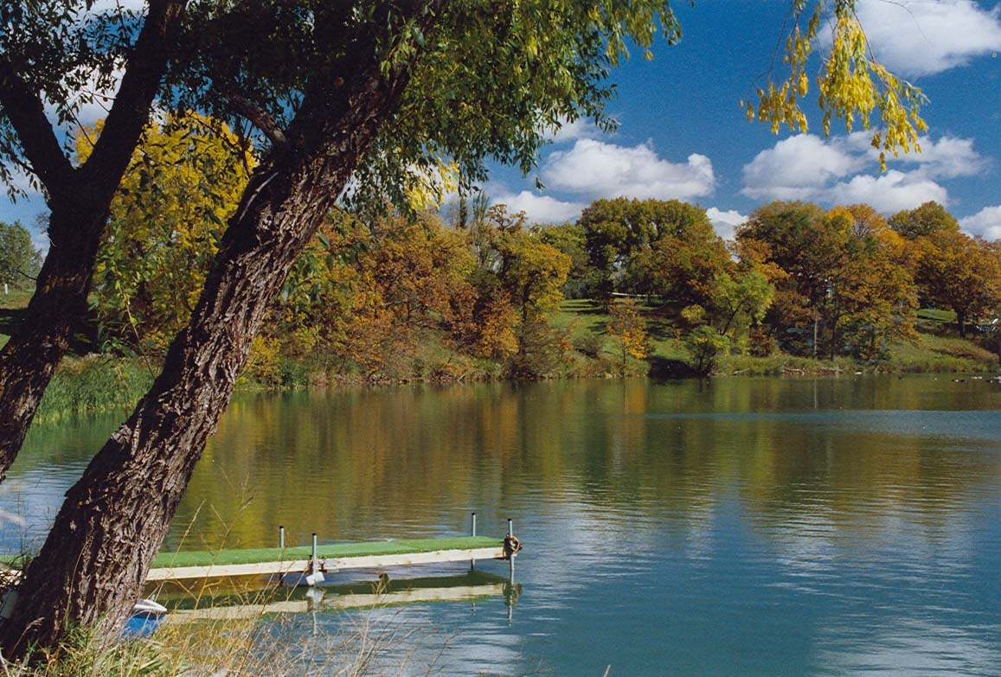
Presentation Overview
Clean Water Legacy Act
Clean Water Land and Legacy Amendment
Clean Water Fund
Interagency Team
Agency Activities
FY2012-13 Proposal
Notes:
To do that, I want to remind you about some of the background that lead to the amendment and then what state agencies are doing to design and deliver programs to protect and restore our waters.

Slide 3
Clean Water Legacy Act
Passed MN Legislature in 2006
FY07 One-time funding of nearly $25 million
FY08-09 One-time funding of $54 million
MPCA’s Accelerated Activities
Monitoring and assessment
Water quality studies (TMDLs)
Notes:
As you recall, the MN Legislature passed into law the Clean Water Legacy Act in 2006, with one-time funding of activities of $25M in FY 07 and $54M in FY08-09 statewide
FY 2007 Legacy Funding: $24.95 million Statewide
FY07 MPCA Received approximately $5.03 million
$1.86mill for WQ assessment; $3.17mill for TMDL development
FY2008-2009 Additional appropriations: $54 million statewide
FY08-09 MPCA Received approximately $30.6 million
$12.6mill for monitoring and assessment; $18mill for TMDL development
Included in the act were two specific directives to MPCA: to develop a monitoring and assessment framework so that all waters of the state would be assessed within 10 years; and conduct timely TMDLs, should a water body not meet WQ stds. We have developed that framework. Specifically, the M&A and TMDL framework is based on an 81 major watershed or 8-digit HUC approach. We are on track to meet the 10-year M&A requirement and are currently transitioning from the past TMDL approach of conducting TMDLs using a single waterbody and parameter approach to this new 81-major watershed model.
The CWLA accelerated Minnesota’s efforts to address impaired waters and protect good-quality waters.
CWLA was a good starting point, but long-term dedicated funding was still needed

Slide 4
Clean Water Land and Legacy Constitutional Amendment
November 2008: voter-approved amendment
3/8 of 1% sales and use tax increase
Dedicated funding for 25 years
…to protect drinking water sources; to protect, enhance, and restore wetlands, prairies, forests, and fish, game, and wildlife habitat; to preserve arts and cultural heritage; to support parks and trails; and to protect, enhance, and restore lakes, rivers, streams, and groundwater.
Notes:
Then in 2008 came the voter-approved constitutional amendment – dedicated funding for 25 years from a 3/8th of 1% increase to the state sales tax.
The amendment really gets to the heart of what people think is critical to quality of life in Minnesota
Clean Water
Wildlife Habitat
Parks and trails
Cultural heritage

Slide 5
Clean Water Fund
33% of revenue from Amendment Funds dedicated to protect, enhance and restore water quality
Rivers
Lakes
Streams
Groundwater (at least 5%)
Amendment funds must supplement traditional sources of funding
Notes:
33% of the sales tax revenue is dedicated to protect, enhance and restore the WQ of our rivers, lakes and streams – with at least 5% going to groundwater
Legislature allocates funds to specific activities, primarily through existing agencies and programs, rather than creating new bureaucracies
And the funding must not replace traditional sources of funding. So, by way of example, MPCA has always done monitoring and assessment activities, however amendment funding allows us to greatly expand and accelerate beyond what we had the funding to do in the past.
MENTION differences between LSOHC and CWF

Slide 6
Clean Water Fund: Interagency Team
Interagency Coordination Team
Minnesota Pollution Control Agency
Minnesota Department of Natural Resources
Minnesota Department of Agriculture
Minnesota Department of Health
Minnesota Board of Water and Soil Resources
Minnesota Public Facilities Authority
Metropolitan Council
University of Minnesota
Notes:
When the amendment was passed in Nov. 2008, the agencies began meeting right away to develop a budget proposal for the governor to present to the legislature in the 2009 session.
Once the session was over and a unified biennial budget established, the agencies began meeting 2x per month in order to ensure that we were utilizing the funding in an efficient and effective manner.
We have long been coordinating water quality management activities (even though not everyone realizes it)
This coordination is now a more institutionalized system – because this is not a short-term assignment; structured coordination will be here for 25 years to come (and longer)
Clean water is a priority for all of the agencies represented here and each receives a part of the Clean Water Fund and coordination is just part of doing the work of the executive branch
The Interagency Team includes only agencies that received money from the fund in the FY2010-2011 biennium

Slide 7
Clean Water Fund Interagency Coordination Team
BWSR, MC, MDA, MDH, DNR, MPCA, PFA, U of M
Team Purpose: Clean Water Fund activity coordination
Clean Water Fund Team Coordinator
Surface water monitoring / assessment
Larry Kramka, CT Liaison
Employ an integrated monitoring approach to understand the status and trends of Minnesota’s waters that will inform decision-making for protection / restoration development, implementation and research.
Protection/ restoration strategy development Rebecca Flood, CT Liaison
Based on monitoring and assessment data, develop protection, restoration and implementation strategies (TMDLs) for Minnesota’s waters, via the state’s 81 major watersheds.
Implementation Julie Blackburn, CT Liaison
Coordinate statewide protection and restoration implementation activities for non-point and point source water pollution.
Groundwater/ drinking water
John Linc Stine, CT Liaison
Coordinate drinking water protection and statewide groundwater sustainability efforts for drinking water and domestic use.
Research and outreach
Rob Sip, CT Liaison
Coordinate interagency academic efforts related to research and outreach.
Measures and outcomes – Deb Swackhamer, CT Liaison
Create measures to report statewide outcomes of Minnesota’s water programs funded by the Clean Water Legacy Act and the Clean Water, Land and Legacy Amendment.
Legislative Coordinating Commission Public Information Web site
Communications – Jennifer Maleitzke, CT Liaison
Develop coordinated communications materials that clearly and accurately describe all activities and outcomes of Clean Water Legacy Act and the Clean Water Fund.
Notes:
This chart is really the meat and potatoes of how the team works and the various activities that are incorporated under the joint leadership
The work is done in the subteams, which have multi-agency representatives on them.
LIST OFF SUBTEAMS and describe tasks.
As their work progresses, and should an issue arise that needs higher level discussion, that subteam will ask their designated CT liaison to bring it to the CWF Interagency Coordination Team for discussion and resolution.
The CT is composed of Assistant Commissioner level folks that ensure that there isn’t duplication and overlap.

Slide 8
Clean Water Fund: All Agencies
$150.8 million FY 2010-11
Notes:
Now I’d like to switch gears to present information on funding and what activities we’ve initiated
The total funds appropriated to all agencies in the FY2010-2011 biennium was nearly $151M with
$21M for M&A
$20M for TMDL and protection strategy development
$95M for point and nonpoint protection and restoration activities and more than
$13M for drinking water protection
Even though the amendment was passed in 2008 and the session ended in May 2009 and the new biennium began in July 2009, tax receipts from the amendment didn’t begin coming into the CWF until September. Some of this money was released to agencies, but MMB withheld most of the CWF dollars for pass through grants until this January, to build up the fund balance. Many of those FY09 contracts didn’t get out until mid-late spring of this year.

Slide 9
Clean Water Fund: MPCA
$51.16 million FY2010-11
Notes:
Revenues appropriated to the MPCA from the Clean Water Fund at the end of the 2009 session totaled $51M with the majority going to M&A and TMDL restoration and protection plan development.

Slide 10
Clean Water Fund: MPCA Activities
Monitoring and assessment efforts to complete watershed approach 10-yr cycle
Fund TMDL projects and staff
Database development
St. Louis River restoration
Clean Water Partnership
Wastewater Beneficial reuse
Groundwater assessment and protection
Notes:
MPCA’s funded activities went to :
M&A in accordance with our 81-major watershed approach
TMDL Development category includes both TMDLs (Water quality studies aimed at restoring impaired waters) and Protection Strategies (developed to keep non-impaired waters from deteriorating) TMDL projects: 32 projects FY10; 25 projects FY11
Database development: the first phase of database development: to create a Watershed Portal to provide central location for reporting, analysis and data management and connect existing data management systems among the state agencies for citizens and the public to access this watershed information
St. Louis river: Partnership with U.S. Army Corps of Engineers: 2x match for every CWF $
CWP: grants to improve basins and watersheds in MN
Wastewater Beneficial Reuse: improved treatments to replace groundwater with wastewater in industrial/municipal processes
Groundwater: enhance monitoring and modeling – most of this orginial $5M appropriation was transferred to DNR to enhance 11-county metro area monitoring system

Slide 11
Clean Water Fund: MPCA Special Projects
Legislative Mandates
Endocrine disruptor monitoring and analysis
Wastewater treatment monitoring (EDC)
Red River Watch
St. Croix Watershed monitoring
Minnesota River water quality effectiveness monitoring
Buffalo River watershed pilot project
Coal tar stormwater best management practices
Notes:
In addition the MPCA received funding for a number of special projects mandated by the legislature

Slide 12
Clean Water Fund: DNR
$14.53 million FY2010-11
Notes:
DNR received $14.5M

Slide 13
Clean Water Fund: DNR Activities
Stream flow monitoring
Biological assessments
Non-point protection
Drinking water protection
County geological atlas
LiDAR
Notes:
The M&A dollars that they received uses DNR expertise to assist us in stream flow gauging, and developing biological indicators for our waterbodies. In addition, they received funding for nonpoint and DW protection, as well as funding to accelerate the completion of the county geologic atlases and $5.6M for the development of LiDAR statewide.

Slide 14
Clean Water Fund: BWSR
$38.22 million FY2010-11
Notes:
BWSR received more than $38M entirely for protection and restoration projects

Slide 15
Clean Water Fund: BWSR Activities
Implementing source protection, restoration and preservation projects
Priorities of local water management and TMDL implementation plans
Permanent Protection (buffers, wellhead)
Projects (feedlots, stormwater, erosion control)
Accomplished via grants to local governments
Notes:
BWSR projects are both protection and restoration focused and include:
Linking local water management plans with TMDL plans for permanent protection through conservation easements, including for wellhead protection areas
Practices that reduce stormwater runoff
Feedlot water quality grants
SSTS grants to counties
All accomplished through nonpoint source pollution reduction and restoration grants to LGUs

Slide 16
Clean Water Fund: MDA
$8.96 million FY2010-11
Notes:
As you can see here, MDA received nearly $9M for their CWF efforts

Slide 17
Clean Water Fund: MDA Activities
Agricultural best management practices loans to local government units
Research and technical assistance
Root River watershed monitoring/analysis
Livestock Environmental Quality Assurance
Drinking water protection
Pesticide monitoring and assessment
Notes:
MDA’s funded activities include Ag BMP loans to LGUs
Research and TA – to evaluate the contribution of the ag sector on WQ
Root River M&A
The Livestock EQA program
DW protection and
Pesticide M&A

Slide 18
Clean Water Fund: MDH
$3.75 million FY2010-11
Notes:
As you might expect, all of MDH’s CWF funded activities are in DW protection

Slide 19
Clean Water Fund: MDH Activities
Wellhead protection plan development
Source water implementation grants
Emerging contaminant guidelines
Notes:
These efforts include:
Wellhead protection plan development at least 90 communities must develop their plan by in 10-11 biennium;
Source Water Implementation Grants, and a requirement for at least 30 in FY10-11 biennium
Emerging contaminants: studies of environmental occurrence and risk assessment methods for 10 contaminants

Slide 20
Clean Water Fund: Met Council
$0.40 million FY2010-11
Notes:
Met Council received $400K in 2009 session and an additional $400K in the 2010 session making their total for the biennium $800,000.

Slide 21
Clean Water Fund: Met Council Activities
Metropolitan Area Water Supply Master Plan
Notes:
The Council’s Metro Area Water Supply Master Plan is intended to evaluate water resources and identify water supplies to meet current and future growth in the Twin Cities area without adverse impacts to natural resources

Slide 22
Clean Water Fund: PFA
$32.70 million FY2010-11
Notes:
Lastly, PFA received nearly $33M for their protection and restoration activities

Slide 23
Clean Water Fund: PFA Activities
Small community SSTS grants and loans
TMDL grants
Phosphorus reduction grants
Notes:
PFA’s CWF work includes
SSTS grants and loans: assist small communities with replacing non-compliant septic systems with new individual or cluster SSTS
TMDL grants: assist municipalities with meeting added wastewater or stormwater requirements resulting from TMDL wasteload allocations
Phosphorus reduction grants: assist municipalities with costs for reducing discharge of total phosphorus to 1mg/l or less

Slide 24
Clean Water Fund: FY2012-2013
Funding proposals still in development
CWF Interagency Coordination Team will continue to work together
Multiple agencies with very specific roles and skills working together to protect and enhance the quality of Minnesota’s waters
Notes:
The work of our individual agencies and the Coordination Team continues as we are now developing proposals for the Governor’s budget request for FY 2012-2013.
The Coordination Team works together to help eliminate duplicative efforts and to create clearer processes for our stakeholders
Coordination helps to compliment programs within each agency.
All of these efforts will lead to cleaner water to achieve the outcome of protecting and restoring our state’s waters.

Slide 25
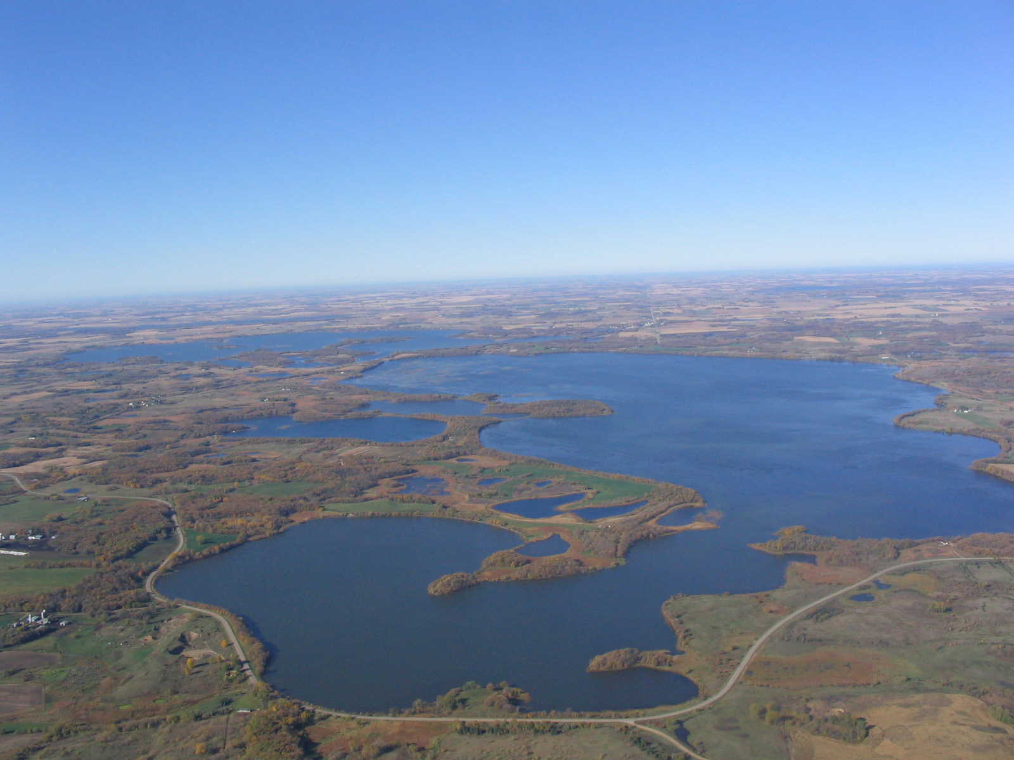
Questions
Rebecca Flood
MPCA Assistant Commissioner

