Slide 1


Systematic Conservation Planning Using Zonation
Paul Radomski and Kristin Carlson

Slide 2
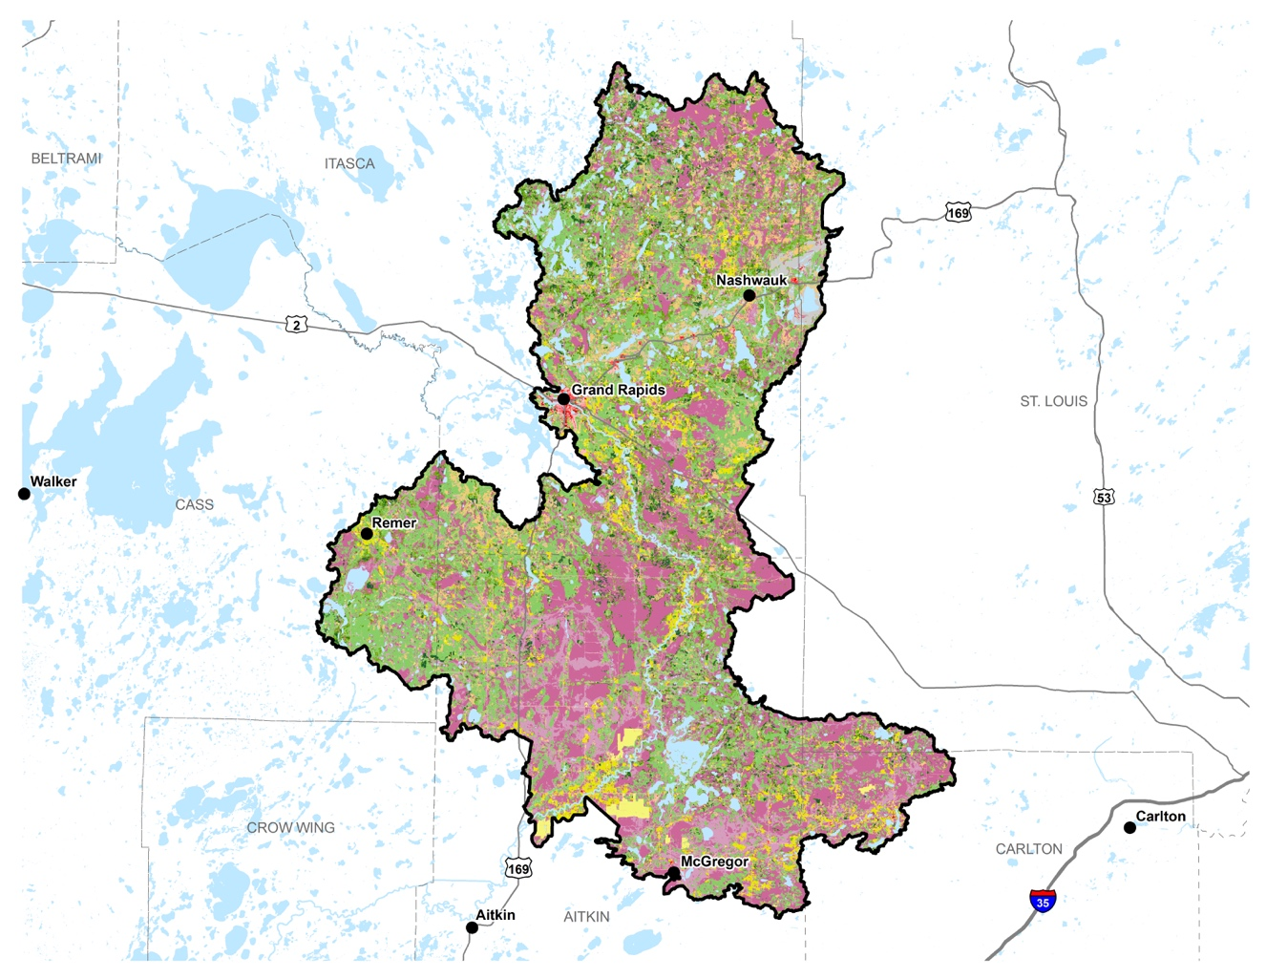
Goal
How do we – in a systematic, objective way – prioritize areas on the landscape for conservation?

Slide 3
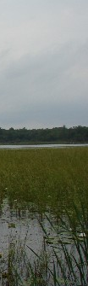
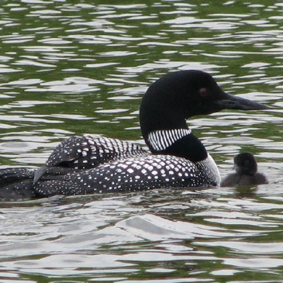
4-step process for conservation priority identification
1. Formulate the objective
• What conservation features are valued?
• How are the conservation features aggregated?
2. Set weights on each conservation feature
• Should reflect social valuation
• Analytic Hierarchy Process
3. Run model & hotspot analysis
• Ranks each parcel of land (30m grid)
• Generates draft priority areas
4. Synthesis
• Edit and finalize priority map and areas

Slide 4


1. Formulate the Objective
Broad-scale Categories Used for Watershed Plans:
Improve/Protect Waters of Concern
Reduce Erosion & Runoff (Hydrology)
Protect/Improve Fish & Wildlife Habitat
Protect Unique Natural Resources
Protect Groundwater
Protect/Improve Forestry, Ag, and Other Lands of Concern

Slide 5
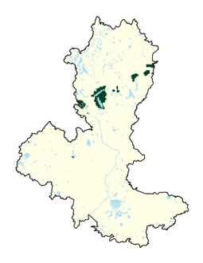
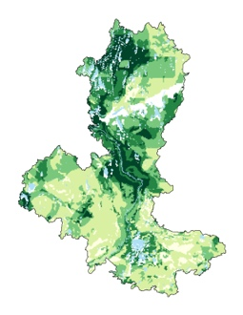
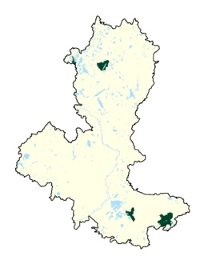
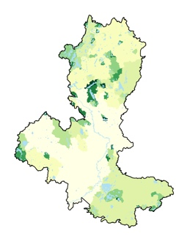
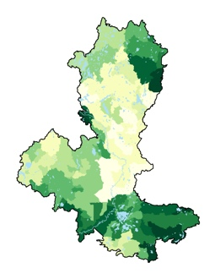
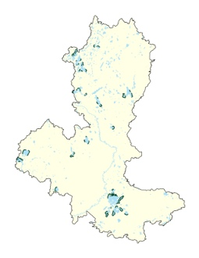
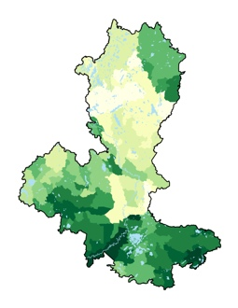
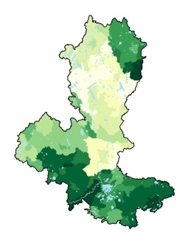
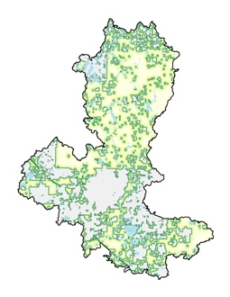
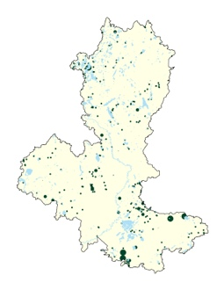
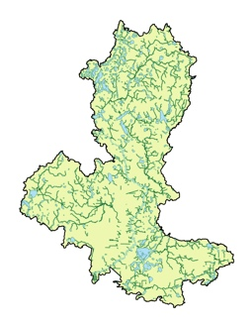
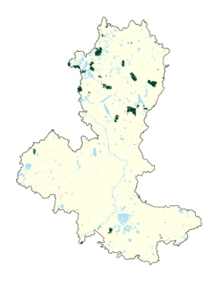
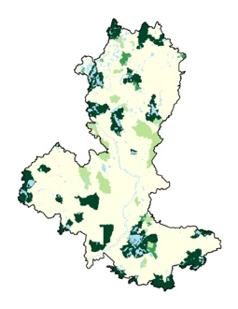
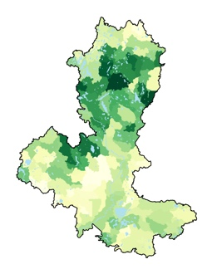
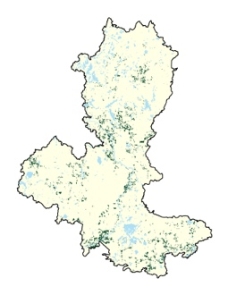
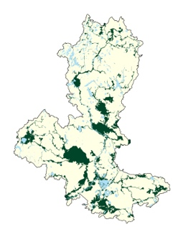
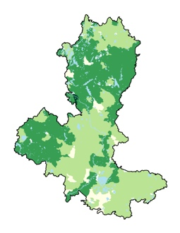
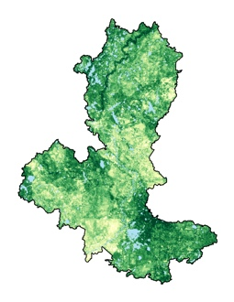
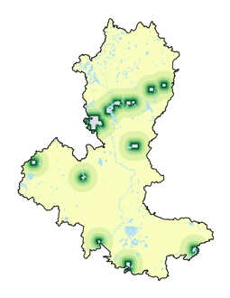
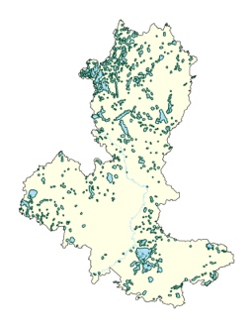
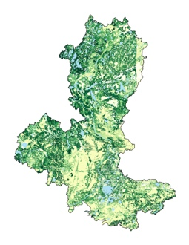
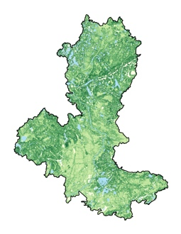
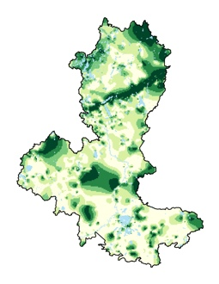
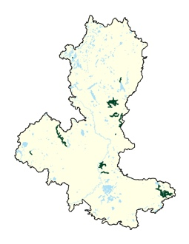
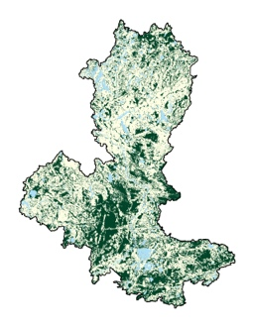
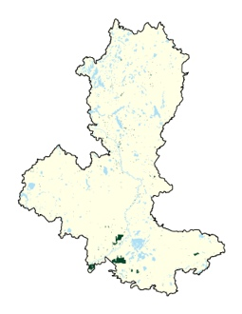
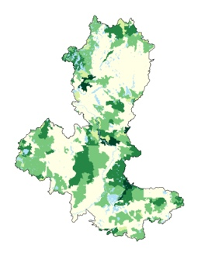
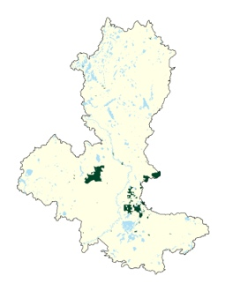
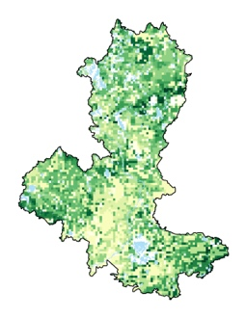
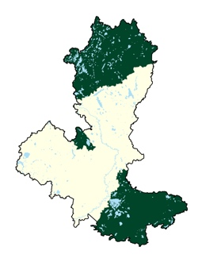
Drinking water vulnerability
Groundwater contam suscept
Lakes with declining WQ
Lakes of P sensitivity
TSS Load - HSPF
Sensitive lakeshore
TP Load - HSPF
TN load - HSPF
ID Protected Lands
Rare features
ID Water
Ecol connection
Lakes of biol significance
Altered hydro
Valuable timber lands
Ag conv. risk
Pasture/Hay
Riparian
Close to urban
Soil erosion
risk
Stream power index
Geol sensitivity
Trout streams
Shorelands
Sites of biol. significance
High value forests
Wetlands
Row crop
GW recharge
Impaired lakes

Slide 6

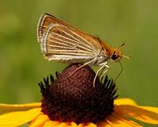
2. Set weights on each conservation feature
Should reflect social valuation
Analytic Hierarchy Process
Scientific approach to make group decisions
Pairwise Comparisons
Hierarchical: Broad-scale & Fine-scale
AHP converts values to numerical weights
Weights given to each conservation feature

Slide 7
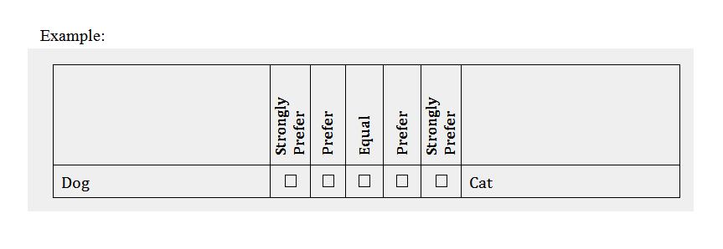
Analytic Hierarchy Process

Slide 9
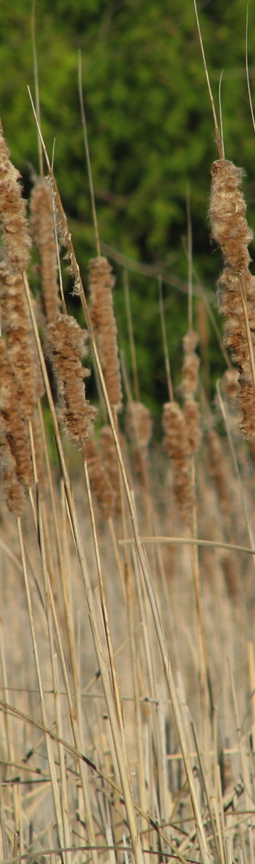
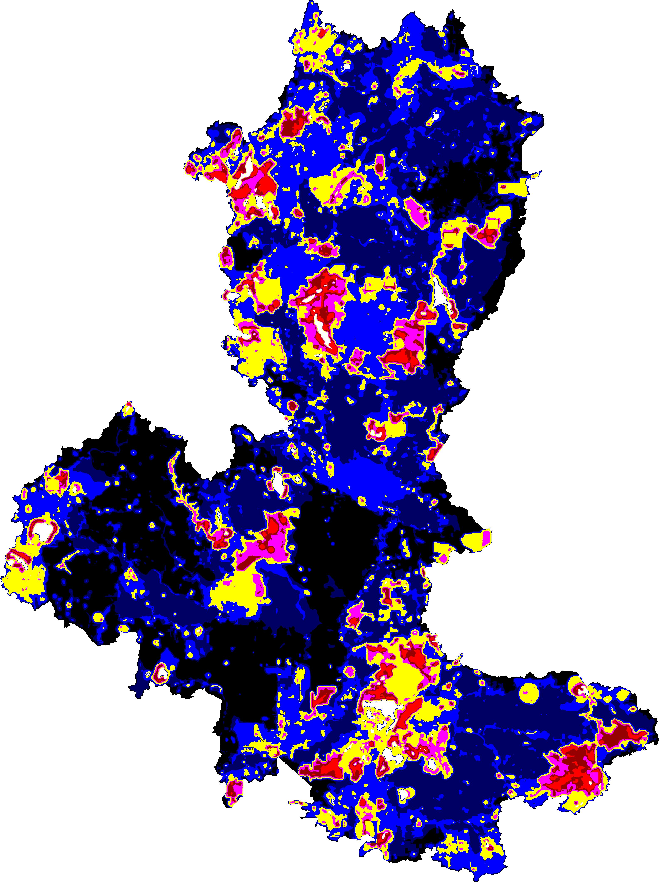
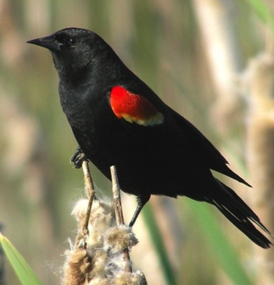
3. Apply the optimization algorithm
Zonation
  Multiple benefits objective
  30 x 30m grid
Hotspot analysis

Slide 10
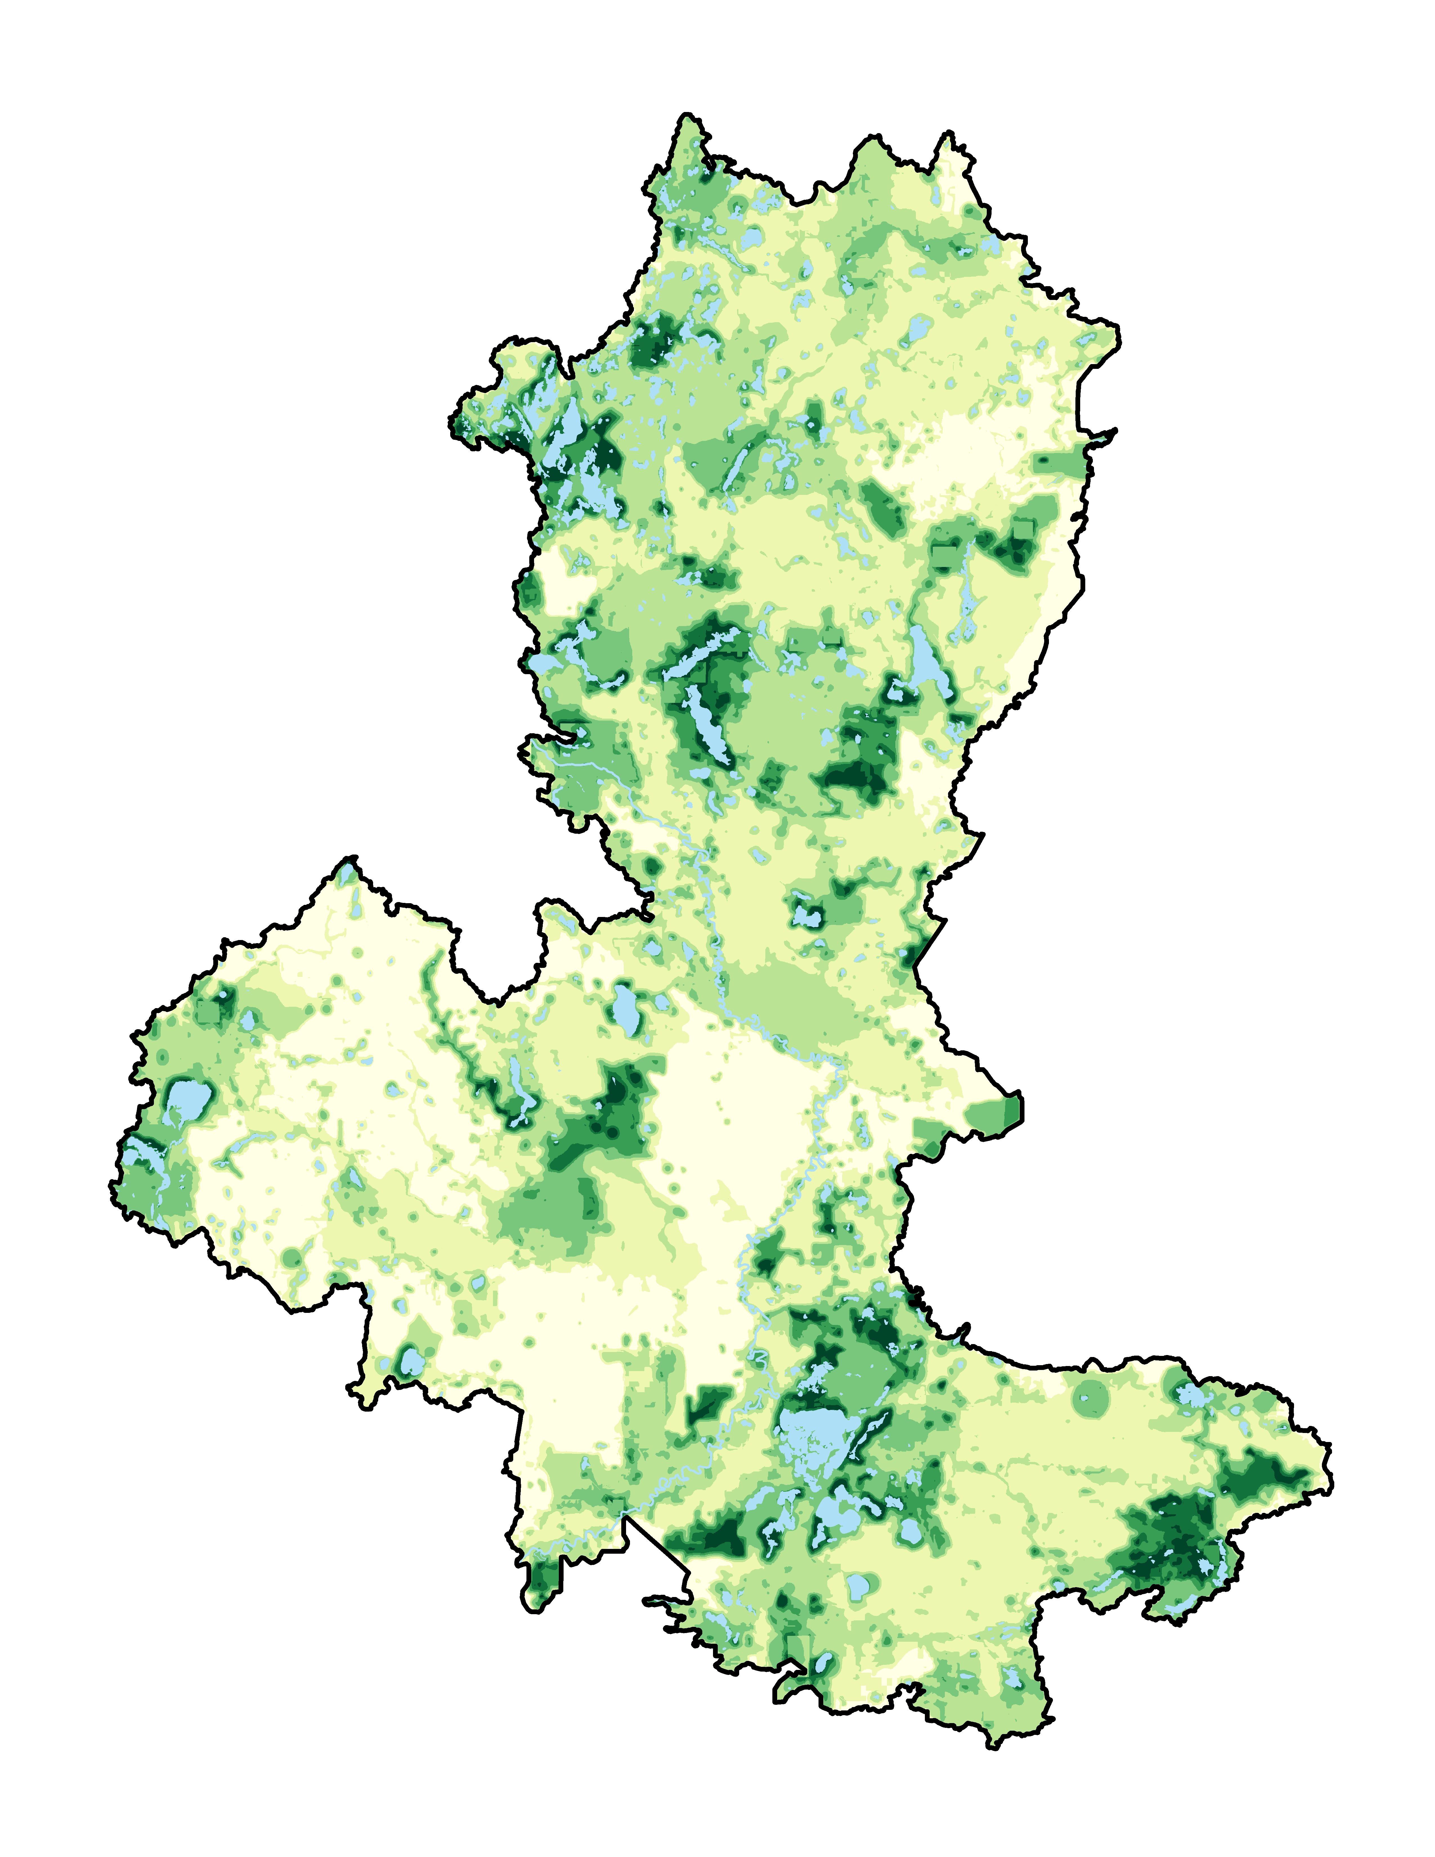
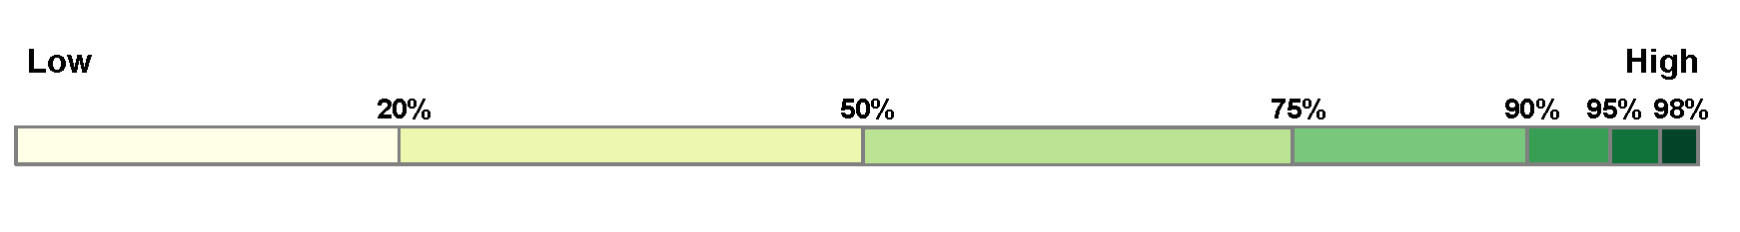
Zonation Output
Conservation Priority

Slide 11

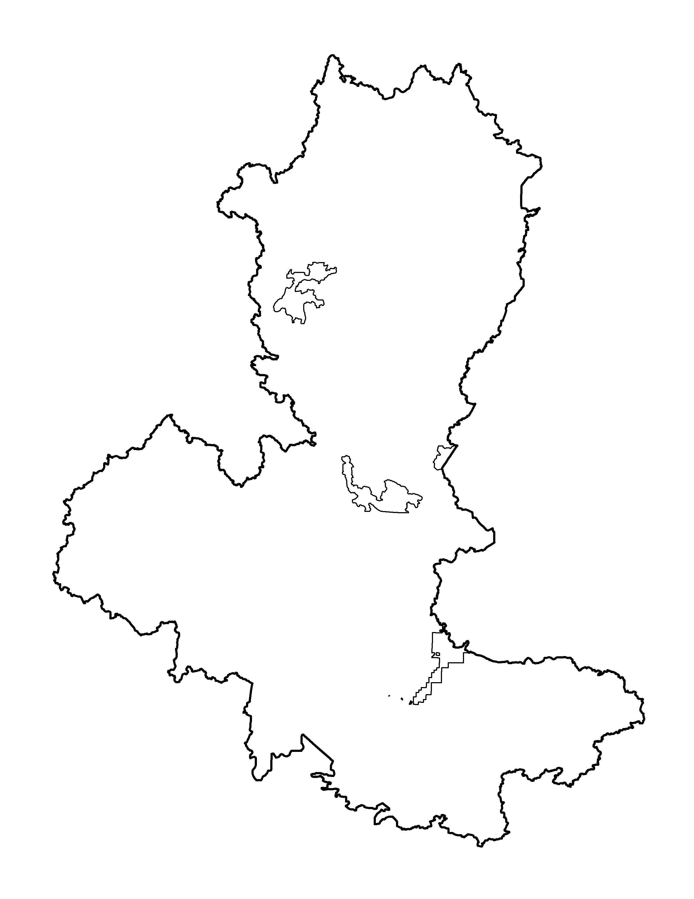
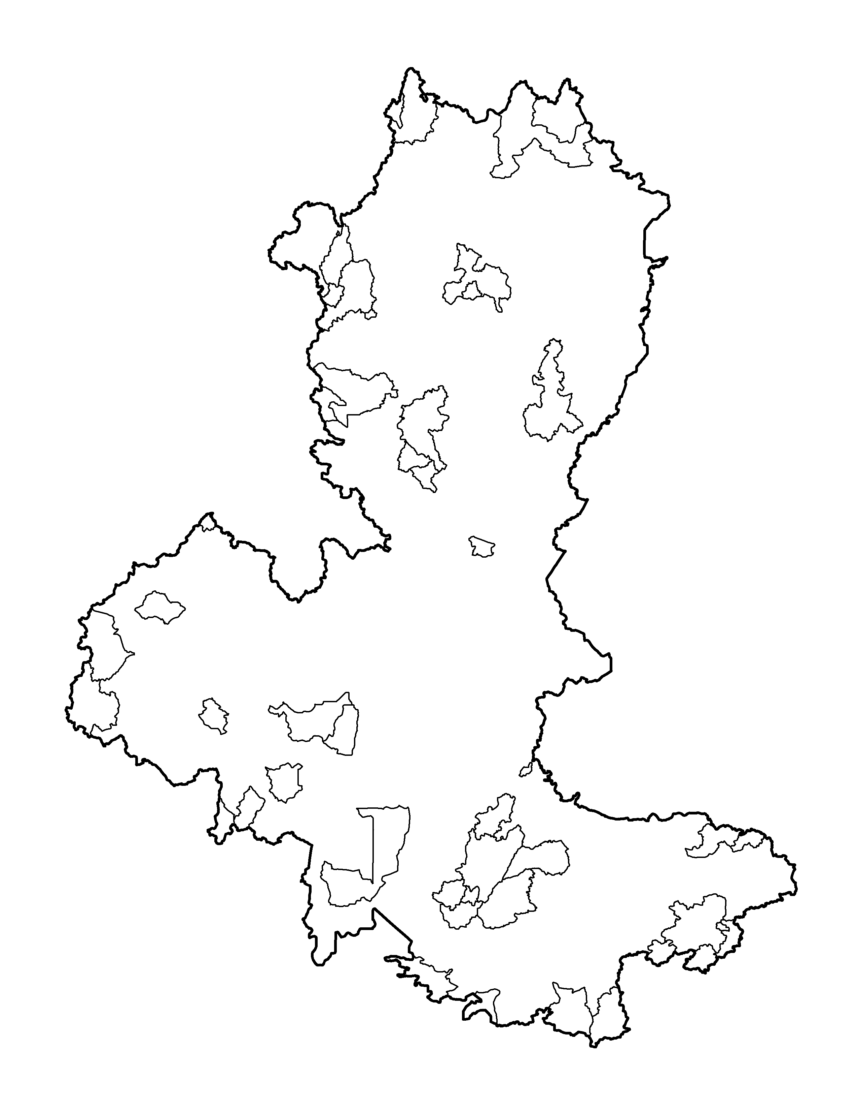
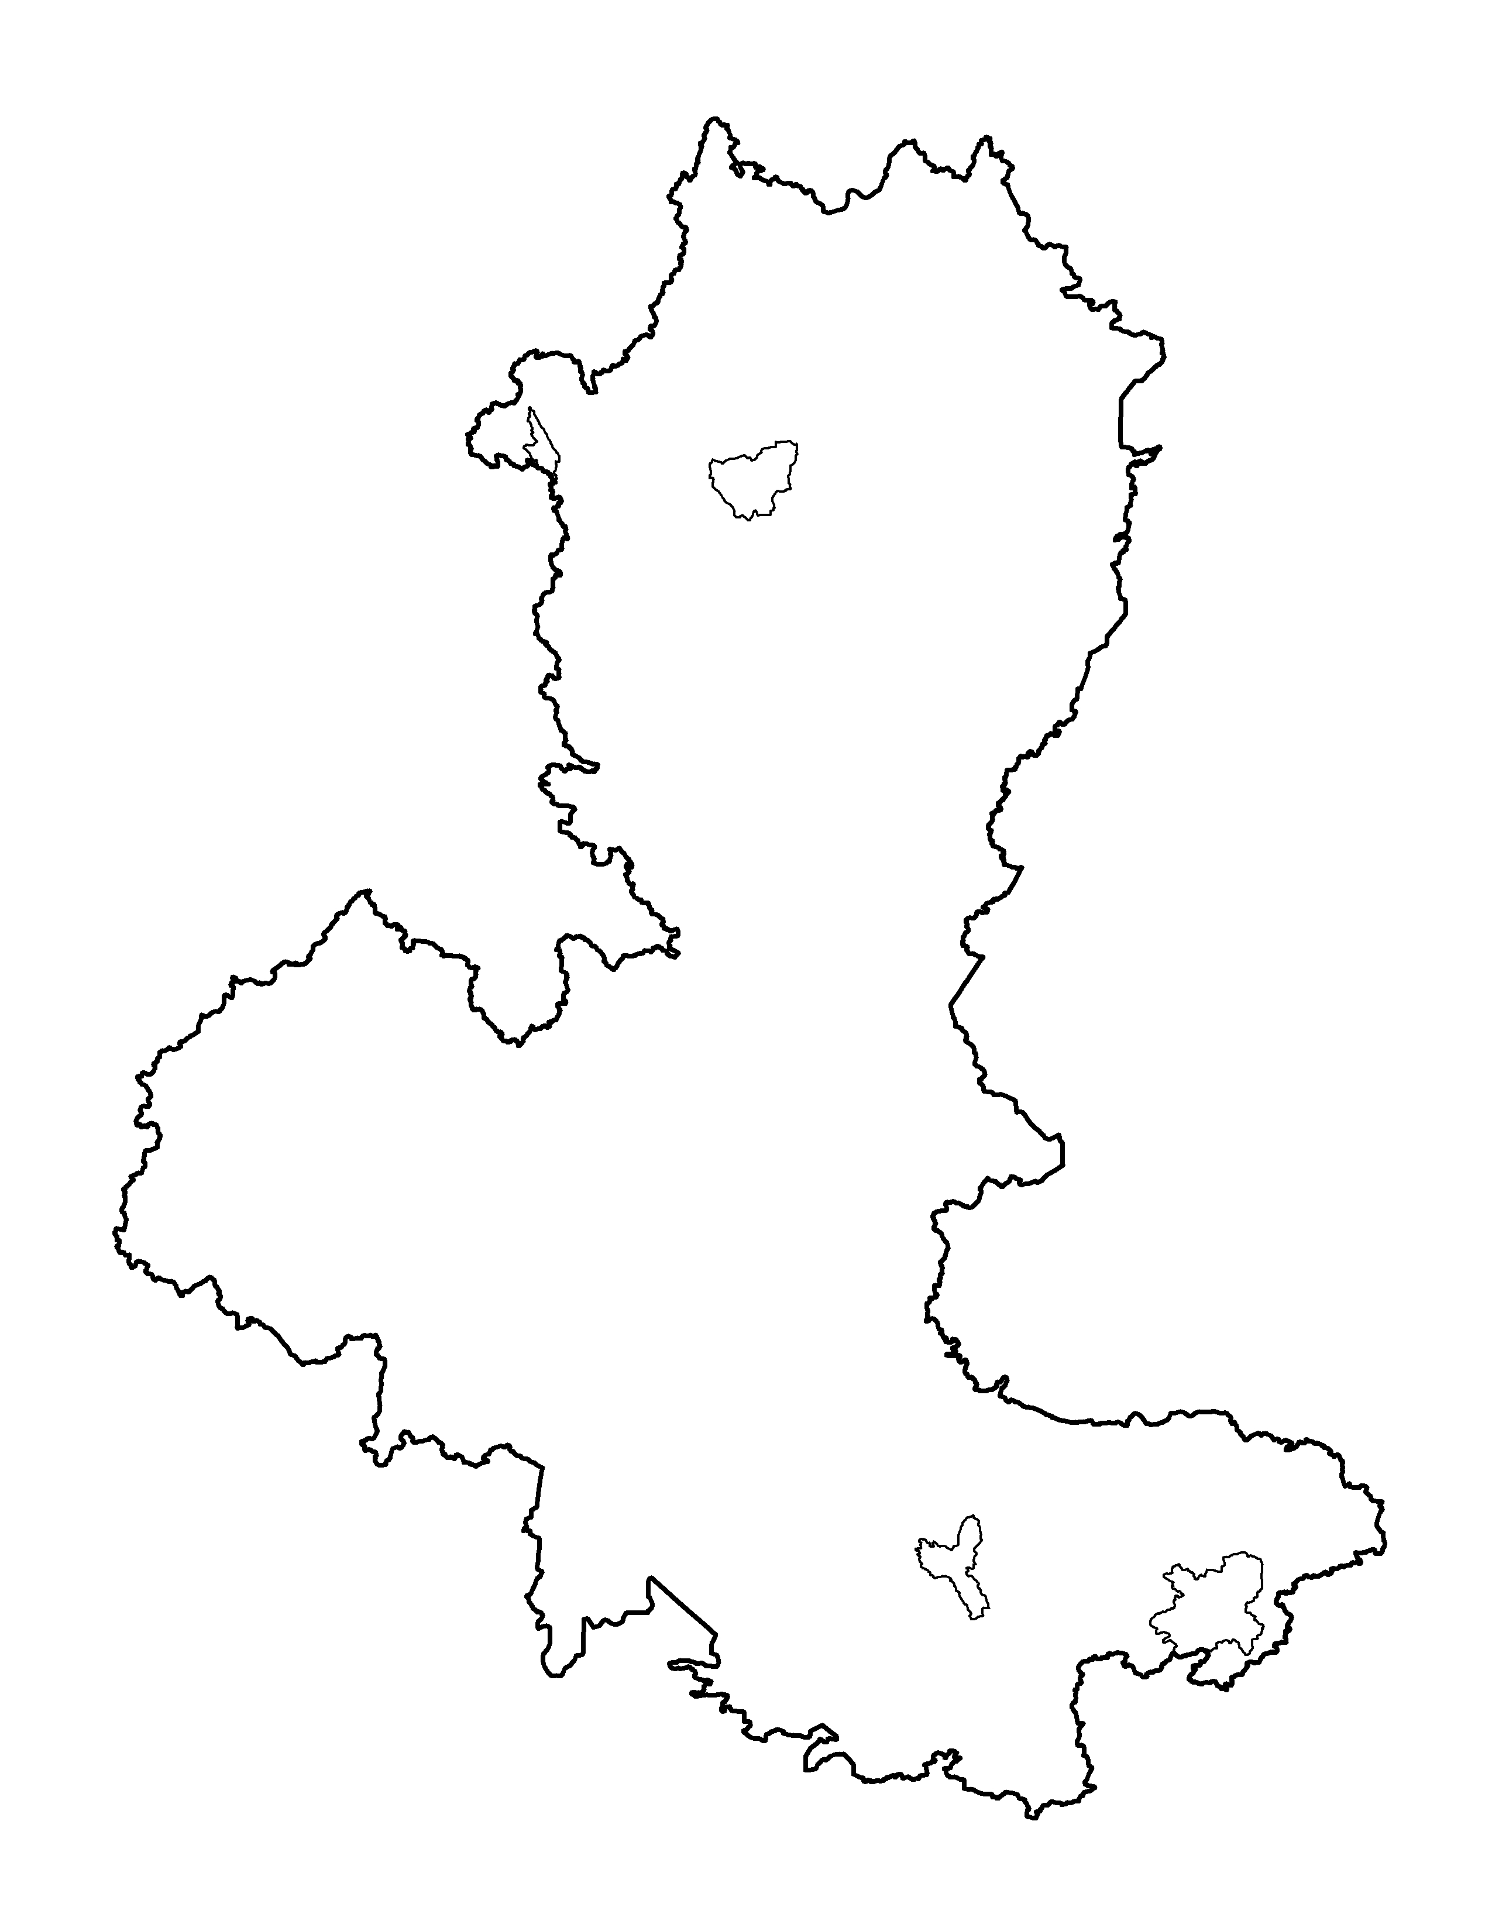
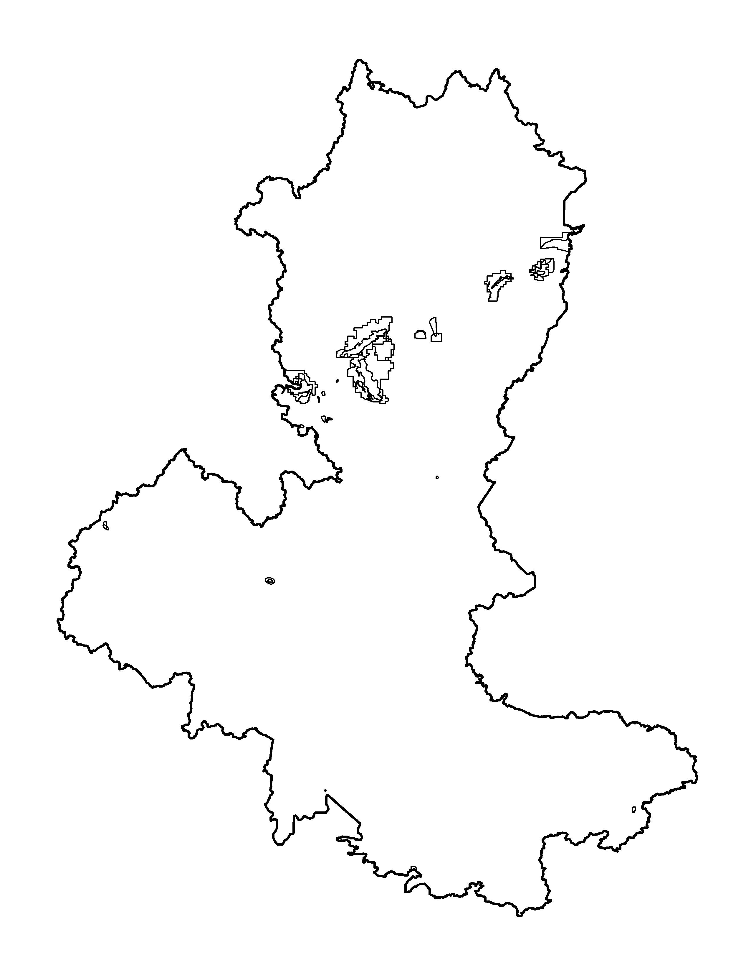
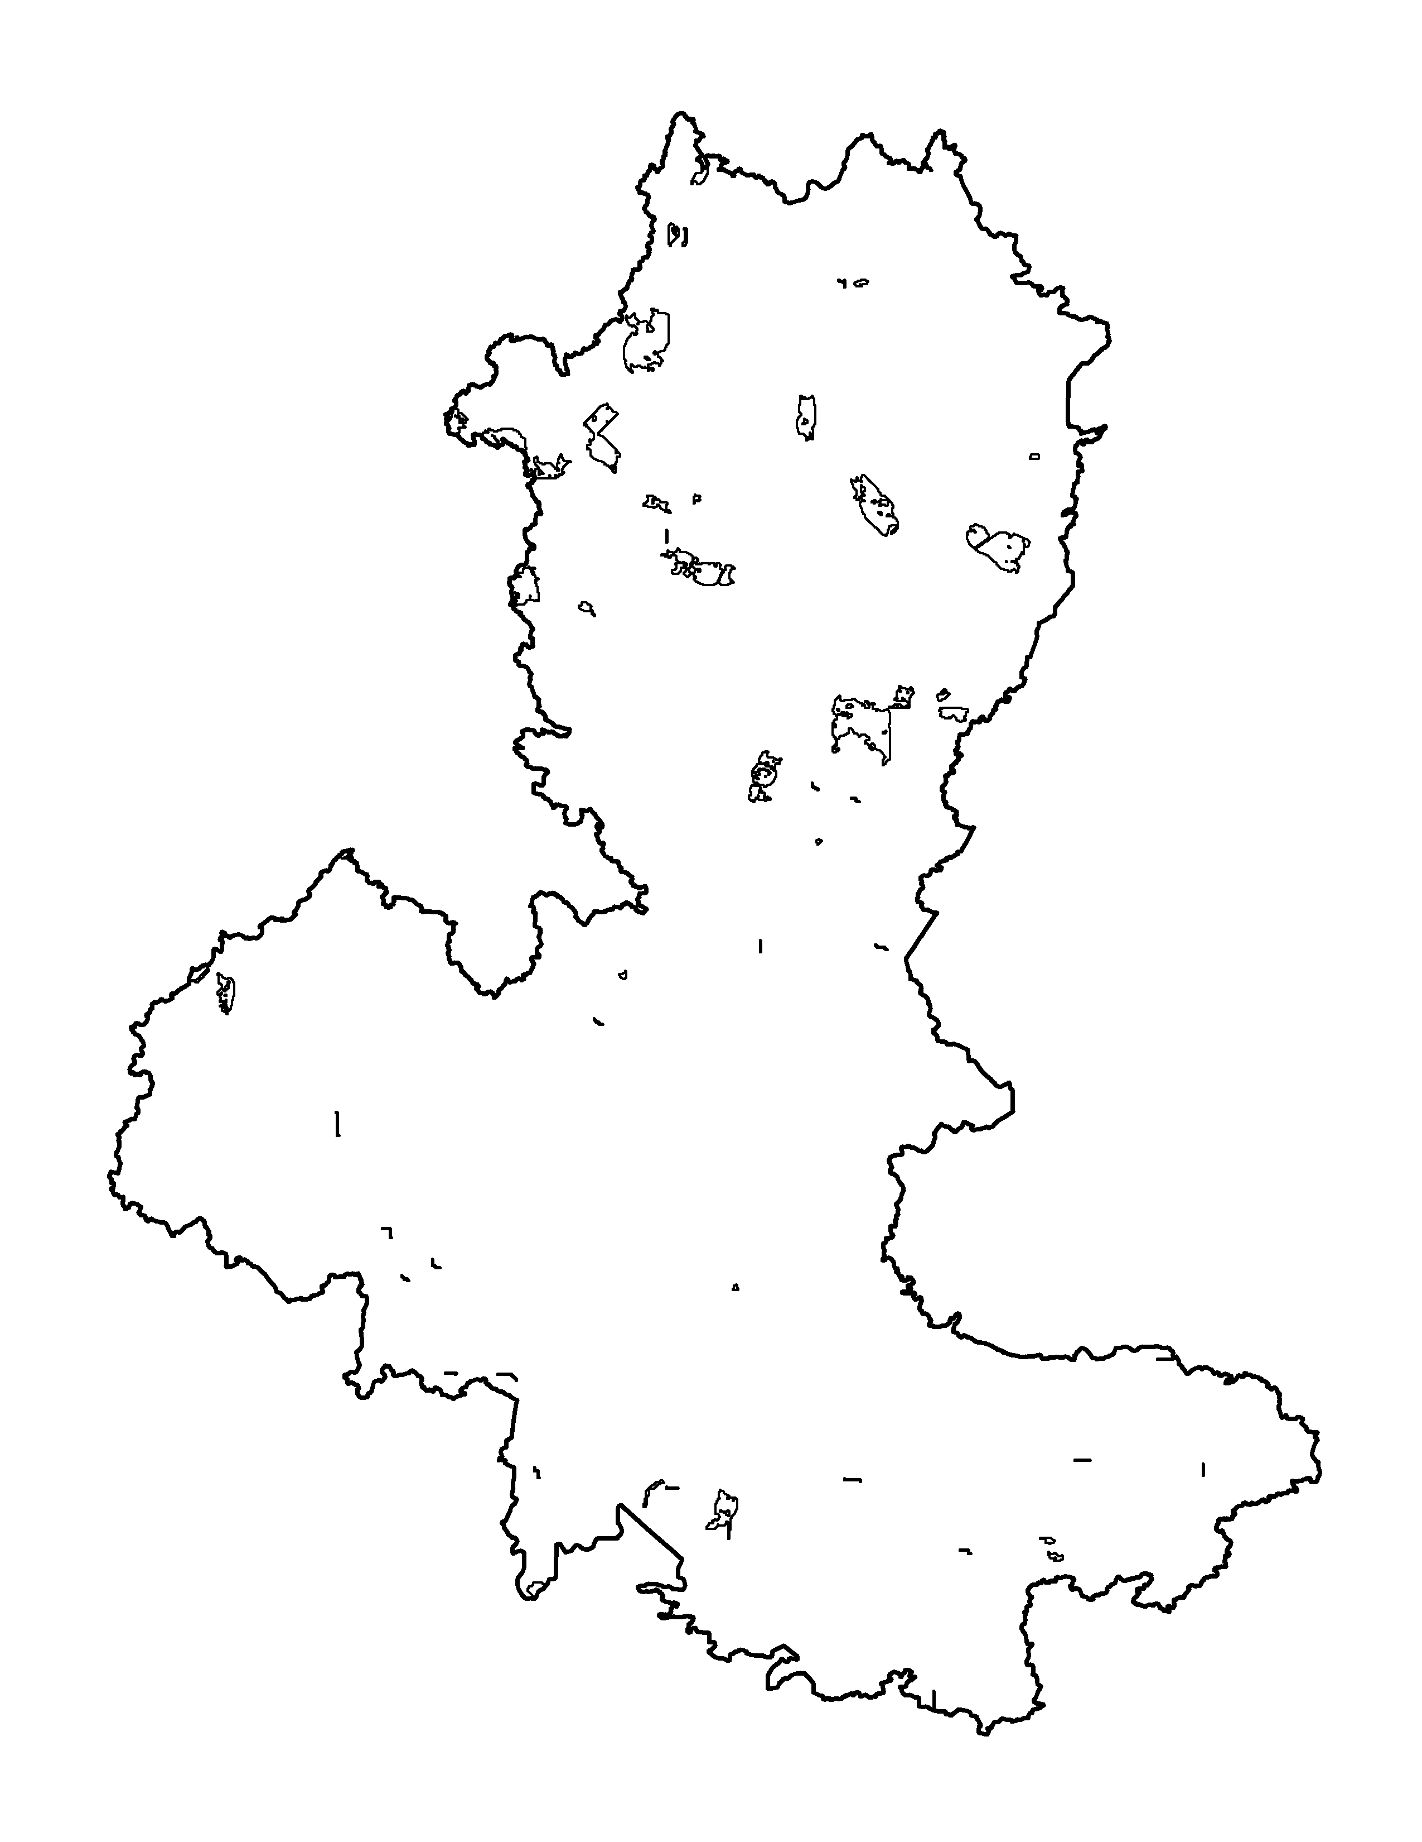
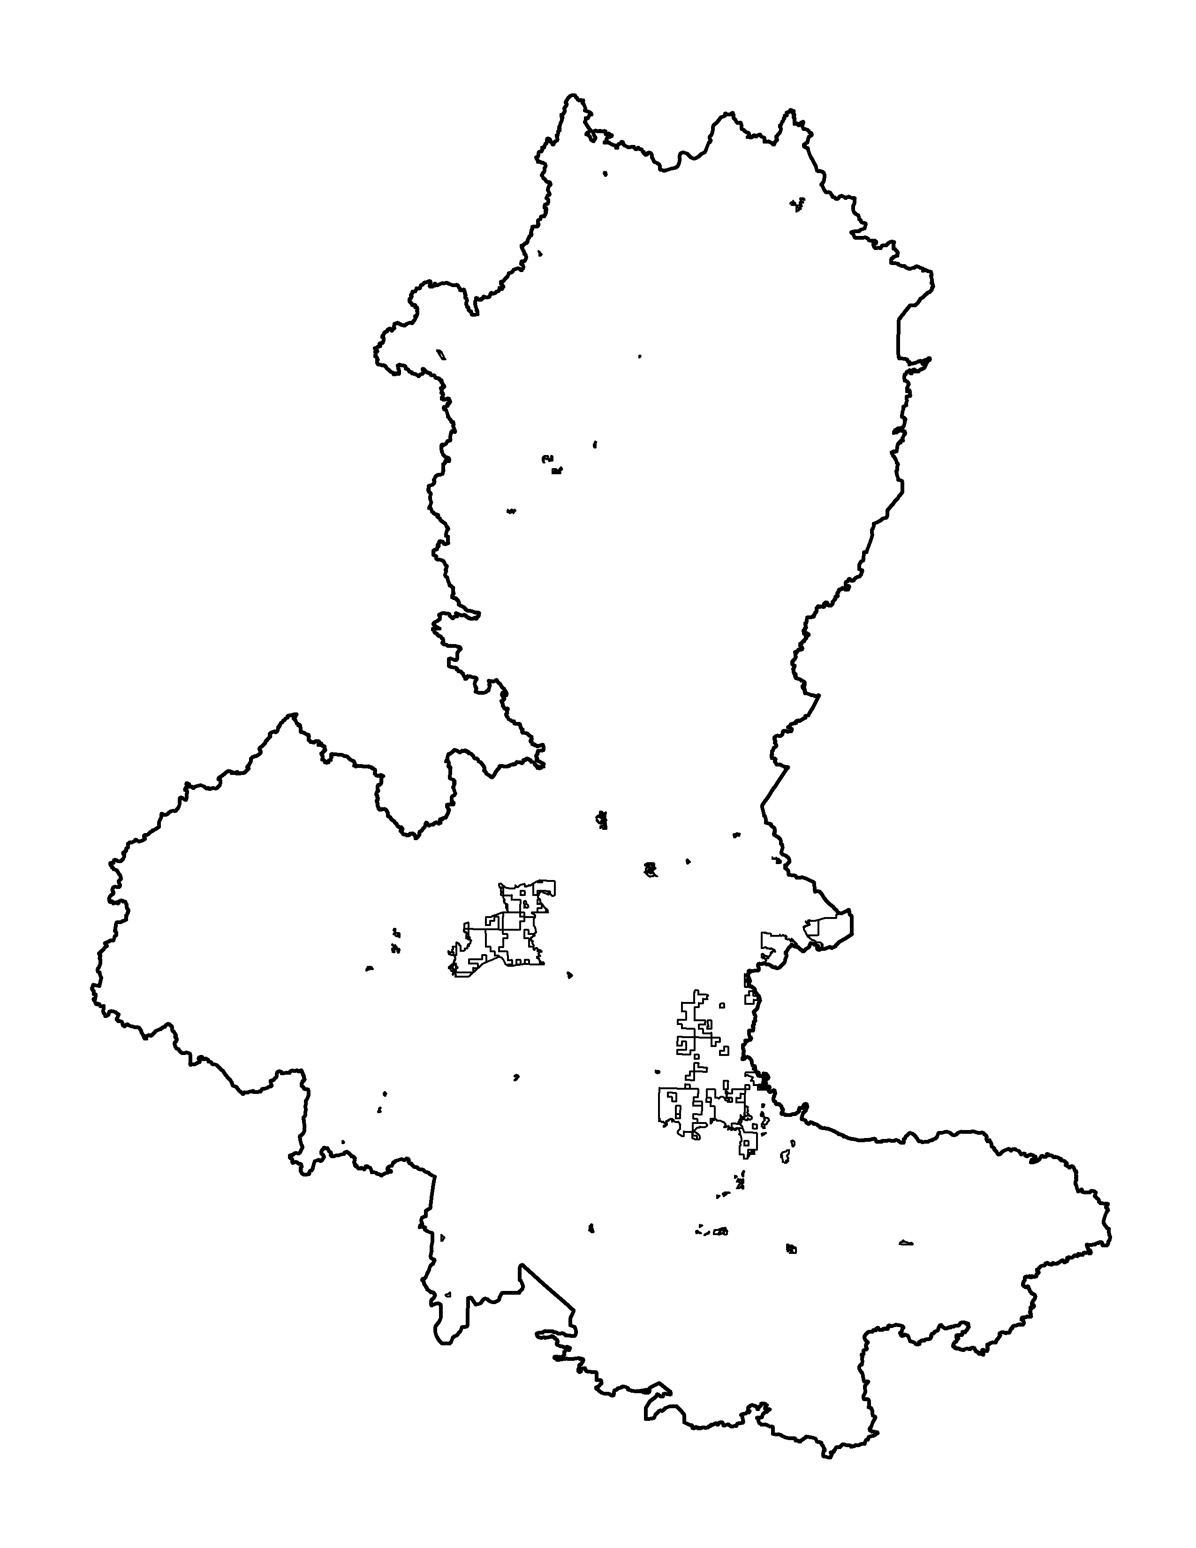
Sites of biodiversity significance (outstanding)
Lakes of biological significance (outstanding)
Lakes of declining water quality
Drinking water/source water areas
Ecological connections
High-value forests

Slide 12
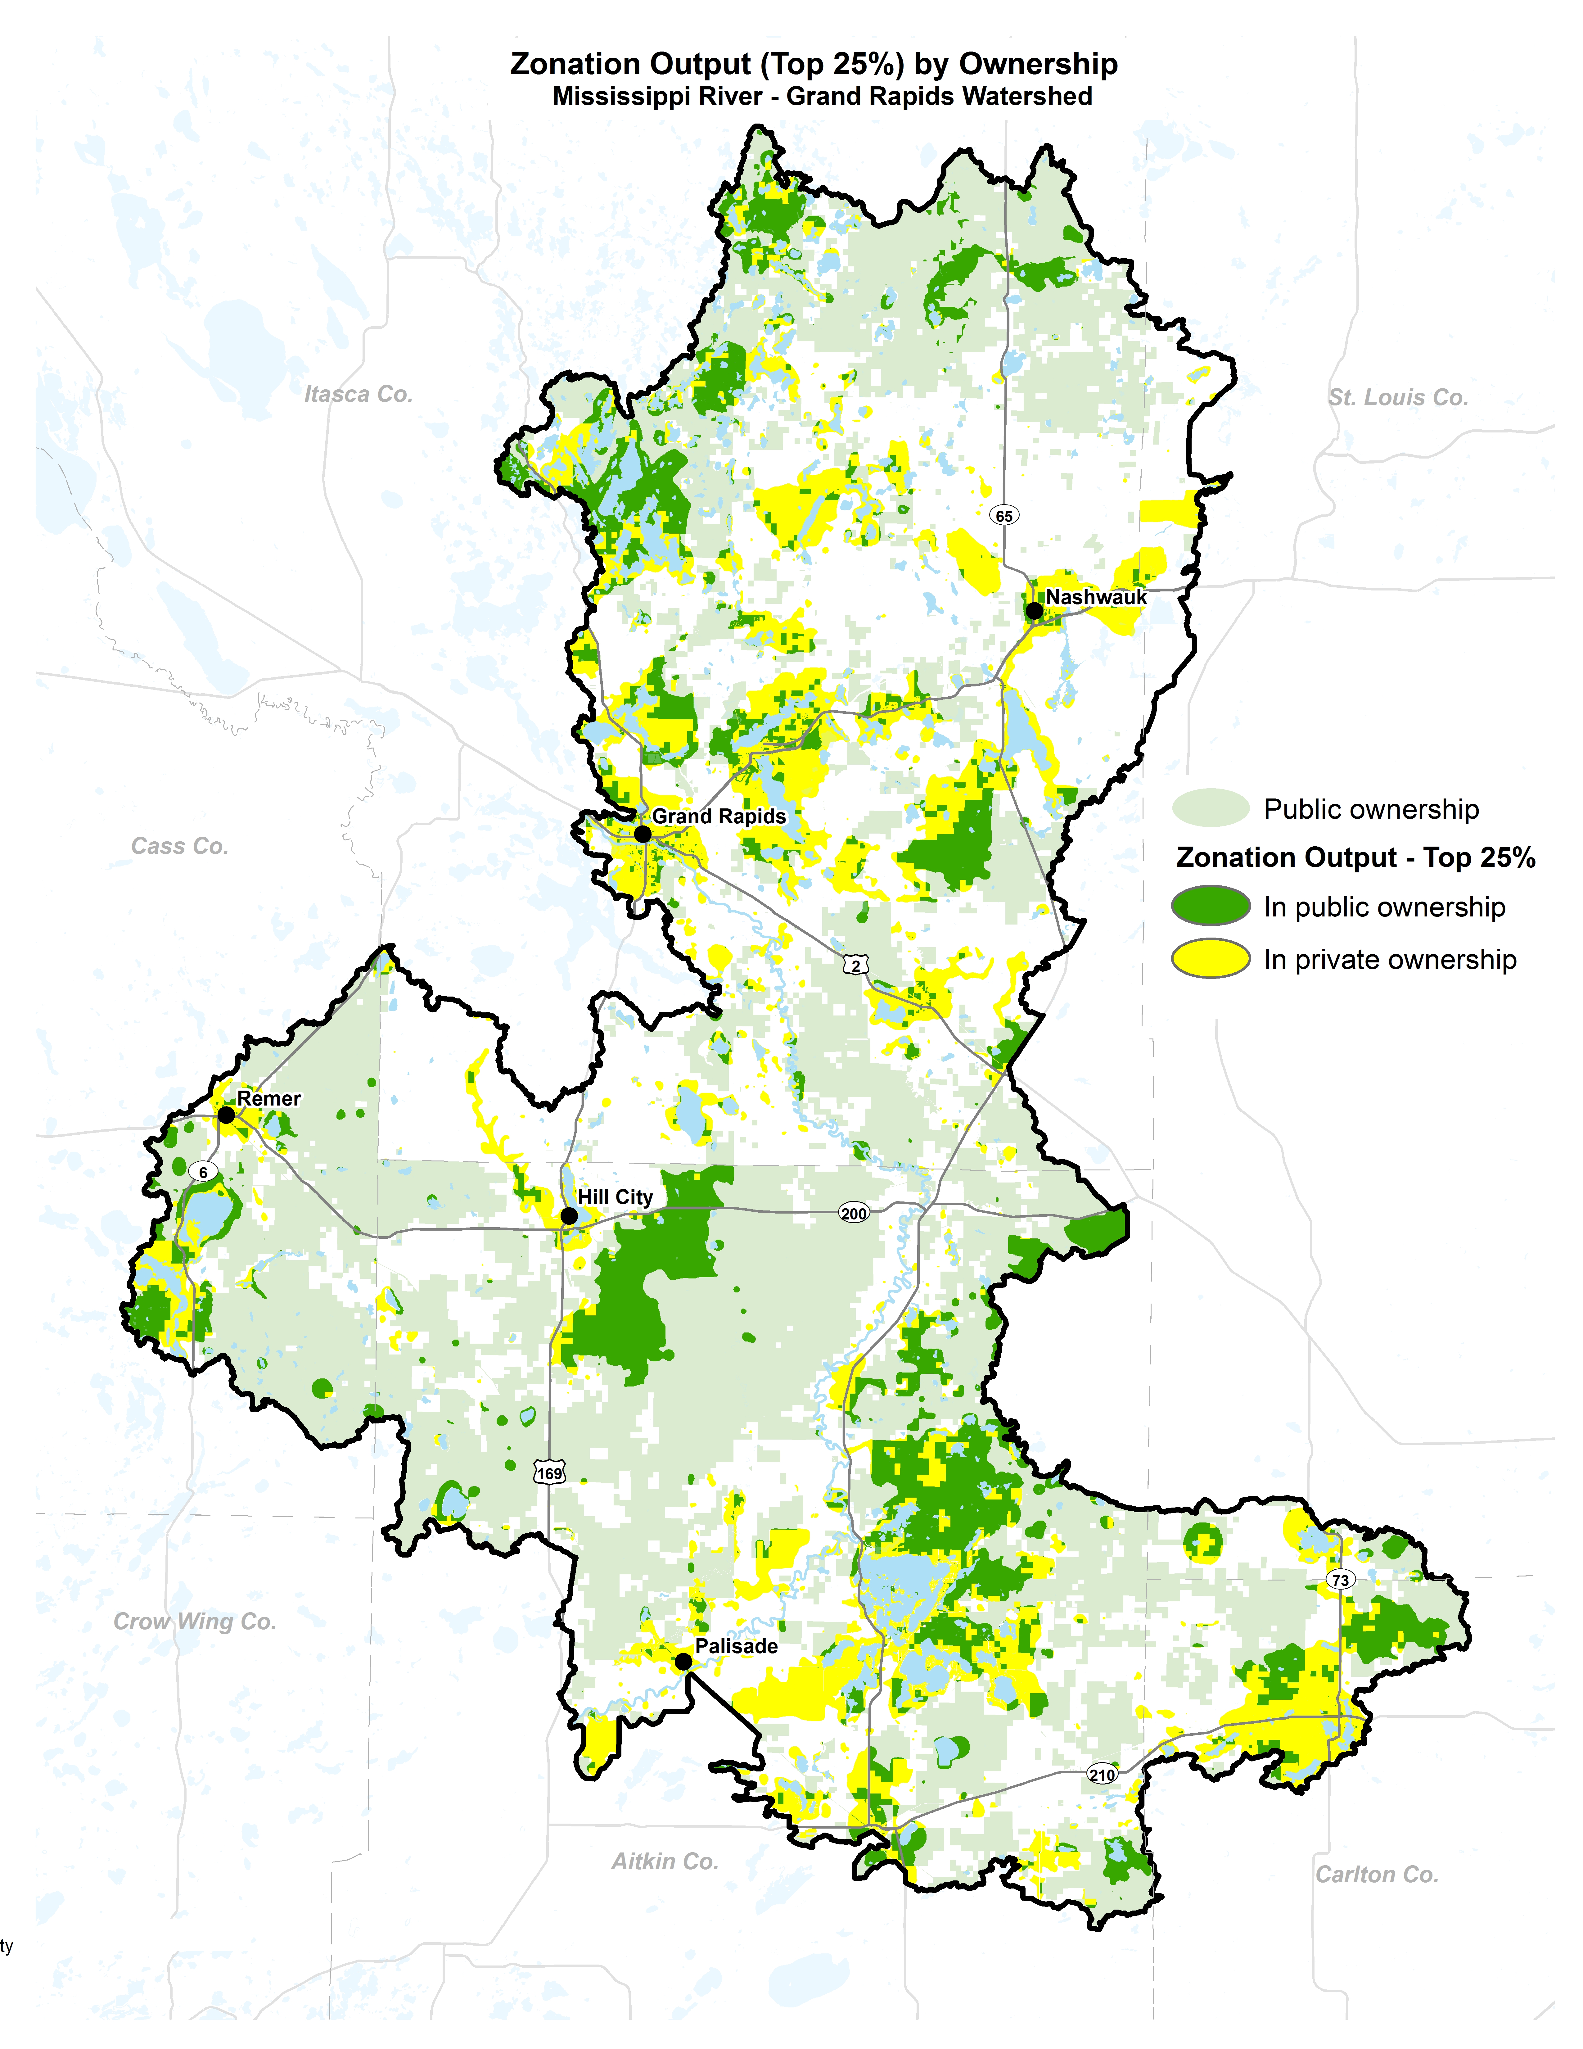
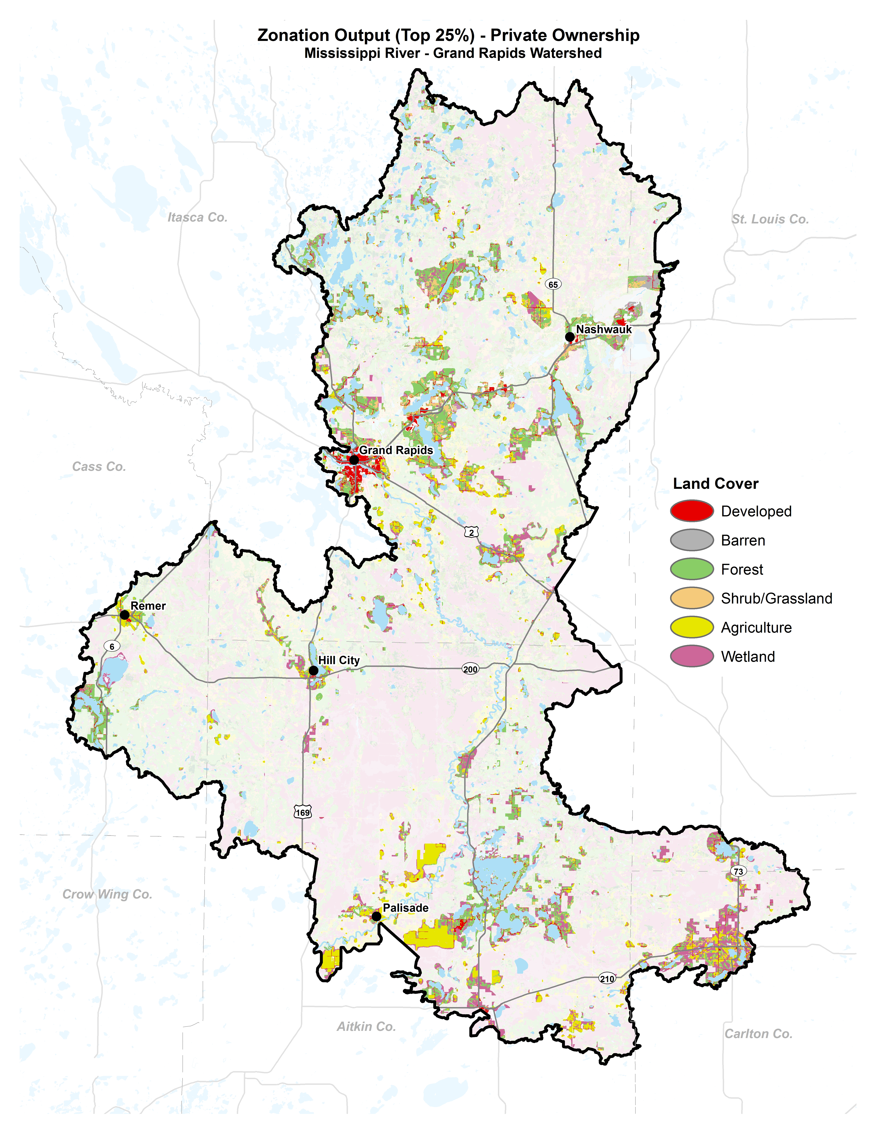

Slide 13

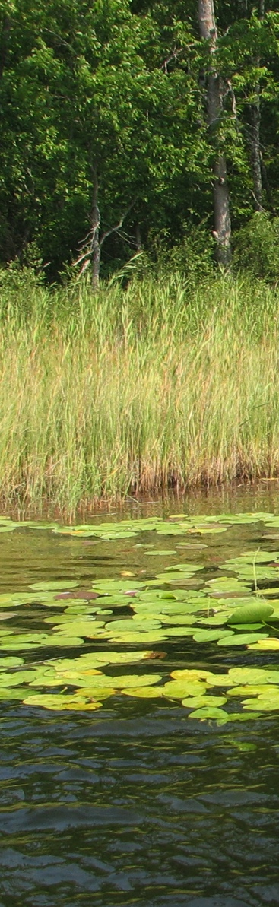

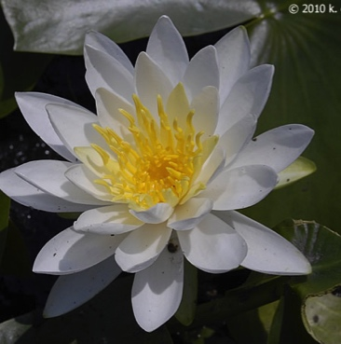
4. Synthesis
Mapping exercise -> final Priority Map
Incorporates wisdom of people interested and knowledgeable about watershed
Select Priority Areas
Start thinking of actions
K. Chayka,
www.minnesotawildflowers.org,

Slide 15
Citizens’ top 3: Civic Leaders’ top 3:
1. Improve Technical Assistance & Incentive Programs 1. Improve Technical Assistance & Incentive Programs
2. Improve Education, Outreach, & Civic Engagement 1. Protect/Restore Riparian Vegetation (a tie with above)
3. Protect/Restore Riparian Vegetation 2. Improve Education, Outreach, & Civic Engagement
Notes:
MODES

Slide 16


Summary
Many benefits of a formal, quantitative planning framework.
The approach facilitates an efficient, organized process to analyze spatial priorities.
Priorities for clean water can be integrated with other priorities (multiple benefits).

